Slide 1
MECHANICS CO – 3 CENTROID, MOMENT OF INERTIA PROBLEMS

Slide 2
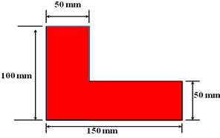
1. Locate the centroid of the shaded area of the Figure
X_{C} =62.5 mm, Y_{C} = 37.5 mm

Slide 3
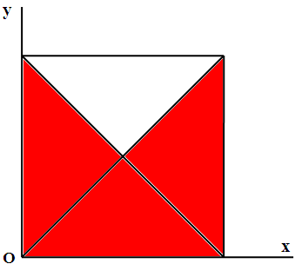
2. Locate the centroid of the shaded three-quarters of the area of a square of dimension ‘a’ as shown in the Figure.
X_{C} =a/2 , Y_{C} = 7a/18

Slide 4
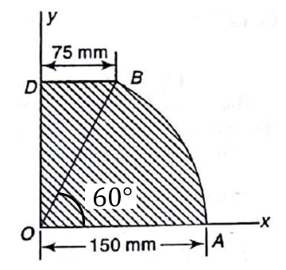
3. Locate the centroid C of the shaded area OABD shown in the Figure.
X_{C} =66 mm , Y_{C} = 59.11 mm

Slide 5
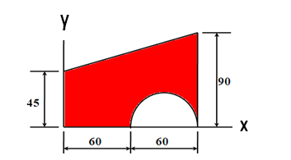
4. A semi-circular area is removed from the trapezium as shown in the Figure. Determine the centroid of the remaining shaded area. (All dimensions in mm).

Slide 6
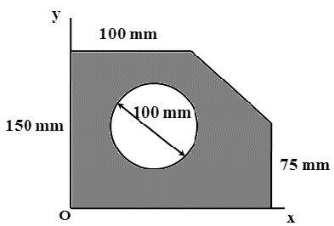
5. Referring to the Figure, determine the coordinates x_{c} and y_{c} of the center of a 100mm diameter, circular hole cut in a thin plate so that this point will be the centroid of the remaining shaded area.
X_{C} = 90.476 mm , Y_{C} = 67.857 mm
200 mm

Slide 7
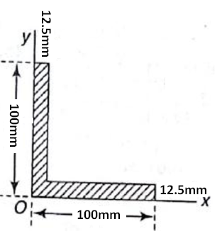
6. Calculate the Moment of Inertia of angle section about X – axis

Slide 8
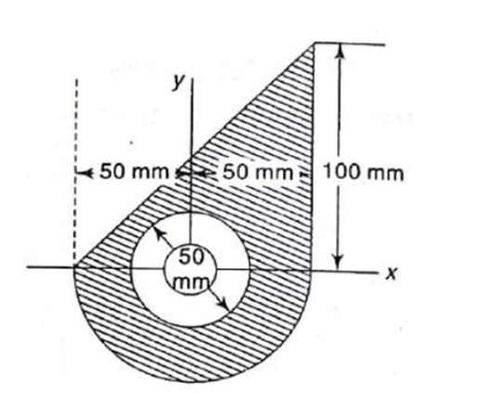
7. Calculate the Moment of Inertia of shaded portion about X – axis.

Slide 9
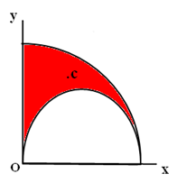
8. Locate the centroid C of the shaded area obtained by cutting a semicircle of diameter ‘a’ from the quadrant of a circle of radius a as shown in the Figure.
X_{C} = 0.349 a , Y_{C} = 0.636 a

Slide 10
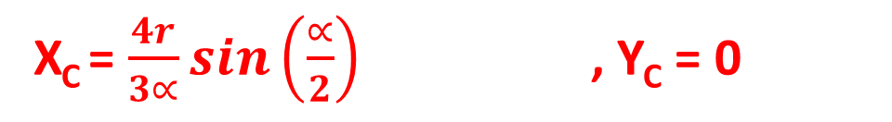
9. Determine the centroid of the Circular Sector by integration method.
Y
X_{C} = $\frac{4r}{3∝}sin\left(\frac{∝}{2}\right)$ , Y_{C} = 0
α
X

Slide 11
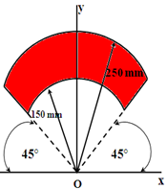
10. Locate the centroid C of the shaded sector of a ring subtending a 90° central angle and symmetrical about the y-axis as shown in the Figure.
X_{C} = 0 , Y_{C} = 183.8 mm
250 mm

Slide 12
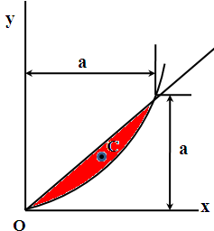
11. Determine the coordinates Xc and Yc of the centroid ‘C’ of the area between the parabola y = x²/a and the straight line y = x .
X_{C} = a/2 , Y_{C} = 2a/5

Slide 13
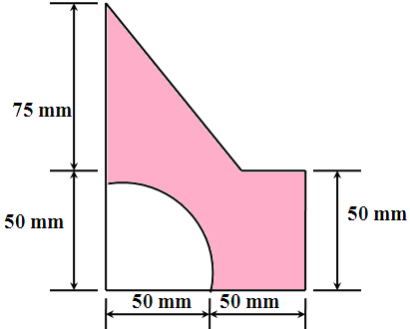
12. With respect to coordinate axes x and y, locate the centroid C of the shaded area as shown in the figure.
X_{C} =48 mm , Y_{C} = 47.7 mm

Slide 14
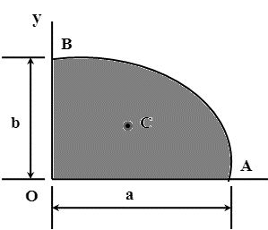
13.Determine the coordinates Xc and Yc of the centroid C of the area of one quadrant of an ellipse OAB with major and minor semi axes a and b, respectively.
X_{C} = 4a/3π , Y_{C} = 4b/3π

Slide 15
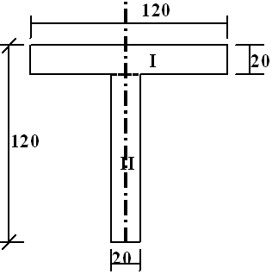
14. Find the centroid of a T – section 120 x 120 x 20 mm as shown in the Figure.

Slide 16
15. Find the Moment of Inertia of a square with sides of length “a” with respect to diagonal.

Slide 17
16. Determine the centroid of the right angled triangle of base ‘b’ and height ‘h’ by integration method.

Slide 18
17. Determine the centroid of the cross sectional area of an unequal I-section as shown in Fig.
200 mm
50 mm
150 mm
50 mm
50 mm
300 mm

Slide 19
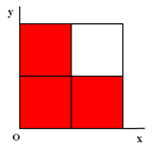
18. Locate the centroid of the shaded three-quarters of the area of a square of dimension ‘a’ as shown in the Figure.
X_{C} = 5a/12 , Y_{C} = 5a/12

Slide 20
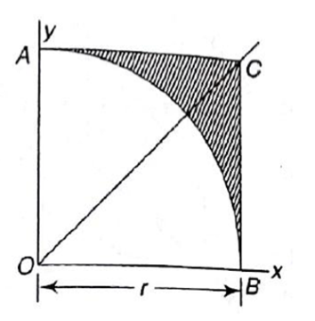
19. Calculate the Moment of Inertia of shaded portion about X – axis.

Slide 21
20. Determine the centroid of the quarter circle of radius ‘R’.

