Slide 1

Paper Id 1140:
Enhancing Strabismus Diagnosis: from Detection to
Classification with Deep Learning
Bhumit Gupta
Madhav Arora
Shubh Garg
Dr. Debabrata Ghosh
Thapar Institute of Engineering and Technology

Slide 2
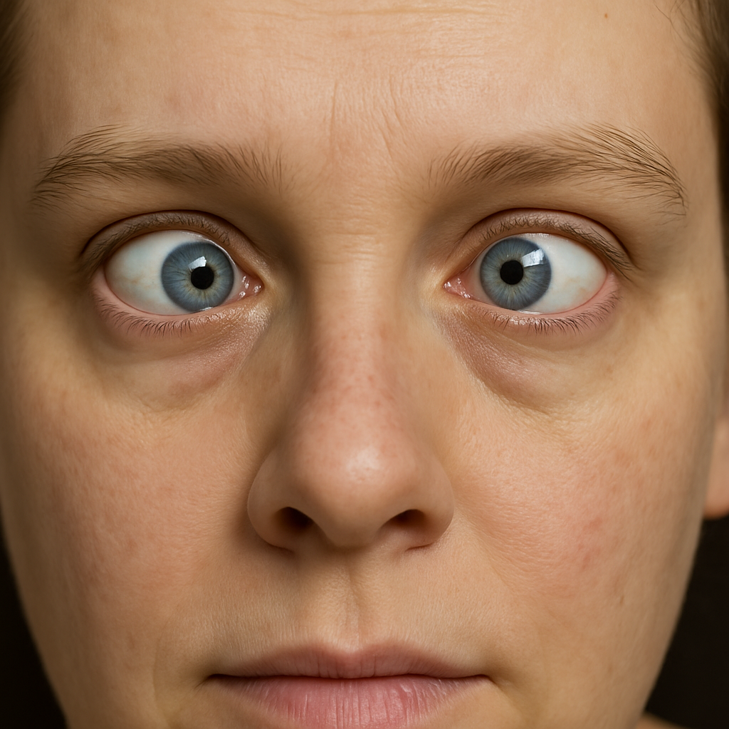
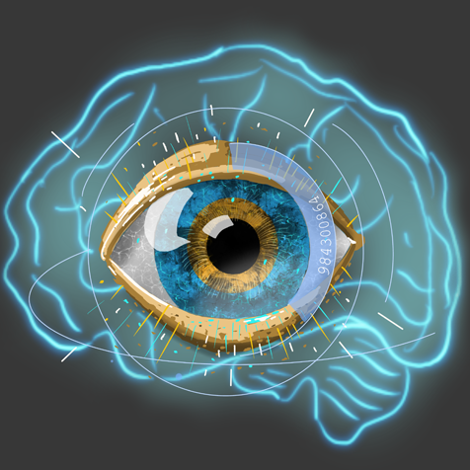
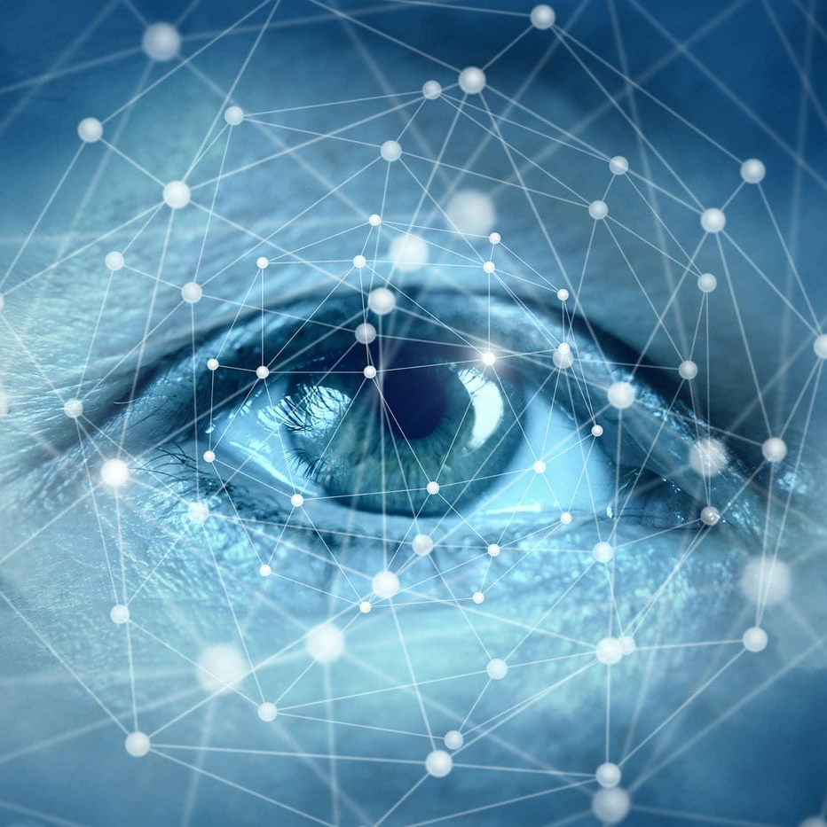
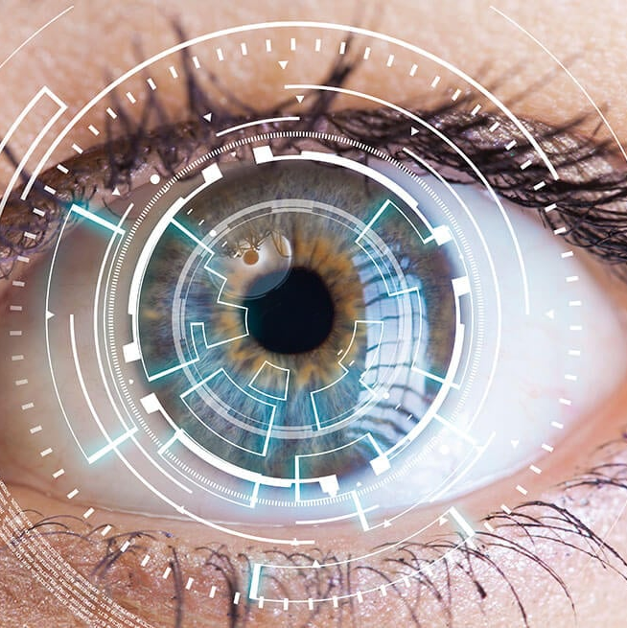
Abstract
Accurate and early diagnosis of strabismus is essential to prevent visual impairment. This work proposes a deep learning framework using CNNs (EfficientNetB7, ResNet50, VGG19, AlexNet) to classify strabismus into five categories. EfficientNetB7 achieved the highest accuracy. The study supports the use of AI in ophthalmology for consistent and scalable diagnosis.

Slide 3
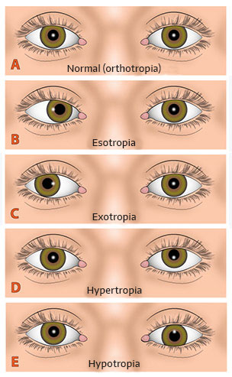
Introduction
Strabismus is a misalignment of the eyes, impacting vision and quality of life. Traditional methods are subjective and require expertise. AI offers objective, scalable solutions for automated diagnosis.
Fig: Strabismus & its 5 Classes

Slide 4
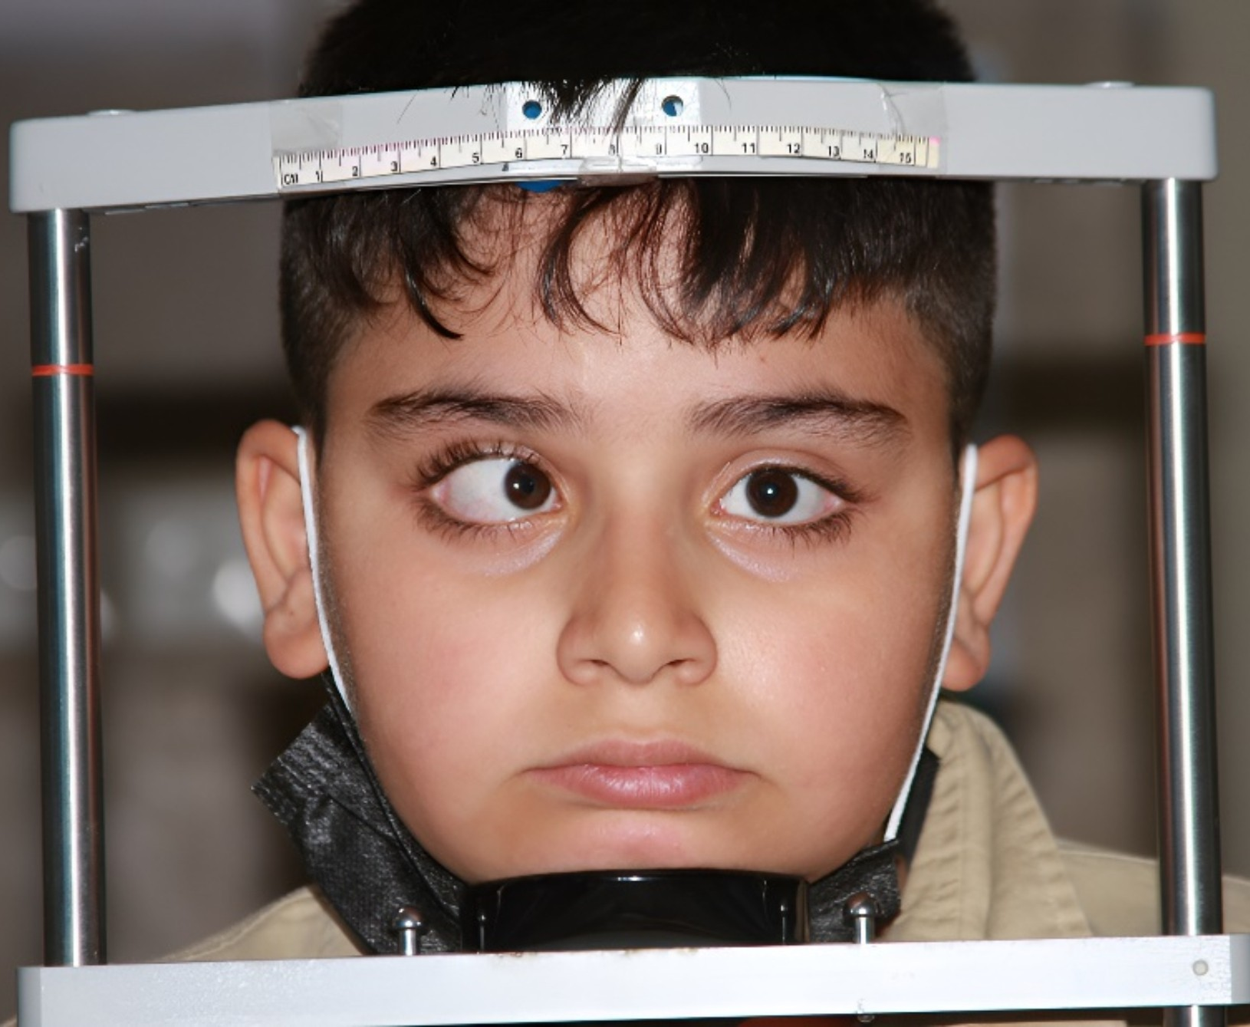
Problem Statement
Manual diagnosis of strabismus is time-consuming, subjective, and lacks scalability. There is a need for an automated, objective, and accurate classification system to aid ophthalmologists in real-world settings.
Fig:1 Strabismus Detection with Scales

Slide 5
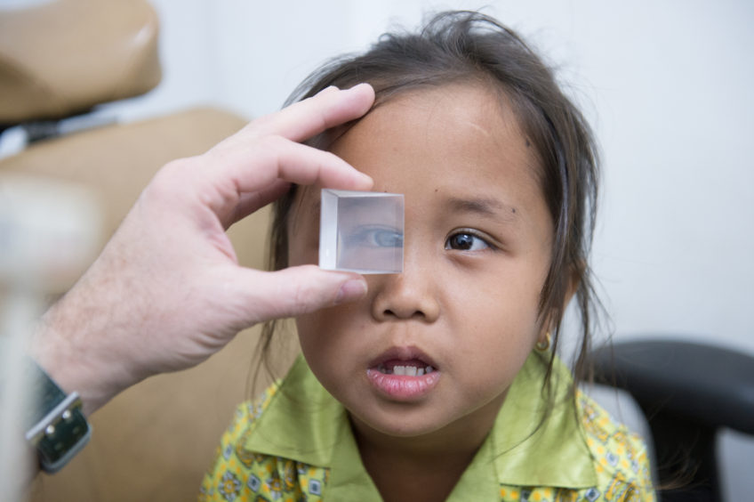
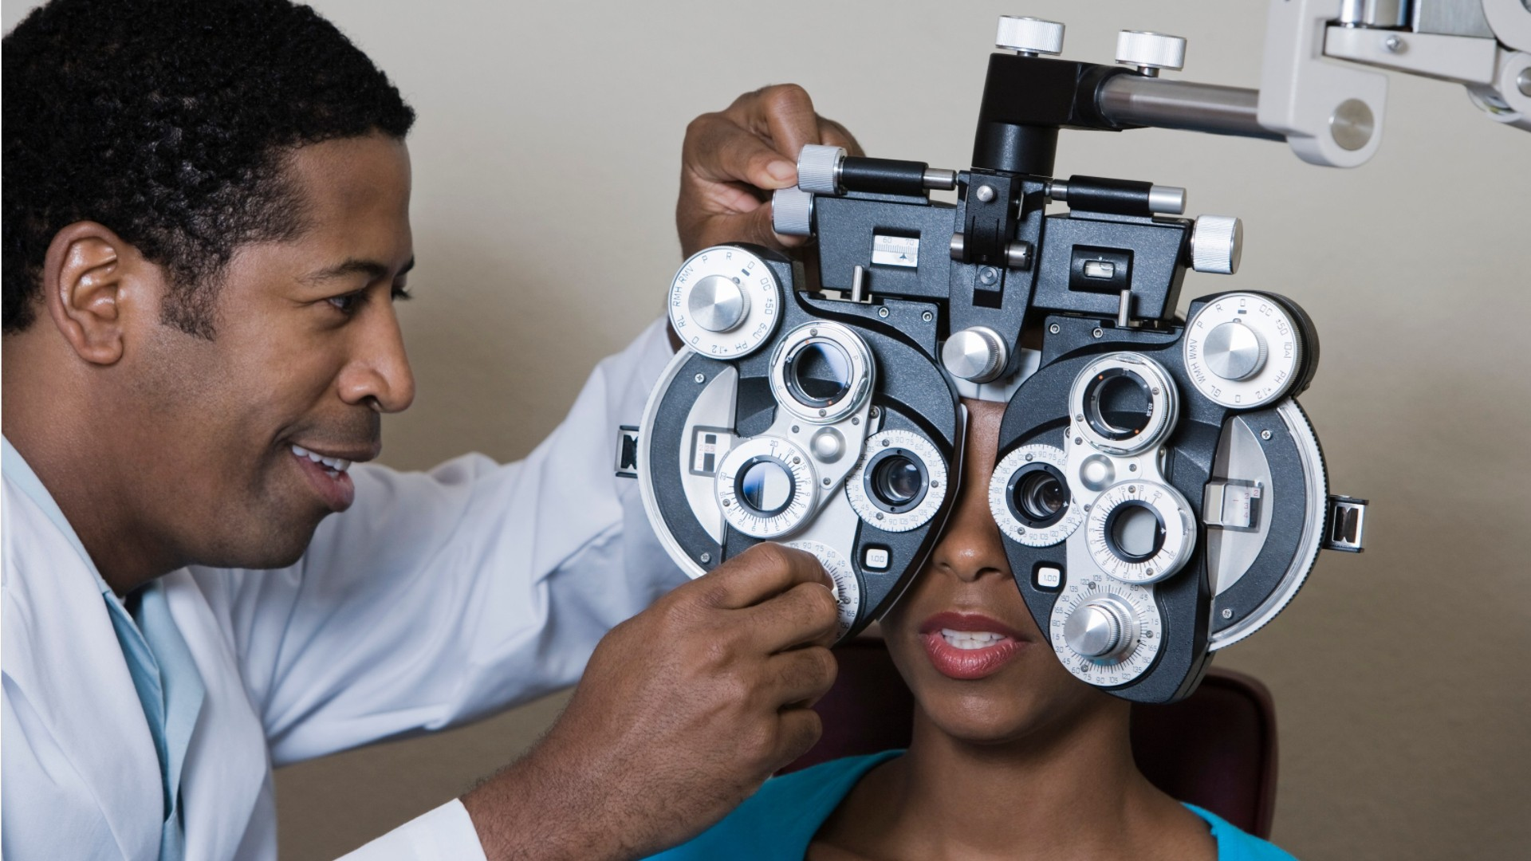
Literature Review
Traditional methods: Hirschberg test, cover test – require expert supervision. Deep learning models (Zheng et al., Lu et al.) show promise but focus mainly on binary classification. Our work enhances multi-class classification for five strabismus types.
Fig: Strabismus Detection with Prism
Fig: Detection using scales

Slide 6
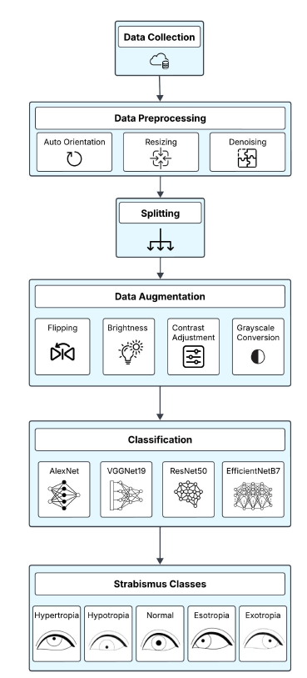
Proposed Framework
We use a pipeline involving data collection, preprocessing, augmentation, and deep learning classification. Models used: EfficientNet-B7, ResNet50, VGG19, Alex Net. Dataset includes five classes: Esotropia, Exotropia, Hypertropia, Hypotropia, Normal
Fig; Piepleline & Propesed Framework

Slide 7
Data Collection & Preprocessing
Data from open-source sources like Kaggle and GitHub. Preprocessing steps: Auto-orientation, resizing (227x227), denoising. Split into training (70%), validation (15%), test (15%).

Slide 8
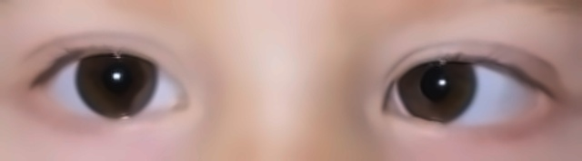
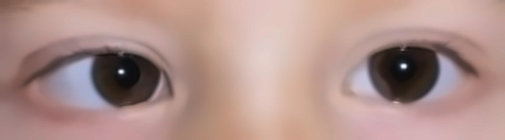
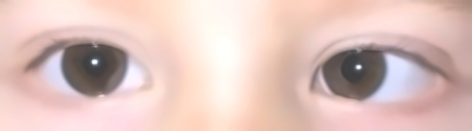
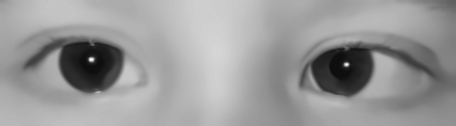
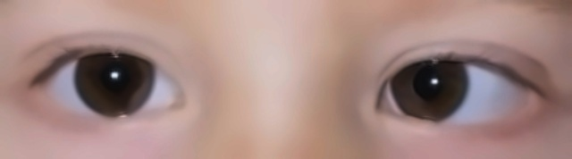
Data Augmentation
To avoid overfitting and improve robustness
- Grayscale conversion
- Horizontal flipping
- Brightness adjustment
- Contrast variation
Fig: Original
Fig:Flipped
Fig: Brightness
Fig: Grayscale
Fig: Contrast

Slide 9
Model Architectures
Four CNNs were used
- AlexNet: Lightweight, uses depthwise conv and mixed precision.
- VGG19: Progressive unfreezing, dropout, batch norm.
- ResNet50: Last 75 layers unfrozen, ReLU, softmax.
- EfficientNetB7: Best performer, last 30 layers unfrozen, weight decay regularization
Fig1: Classification With Alexnet & VggNet19
Fig1: Classification With ResNet50 & EfficientNetB7

Slide 10
Results - Model Comparison
EfficientNetB7: Accuracy 84.00%, Precision 85.00%, Recall 83.00%, F1 84.40%
ResNet50: 74.00%, 79.00%, 73.00%, 74.00%
VGG19: 66.67%, 67.45%, 66.67%, 67.00%
AlexNet: 59.26%, 58.88%, 59.26%, 58.71%
Fig: F1-Score Radar Graph
Fig: Precision Radar Graph
Fig: Accuracy Radar Graph
Fig: Recall Radar Graph

Slide 11
Confusion Matrix - AlexNet

Slide 12
Confusion Matrix - VGGNet-19

Slide 13
Confusion Matrix – ResNet50

Slide 14
Confusion Matrix – EfficientNetB7

Slide 15
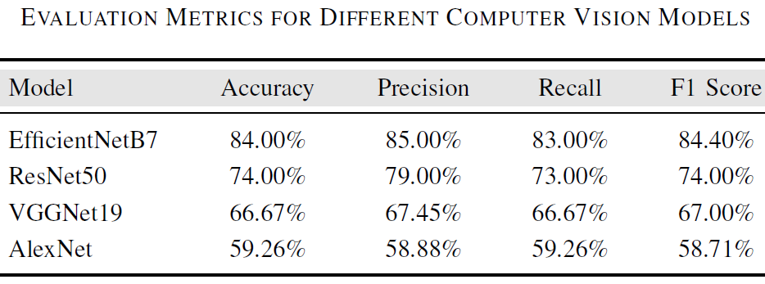
Conclusion & Future Work
EfficientNetB7 showed best results for multi-class strabismus classification. This automated system aids ophthalmologists with consistent, accurate predictions.
Future: Expand dataset, add explainability, test real-time deployment.
Fig: Eval Matrices For Different CV Models

Slide 16
Acknowledgment
We thank Thapar Institute of Engineering and Technology for supporting this research

