Slide 1
WEEK-01
BASICS- MACHINE LEARNING

Slide 2
CONTENTS
COMMA SEPARATED VALUES (CSV)
CSV FILE IN PYTHON
CSV FILES WITH PANDAS
IMPORTANT LIBRARIES

Slide 3
Why CSV files are useful for Machine Learning
CSV files are widely used for storing tabular data.
They are a simple and efficient way to organize data in a plain text format, making them compatible with various software applications, including Microsoft Excel.
Furthermore, CSV files can be easily edited and manipulated using spreadsheet software, allowing you to make quick changes to your data without the need for complex coding or programming.
CSV files serve a number of different purposes.
They help users export a high volume of data to a more concentrated database.
They also have following advantages:
  CSV files are plain-text files, making them easier for users to create.
  Since they’re plain text, they’re easier to import into a spreadsheet or another storage database, regardless of the specific software you’re using.
  It better organizes large amounts of data.

Slide 4
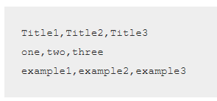
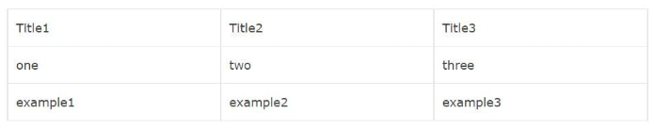
How to Create a CSV File?
A CSV is a text file, so it can be created and edited using any text editor (like Notepad).
More frequently, however, a CSV file is created by exporting (File > Export) a spreadsheet or database in the program that created it.
Using Notepad
  To create a CSV file with a text editor, first choose your favourite text editor, such as Notepad, and open a new file.
  Then enter the text data you want the file to contain, separating each value with a comma and each row with a new line.
Save this file with the extension .csv.
You can then open the file using Microsoft Excel or any other spreadsheet program.
It would create a table of data similar to the following:

Slide 5
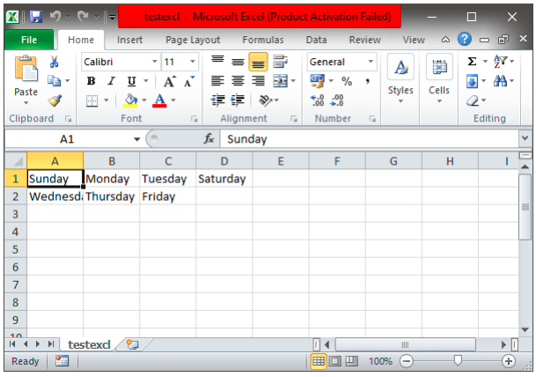
CSV
Using Spreadsheet
To create a CSV file using spreadsheet software (like Microsoft Excel), launch the program and then enter the data in cells (each value in a separate cell and each row with a new row).
After entering the data click File and choose Save As. Under Save as type, select Text CSV and save the file.

Slide 6
CSV FILE IN PYTHON
Working With CSV File in Python
For working CSV files in python, there is an inbuilt module named csv.
Python provides a CSV module to handle CSV files.
To read/write data, you need to loop through rows of the CSV.
The csv module implements classes to read and write tabular data in CSV format.
It allows programmers to say “write the data in the format preferred by Excel”, or “read data from this file which was generated by Excel”, without knowing the precise details of the CSV format used by Excel.
Programmers can also describe the CSV formats understood by other applications or define their own special-purpose CSV formats.
To pull the information from CSV files you use loop and split methods to get the data from individual columns.
The CSV module explicitly exists to handle this task, making it much easier to deal with CSV formatted files.
This becomes especially important when you are working with data that’s been exported from actual spreadsheets and databases to text files.
The information can be tough to read on its own.

Slide 7
CSV FILE IN PYTHON
Reading CSV Files
To read data from a CSV file, you must use the reader function to generate a reader object.
The reader function is developed to take each wow of the file and make a list of all columns.
Then, you have to choose the column you want the variable for.
To understand it better, let’s consider the following example. Let the data.csv contains the following data:
  Programming language, Designed by, Appeared, Extension
  Python, Guido van Rossum, 1991, .py
  Java, James Gosling, 1995, .java
  C++, Bjarne Stroustrup, 1983, .cpp
#import necessary modules
import csv
with open('/home/student/Documents/data.csv', 'rt') as f:
data=csv.reader(f)
for row in data:
print(row)
When you execute the program above, the output will be:
[‘Programming language; Designed by; Appeared; Extension’]
[‘Python; Guido van Rossum; 1991; .py’]
[‘Java; James Gosling; 1995; .java’]
[‘C++; Bjarne Stroustrup;1983;.cpp’]

Slide 8
CSV FILE IN PYTHON
Reading CSV file as a Dictionary
You can also use DictReader to read CSV files.
The results are interpreted as a dictionary where the header row is the key, and the other rows are the values.
#import necessary modules
import csv
reader=csv.DictReader(open("/home/student/Documents/data.csv",'rt'))
for raw in reader:
print(raw)
The result of this code is:
OrderedDict([(‘Programming language’, ‘Python’), (‘Designed by’, ‘Guido van Rossum’), (‘ Appeared’, ‘ 1991’), (‘ Extension’, ‘ .py’)])
OrderedDict([(‘Programming language’, ‘Java’), (‘Designed by’, ‘James Gosling’), (‘ Appeared’, ‘ 1995’), (‘ Extension’, ‘ .java’)])
OrderedDict([(‘Programming language’, ‘C++’), (‘Designed by’, ‘ Bjarne Stroustrup’), (‘ Appeared’, ‘ 1985’), (‘ Extension’, ‘ .cpp’)])

Slide 9
CSV FILE IN PYTHON: Writing CSV Files
When you have a set of data that you would like to store in a CSV file you have to use the writer() function.
To iterate the data over the rows, you have to use the writerow() function.
Consider the following example. We write the data into a file “writeData.csv” where the delimiter is an apostrophe.
#import necessary modules
import csv
with open ("/home/student/Documents/data1.csv",mode='w') as file:
writer=csv.writer(file,delimiter=',',quotechar='"',quoting=csv.QUOTE_MINIMAL)
writer.writerow(['Programming Language', 'Designed by', 'Appeared','Extension'])
writer.writerow(['Python', 'Guido Van Rossam', '1991','.py'])
writer.writerow(['Java', 'James Gosling', '1995','.java'])
writer.writerow(['C++', 'Bjarne Stroupstrup', '1985','.cpp'])
Result in the csv file is:
Programming language, Designed by, Appeared, Extension
Python, Guido van Rossum, 1991, .py
Java, James Gosling, 1995, .java
C++, Bjarne Stroustrup,1983,.cpp

Slide 10
CSV FILES WITH PANDAS
Reading CSV Files with Pandas
Pandas is an open-source library that allows you to import CSV in Python and perform data manipulation.
Pandas provide an easy way to create, manipulate and delete data.
Reading the CSV into a pandas DataFrame is very quick and easy:
#import necessary modules
import pandas
result = pandas.read_csv((‘/home/student/Documents/data1.csv')
print(result)
The result of the above will be:
Programming language, Designed by, Appeared, Extension
0 Python, Guido van Rossum, 1991, .py
1 Java, James Gosling, 1995, .java
2 C++, Bjarne Stroustrup,1983,.cpp
It’s very easy to read CSV files using pandas.
In just three lines of code, you get the same result as earlier.
Pandas know that the first line of the CSV contains column names, and it will use them automatically.

Slide 11
CSV FILES WITH PANDAS
Writing CSV Files With Pandas
Writing to a CSV file with Pandas is as easy as reading.
First, you must create a DataFrame and write the data in it.
Then export the data from the DataFrame to a CSV file.
The following code does the same:
from pandas import DataFrame
C={'Programming Language':['Python','Java','C++'],
'Designed by':['Guido Van Rossam','James Gosling','Bjarne Stroupstrup'],
'Appeared':['1991','1995','1985'],
'Extension':['.py','.java','.cpp'],
}
df=DataFrame(C,columns=['Programming Language','Designed by','Appeared','Extension'])
export_csv=df.to_csv(r'/home/student/Documents/data2.csv',index=None,header=True)
print(df)
The output of the above code will be the following CSS file:
Programming language, Designed by, Appeared, Extension
0 Python, Guido van Rossum, 1991, .py
1 Java, James Gosling, 1995, .java
2 C++, Bjarne Stroustrup,1983,.cpp

Slide 12
CSV FILES WITH PANDAS
So, now you know how to use the method ‘csv’ and also read and write data in CSV format.
CSV files are widely used in software applications because they are easy to read and manage, and their small size makes them relatively fast for processing and transmission.
The csv module provides various functions and classes which allow you to read and write easily.
CSV is the best way for saving, viewing, and sending data. Pandas is also a great alternative to reading CSV files.
Actually, it isn’t as hard to learn as it seems at the beginning. But with a little practice, you’ll master it.

Slide 13
IMPORTANT LIBRARIES
NumPy
Pandas
SciPy
Matplotlib
Scikit Learn.
Seaborn
Install
$pip install numpy
$pip install pandas
$pip install scipy
$pip install matplotlib
$pip install seaborn
$pip install scikit-learn
Check at UBUNTU
Open terminal and type spyder
At Console type
import numpy
import pandas
import scipy
import matplotlib
import seaborn
import sklearn

Slide 14
Thank You

