Slide 1

ENERGY CONSUMPTION PREDICTION
ECE9039
GROUP 20
Lionel Rajaona
Augusto Bedin
Madhavee Kaushik

Slide 2
TODAY WE ARE TALKING ABOUT:
DATASET
MODEL
IMPLEMENTATION
RESULTS
NEXT STEPS

Slide 3
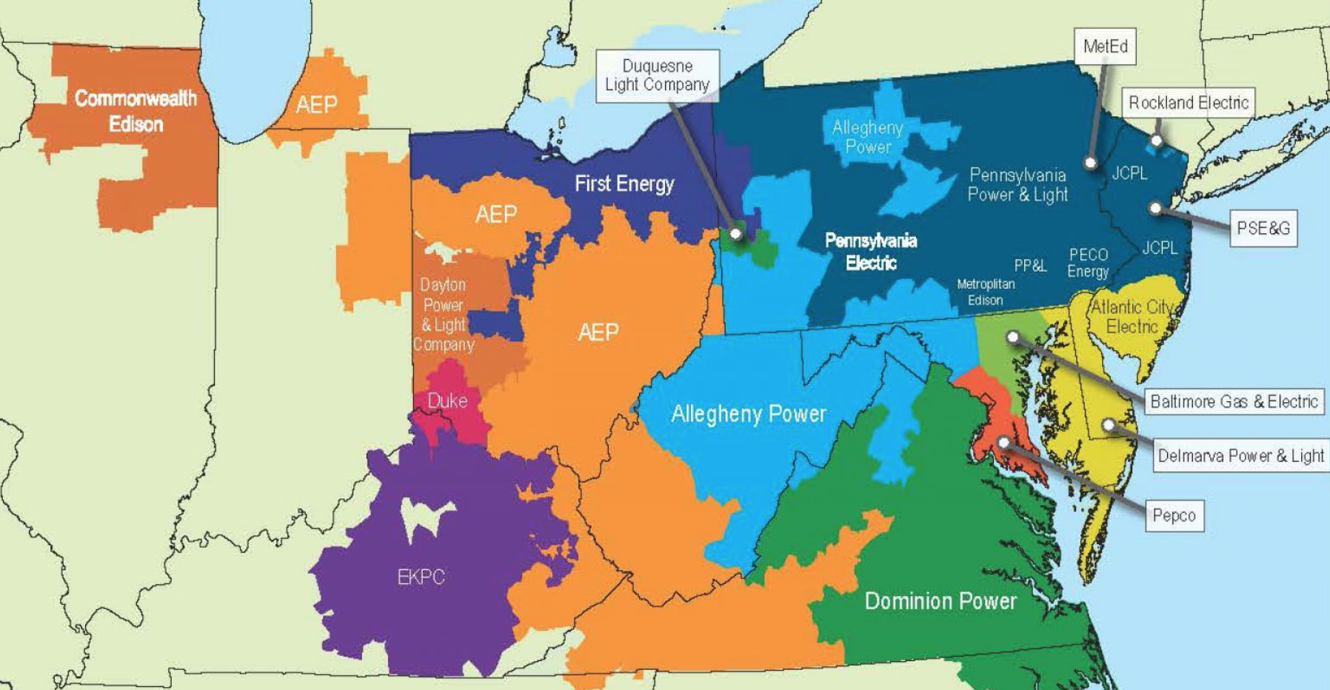
DATASET
PJM Evolution dataset consisting of hourly energy consumption from 2000 to 2018.

Slide 4
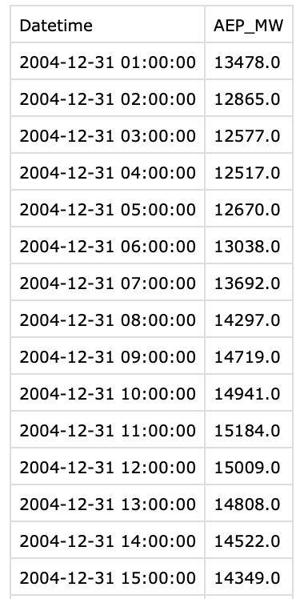
DATASET
AEP area hourly consumption from 2004 to 2018.
Hour and day of the week, season, weather, holidays

Slide 5
TIME SERIES FORECASTING
Which model to use?

Slide 6
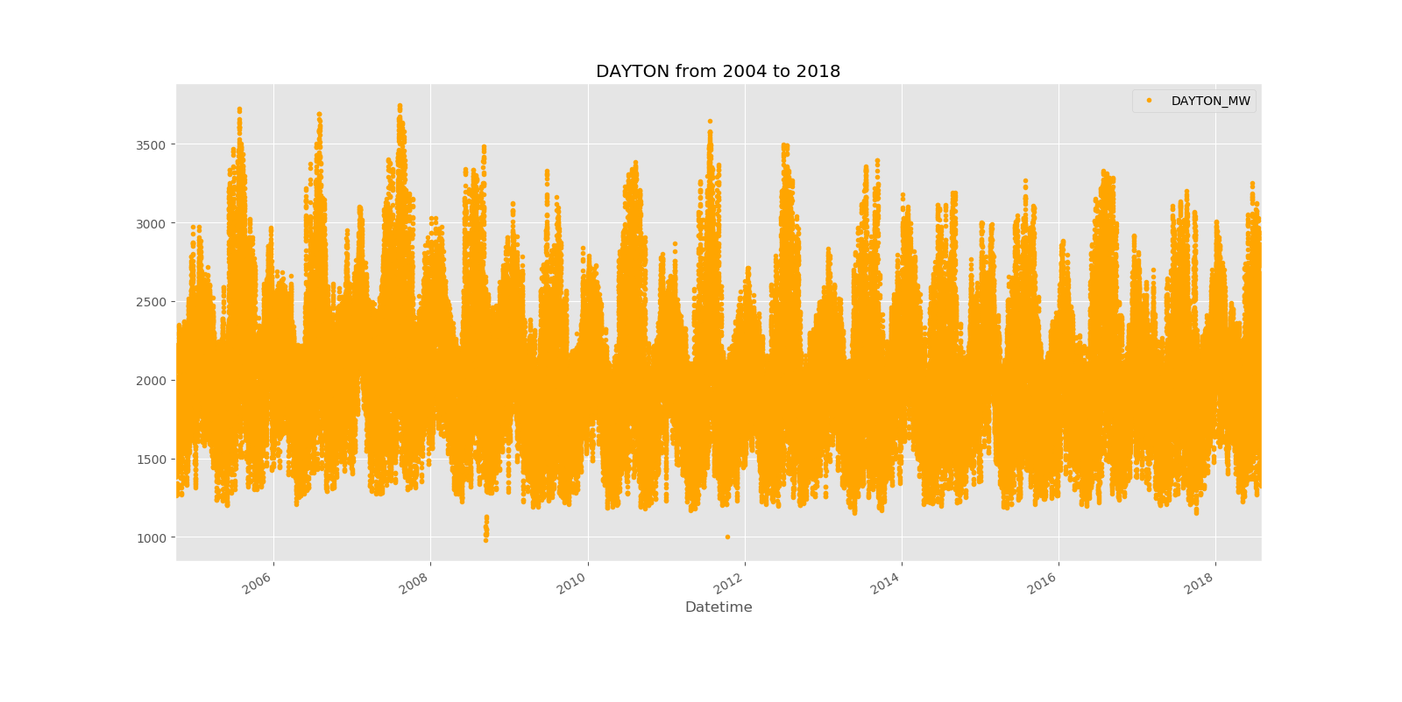

Slide 7
MODEL: FACEBOOK PROPHET
forecasting problem as a curve-fitting exercise

Slide 8

non-periodic changes

Slide 9
non-periodic changes
periodic changes

Slide 10
non-periodic changes
periodic changes
holidays

Slide 11
non-periodic changes
periodic changes
holidays
error

Slide 12
MODEL: FACEBOOK PROPHET
GAM (Generalized Additive Model)
accomodates new components as necessary

Slide 13
IMPLEMENTATION
Data visualization
Training model (80:20)
Forecasting from 2018 to current values

Slide 14
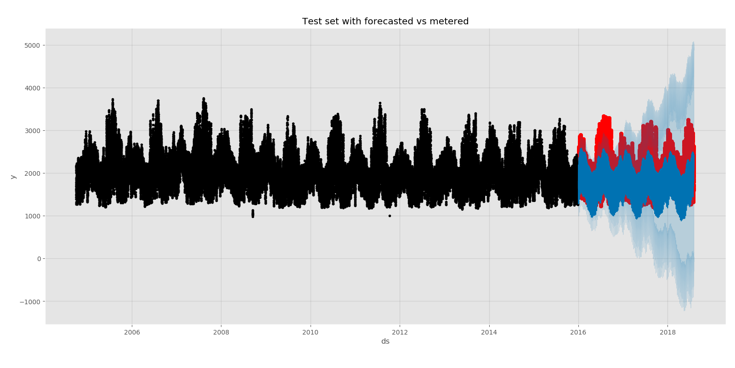
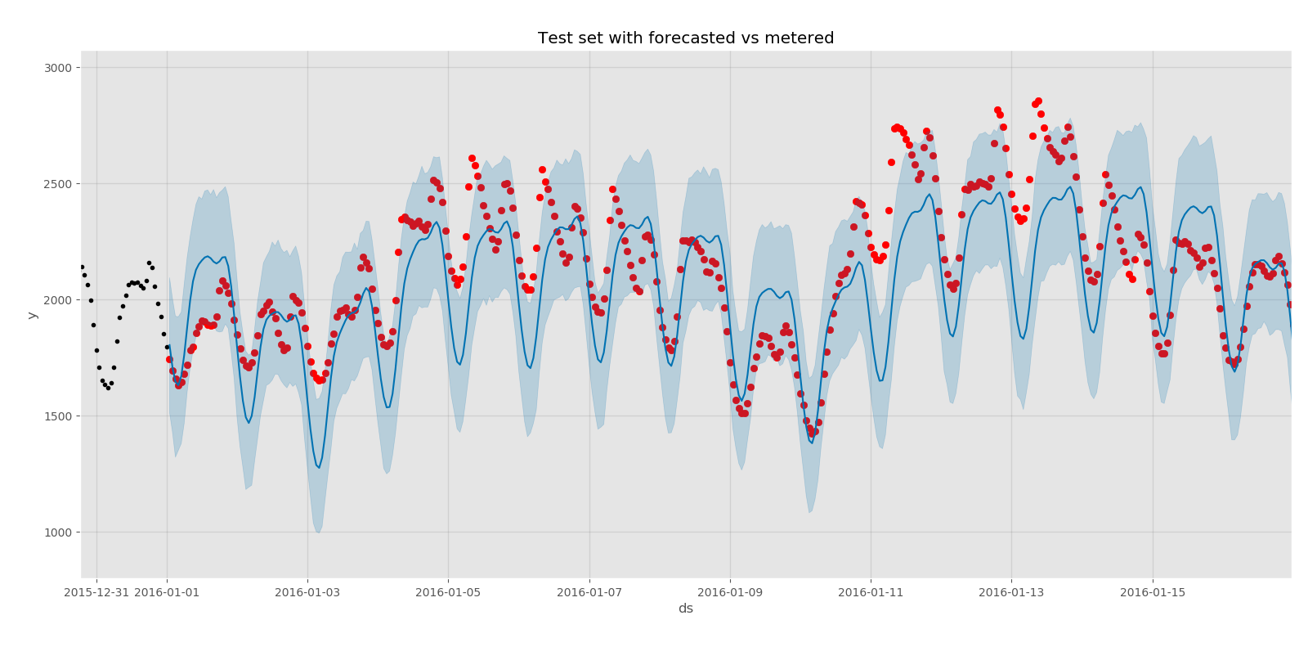
RESULTS FOR VALIDATION
Recognize patterns

Slide 15
VALIDATION
Root Mean Squared Error (MW) | Mean Absolute Error (MW) | Accuracy (%)
393.172 | 311.564 | 83

Slide 16
FORECASTING
Recognize patterns

Slide 17
FORECASTING
Root Mean Squared Error (MW) | Mean Absolute Error (MW) | Accuracy (%)
393.172 | 311.564 | 83

Slide 18
CHALLENGES
Heavy dependencies
Processing-time

Slide 19
FURTHER STEPS
Design another model to compare
Add holidays as a feature
Compare our forecasting with PJM's one
Bigger geographical scale

