Slide 1
Deep-Dive Analysis & Interactive Dashboarding
ApexPlanet Software Pvt. Ltd. Internship
Prepared By: Madhav Gorla

Slide 2
Project Objective
Objective :
Transform analytical findings into a business story.
Validate findings using statistical methods.
Provide actionable business recommendations.
Support data-driven decision making.

Slide 3
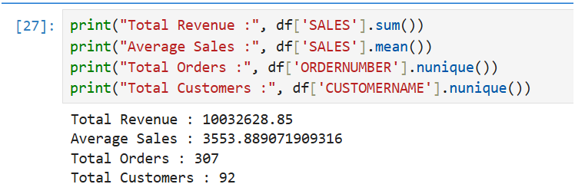
KPI Dashboard
Project Overview
This project focuses on performing Exploratory Data Analysis (EDA) on a sales dataset to identify patterns, trends, and business insights. Various visualization techniques were used to understand customer behavior, product performance, and sales distribution.
Key Performance Indicators
Total Revenue: 10,032,628.85
Average Sales: 3,553.89
Total Orders: 307
Total Customers: 92

Slide 4
Business Story
What We Wanted to Understand
Which products drive revenue?
What factors influence sales?
How can business performance be improved?
Which customer segments contribute most?

Slide 5
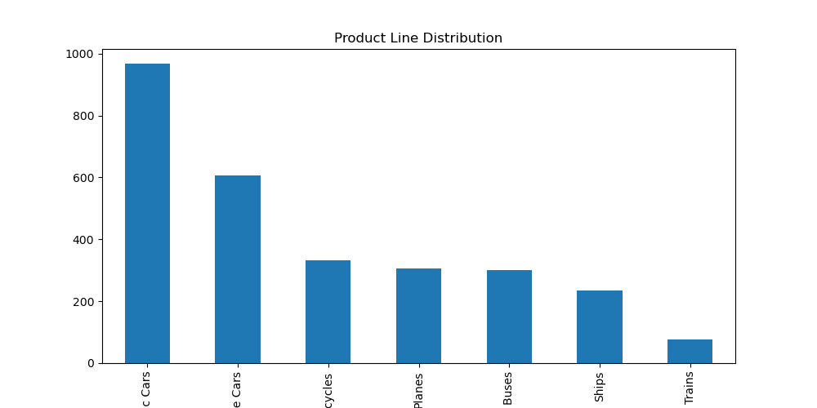
Product Line Distribution Analysis
Analysis
The Product Line Distribution chart shows the number of orders across different product categories. Classic Cars recorded the highest number of sales transactions, making it the most popular product line. Trains recorded the lowest number of transactions.
Key Insight
Classic Cars is the top-performing category.
Vintage Cars also contribute significantly.
Trains have the lowest demand.

Slide 6
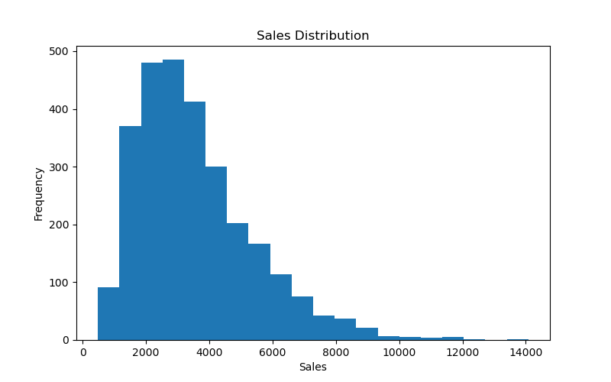
Sales Distribution Analysis
Analysis
The histogram illustrates the distribution of sales transactions across the dataset. Most sales values fall between 2,000 and 5,000, indicating that medium-value transactions contribute significantly to overall revenue. A few high-value transactions create a right-skewed distribution.
Key Insight
Majority of transactions are medium-sized.
High-value transactions occur less frequently.
Sales distribution is positively skewed.

Slide 7
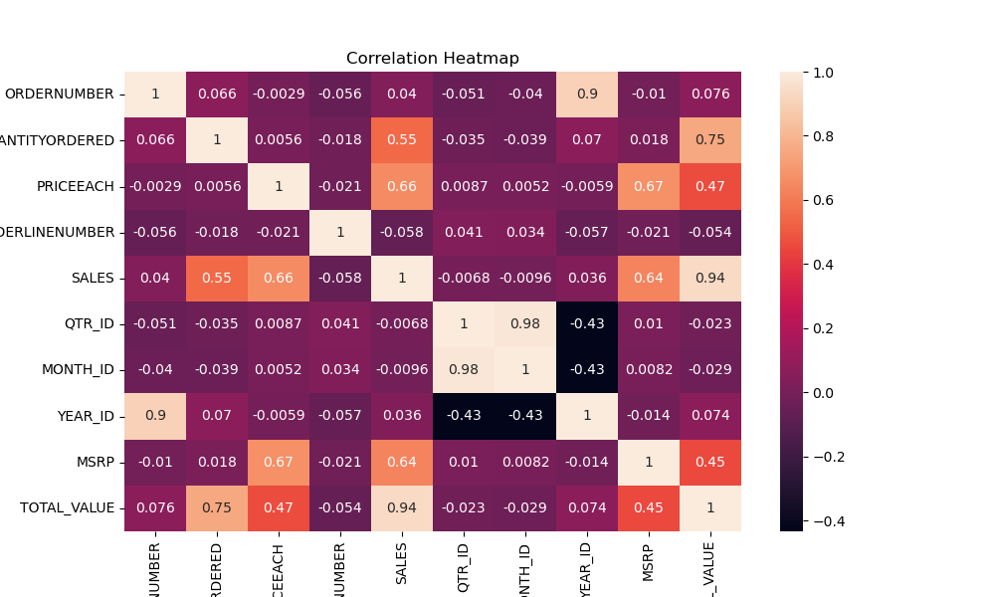
Correlation Analysis
Analysis
The heatmap visualizes relationships between numerical variables. Sales show a strong positive correlation with Total Value, MSRP, and Quantity Ordered. These variables play a crucial role in revenue generation.
Key Insight
Sales and Total Value have a very strong
relationship.
Quantity Ordered positively impacts Sales.
Pricing variables influence revenue growth.

Slide 8
Statistical Validation
Hypothesis Testing
Null Hypothesis (H₀): There is no relationship between Quantity Ordered and Sales Revenue.
Alternative Hypothesis (H₁): There is a significant relationship between Quantity Ordered and Sales Revenue.
Result
Positive Correlation Found
P-value < 0.05
Reject H₀

Slide 9
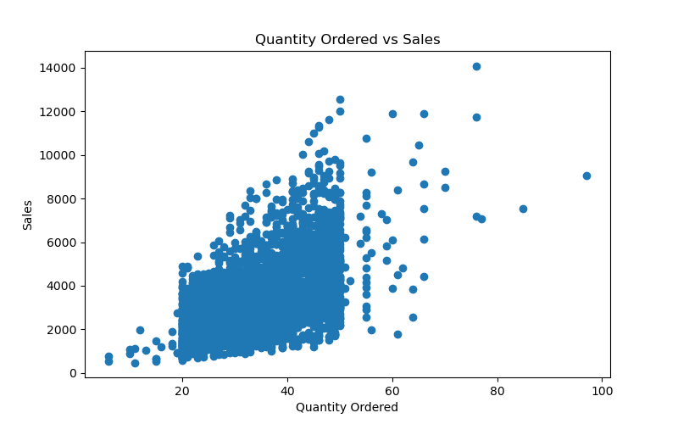
Quantity Ordered vs Sales
Analysis
The scatter plot demonstrates the relationship between Quantity Ordered and Sales. A positive trend can be observed, indicating that larger order quantities generally result in higher sales values.
Key Insight
Strong positive relationship between
quantity and sales.
Bulk purchases generate higher revenue.
Customer order volume directly affects
business performance.

Slide 10
Business Recommendations
Recommendations :
✔ Focus on high-performing product categories
✔ Promote bulk purchasing strategies
✔ Improve customer retention programs
✔ Use dashboards for continuous monitoring
✔ Expand marketing toward profitable segments

Slide 11
Conclusion & Recommendations
Project Summary :
Performed complete EDA and Business Intelligence analysis.
Conducted statistical validation.
Identified major revenue drivers.
Generated actionable business recommendations.
Demonstrated practical skills in:
Python
Numpy
Pandas
Matplotlib
Seaborn
Statistical Analysis
Business Intelligence
Data Storytelling
Thank You
Madhav Gorla
ApexPlanet Software Pvt. Ltd. Internship

