Slide 1

Resume Craft

Slide 2
Tasks
Introducing Resume Craft: An AI-powered resume crafting tool.
Streamlining Success: Reduce stress in resume writing.
User-Friendly Interface: Input history, skills for tailored suggestions.

Slide 3
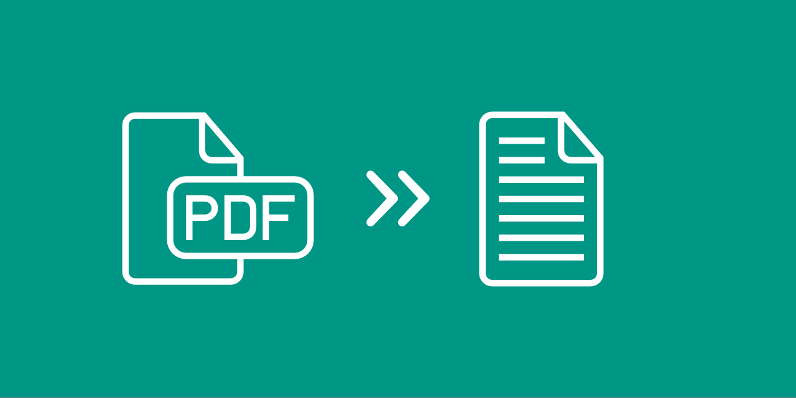


Approach
Text extracted with OCR.
LLM fine-tuned on extracted text.
User-friendly interface developed.

Slide 4



OCR
Google Drive has all the stored resume in pdf format.
Pdf2Image converted them into jpg format.
Pytesseract converted them into raw txt format.

Slide 5
2. MISTRAL 7B
Compact, powerful 7B parameters.
Unique architecture: GQA, SWA.
Flexible fine-tuning for tasks.

Slide 6
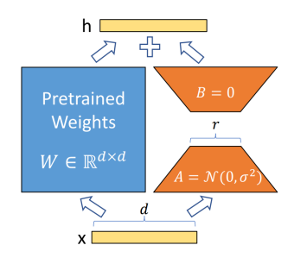
3. FINE TUNING OF LLM
Finetuning for custom data challenges.
LoRa reduces trainable parameters.
PEFT adapts PLMs efficiently.

Slide 7
COMPARISON OF OUTPUT
Prompt : Write some resume points on RISC pipelined

Slide 8

ChatGPT

Slide 9
• Designed and implemented a RISC pipelined architecture to improve instruction throughput and overall processor performance.
• Executed stages, including instruction fetch, decode, execute, memory access, and write-back, optimizing for speed and efficiency

Slide 10
2. Mistral - 7b

Slide 11
• Pipelining: Implemented a multi-stage processor with hazard mitigation and forward data flow.
• Data Flow Simulation: Developed a simulator for the pipeline to analyse performance under different conditions.
• Register Allocation: Designed an algorithm to optimize register allocation in the pipeline using heuristics.

Slide 12

3. LLAMA2 13b

Slide 13
• Designed a 6-stage pipelined processor with an out-of-order pipeline and implemented it in VHDL.
• Studied and analyzed various techniques for implementing pipelines in digital circuits such as Hazard Detection Mechanism (HDM), Forwarding, and Branch Prediction.
• Examination of the use of branch prediction and its effectiveness in improving the performance of pipelines

