Slide 1
Ch@t Bot
Welcome to the world of living people and artificial intelligence entities called bots!

Slide 2
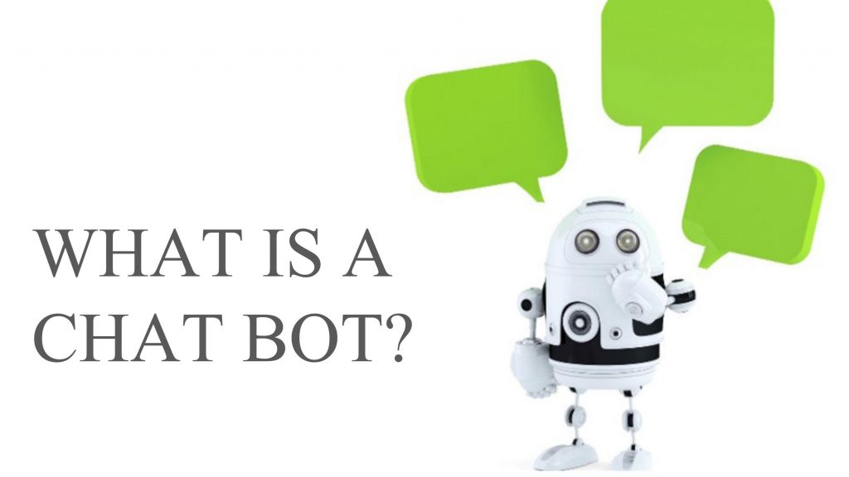

Slide 3
Introduction
Chat Bot: A computer program that can talk to humans in natural language!
Uses Artificial Intelligence Markup Language (AIML) to represent knowledge.
Can replace a human for monotonous jobs of answering queries, e.g. E-help desk.

Slide 4
How It All Started
Eliza – the first chat bot made by Joseph Weizenbaum.
Eliza Effect
  tendency of humans to attach associations to terms from prior experience.
Working of Eliza is based on
  Knowledge Representation
  Pattern Recognition
  Substitution of key words into known phrases.

Slide 5
How does it respond
Looks for certain patterns of words in the user's input.
Replies with pre-determined output, if the pattern is matched.
Needs to have an idea of what the user will chat
Has suitable responses defined in the AIML file

Slide 6

Architecture of a Chat Bot
Responder
AIML Interpreter
AIML Objects
A Chat Bot

Slide 7
AIML
AIML stands for Artificial Intelligence Modelling Language.
AIML is an XML based markup language meant to create artificial intelligent applications.
AIML keeps the implementation simple to program, easy to understand and highly maintainable.

Slide 8
Knowledge Representation
Types of AIML objects
  Topics
  Categories
E.g. :
<aiml>
  <topic name=“the topic” >
  <category>
  <pattern>PATTERN</pattern>
  <that>THAT</that>
  <template>TEMPLATE</template>
  </category>
  </topic>
  </aiml>

Slide 9
Can It Answer All My Questions?
A Chat Bot has a limited number of patterns and responses.
The AIML structure supports regular expressions
In AIML, you can define recursive categories.
The bot may sometimes give funny replies, but that depends on the AIML spec, i.e. Its brain!

Slide 10
What is a Chat Bot useful for?
Commercial chatter bots to help customers
  At web-shops and e-commerce sites.
  Bots to receive complaints from users, online
An interactive (talking) encyclopedia.
Chatter bots administrating IRC-channels and Hotline server.
The Psychiatrist – the famous pronoun reversal trick
Starship Titanic, a game created by the famous writer Douglas Adams along with Terry Jones

Slide 11
Problem with current scenario
Traditionally, the chat bot system is not known to people who are not more into the technology.
Students need to manually visit to the college to get their queries answered by the college help desk.
This process consumes lot of time as well as money because even for minute details the customer needed to visit the college
This leads to communication gap between student and college.

Slide 12
Project Proposal
Extension to Chat Bot, that will reply queries
Will maintain a chat session in terms of queries asked by the user.
Can be useful for auto replying to basic questions asked about JIS College and CSE department
.

Slide 13
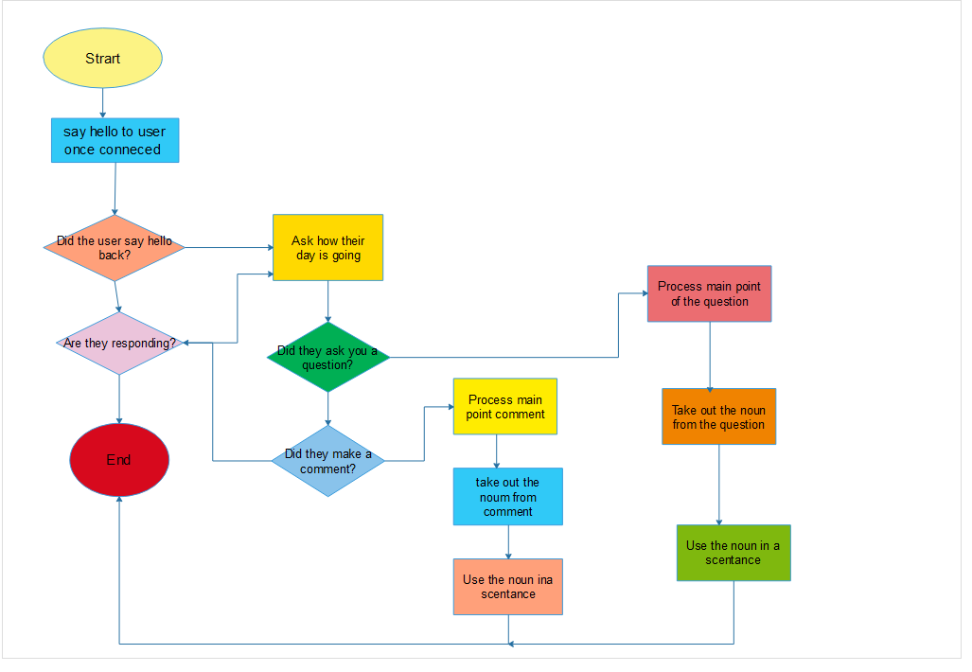
FLOWCHART
This diagram represents the sequence of movements or actions involved in a chatbot system at the time of its processing.

Slide 14
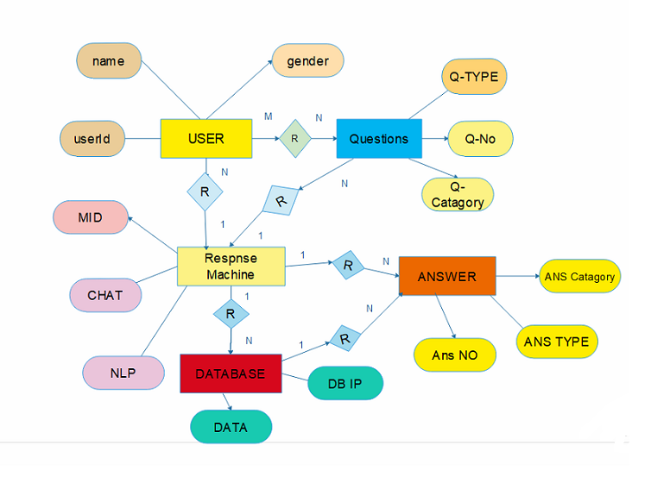
ER Diagram
This entity relationship diagram (ERD), also known as an entity relationship model, is a graphical representation of a chatbot system that depicts the relationships among different entities ,concepts or events within that system.

Slide 15
IMPLEMENTATION
The system includes a user interface with the following options:
Engage in a conversation
Give feedback
The Admin interface provides the options to add questions, answers and keywords.

Slide 16
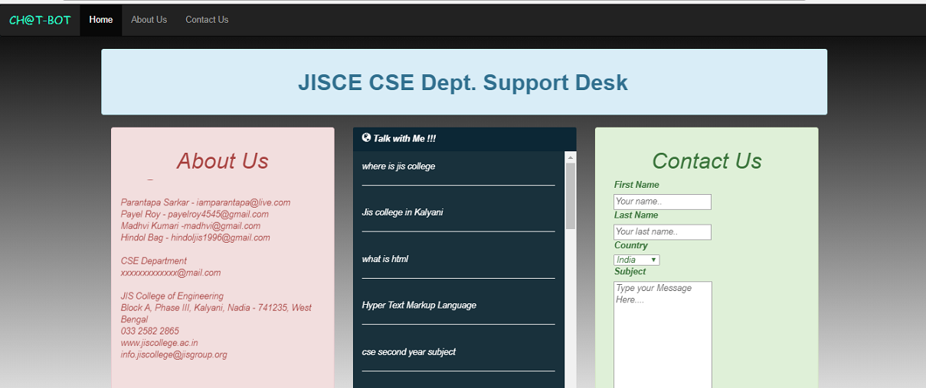

Slide 17
CONCLUSION
The main objectives of the project were to develop an algorithm that will be used to identify answers related to user submitted questions.
A background research took place, which included an overview of the conversation procedure and any relevant chat bots available.
A database was developed, which stores information about questions, answers, keywords, logs and feedback messages. An evaluation took place from data collected by potential students of the University.
Also after received feedback from the first deployment, extra requirements were introduced and implemented

Slide 18
Thank You

