Slide 1
MRI Data Analysis of Patients Diagnosed with Dementia
Madhu Raghunath
Yamini Sasidhar
Shishir Tewari
Notes:
Madhu Today we’ll be presenting...

Slide 2
Summary
Overview
Motivation
Questions + Data Overview
Data Cleanup + Exploration
Data Analysis
Discussion
Post-Mortem
Notes:
SHISHIR I would like to setup agenda for today’s discussion. First we will be giving you a brief overview of what clinical dementia is, following with motivation, questions we asked, data clean-up, analysis and finally will close with a post-mortem of our analysis.

Slide 3

Overview
What is Dementia?
Dementia is not a specific disease.
Group of symptoms associated with decline in memory.
Severe enough to reduce a person’s ability to perform everyday activities.
Alzheimer’s is the most common type of dementia.
Increase in age is the greatest known risk factor.
Notes:
MADHU
Let’s begin with what really dementia is and its different types…...
Alzheimer’s is the most common type of dementia. The greatest known risk factor is increasing age, and the majority of people with Alzheimer's are 65 and older. Approximately 200,000 Americans under the age of 65 have early-onset Alzheimer’s disease.

Slide 4
Motivation
We had data to analyze and didn’t know what to do!
Notes:
SHISHIR

Slide 5
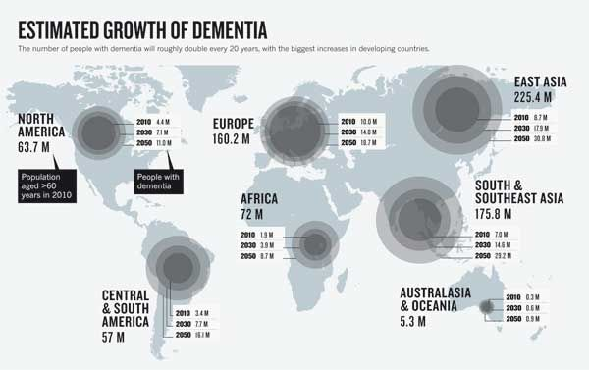
Motivation
On serious note– we wanted to characterize the population of older people who develop dementia.
As the number of dementia cases increases rapidly, there is a growing need to understand its indicators.
Year 2010 number of patients were 4.4M which are estimated to increase to 11.0 M by 2050.
Notes:
SHISHIR : highlight indicators behind dementia

Slide 6
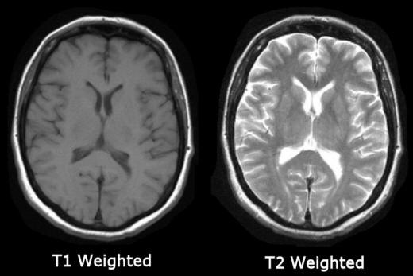
Data Overview
Longitudinal vs. cross-sectional ^{[3,4]}
150 subjects aged 60-96
1-5 visits by each subject, 373 MRI images total
Each subject grouped into clinical groups:
Nondemented
Demented
Converted (MCI -> Dementia) ^{[5]}
Sample population:
72 clinically nondemented (static)
64 clinically demented (static)
51 with mild to moderate AD
14 diagnosed with dementia by end of study
Notes:
YAMINI
https://www.ncbi.nlm.nih.gov/pmc/articles/PMC4523414/
Longitudinal studies provide more consistent evidence for effects of aging on intercranial volume
MILD COGNITIVE IMPAIRMENT

Slide 7

Questions of the Data
Which gender is more at risk of developing dementia?
Which age group in the older population is more at risk?
Do socioeconomic status and education play a role?
How do clinical scores determine the risk factor?
How does brain volume factor in?
Notes:
MADHU, so with given data, we came up with these questions…….

Slide 8
Variables Under Study
Identifiers:
Subject ID
MRI ID
Visit (1-5)
Categorical:
Group
Gender
Hand
Subject Details:
Age (60-96)
Years of education
Socio-economic status (1-5)
Ratings:
Mini-Mental State Examination (MMSE 0-30)
Clinical Dementia Rating (CDR 0-2)
Quantitative:
Total Intracranial Volume (eTIV)
Whole Brain Volume (nWBV)
Misc:
MR Delay (ms)
Atlas Scaling Factor (ASF)
Notes:
SHISHIR
****GRAPHIC (mmse and cdr)

Slide 9

Data Cleanup + Exploration

Slide 10
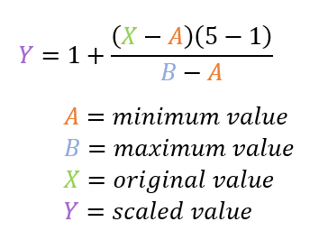
Data Cleanup
Removed columns for MRI ID, MR Delay, Hand, ASF.
Renamed converted group as demented.
Renamed columns for convenience. (“M/F” -> “Gender”)
Removed missing rows from data. (19 rows, leaves 142 subjects)
Created separate dataframes for first and last visit.
Calculated normalized scores for years of education, scale of 1-5.
Notes:
YAMINI
Removed duplicate values based on first/last
Removed missing rows from data
Renamed columns for ease of use
Renamed converted group as demented
Calculated scored values for education, scale 1-5 (normalized)
MR Delay, ASF, RIGHT, MRI ID columns unnecessary

Slide 11
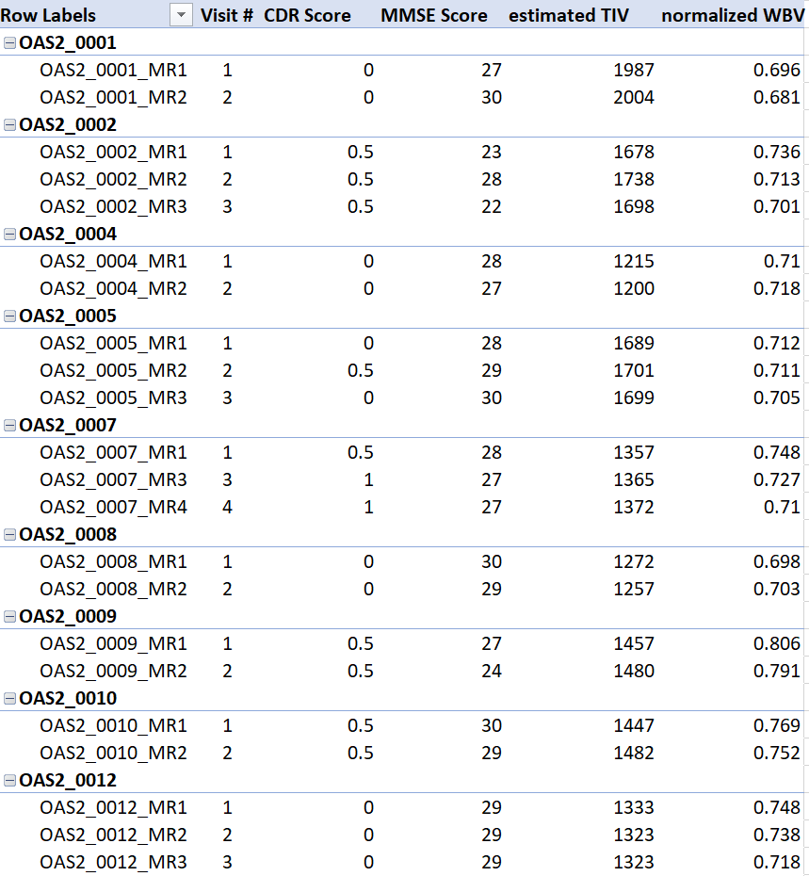
Exploration
We created Pivot Tables in MS Excel to help visualize our data and look for discrepancies when working with our dataset.
We compared our results in pandas DataFrames to Pivot Table results to make sure we were using the right group-bys, sorted indexes, functions, etc.
Notes:
Madhu, Our team’s intent to explore the dataset was to rule out any discrepancies, to do so we created pivot table using excel. Compared these results with dataframe results to make sure we used right sorted values, groupbys and such..

Slide 12
Data Analysis

Slide 13
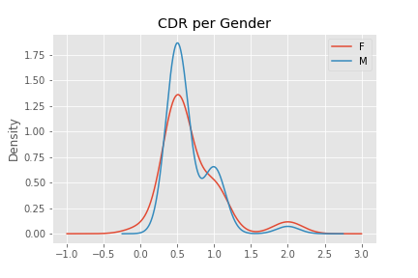
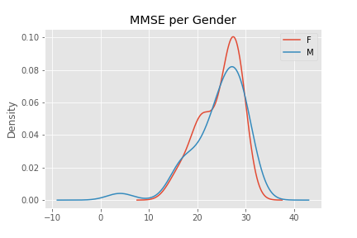
Gender based plots with CDR & MMSE
With the given dataset we see no difference in the median representing the data between the gender.
Female & Male - 0.5 Female & Male - 26.0
Notes:
Madhu , we started our analysis by grouping the patients by their gender and comparing them clinical tests. Firstly when compared

Slide 14
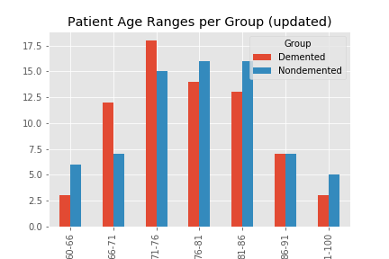
Age Vs Group
Out of the age range of 60 to 98, there seems to be a higher concentration of 66-76 years old in the clinically demented group than those in the nondemented patients.
Notes:
Next we analysed with the group

Slide 15
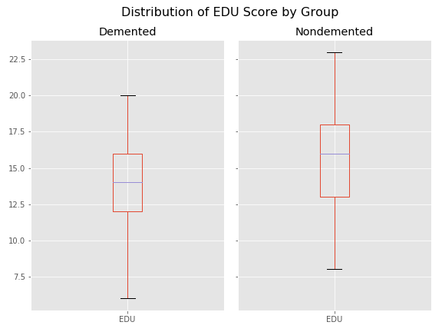
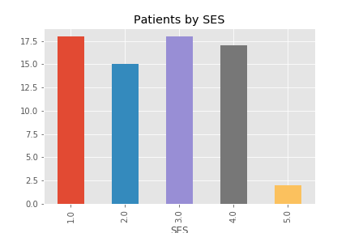
Education Vs Group
Patients by SES
Clinically demented patients had less median years of education compared to the nondemented. Which is 14 for demented and 16 nondemented patients.
We can see that there is no obvious relation between clinically demented patients and their socioeconomic status. However very less patients are in higher SES range.
Notes:
SHISHIR

Slide 16
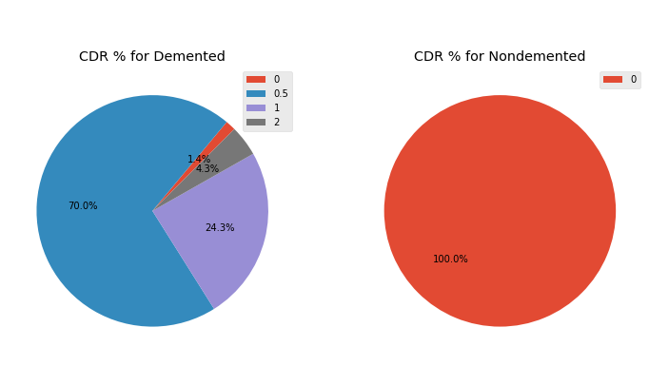
CDR % by Group
Clinically Non Demented patients will have CDR 0 where as most of the demented patients (95%) have 0.5 and 1 CDR.
CDR-0: no cognitive impairment
CDR-0.5: questionable or very mild dementia
CDR-1: mild
CDR-2: moderate[2]
Notes:
SHISHIR

Slide 17
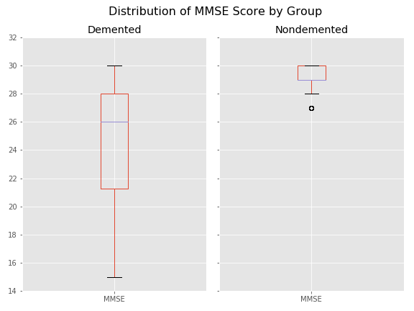
MMSE by Group
The MMSE score of the Demented group on the range of 14 to 30 is clearly lower than the patients in Nondemented, where the scores of Nondemented have ranged from 28 and above.
Demented 26.0 Nondemented 29.0
Notes:
Madhu

Slide 18
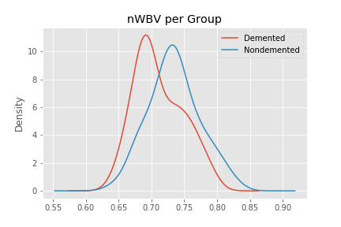
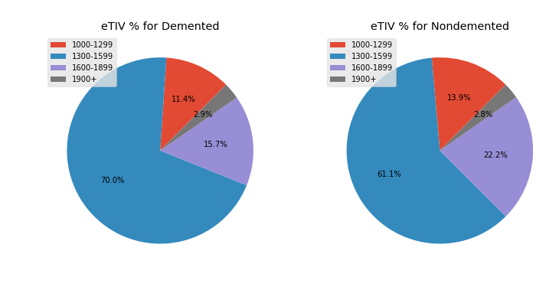
Density Plot for nWBV
eTIV% by Groups
We can see that the clinically demented group has a lower median representing the data subset, showing a lower normalized whole brain volume for these patients.
Demented 0.6995 Nondemented 0.7345
Estimated Total Intracranial Volume (eTIV) , ranges from 1106 to 2004, has higher number of demented patients in 1300 to 1599 range.
Notes:
YAMINI/SHISHIR

Slide 19
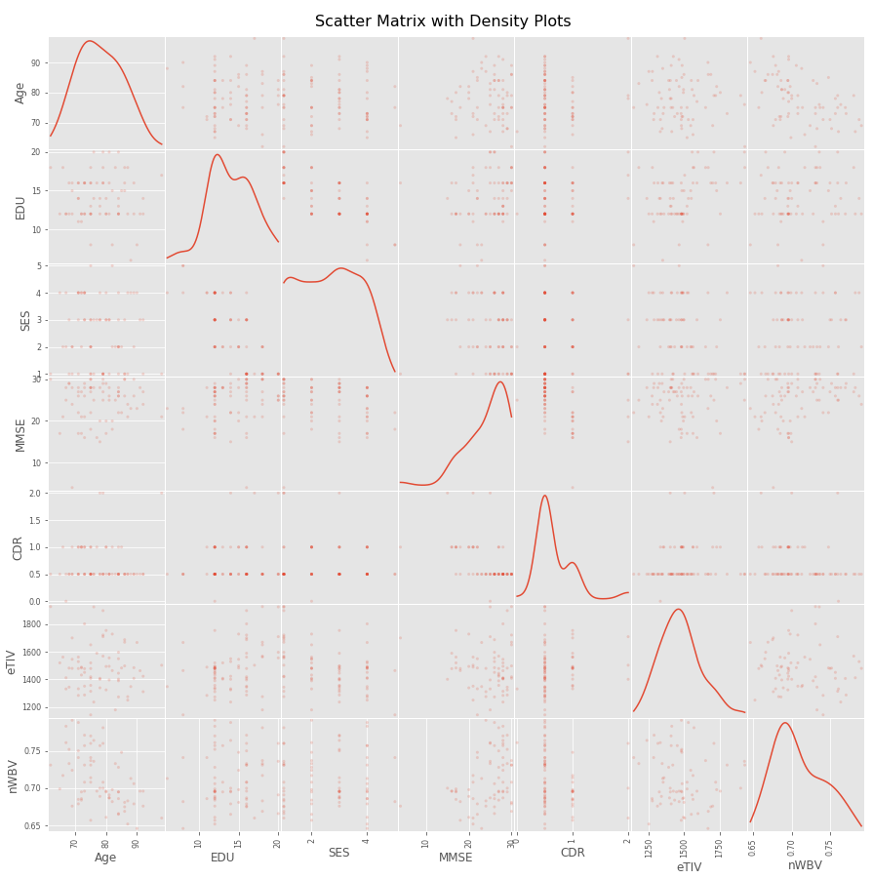
Scatter Matrix
Efficient method of visualizing the relationships between all variables of interest.
Performed on specifically the group of clinically demented patients.
Depict a density plot for the diagonal.
What can we see from this plot?
Does this help our analysis?
Notes:
YAMINI
Vs histograms or boxplots, more common

Slide 20
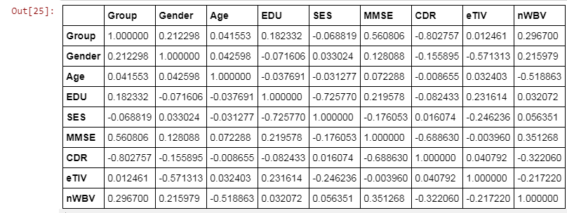
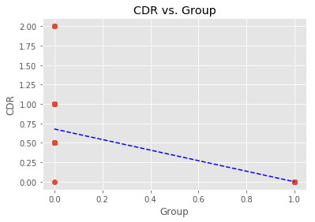
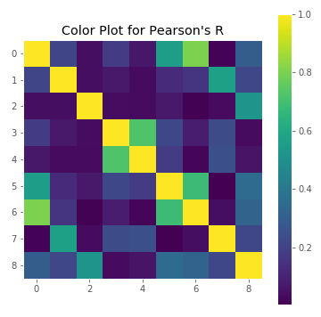
Colorplot (Pearson’s R)
CDR vs. Group
This regression does not tell us much.
r:-0.8027571865207666
Notes:
YAMINI: p-tests, colorplot (r val), wbv_dens, scatter matrix

Slide 21
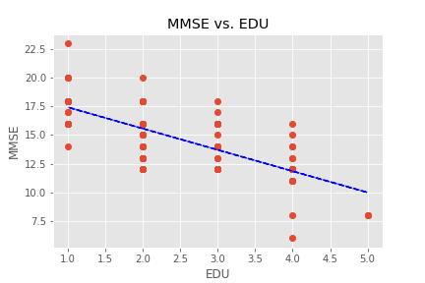
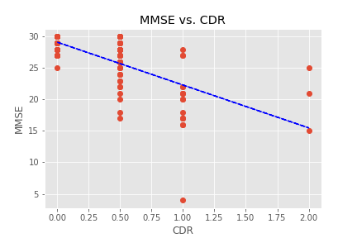
MMSE vs EDU
MMSE vs CDR
Data points are clustered to normalized education scores. MMSE is getting declined to higher education.
r:-0.725770294653746
pearsons r:-0.725770294653746
Higher MMSE signifies lower CDR scores.
r:-0.688629766665064
Notes:
Shishir

Slide 22
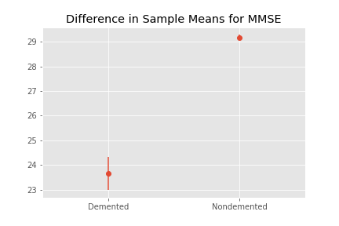
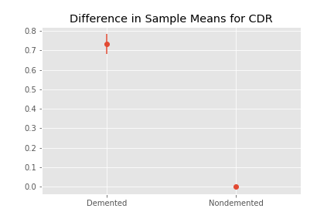
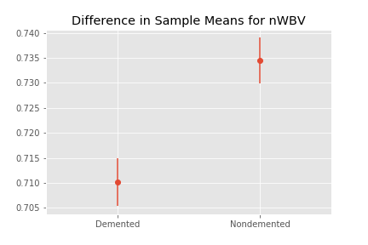
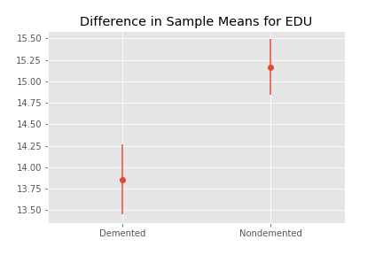
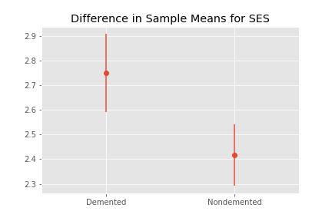
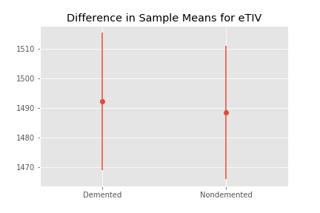
Can we trust our data? (Student’s t-tests)
Difference in sample means is significant for:
MMSE
CDR
nWBV
EDU
Difference in sample means is not significant for:
SES
eTIV
What does this mean in regards to null hypothesis?
Notes:
YAMINI: p-tests, colorplot (r val), wbv_dens, scatter matrix

Slide 23

Discussion

Slide 24
Discussion
We performed this data analysis to see whether we could identify any indicators for the progression of dementia in an older patient population. Our statistical tests couple with our generated plots to accurately depict our population under study.
The tools we used include:
Pandas
Matplotlib
Numpy
Scipy
Excel
Notes:
MADHU - In overall we used this dataset to analyse if we could identify any indicators for progression of dementia in older population. Our statistical test along with our generated plots depict accurately the sample under study.

Slide 25
Post-Mortem
For this sample population, we succeeded in finding:
The age group (66-76) with a higher prevalence of dementia.
A negative linear trend between CDR score and MMSE score.
A significant difference in normalized whole brain volume between groups.
We were not able to find:
If one gender had higher prevalence of dementia.
A relationship between socioeconomic status and prevalence of dementia.
A significant difference in estimated intracranial volume between groups.
Notes:
SHISHIR

Slide 26
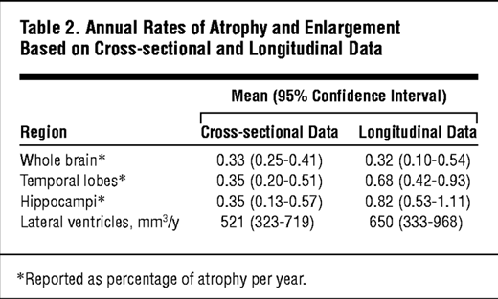
Limitations
Further Direction
Our data was limited in quantity, with only 142 subjects of uneven gender counts.
Some of the variables remained unclear even with research, the uploader did not provide sufficient documentation.
Are eTIV and nWBV specific?
We’d be interested in acquiring a larger dataset with additional variables and information:
Race, profession, lifestyle, genetic background, and pre-existing conditions.
Additionally: atlas-scaled normalized volumes of different brain regions. ^{[6]}
Notes:
YAMINI
In taking steps to expand upon this analysis...
Scahill RI, Frost C, Jenkins R, Whitwell JL, Rossor MN, Fox NC. A Longitudinal Study of Brain Volume Changes in Normal Aging Using Serial Registered Magnetic Resonance Imaging. Arch Neurol.2003;60(7):989–994. doi:10.1001/archneur.60.7.989

Slide 27

Questions?

Slide 28
References
[1] https://www.alz.org/alzheimers-dementia/what-is-dementia
[2]https://www.sciencedirect.com/topics/neuroscience/clinical-dementia-rating
[3]OASIS: Longitudinal: Principal Investigators: D. Marcus, R, Buckner, J. Csernansky, J. Morris; P50 AG05681, P01 AG03991, P01 AG026276, R01 AG021910, P20 MH071616, U24 RR021382
[4]Pfefferbaum, A., & Sullivan, E. V. (2015). Cross-sectional versus longitudinal estimates of age-related changes in the adult brain: overlaps and discrepancies. Neurobiology of Aging, 36(9), 2563–2567. http://doi.org/10.1016/j.neurobiolaging.2015.05.005
[5]Farias, S. T., Mungas, D., Reed, B. R., Harvey, D., & DeCarli, C. (2009). Progression of Mild Cognitive Impairment to Dementia in Clinic- vs Community-Based Cohorts. Archives of Neurology, 66(9), 1151–1157. http://doi.org/10.1001/archneurol.2009.106
[6]Scahill RI, Frost C, Jenkins R, Whitwell JL, Rossor MN, Fox NC. A Longitudinal Study of Brain Volume Changes in Normal Aging Using Serial Registered Magnetic Resonance Imaging. Arch Neurol.2003;60(7):989–994. doi:10.1001/archneur.60.7.989

