Slide 1


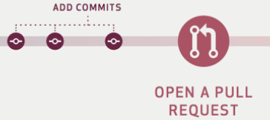
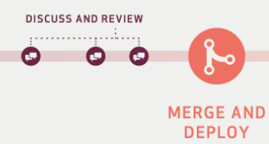





Jenkins-Docker-Azure Workflow
Re-view fails
If code review fails an email will send to developer to recheck the code
If fails, an email notification will be sent to user
Merge the feature branch changes to main/master branch
Successful merged the code in staging branch
PR to review the code for approval
Build pipeline
User will create a Feature Branch .
Developers pushes the code in bit bucket in feature branch
Feature Branch
Re-view pass
Staging Branch
User
Jenkins
Build failed
Raise a Pull Request to merge from staging to main/prod branch
Docker Image will push to JFrog repo
Build Success.
Take latest docker images and deploy it to any Azure Resources
Docker will create an image/container.
PROD build pass
Staging pass
SQube pass
PROD Branch
Azure Resources like Logic Apps, AKS, Web Apps
Azure Staging
Repository
Docker
Code Coverage
Azure PROD
Jenkins
PROD fails
Staging fails
If SQube pass, results will export in dashboard and selenium testing will start if applicable
SQube fails
Pull the latest docker from jfrog repo and deploy the same to PROD env
Another method where we can push the code Azure Service

Slide 2
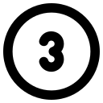


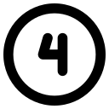



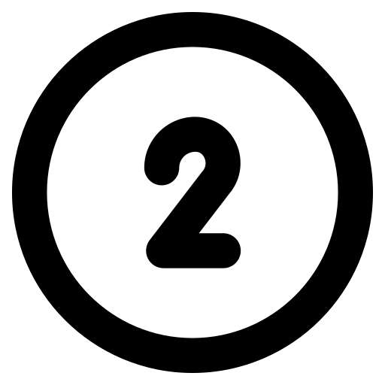

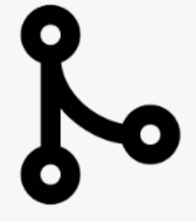


Jenkins Workflow
User
Feature Branch
Pull Request
Merge the PR
Staging Branch
Jenkins
Code Coverage
Artifact Repo
Code Coverage
Merge the PR
Pull Request
Staging Branch
Azure Web App
Azure Web App
Artifact Repo
Jenkins
Prod Branch
1 – Developer pushes the code in Feature Branch
2 – Developer raise a pull request to merge the code to Staging/Prod Branch
3 – If the review fails, developer need to re-check the code
4 – If the build or Staging validation Or SonarQube fails an email notification will send to respective development team
- Build/PR/SonarQube/Staging Pass - Build/PR/SonarQube/Staging Fails

Slide 3


Azure DevOps Workflow
User
Feature Branch
Pull Request
Merge the PR
Staging Branch
Azure Pipeline
Code Coverage
Artifact Repo
Code Coverage
Merge the PR
Pull Request
Staging Branch
Azure Web App
Azure Web App
Artifact Repo
Azure Pipeline
Prod Branch
1 – Developer pushes the code in Feature Branch
2 – Developer raise a pull request to merge the code to Staging/Prod Branch
3 – If the review fails, developer need to re-check the code
4 – If the build or Staging validation Or SonarQube fails an email notification will send to respective development team
- Build/PR/SonarQube/Staging Pass - Build/PR/SonarQube/Staging Fails

Slide 5
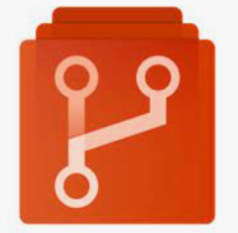



Azure DevOps Workflow
Re-view fails
If code review fails an email will send to developer to recheck the code
If fails, an email notification will be sent to user
Merge the feature branch changes to main/master branch
Successful merged the code in staging branch
PR to review the code for approval
Merged to Azure Repo
User will create a Feature Branch .
View pass
User
Developers pushes the code in bit bucket in feature branch
Feature Branch
Staging Branch
Azure Repo
Sqube for PROD env
Review Fails
Take latest docker images and deploy it to App Service
Artifact will push the code in Azure .
Review Success.
Staging pass
Review pass
Build pass
Build failed
Prod Branch
Staging Branch
Azure App Service
Container Registry
Azure Resources like Logic Apps, AKS, Web Apps
Azure Artifacts
Build Pipeline
Build Pipeline
Build pass
Build Fails.
SQube fails
PROD build fails
Another method where we can push the artifact to app service
Artifact will push it to PROD env

