Slide 1
DevOps Overview

Slide 2
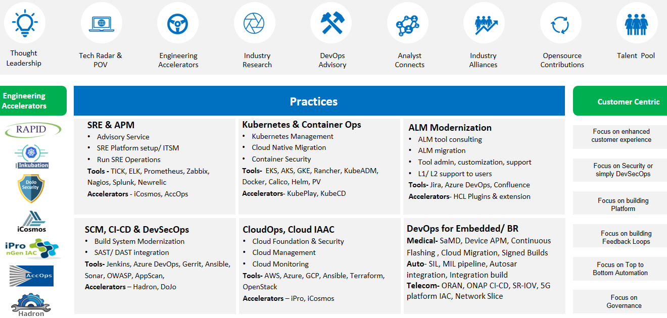
CoE Led Engineering Based Customer Centric DevOps

Slide 3
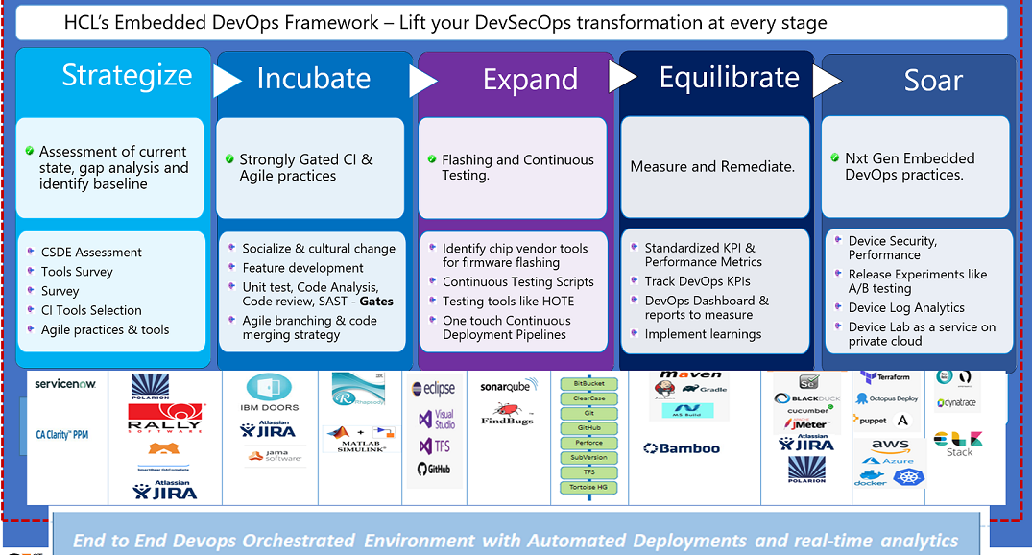
HCL’s RED (RAPID Embedded DevOps) Framework
Tools and Frameworks

Slide 4
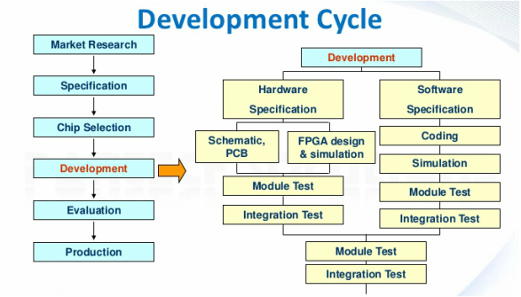
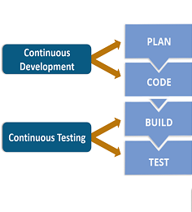




Mapping Embedded SDLC & DevOps
In embedded SDLC hardware specifications, design and testing of target device/ board/ chip should go hand in hand with the Software being developed for it.
DevOps Lifecycle
Dynamical systems, modeling, optimization, and control, and statistical methods for Validation and Verification (V&V) are considered holistically for software and hardware
Organizations need ways to effectively integrate portions of the embedded development process to produce better software faster.

Slide 5
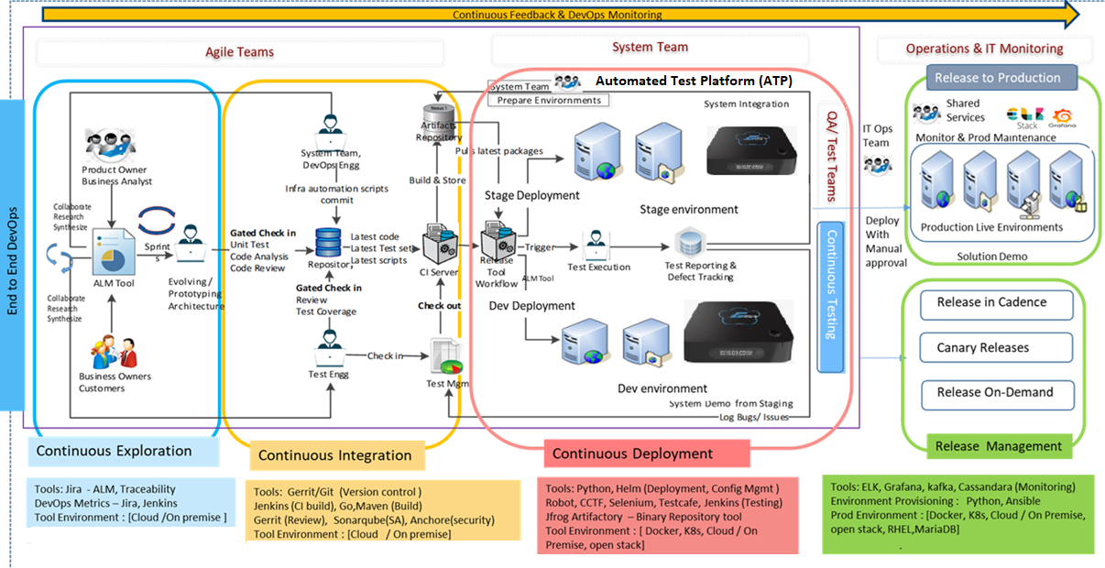
HCL Reference Fully Automated DevOps platform

Slide 6
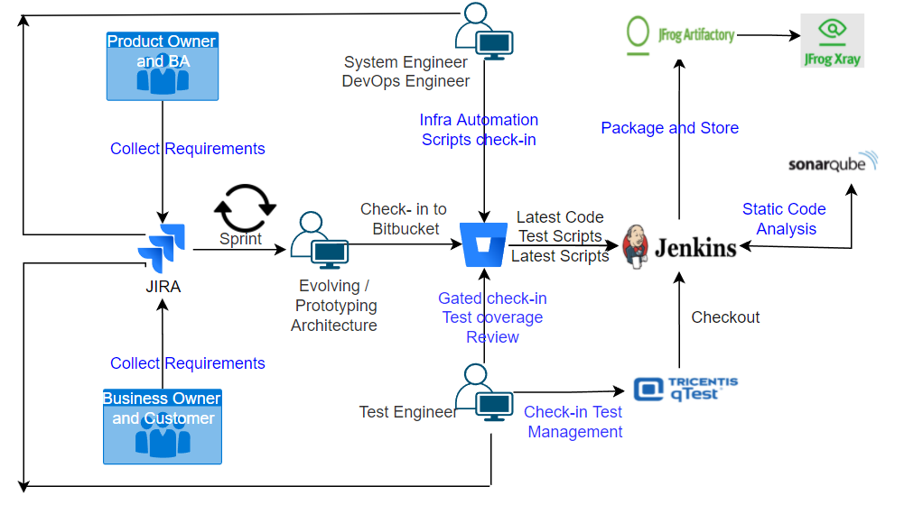

Slide 7
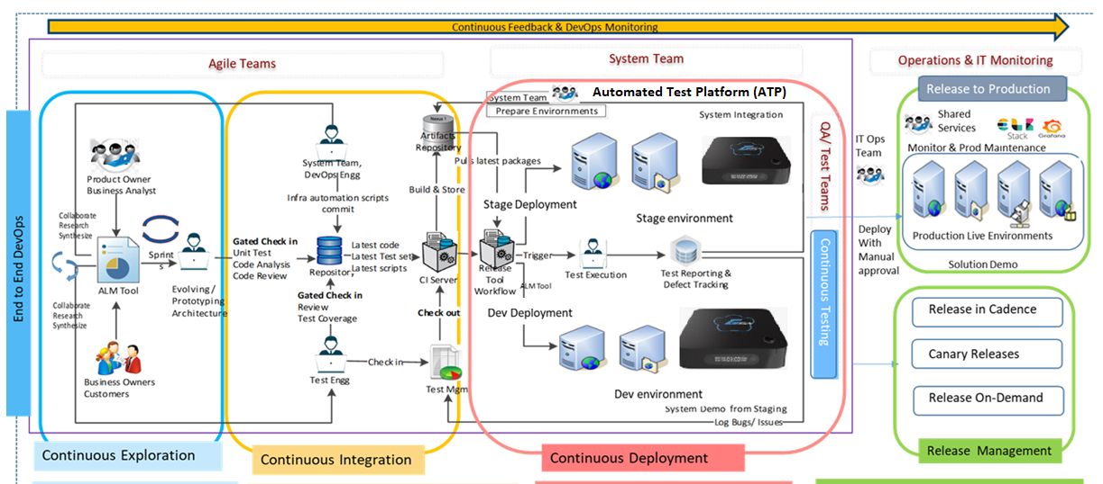
Tools :Jira –ALM, Traceability
DevOps metrics – Jira, Jenkins
Tools environment – [Cloud/On prime]
Tools: Bitbucket (Version control), Jenkins (Continuous Integration), .deb (Packaging), JFrog (Artifactory Repository), JFrog Xray (Security Scan), SonarQube (Static Code Analysis),
Tools environment – [Cloud/On prime]
???
???

Slide 8
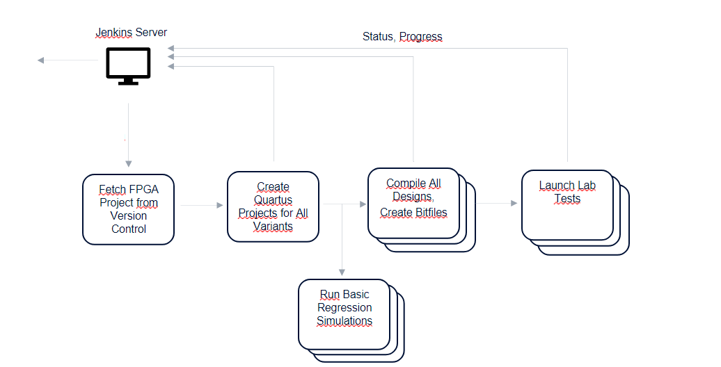
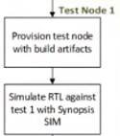
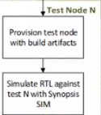
Automatic FPGA Build/ Regression Test Flow
Email notification for failed cases
IP Module
Sub-System
System
Prototype
FPGA boards
Emulators
Test equipments
PythonTest Framework
H/W & S/W integration
RTL Design
Compilation
Initial Synthesis
TestBench Development
Test Case Development
Simulations
Subsystem Design
Compilation
Initial Synthesis
TestBench Development
Test Case Development
Simulations
RTL Design
Compilation
Synthesis
Netlist Validation
TestBench Development
Test Case Development

Slide 9







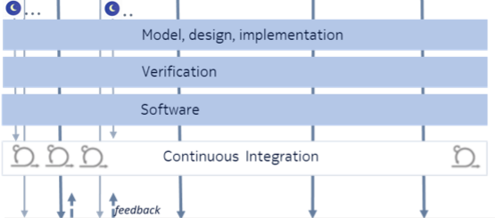
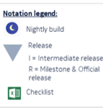


Pipeline for IP / modules
Stakeholders
BU & DU requts
Product Platform requts
Standards
Concepting
Chipset
Feature Screening
FS1, FS2, FS3…Backlog
Change Management
IP0, IP1, IP2,….IPn
Tool : Quartus Prime
Tool : Modelsim/Qsim
Tool : Jenkins
Program Management

Slide 10



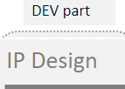
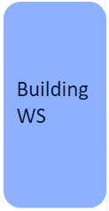

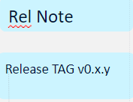





Integration Workflow
Delivery
Design Implementation
Synthesis, PnR ( Tool : Quartus Prime)
Programming file loading to FPGA
RTL development/modifications
(VHDL / Verilog / System Verilog)
( Tool : Quartus Prime)
Functional Simulation
(Zero Delay)
( Tool : Modelsim/Qsim)
In-Circuit Testing/Hardware testing
Code Coverage
(Branch / FEC / Toggle)
( Tool : Modelsim/Qsim)
Timing Simulation
(Min, Max, Typical Delay)
( Tool : Modelsim/Qsim)
Notes:
Whenever source code is changed, full FPGA build will run
Automate the fpga compilation, verification and validation flow
Everything is stored and labelled in artifactory

Slide 11
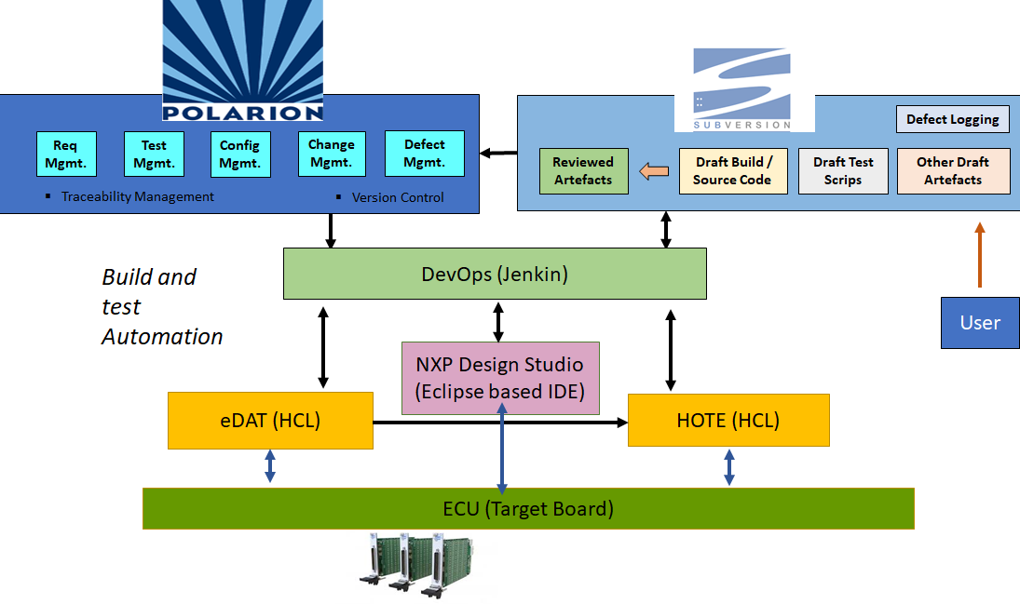
Case study for Aero

Slide 12















Case Study for SaMD
Requirements
Product owner
Customer
User story
Release notes
Product backlog
Cloud Deployment
Sprints and tasks
External release
R&D Agile team
Repository container
Source code
Source Control
Tested Deliverables
Integration performance test
Software build
Unit test and code quality
Source code
Binaries & Deliverables
Modules

