Slide 1


Unsupervised Machine Learning
Zomato Restaurant Clustering and Sentiment Analysis
By
Madhavi Mali
https://colab.research.google.com/drive/madhavi_mali/ZomatoRCASA
https://github.com/madhavimali/Zomoto_Restaurant_Clustering_and_Sentiment_Analysis_MM

Slide 2
Contents
Problem statement
Data summary
EDA
Feature engineering
NLP operations
Sentiment Analysis
Machine learning models
Clustering
Model validation 10.Conclusion

Slide 3
Problem Statement
The Project focuses on analyzing the Zomato restaurant data. You have to analyze the sentiments of the reviews given by the customer in the data and made some useful conclusion in the form of Visualizations. Also, cluster the Zomato restaurants into different segments.
The Analysis also solves some of the business cases that can directly help the customers ﬁnding the Best restaurant in their locality and for the company to
grow up and work on the ﬁelds they are currently lagging in.
This could help in clustering the restaurants into segments. Also the data has valuable information around cuisine and costing which can be used in cost vs. beneﬁt analysis Data could be used for sentiment analysis. Also the metadata of reviewers can be used for identifying the critics in the industry.

Slide 4
Data summary
Zomato Restaurant Reviews 1.Restaurant :Name of the Restaurant
Reviewer :Name of the Reviewer
Review :Review Text
Rating :Rating Provided by Reviewer
MetaData :Reviewer Metadata - No.
of Reviews and followers
Time:Date and Time of Review 7.Pictures :No.of pictures posted with review
Zomato Restaurant names and Metadata
Name :Name of Restaurants
Links :URL Links of Restaurants
Cost :Per person estimated Cost of
dining
Collection :Tagging of Restaurants w.r.t.
Zomato categories
Cuisines :Cuisines served by Restaurants
Timings :Restaurant Timings
Notes:
There are two data sets are given
Feachers in fist dataset are

Slide 5
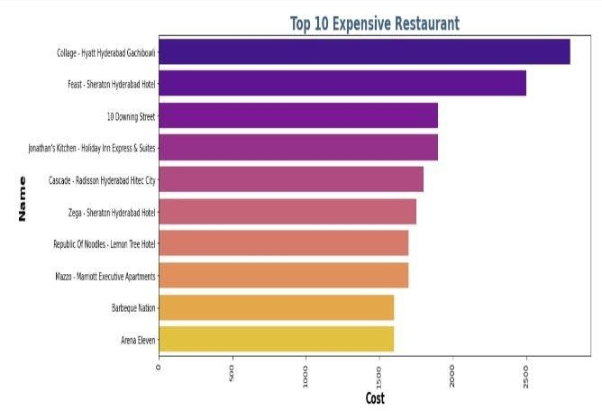
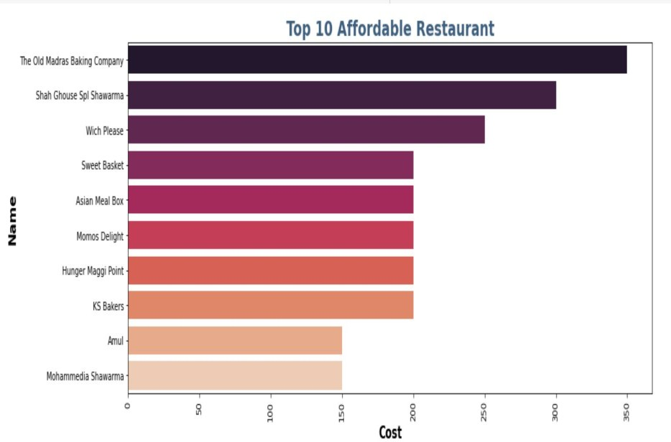
Exploratory Data Analysis
Finding out the most expensive and most affordable restaurants can help a lot according to different pocket sizes
Notes:
Here there are two charts
In first chart you can see

Slide 6
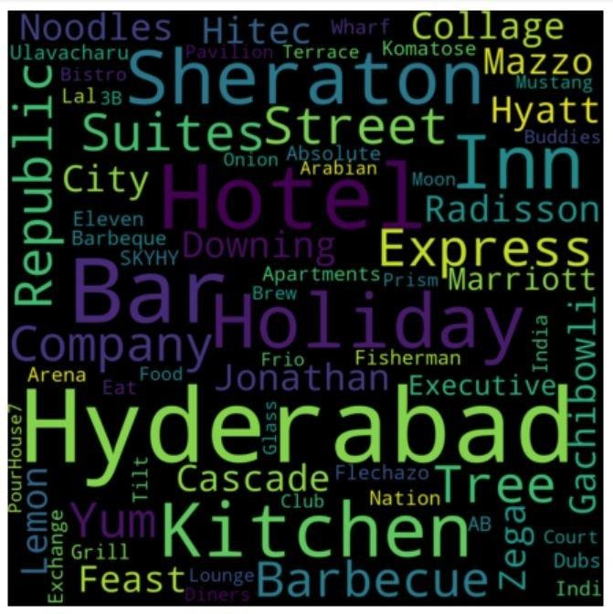
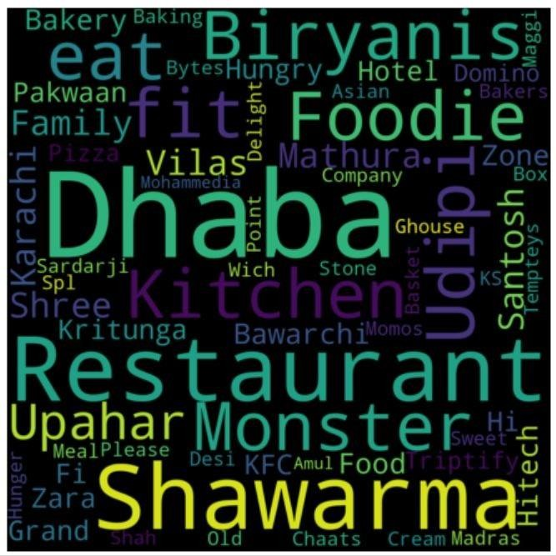
Exploratory Data Analysis(contd)
Word cloud for expensive restaurants
Word cloud for affordable restaurants
Notes:
Here is a

Slide 7
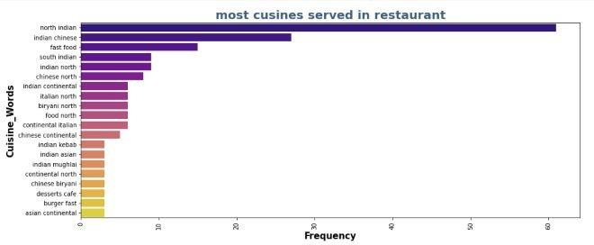
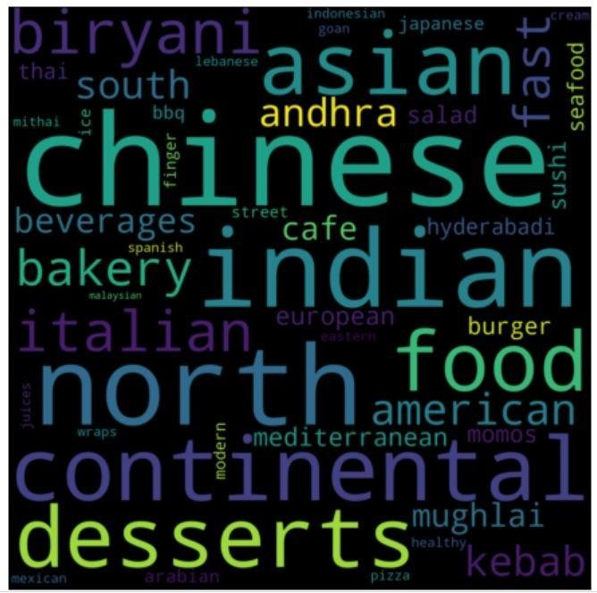
Exploratory Data Analysis(contd)
Most cuisines served
Most cuisines served word cloud
North-Indian being the most served cuisines followed by the Indian Chinese.
Notes:
Here is a chart for
And word cloud for

Slide 8
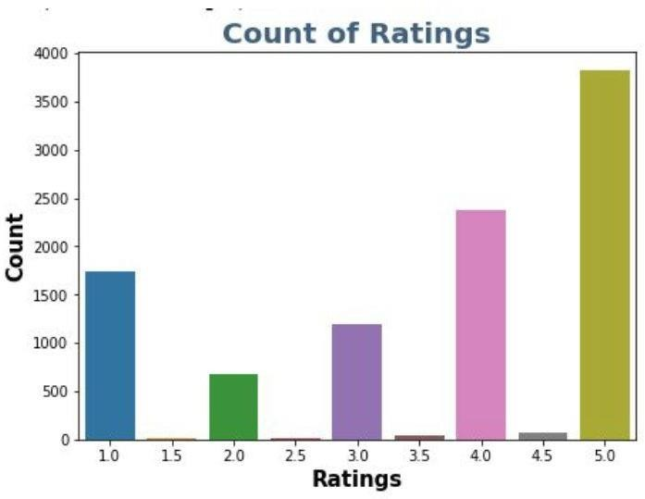
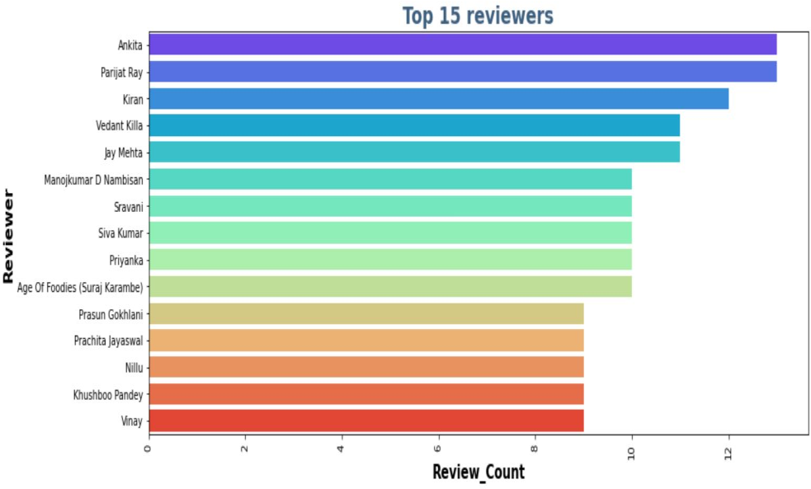
Exploratory Data Analysis(contd)
Ratings with 5 have more in count
Ankita has reviewed the most with compared to the others
Notes:
Here is a bar chart of ratings count
And chart of top 15 reviewers

Slide 9
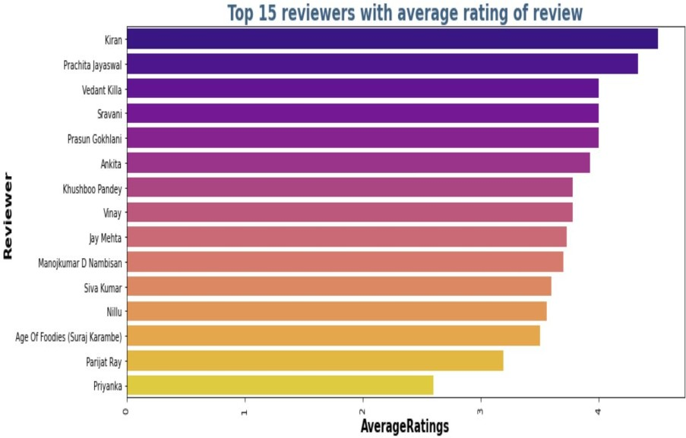
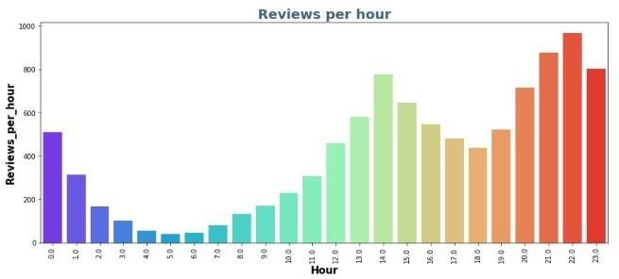
Exploratory Data Analysis(contd)
TOP average rating by the reviewers
Reviews per hour
Kiran is the most satisﬁed customer it seems as he has nearly 5 star rating average
Reviews are high at the time of 22.00 hrs

Slide 10
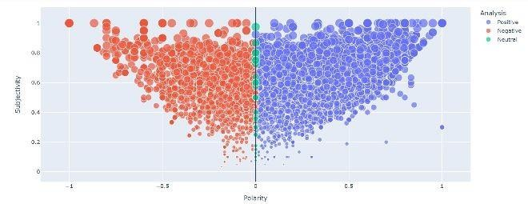
Sentiment Analysis
After completing the necessary text processing part,which contained removing punctuation, Removing stop words & Lemmatization, we move towards Sentiment Analysis
The subjectivity column that showcases the sentiment is visualized above, where lite purple being Positive,red being Negative and green being neautral

Slide 11
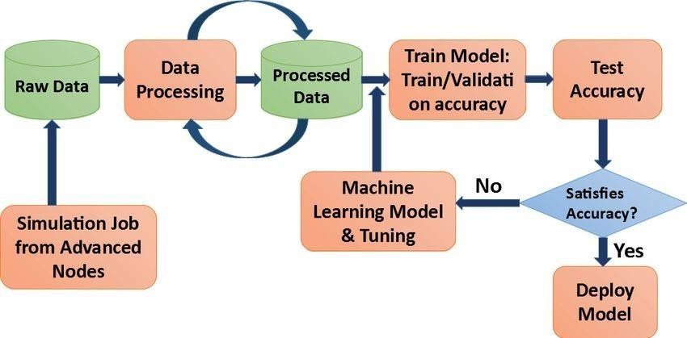
Models performed
Multinomial Naive Bayes
Random Forest Classiﬁer
XGB Classiﬁer
Support Vector
Classiﬁer

Slide 12
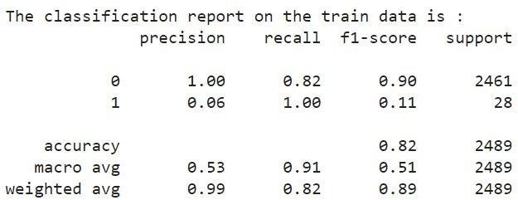
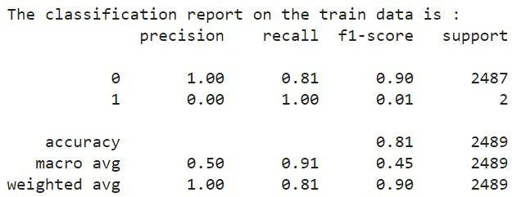

Models performance
Multinomial Naive Bayes
Random Forest Classiﬁer
Train accuracy is: 0.8365706630944407 Test accuracy is: 0.823222177581358

Slide 13
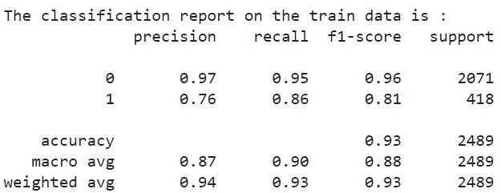
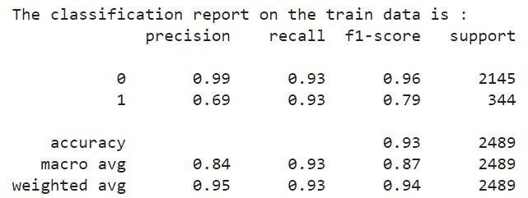
Models performance
XGB Classiﬁer
Support Vector Classiﬁer
Train accuracy is: 0.9880776959142665
Test accuracy is: 0.9369224588188028
Train accuracy is: 0.9961152042866711
Test accuracy is: 0.9188429087987143

Slide 14
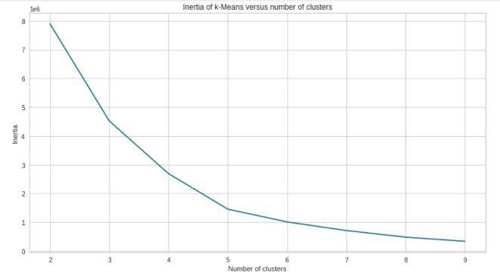
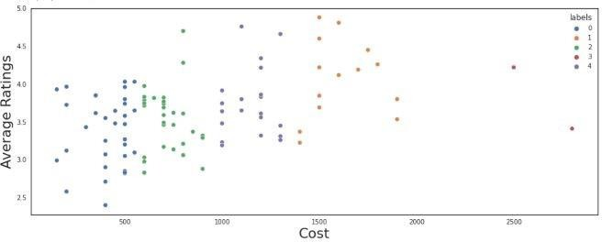
Clustering
K-Means Clustering
According to the elbow curve we should have 5 clusters for the best results
5 clusters on the average rating and the cost

Slide 15
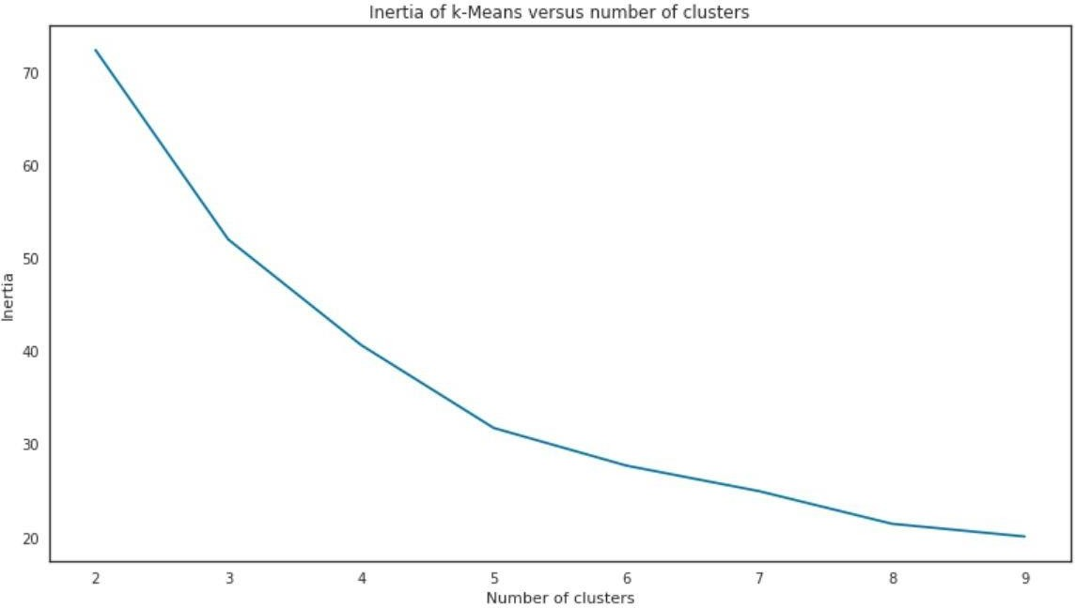
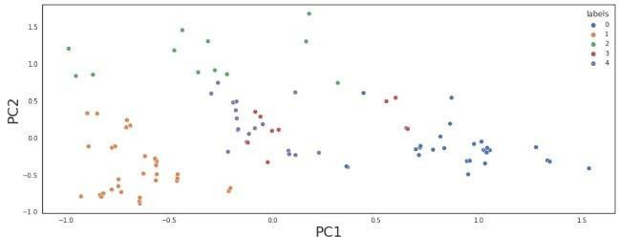
Clustering(contd)
PCA - Principal Component Analysis
According to the elbow curve we should have 5 clusters for the best results using PCA.
5 clusters on the average rating and the cost using PCA

Slide 16
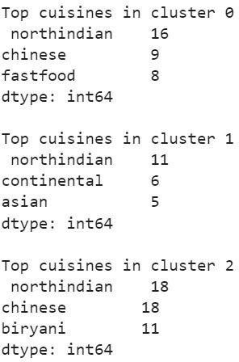
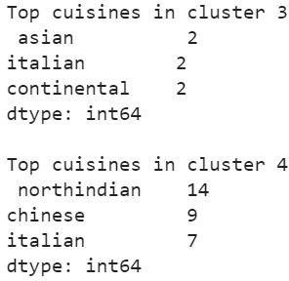
Top 3 Cuisines in 5 clusters K-Means

Slide 17
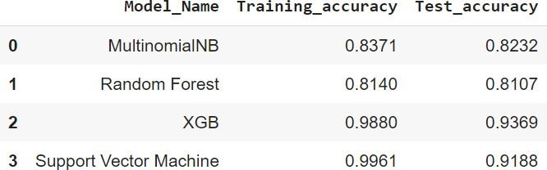
Model Validation
As it is clear form the validation table that both XGB and SVM (Classiﬁer) are working exceptionally well than other models.
So we can choose between any one of them for the production

Slide 18
Conclusion
The most popular cuisines are the cuisines which most of the restaurants are willing to provide. The most popular cuisines in Hyderabad are North Indian, Chinese, Continental, and Hyderabadi.
The cheapest is the food joint called Mohammedia Shawarma and the costliest
restaurant is Collage –Hyatt Hyderabad Gachibowli.
Sentiment Analysis was done on the reviews and a model was trained in order to identify negative and positive sentiments.
SVM and XGB both performed well and we can choose any one them.
SVM and XGB are having 0.9188and 0.9369of testing accuracy respectively.
We got best cluster as 5 in K-Means and Principal Component Analysis(PCA).

Slide 19
References
1. Machine Learning Mastery
2.GeeksforGeeks
3.Analytics Vidhya Blogs
4.Towards Data Science Blogs
5.Built in Data Science Blogs
6.Scikit- Learn Org
7.Jovian.ai
8.Youtube

Slide 20


