Slide 1
Basic Electronics
Transducers

Slide 2
Block Diagram of Instrumentation System
Transducers
Signal Conditioner Element
Data Transmission Element
Printer
Data Presentation Element
Display
Controller

Slide 3
Transducers
A transducer is a device that convert one form of energy to other form. It converts the measurand to a usable electrical signal.
it is a device that is capable of converting the physical quantity into a proportional electrical quantity such as voltage or current.

Slide 4
CLASSIFICATION OF TRANSDUCERS
Active and passive transducers.
Analog and digital transducers.
On the basis of transduction principle used.
Primary and secondary transducer
Transducers and inverse transducers.

Slide 5
ACTIVE AND PASSIVE TRANSDUCERS
Active transducers :
These transducers do not need any external source of power for their operation. Therefore they are also called as self generating type transducers.
The active transducer are self generating devices which operate under the energy conversion principle.
As the output of active transducers we get an equivalent electrical output signal e.g. temperature or strain to electric potential, without any external source of energy being used.

Slide 6
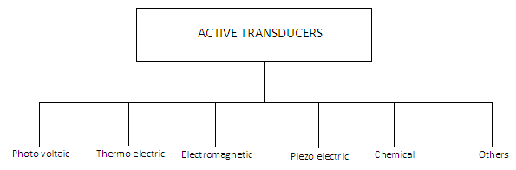
CLASSIFICATION OF ACTIVE TRANSDUCERS

Slide 7
PASSIVE TRANSDUCERS
Passive Transducers :
These transducers need external source of power for their operation. So they are not self generating type transducers.
A DC power supply or an audio frequency generator is used as an external power source.
These transducers produce the output signal in the form of variation in resistance, capacitance, inductance or some other electrical parameter in response to the quantity to be measured.

Slide 8
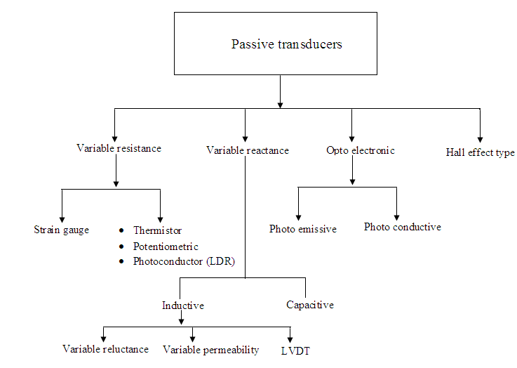
CLASSIFICATION OF PASSIVE TRANSDUCERS

Slide 9
PRIMARY AND SECONDARY TRANSDUCERS
Some transducers contain the mechanical as well as electrical device. The mechanical device converts the physical quantity to be measured into a mechanical signal. Such mechanical device are called as the primary transducers, because they deal with the physical quantity to be measured.
The electrical device then convert this mechanical signal into a corresponding electrical signal. Such electrical device are known as secondary transducers.

Slide 10
CLASSIFICATION OF TRANSDUCERS Transducer and Inverse Transducer
TRANSDUCER:
Transducers convert non electrical quantity to electrical quantity.
INVERSE TRANSDUCER:
Inverse transducers convert electrical quantity to a non electrical quantity

Slide 11
CHARACTERISTICS OF TRANSDUCERS
Ruggedness
Linearity
Repeatability
Accuracy
High stability and reliability
Speed of response
Sensitivity
Small size

Slide 12
TRANSDUCERS SELECTION FACTORS
Operating Principle: The transducer are many times selected on the basis of operating principle used by them. The operating principle used may be resistive, inductive, capacitive , optoelectronic, piezo electric etc.
Sensitivity: The transducer must be sensitive enough to produce detectable output.
Operating Range: The transducer should maintain the range requirement and have a good resolution over the entire range.
Accuracy: High accuracy is assured.
Cross sensitivity: It has to be taken into account when measuring mechanical quantities. There are situation where the actual quantity is being measured is in one plane and the transducer is subjected to variation in another plan.
Errors: The transducer should maintain the expected input-output relationship as described by the transfer function so as to avoid errors.

Slide 13
Contd…
Transient and frequency response : The transducer should meet the desired time domain specification like peak overshoot, rise time, setting time and small dynamic error.
Loading Effects: The transducer should have a high input impedance and low output impedance to avoid loading effects.
Environmental Compatibility: It should be assured that the transducer selected to work under specified environmental conditions maintains its input- output relationship and does not break down.
Insensitivity to unwanted signals: The transducer should be minimally sensitive to unwanted signals and highly sensitive to desired signals.

Slide 14
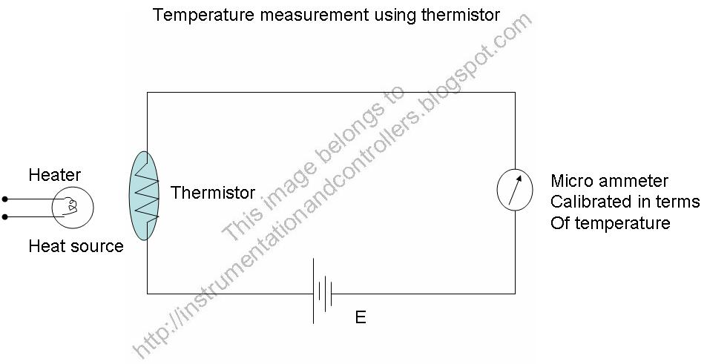
Thermistors

Slide 15
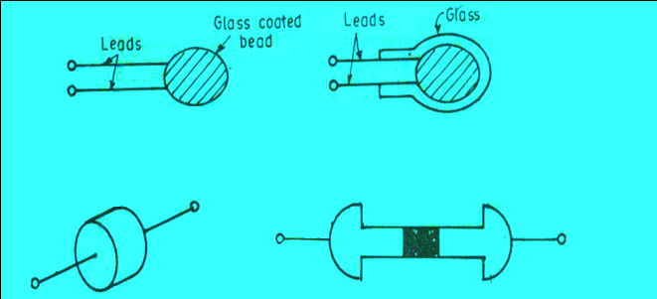
The thermistor may be in the form of beads, rods and discs.
The thermistor provide a large change in resistance for small change in temperature. In some cases the resistance of themistor at room temperature may decreases as much as 6% for each 1ºC rise in temperature.

Slide 16
University Question…..
Q1. Draw and explain the block diagram of Instrumentation system.
Q2. What is transducer? Give classification of transducers.
Q3.Compare active and passive transducers and also compare primary and secondary transducers.
Q4. Explain different characteristics of transducers.
Q5. Write a short note on selection criteria of transducers.
Q6. Explain Principle, operation of thermister with suitable diagram. State the materials used and applications of thermistor.

Slide 17
RTD (resistance temp.Detector)
The Primary Electrical Transducer which measures the temperature is called RTD

Slide 18
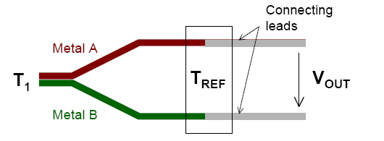
Thermocouples
See beck Effect
When a pair of dissimilar metals are joined at one end, and there is a temperature difference between the joined ends and the open ends, thermal emf is genera
This forms the basis of thermocouples.

Slide 19
Advantages and Limitations
Advantages:
Wide temperature from -230C to 2700C.
Small in size
Easy to Calibrate
Limitations:
Amplification of signal is required.

Slide 20
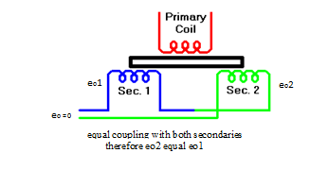
LINEAR VARIABLE DIFFERENTIAL TRANSFORMER(LVDT)
AN LVDT transducer comprises a coil former on to which three coils are wound.
The primary coil is excited with an AC current, the secondary coils are wound such that when a ferrite core is in the central linear position, an equal voltage is induced in to each coil.
The secondary are connected in opposite so that in the central position the outputs of the secondary cancels each other out.

Slide 21
Contd…
E01=E02 ; E0= 0V.
E01>E02 ; E0= Positive
E01<E02 ; E0= Negative

Slide 22
University Questions
Q1. What is RTD? Draw its constructional diagram and explain its operation.
Q2. Explain the thermocouple with the following points.
Principle of operation
Construction
Applications
Advantages and disadvantages
Q3. Compare RTD and Thermocouple.
Q4. State the principle of operation of LVDT. Draw and explain the construction of a LVDT. State its advantages and disadvantages.

Slide 23
4. Application of transducers
Q1.Draw a neat diagram of digital thermometer and explain its operation.
Q2.Draw a block diagram of electronic weighing machine and explain its operation.

