Slide 1

RESEARCH STUDY
A Study on Customer Churn and Retention Strategies in UPI-Based Digital Payment Platforms in India
Understanding why users leave — and what keeps them engaged — in one of the world’s fastest-growing digital payment ecosystems.
This research examines the key drivers of churn, the signals of retention, and the strategic levers platforms can use to build long-term customer loyalty.

Slide 2

INTRODUCTION
Meet the Project
Project Details
First Impressions
Title: A Study on Customer Churn and Retention Strategies in UPI-Based Digital Payment Platforms in India
Submitted by: Madhavi Srivastava (PRN: 2402914103400)
Programme: MBA in Business Analytics
Institution: Symbiosis School of Online & Digital Learning (SSODL)
Guide: Dr. Shradha Gupta
India's UPI ecosystem is one of the busiest digital payments landscapes in the world. Yet in a market where every major app works well, the customer feels free to move. That tension — growth alongside churn — is precisely what this study sets out to understand.
Why This Study?
Getting a customer to download a UPI app is one thing. Keeping that customer for months and years is a very different challenge. This study investigates the factors that push customers away from one UPI platform and towards another, and then suggests retention strategies that service providers can actually use. The analysis is grounded in both primary survey data and secondary reports, processed through Python, SQL, Excel and Power BI.

Slide 3

The UPI Landscape
When
Where
UPI was launched in 2016 by the National Payments Corporation of India. By May 2026 it processed 23.2 billion transactions in a single month — a 24% year-on-year rise — placing it among the largest real-time payment systems in the world.
From metro cities into smaller towns and rural pockets, UPI has spread across India. A tea stall, a vegetable vendor, an auto driver — all accept UPI today. Cheap smartphones, affordable data and over 700 connected banks made this reach possible.
The setting is far more than just a payments backdrop—it actively shapes why churn is so damaging. Most UPI apps charge users nothing for basic transactions. Revenue comes from lending, merchant services, advertising and cross-selling. This means a churned user represents not a lost fee but an entire future stream of data and value. Even in a booming market, retaining customers is a constant, serious concern, and it forms the backdrop against which this entire study is set.

Slide 4
KEY PLAYERS
The Major UPI Applications
Google Pay — Market Leader
Chosen by 50% of respondents in this study, Google Pay is known for its clean, uncluttered interface and reliability. Users say it simply works. It leans on security and simplicity as its main selling points, building a loyal base that values a smooth, predictable everyday experience.
PhonePe — Close Second
Preferred by 28% of respondents, PhonePe grew fast on aggressive cashback and a wide merchant network. It expanded beyond payments into insurance, mutual funds and bill payments, positioning itself as a place where users manage many parts of their financial life.
Paytm, BHIM & Amazon Pay
Paytm — the oldest in Indian digital payments memory — offers the broadest range of services from a payments bank to ticketing. BHIM, launched by NPCI itself, does the core job cleanly and is trusted for its institutional credibility. Amazon Pay leverages the existing shopping ecosystem to retain users through shopping-linked rewards.

Slide 5

Research Methodology
Analysis & Visualisation
SQL queries for insights; Power BI interactive dashboards for patterns.
Data Preparation
Cleaned in Excel, transformed with Python, loaded into MySQL database.
Data Collection
Structured questionnaire via Google Forms; 46 valid responses collected.
The study follows a descriptive and analytical research design, drawing on both primary and secondary data to understand customer behaviour and retention factors.
01
02
03
Step 1: Primary Data Collection
Step 2: Cleaning, Python & MySQL
Step 3: SQL Analysis & Power BI Dashboard
A structured 12-question questionnaire covering demographics, UPI usage, churn factors and loyalty was circulated via Google Forms. Convenience sampling was used across students, working professionals and business owners.
Responses were exported to Excel for cleaning and standardisation, then loaded into a MySQL database via Python (pandas and mysql-connector-python) for structured querying.
SQL aggregate functions (COUNT, AVG, GROUP BY) extracted frequencies, satisfaction levels and churn reasons. Power BI dashboards with KPI cards, bar, pie and donut charts, and interactive slicers brought the patterns to life.

Slide 6
DATA ANALYSIS
Research Framework & Process Overview
A structured capstone workflow designed to investigate customer churn and retention in UPI-based digital payment platforms through survey research, data preparation, analysis, and dashboarding.
This process moves from primary data collection to actionable business insights, turning raw survey responses into a clean analytical dataset and an interactive reporting dashboard.
Step 1: Primary Data Collection Using Google Forms
A structured 12-question questionnaire was designed and distributed via Google Forms to collect primary data. The questionnaire covered four key sections: Basic Information, Banking Usage, Customer Churn Factors, and Customer Retention & Loyalty. The form was shared across WhatsApp, Email, and social media platforms, collecting 46 valid responses from students, working professionals, and business owners.
Step 2: Data Cleaning & Preparation Using Microsoft Excel
The exported responses were cleaned in Excel by removing duplicates, handling missing values, standardizing data formats (e.g., "Gpay" → "Google Pay"), and ensuring consistent capitalization and formatting. The cleaned dataset was saved in both Excel and CSV formats for further processing.
Step 3: Data Transformation & Loading Using Python
Python (with pandas and mysql-connector-python libraries) was used to automate data processing. The CSV file was imported, additional cleaning was performed, and the data was loaded into a MySQL database called "Digital_Banking" using INSERT statements.
Step 4: Data Analysis Using MySQL
SQL queries with aggregate functions (COUNT, AVG, GROUP BY, ORDER BY) were executed to analyze customer behavior, including age distribution, gender breakdown, occupation analysis, UPI app preferences, usage frequency, satisfaction levels, churn patterns, and loyalty factors.
Step 5: Dashboard Development Using Microsoft Power BI
The MySQL database was connected to Power BI, where interactive dashboards were created using KPI cards, bar charts, pie charts, column charts, and interactive slicers. The dashboard enabled dynamic exploration of survey results by age group, gender, occupation, and UPI application.

Slide 7

DETAILED PROCESS & ETHICS
Research Process Documentation & Ethical Considerations
Detailed Implementation Steps
Ethical Considerations
Google Forms Data Collection
Key principle: the research prioritized participant privacy, consent, and academic use only.
The questionnaire was carefully designed with 12 questions divided into four sections. Most questions used multiple-choice format for consistency. The form was marked as required for important questions to minimize missing data. Responses were automatically stored and later exported to Google Sheets, then downloaded as an Excel file.
Voluntary Participation
No respondent was coerced or pressured to take part in the survey.
Excel Data Cleaning
The dataset was reviewed for blank responses, duplicates, incorrect spellings, and inconsistent values. Excel's Remove Duplicates feature eliminated repeated entries. Data standardization converted variations (e.g., "Gpay" → "Google Pay", "Phone pe" → "PhonePe") into consistent formats. Column headers were formatted, unnecessary spaces removed, and capitalization corrected.
Confidentiality
Respondent identities were kept confidential throughout the research process.
Python Data Processing
Academic Use Only
Libraries used: pandas and mysql-connector-python. The CSV file was imported into a DataFrame for processing. Python performed additional cleaning including duplicate removal, missing value handling, text trimming, and value standardization. The dataset was converted into a MySQL-compatible format with proper column naming and data type conversion.
Data was collected and used exclusively for academic purposes, with no disclosure of personal or sensitive information.
MySQL Database Setup
Informed Consent
A database named "Digital_Banking" was created. Python dynamically generated a table based on CSV column names, with each survey question becoming a database column. Data was inserted using SQL INSERT statements, and transactions were committed to make records available for analysis.
Participants were informed about the study's purpose and their rights before completing the survey.
SQL Analysis Queries
Ethical standard: respect for respondents was maintained at every stage, from collection to analysis.
Aggregate functions were used extensively: COUNT() for totals, AVG() for averages, GROUP BY for categorization, ORDER BY for sorting, and CASE statements for conditional logic. Queries analyzed age distribution, gender breakdown, occupation categories, most-used UPI apps, usage frequency, satisfaction scores, churn patterns, and loyalty factors.
Power BI Dashboard Creation
The MySQL database was connected directly to Power BI. Data was imported and transformed using Power Query Editor. DAX measures were created for KPIs including Total Responses, Average Satisfaction Rating, and Most Used UPI Application. Interactive slicers enabled filtering by age group, gender, occupation, and UPI application.

Slide 8
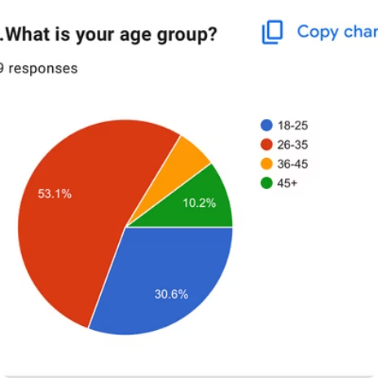
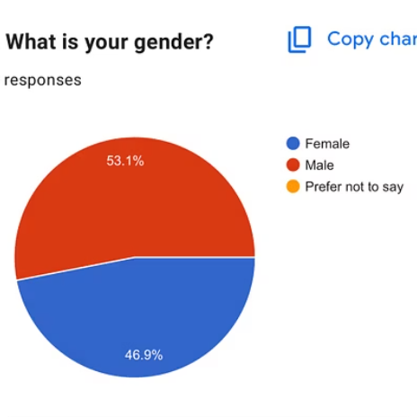
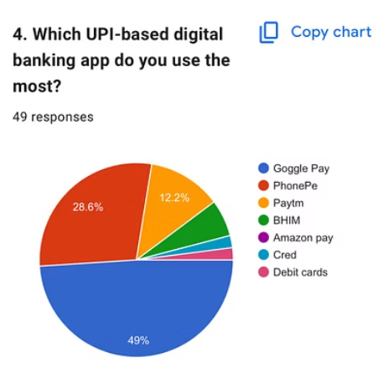
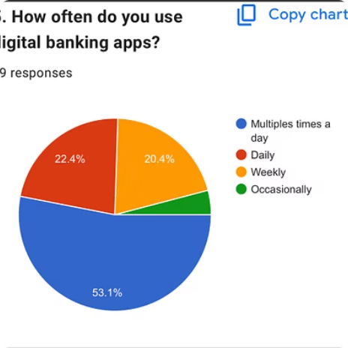
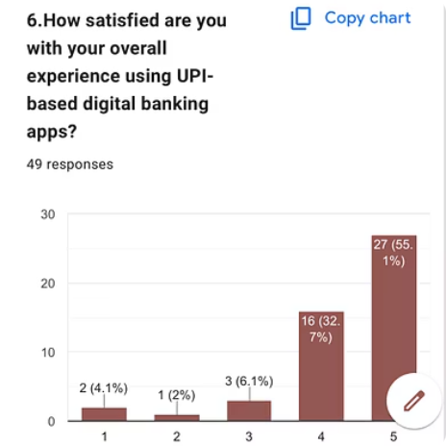
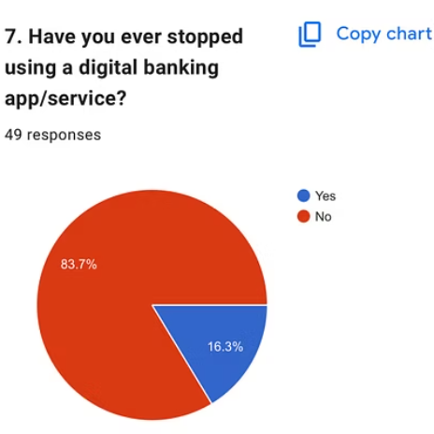
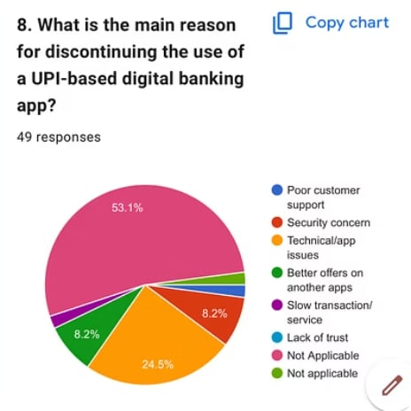
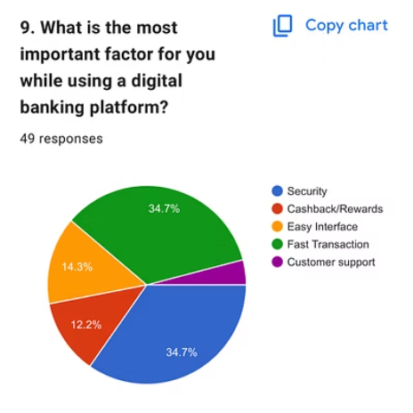
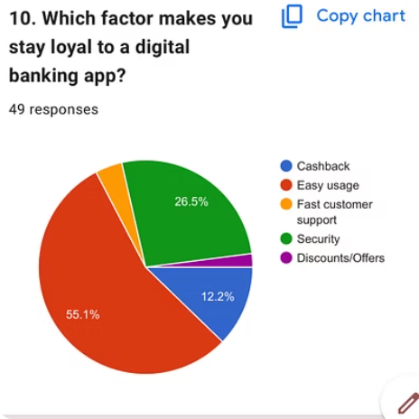
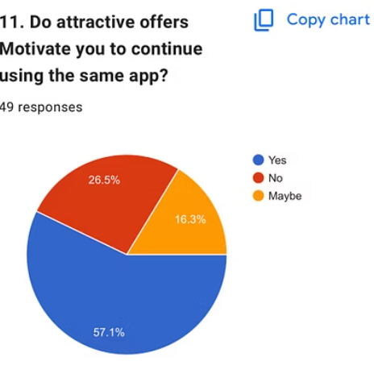
SURVEY DATA
Survey Responses: Primary Data Collection
A structured 12-question questionnaire was circulated via Google Forms to collect primary data on customer behaviour, churn factors, and retention drivers in UPI-based digital payment platforms. A total of 49 valid responses were collected from students, working professionals, and business owners across India.
The survey covered:
Demographics (age, gender)
UPI app usage patterns and frequency
Customer satisfaction levels
Churn experience and reasons
Key factors influencing loyalty and retention
Impact of offers and incentives
Below are the charts representing the distribution of responses for each of the survey questions, providing a visual overview of the collected data.

Slide 9
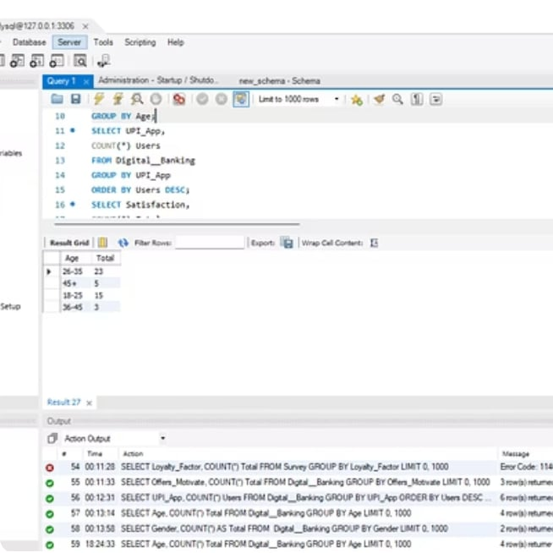
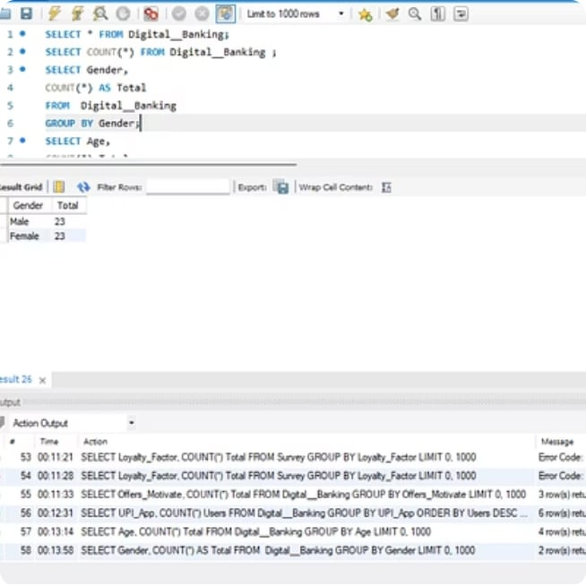
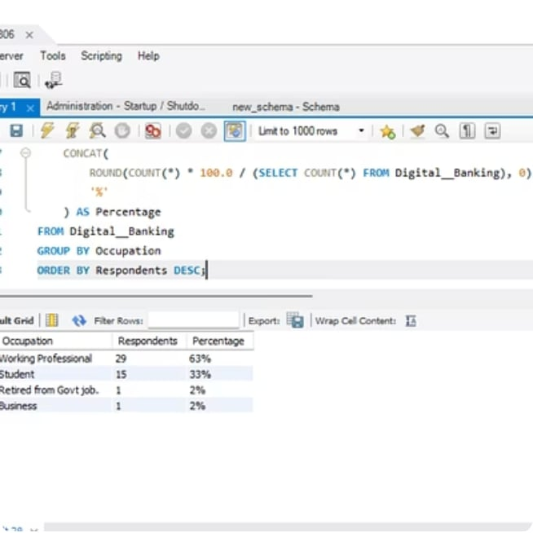
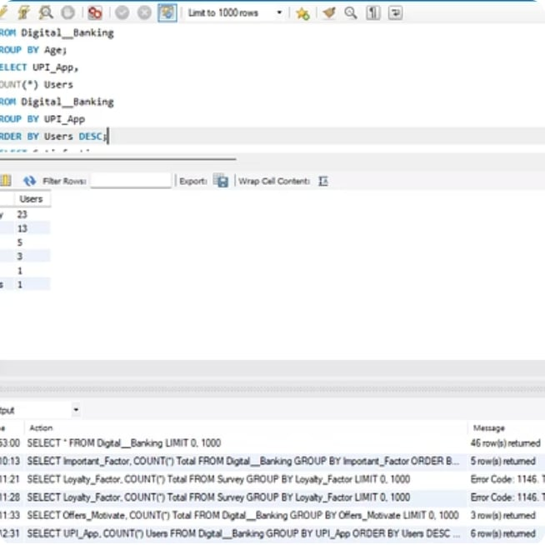
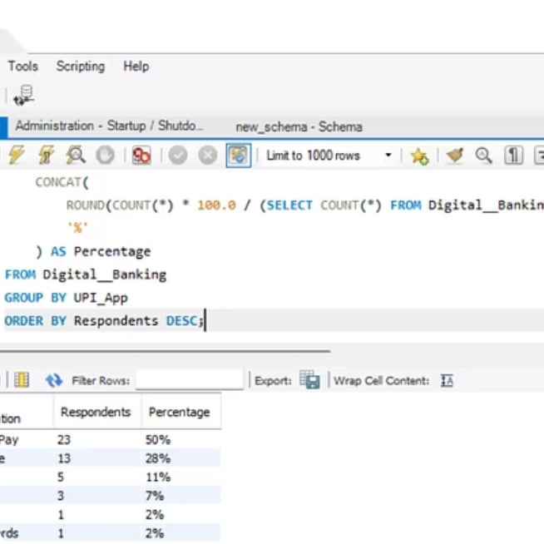
DATA ANALYSIS
Data Analysis Using SQL - Part 1
Detailed SQL analysis of the primary survey data was conducted to extract meaningful insights from the collected responses. The analysis focused on demographic segmentation, app usage patterns, and key behavioral metrics.
Key Analysis Areas:
Demographic breakdown (Age, Gender, Occupation)
UPI app usage distribution and preferences
Customer satisfaction metrics
Churn patterns and reasons
Below are screenshots of the SQL queries and their results, illustrating the analysis performed on demographics and app usage patterns from the survey data.

Slide 10
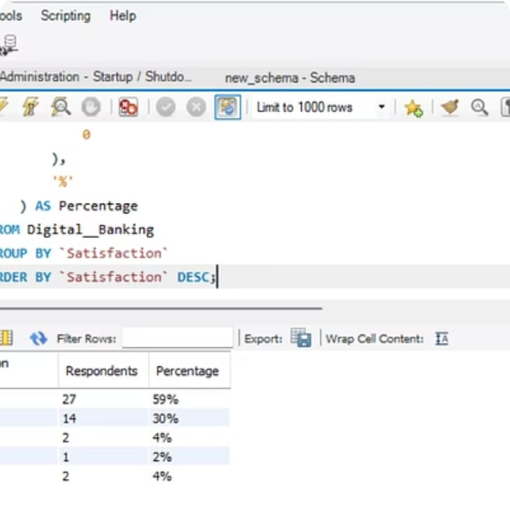
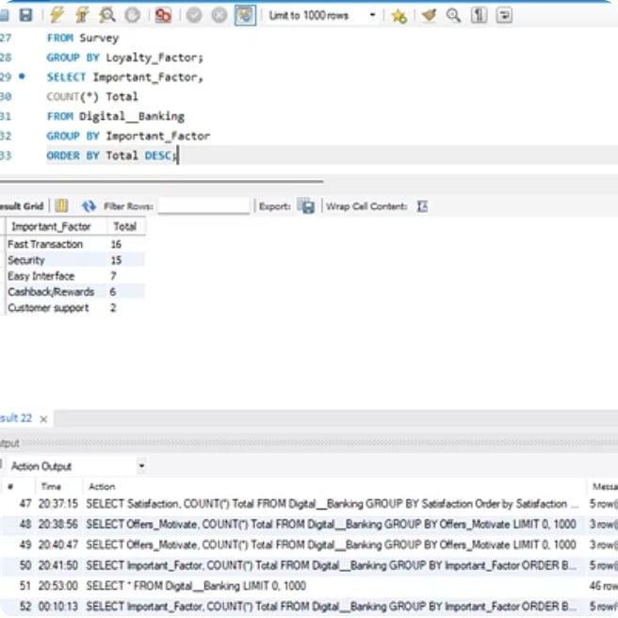
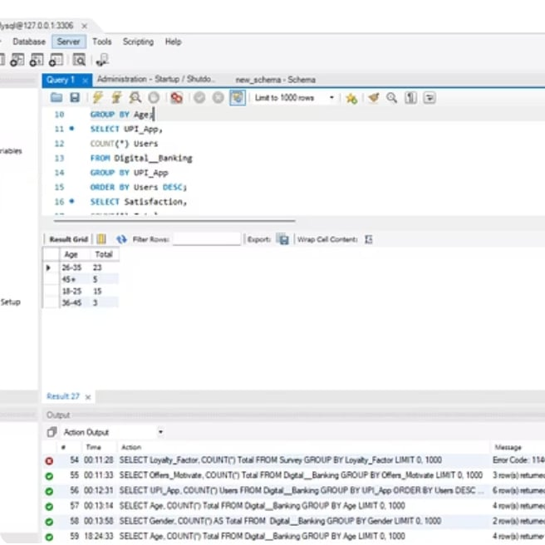
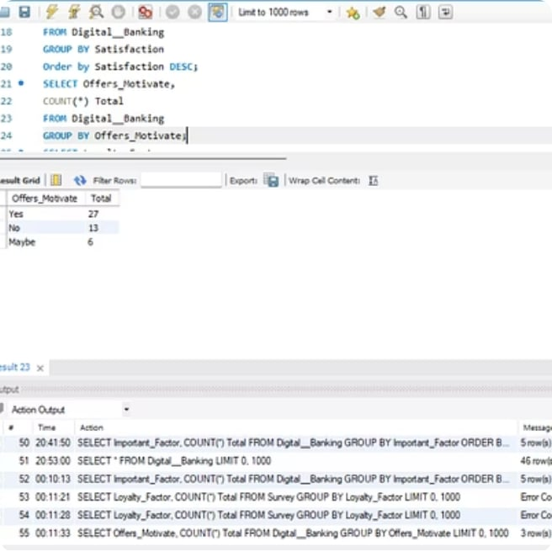
DATA ANALYSIS
Data Analysis Using SQL - Part 2
Continued SQL analysis focusing on customer behavior, satisfaction metrics, and retention factors. This section examines the key drivers of churn and loyalty among UPI platform users.
Key Metrics Analyzed:
Customer satisfaction levels and ratings
Churn experience and discontinuation patterns
Primary reasons for app discontinuation
Important factors influencing platform choice
Impact of offers and incentives on retention
Loyalty factors and user retention drivers
Display all SQL query screenshots and results in a gallery showing the analysis of satisfaction, churn reasons, important factors, and offer motivation.

Slide 11
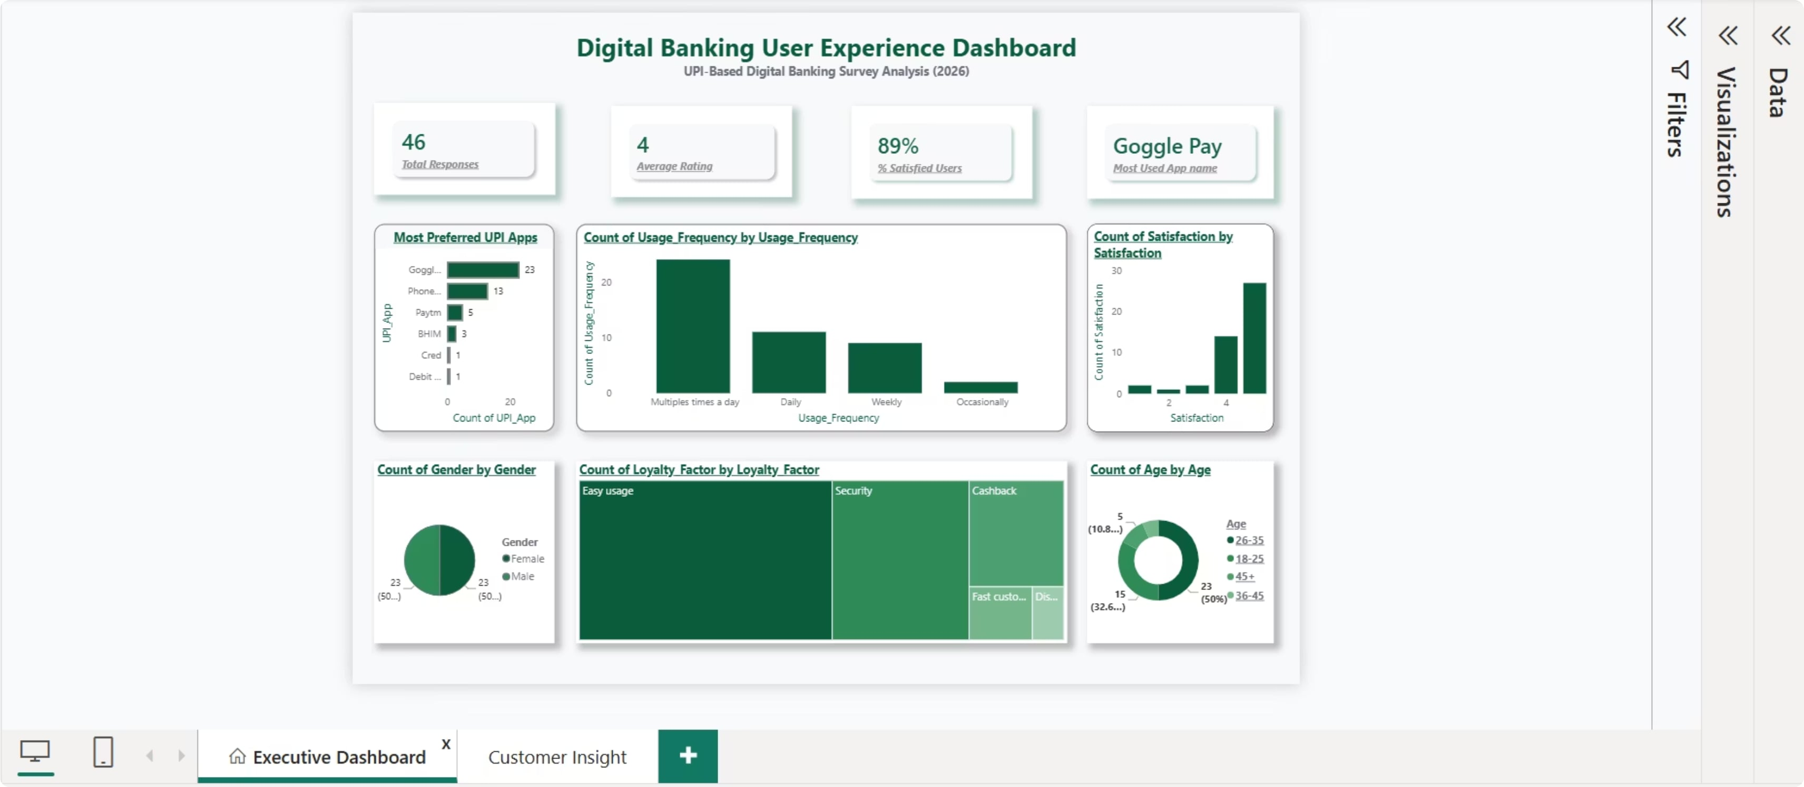
Executive Dashboard:

Slide 12
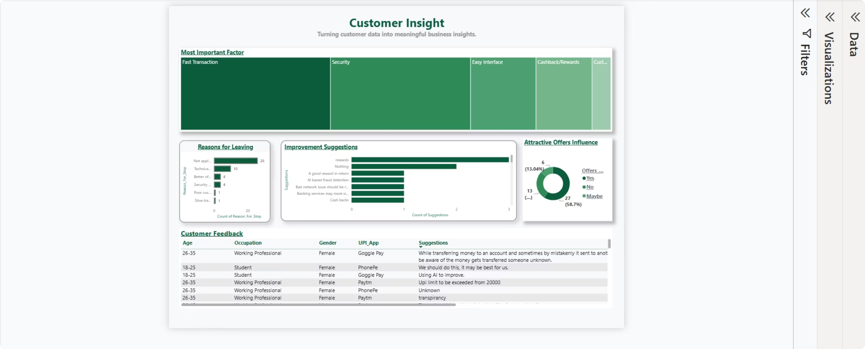

Slide 13
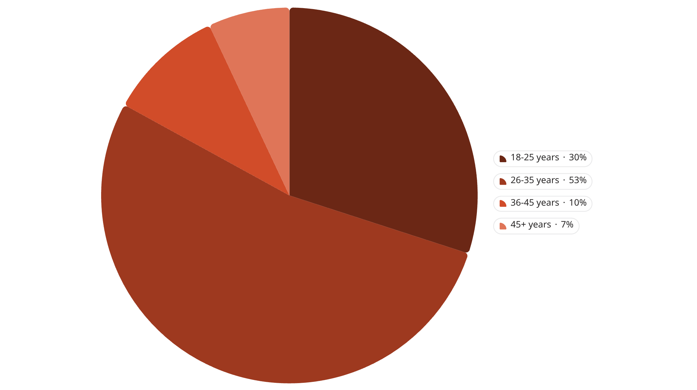
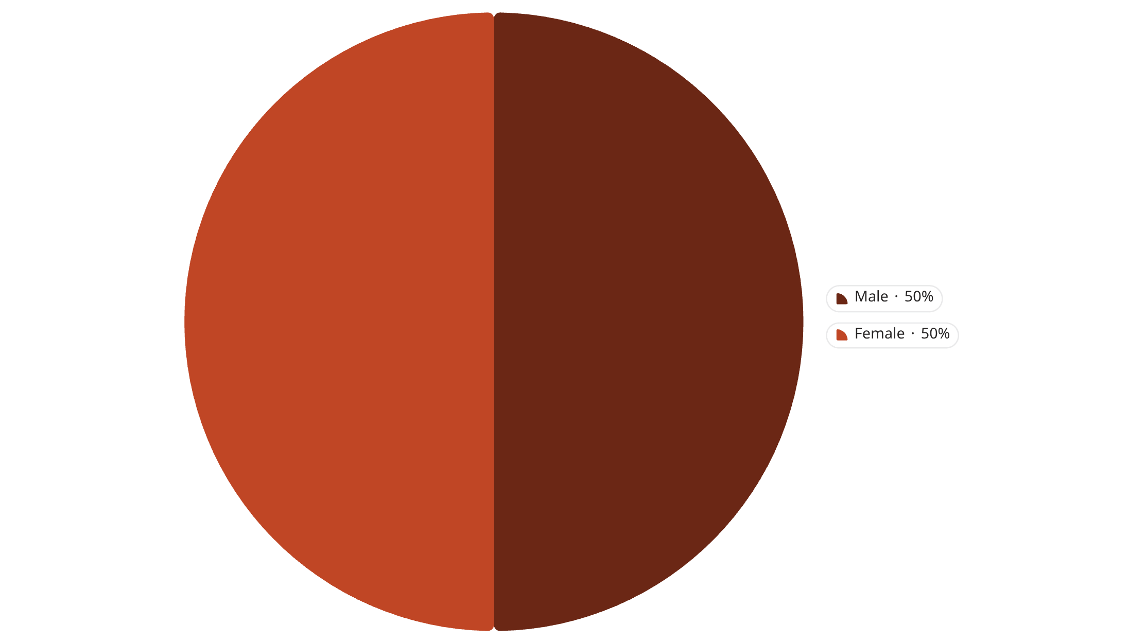
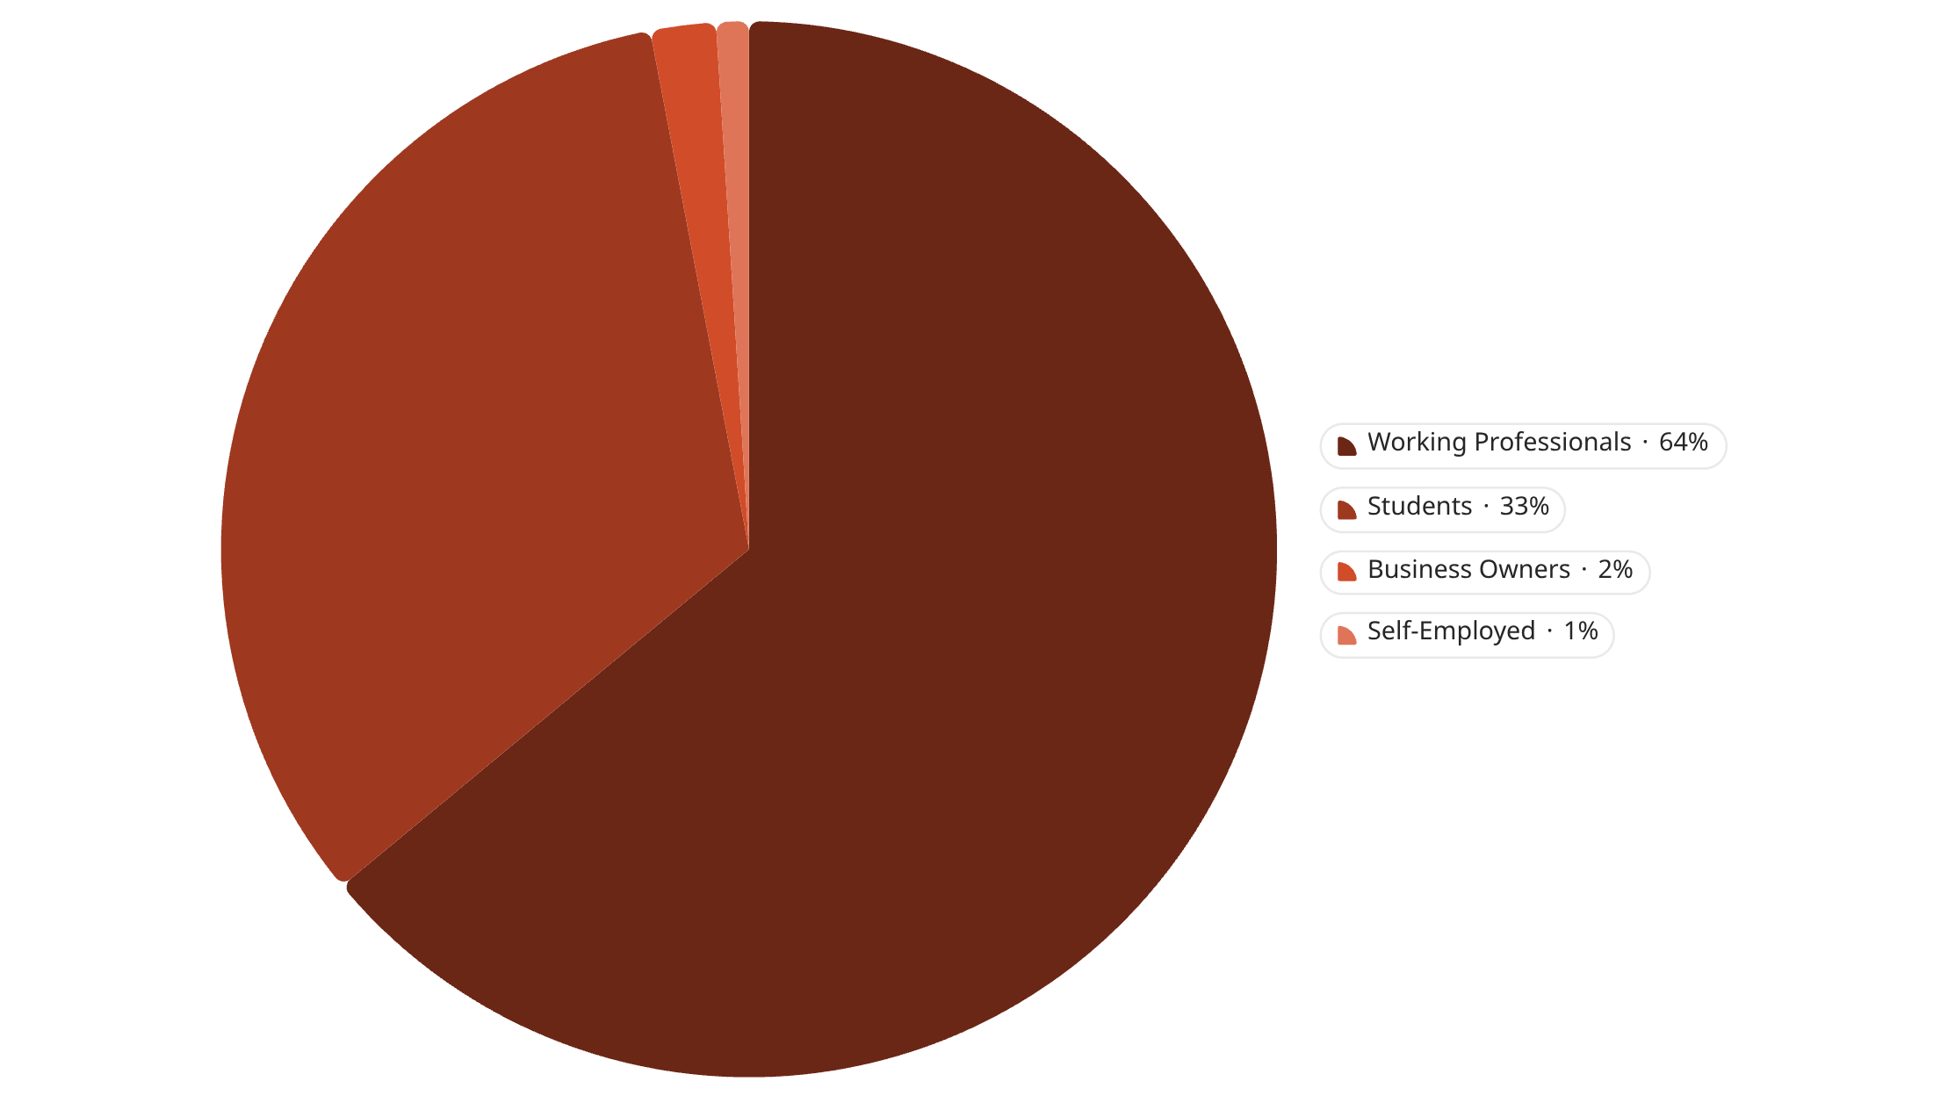
Results & Analysis - Demographic Insights
Gender-wise Distribution
Age-wise Distribution
More than half of respondents fall in the 26-35 age group, indicating young adults are the primary UPI users in this sample. The tilt towards younger users reflects their comfort with smartphones and willingness to adopt new payment habits, meaning churn patterns are largely viewed through digitally confident eyes.
Occupation Distribution
Working Professionals dominate the sample at 64%, with students close behind at 33%. This spread shows UPI has become a common tool across working and studying life, not confined to any single occupation.

Slide 14
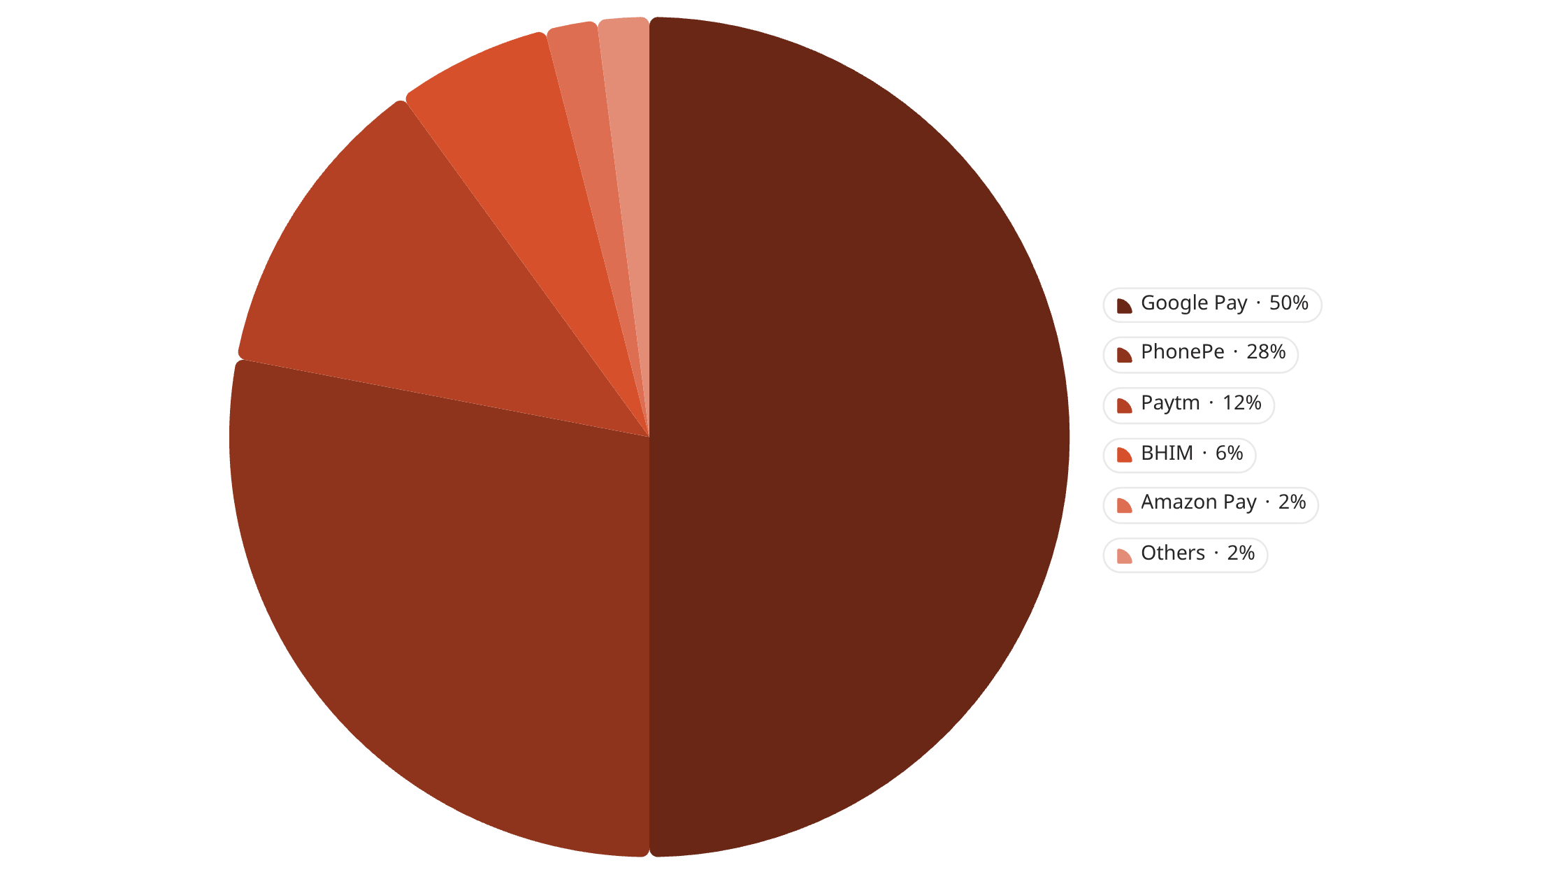
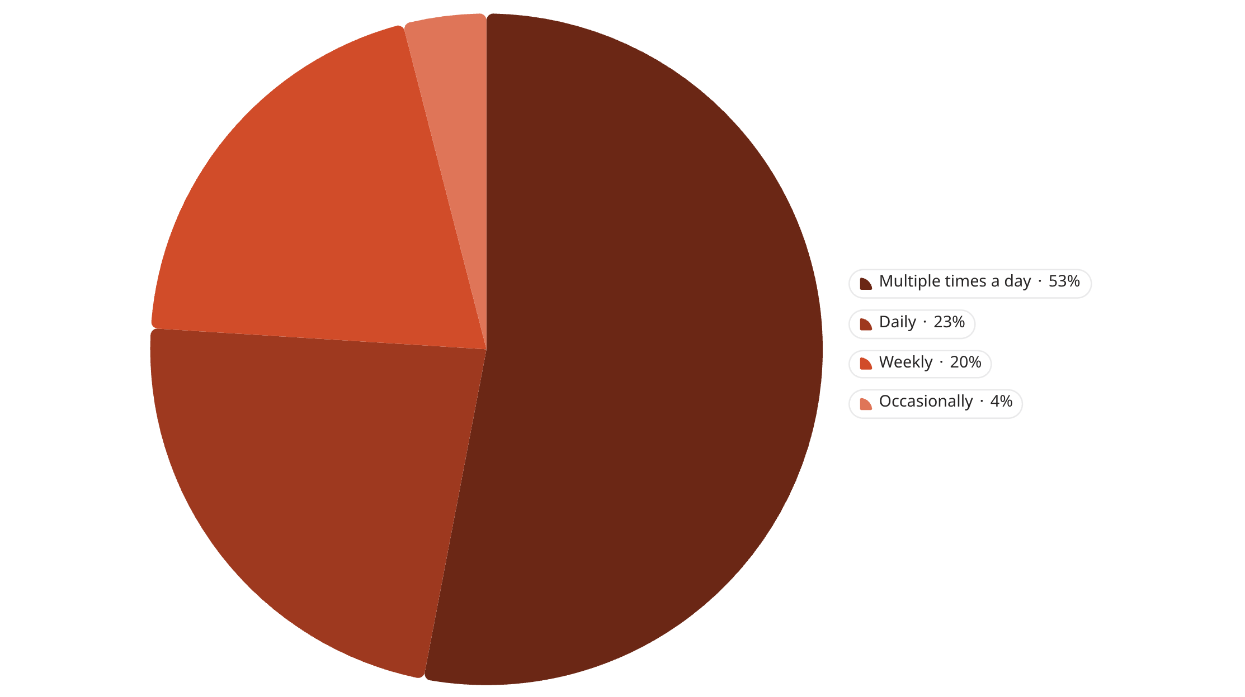
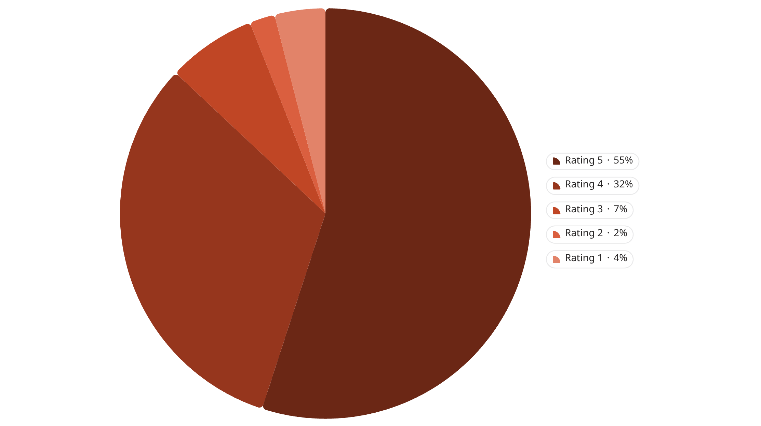
Results & Analysis - UPI Usage & Satisfaction
8.2 UPI Usage Analysis
Preferred UPI Application
Frequency of UPI Usage
A clear majority (76%) use UPI daily or multiple times daily, indicating habitual, heavy usage. This frequency is critical for understanding churn—when a service is used this often, small irritations accumulate quickly, and a series of failed transactions or poor support can trigger switching behavior.
8.3 Customer Satisfaction Analysis
Overall Satisfaction Rating (1-5 Scale)
Most respondents rated satisfaction at 4 or 5, reflecting a healthy satisfaction level. However, the 7% at neutral 3, plus those below, represent the highest-risk churn segment—customers neither delighted nor loyal, simply getting by.

Slide 15
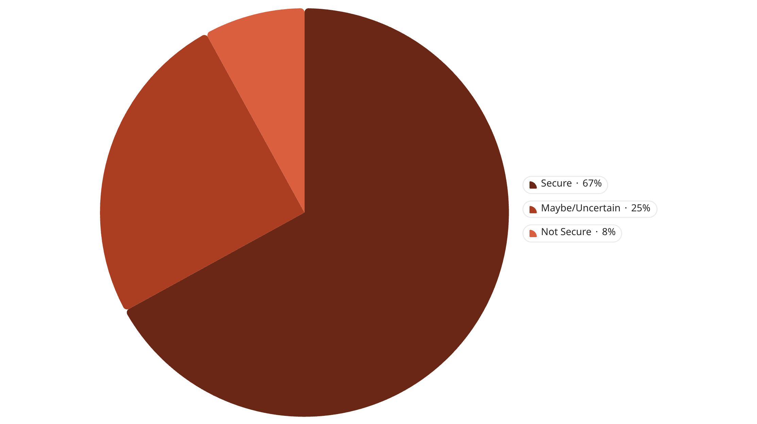
Results & Analysis - Security Perception
8.4 Security Perception Analysis
Trust in UPI Transaction Security
Two-thirds of respondents feel UPI transactions are secure, which is a positive signal for ecosystem trust and retention. However, the 25% who answered "maybe" warrant attention—their trust is conditional and fragile. A single fraud incident or negative news story could tip them toward switching.

Slide 16
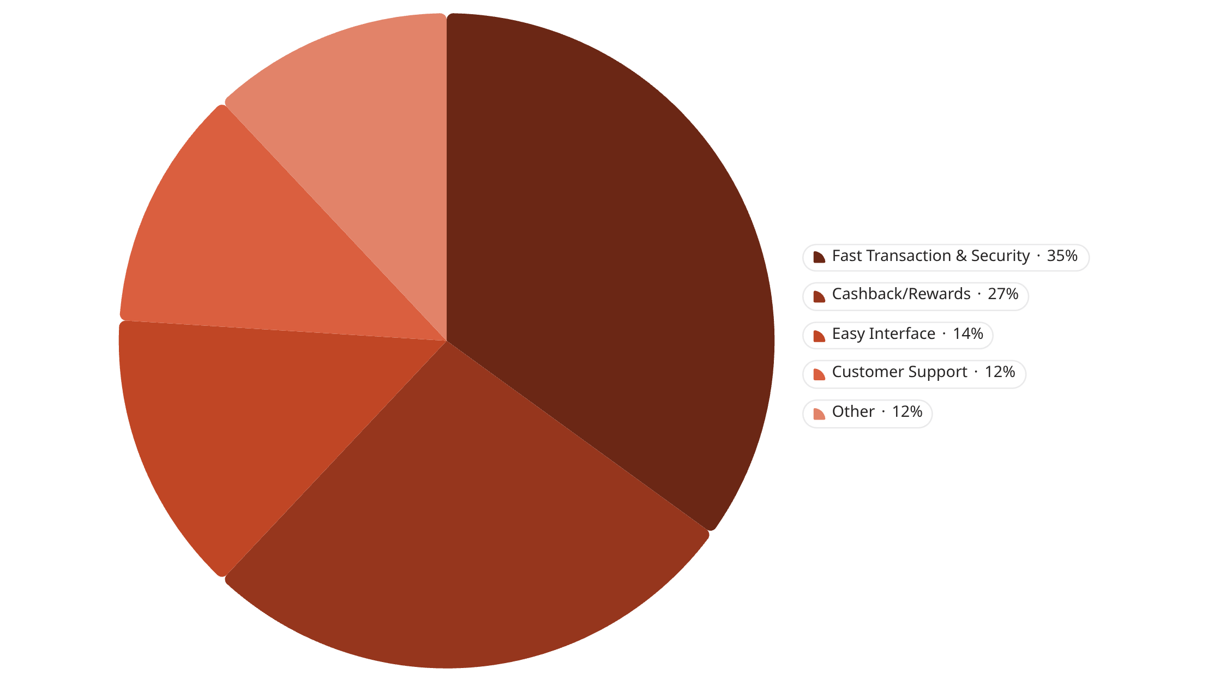
Results & Analysis - Rewards & Incentives Impact
8.5 Cashback & Rewards Influence Analysis
Factors Influencing App Choice
Fast transaction speed and security emerge as the primary decision drivers at 35%, with cashback influencing 27% of users. This reveals a critical insight: retention requires a two-sided approach.
The Two-Sided Retention Challenge:
One side is being pulled away by better deals (cashback and rewards)
The other side is pushed away by poor experience (slow transactions, security concerns)
Both fronts must be held simultaneously.
Strategic Implication: Platforms cannot rely on cashback alone to retain customers. While 27% are influenced by rewards, 35% prioritize core service quality. A balanced strategy addressing both competitive incentives AND core service reliability is essential for sustainable retention.

Slide 17
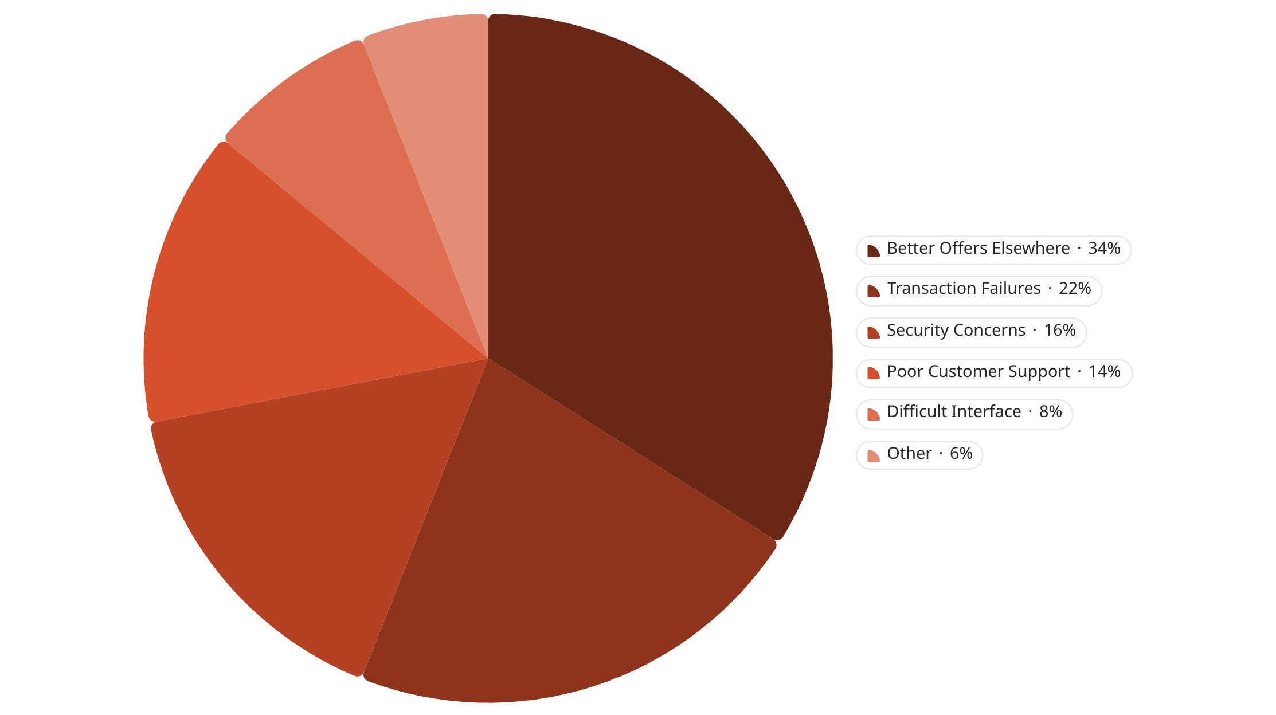
Results & Analysis - Churn Drivers & Root Causes
8.6 Churn Analysis - Key Findings
Primary Reasons for Switching Apps
This chart illustrates the primary reasons users switch UPI applications, with "Better Offers Elsewhere" being the leading factor, followed by "Transaction Failures" and "Security Concerns." These insights are crucial for understanding the dynamics of customer retention.
The Two-Force Churn Model:
The data reveals a critical pattern in customer churn behavior:
Pull Factors (34%)
Push Factors (52% combined)
Better offers elsewhere
Customers are attracted away by competitive incentives
Loyalty built on cashback alone is "rented, not owned"
Can be outbid at any time by competitors
Transaction Failures: 22%
Security Concerns: 16%
Poor Customer Support: 14%
Customers are pushed away by service failures and trust gaps.
Critical Insight: A payment that fails at a shop counter with people waiting behind leaves an emotional impression that months of good service struggle to undo. The combination of push and pull forces creates a two-sided retention problem that requires simultaneous attention to both competitive incentives and core service reliability.

Slide 18




Churn Drivers and Conflicts
Pull Factor: Better Offers Elsewhere
34% of respondents who switched cited better cashback and offers on another app as the primary reason. This is a "pull" conflict — the customer is attracted away rather than pushed out. Loyalty built on cashback alone is rented, not owned, and can be outbid at any time by a competitor.
Push Factor: Service Failures & Trust Gaps
Transaction failure (22%), security concerns, poor customer support and a clunky experience collectively form the "push" side of churn. A payment that fails at a shop counter with people waiting behind leaves an emotional impression that months of good service can struggle to undo.
These two forces create a two-sided retention problem. The customer cannot be kept by offers alone, nor by reliability alone. Both fronts must be held simultaneously.
5/5
Avg. Satisfaction: 3.85 / 5
Most respondents are satisfied, yet a neutral middle group of ~22% sits exactly in the danger zone — neither delighted nor disloyal, just getting by. This is the cohort most likely to drift at the next better offer or failed transaction.

Slide 19
KEY FINDINGS
What the Data Reveals
Beyond the surface numbers, the study surfaces profound insights about customer behaviour in India's UPI ecosystem.
Customer Support Is the Weakest Link
Security Confidence Is Conditional
Habitual Daily Use Amplifies Churn Risk
Only just over half of respondents rated support as good or excellent, while more than one in ten called it poor. Support is the one moment a frustrated user reaches out — if that moment goes badly it confirms every doubt they had and accelerates departure.
Two-thirds of respondents feel UPI is secure — but 25% answered "maybe." That unsure group is fragile: one fraud story in their circle could tip them into churning. Security must be both genuinely strong and visibly communicated, not just technically robust.
76% of respondents use UPI every single day. When a service is used this frequently, small irritations compound quickly. A run of failed transactions or a bad support experience can turn a daily user into someone who quietly shifts to a rival app within days.
Ultimately, the study shows that cashback gets a customer in the door, but the quieter factors — reliable transactions, visible security, and support that actually helps — are the ones that build loyalty which survives a competitor's next promotion. Companies that lean on analytics to spot these patterns early stand the best chance of keeping their customers in a crowded, competitive market.

Slide 20

Conclusions & Recommendations
What the Study Concludes
Retention Strategies
Retention has become one of the toughest challenges in this space — not because the products are weak, but precisely because they are all strong and all similar. Customer satisfaction is shaped most by transaction speed, security, ease of use, cashback offers, customer support and overall service quality. Google Pay and PhonePe lead largely on the strength of a smooth, trustworthy everyday experience rather than any single feature.
The analytics toolkit used in this study — Excel, SQL, Python and Power BI — demonstrates in a concrete way that raw survey data can be turned into a usable picture of churn factors and retention opportunities. The data already exists inside these companies; the real gap is the analysis.
Drawing the findings to a close, seven strategies are recommended for UPI platforms looking to reduce churn.
Personalised rewards shaped around individual transaction history rather than generic cashback campaigns lift engagement without becoming a bidding war. 24/7 multi-channel customer support addresses the study's weakest area directly. Technical backbone investment to cut transaction failures removes the second-biggest switching trigger.
AI-based churn prediction can flag at-risk users before they leave. Loyalty programmes with points and exclusive benefits for frequent users deepen long-term relationships. Biometric checks, fraud detection and real-time alerts keep the "maybe" security group from tipping the wrong way. Finally, regular Power BI-driven feedback analysis lets companies spot service gaps early — before they become churn.
H11 Supported: Customer satisfaction significantly relates to retention
H12 Supported: Service quality significantly influences churn
H13 Supported: Trust and security significantly influence retention
H14 Supported: Cashback and offers significantly improve loyalty
H15 Supported: Ease of use significantly improves retention

Slide 21
References
Reserve Bank of India. (2026). Annual Report 2025–26. Reserve Bank of India, Mumbai.
National Payments Corporation of India. (2026). UPI Product Statistics and Monthly Performance Report, May 2026. NPCI, Mumbai.
Dash, M., & Shaik, M. (2025). Enhancing customer retention from churn analysis using Power BI and machine learning techniques. Journal of Business Analytics and Data Science, 4(1), 1–12.
Rathore, H. S. (2016). Adoption of digital wallet by consumers. BVIMSR's Journal of Management Research, 8(1), 69–75.
Panchal, S., & Balachandran, M. (2018). The rise of UPI and the push towards a cashless economy in India. Forbes India Fintech Review, 6(2), 22–29.
Thomas, R., & Chatterjee, A. (2017). Unified Payment Interface (UPI): A catalyst tool supporting digitalisation. International Journal of Research in Economics and Social Sciences, 7(7), 40–48.
Philip, B. (2019). Unified Payment Interface: Impact of UPI in customer satisfaction. Research Guru, 12(4), 124–129.
Rana, R. (2017). Education and adoption of digital payment systems in India. International Journal of Advanced Research, 5(6), 1515–1520.
Rouibah, K. (2015). Digital payment adoption: Barriers of trust, security and awareness. Journal of Electronic Commerce Research, 16(3), 210–224.
Cashfree Payments. (2026). State of Digital Payments in India Report 2026. Cashfree Payments, Bengaluru.
Google Pay. (2024). Google Pay India Insights Report 2024. Google India.
PhonePe. (2025). PhonePe Pulse: The Beat of Progress Report 2025. PhonePe, Bengaluru.
Reserve Bank of India. (2025). Payments Vision 2028. Department of Payment and Settlement Systems, RBI.

Slide 22
Thank You

