Slide 1
CYBERSECURITY PROJECT · SECURE FILE SHARING
RSA-2048 KEY PAIR
Detecting Man-in-the-Middle
Attacks with RSA Digital Signatures
SHA-256 DIGEST
RSA-PSS SIGNATURE
A Flask dashboard that signs a file, lets an attacker tamper with it in transit, and then proves — cryptographically — that the tampering was detected.
MITM BYTE TAMPER
Python 3
Flask
cryptography
HTML / CSS / JS
REST + JSON
VERIFY → DETECTED
PRESENTED BY
Vanshika · Madhav · Vedant
DATE
22 October 2026
Notes:
Welcome and introduce the team. One line framing: the goal is to demonstrate that a man-in-the-middle modification of a file is cryptographically detectable, and to build a working dashboard that proves it end to end.

Slide 2
AGENDA
What this presentation covers
01
Problem Statement
Why in-transit modification is dangerous
06
Structure & Tech Stack
File layout and the libraries used
02
Objectives & Scope
Six concrete deliverables for the system
07
Core Modules
Code walkthrough of all four modules
03
Understanding MITM
Anatomy of the attack and its variants
08
API & Dashboard
Five REST routes and the frontend UI
04
Cryptographic Primitives
RSA-2048, SHA-256 and RSA-PSS
09
Testing & Screenshots
Validated results from a live run
05
System Architecture
Layered design of the Flask application
10
Analysis & Roadmap
Strengths, limitations and next steps
MITM Detection · Secure File Sharing Dashboard
02
Notes:
Walk through the agenda quickly. Emphasise that the deck moves from theory to cryptography to implementation to validation.

Slide 3
PROBLEM STATEMENT
The trust problem behind every request
APPLICATION PAYLOADS ARE THE WEAKEST LINK
THE THREAT SURFACE
▸ Implicit trust assumption — every remote exchange begins with the belief that the bytes received are the bytes sent. On a shared, proxied or unencrypted channel that belief is unverified.
▸ Classic MITM position — an adversary between client and server can read, alter or replace the payload while transparently relaying traffic to both endpoints.
▸ Transport security is not enough — TLS and VPN stacks protect the tunnel, but exported files, reports and configuration bundles routinely travel outside that protected channel.
INTERCEPTION
Eavesdrops on plaintext payloads in transit.
TAMPERING
Alters bytes — the payload looks valid but is wrong.
IMPERSONATION
Substitutes a forged file or a forged sender identity.
IMPACT IF UNDETECTED
A tampered executable, a rewritten audit log or an altered configuration file is accepted as authentic. The receiver has no cryptographic basis to object.
OUR APPROACH
Bind integrity and origin to the payload itself with a detached RSA-PSS signature over a SHA-256 digest.
MITM Detection · Secure File Sharing Dashboard
03
Notes:
Explain the core insight: a signature protects the DATA, TLS protects the CHANNEL. When data travels outside a protected channel, only a data-bound mechanism can detect modification.

Slide 4
OBJECTIVES
Six concrete objectives for the system
01
02
03
Key Generation
Content Fingerprinting
Authenticity Binding
Produce an RSA-2048 key pair (e = 65537) serialised as PKCS#8 / SPKI PEM.
Compute a SHA-256 digest of the target file to act as a fixed-length integrity fingerprint.
Create a detached RSA-PSS signature over the digest using MGF1-SHA256 with a maximum-length salt.
04
05
06
Adversary Simulation
Tamper Detection
Interactive Demonstration
Emulate a man-in-the-middle by mutating bytes of the in-transit payload at a controlled offset.
Verify the signature on the receiver side and unambiguously reject any modified payload.
Expose the complete lifecycle through a live Flask dashboard with status reporting and detail panes.
MITM Detection · Secure File Sharing Dashboard
04
Notes:
These map one-to-one onto the six implemented functions. Point out that objective 04 is the attack simulation and 05 is the detection.

Slide 5
CONCEPT
Anatomy of a man-in-the-middle attack
DEFINITION A man-in-the-middle attack is one in which an adversary relays communication between two parties who believe they are talking directly to each other, while secretly reading or altering it.
CLIENT
ADVERSARY
SERVER
Alice
request
Eve
response
Bob
Originates the request
and holds the private key
Intercepts, inspects and
rewrites the payload
Receives the payload and
validates the signature
✘ PAYLOAD MODIFIED IN TRANSIT
PASSIVE
ACTIVE ◀ ACTIVE IN THIS PROJECT
ROGUE GATEWAY
Eavesdropping
Reads traffic without altering it — invisible to both endpoints.
Tampering
Modifies the payload so the receiver accepts altered data.
Insider / Wi-Fi
A trusted-looking intermediary that controls the whole path.
MITM Detection · Secure File Sharing Dashboard
05
Notes:
Define MITM, show the diagram, then distinguish passive, active and rogue-gateway variants. Point out that our project exercises the ACTIVE tampering variant.

Slide 6
CRYPTOGRAPHY
The primitives that make detection possible
Primitives | Algorithm | Parameters | Role in this project
Asymmetric key pair | RSA | 2048-bit modulus, e = 65537 | Establishes the signing identity: only the private key can produce a valid signature.
Cryptographic hash | SHA-256 | 256-bit (32-byte) digest | Fixed-length fingerprint of the file; any single-bit change produces a different digest.
Signature scheme | RSA-PSS | MGF1-SHA256, salt length = MAX_LENGTH | Proves both origin (private key) and integrity (digest match) without revealing the key.
Serialisation | PEM / PKCS#8 / SPKI | Base64-armoured text | Portable key files that can be exchanged or stored outside the application.
WHY PSS AND NOT PKCS#1 v1.5?
RSA-PSS (Probabilistic Signature Scheme) is randomised — each signature uses a fresh random salt — which is what makes it provably secure against forgery. PKCS#1 v1.5 is deterministic and has a long history of padding-oracle attacks.
WHY HASH BEFORE SIGNING?
RSA-2048 can only encrypt up to 190 bytes under OAEP/PSS padding, so an arbitrary file cannot be signed directly. Hashing first reduces any input to exactly 32 bytes — one fixed-size signature covers a file of any size.
MITM Detection · Secure File Sharing Dashboard
06
Notes:
Explain each primitive in plain language. The key point to land: PSS is used over PKCS#1 v1.5 because it is provably secure against forgery, and the salt length is MAX_LENGTH.

Slide 7
ARCHITECTURE
Layered system architecture
L1 PRESENTATION LAYER
Browser · JavaScript
– templates/index.html — dashboard markup, button row, status and detail panes
– static/style.css — dark theme tokens, status colour classes
– static/script.js — fetch() client, status mapping, HTML escaping
L2 APPLICATION / API LAYER
Flask WSGI
– app.py — Flask application, five REST routes, JSON envelope handling
– Each route delegates to crypto_utils and returns a typed JSON status
– Runs on 127.0.0.1:5000 (debug mode)
L3 CRYPTOGRAPHY SERVICE LAYER
Python 3 + cryptography
– crypto_utils.py — generate_keys(), encrypt_file(), attack_file(), verify_file()
– Uses the `cryptography` library: rsa, padding, hashes, serialization
– Zero business logic lives in the route handlers
L4 STORAGE LAYER
Local filesystem
– input_files/sample.txt — the plaintext payload under test
– keys/*.pem — generated RSA key pair (PKCS#8 private, SPKI public)
– output/*.bin — encrypted_file.bin, signature.bin, hash.bin
REQUEST FLOW → Browser triggers fetch() → Flask route resolves → crypto_utils executes → JSON envelope returns → UI repaints status + details
MITM Detection · Secure File Sharing Dashboard
07
Notes:
Walk top to bottom. Emphasise the separation of concerns: routing in app.py, cryptography in crypto_utils.py, presentation in templates/ and static/.

Slide 8
PROJECT STRUCTURE
Repository layout and purpose of every file
FILE INVENTORY
Man-In-The-Middle-main/
├── app.py
├── crypto_utils.py
├── input_files/
│ └── sample.txt
├── keys/
│ ├── private_key.pem
│ └── public_key.pem
├── output/
│ ├── encrypted_file.bin
│ ├── encrypted_key.bin
│ ├── hash.bin
│ └── signature.bin
├── static/
│ ├── script.js
│ └── style.css
├── templates/
│ └── index.html
├── screenshots/
└── .vscode/launch.json
app.py
Flask entry point — 5 REST routes, JSON responses, server bootstrap.
crypto_utils.py
All cryptographic logic — keygen, hash, sign, tamper, verify.
input_files/
Plaintext input consumed by the pipeline (sample.txt).
keys/
RSA-2048 key pair in PEM format, generated at runtime.
output/
Artefacts of the pipeline: payload copy, signature and digest.
static/ + templates/
Frontend — HTML layout, CSS theme, JS fetch client.
screenshots/
Captured evidence of every dashboard state during the run.
MITM Detection · Secure File Sharing Dashboard
08
Notes:
Briefly explain each directory. Note the .vscode folder which wires up a Chrome debug launch configuration.

Slide 9
TECHNOLOGY STACK
Languages, libraries and runtime
Layer | Technology | Version | Role in the project
Runtime | Python | 3.x (3.11 / 3.14 bytecode caches present) | Executes the Flask server and every cryptographic operation.
Web framework | Flask | 3.1.3 | Serves the dashboard and exposes five JSON REST endpoints.
Crypto library | cryptography | 50.0.2 | RSA-2048 keygen, PSS signing / verification, SHA-256, PEM serialisation.
Frontend | HTML5 + CSS3 | Native | Dark-themed dashboard with status colour classes and info-card grid.
Client logic | JavaScript (ES2021) | Native | fetch() API calls, status-to-style mapping, XSS-safe HTML escaping.
Deployment | Localhost dev server | 127.0.0.1:5000 | Single-process Flask dev server with debug mode and auto-reload.
Editor config | VS Code | launch.json | Chrome debug launch configuration (targets localhost:8080).
SECURITY NOTE
All cryptographic primitives are delegated to the `cryptography` package (pyca/cryptography) — an OpenSSL-backed, continuously audited implementation. No cipher, padding scheme or key schedule is hand-rolled in this project.
MITM Detection · Secure File Sharing Dashboard
09
Notes:
Mention that Flask is only a delivery shell — all security value comes from the cryptography library, which is a vetted, audited implementation.

Slide 10
WORKFLOW
End-to-end lifecycle of a protected file
01
02
03
04
05
Generate Keys
Encrypt + Sign
Transmit
MITM Tamper
Verify
RSA-2048 pair written to keys/
Hash, then detach a PSS signature
Payload + signature reach the receiver
Eve flips a byte in the payload
Receiver recomputes digest and checks
VERIFICATION OUTCOMES
✅ PAYLOAD INTACT
Recomputed digest equals the signed digest and the PSS verification succeeds → "Verification successful. File is secure."
Status code returned to the client: success · badge: ✅ Secure File
🚨 PAYLOAD TAMPERED
The recomputed digest no longer matches the signed digest, so public_key.verify() raises → "Verification failed. Attack detected."
Status code returned to the client: danger · badge: 🚨 ATTACK DETECTED
MITM Detection · Secure File Sharing Dashboard
10
Notes:
Walk the five steps in order, then branch on the verify result. Make clear that steps 4 and 5 are what demonstrate the security property.

Slide 11
MODULE 1 · KEY GENERATION
crypto_utils.generate_keys()
crypto_utils.py · generate_keys() (abridged)
HOW IT WORKS
1 def generate_keys():
2 os.makedirs("keys", exist_ok=True)
3
4 private_key = rsa.generate_private_key(
5 public_exponent=65537,
6 key_size=2048
7 )
8 public_key = private_key.public_key()
9
10 with open("keys/private_key.pem", "wb") as f:
11 f.write(private_key.private_bytes(
12 encoding=serialization.Encoding.PEM,
13 format=serialization.PrivateFormat.PKCS8,
14 encryption_algorithm=serialization.NoEncryption()
15 ))
16
17 with open("keys/public_key.pem", "wb") as f:
18 f.write(public_key.public_bytes(
19 encoding=serialization.Encoding.PEM,
20 format=serialization.PublicFormat.SubjectPublicKeyInfo
21 ))
22
23 return {"status": "success",
24 "msg": "RSA public and private keys generated successfully."}
▸ RSA-2048 — a 2048-bit modulus with the standard public exponent 65537. Generating a fresh pair on demand removes any reliance on hard-coded key material.
▸ PKCS#8 — the private key is serialised in the modern, interoperable private-key format.
▸ SubjectPublicKeyInfo — the public key is serialised in X.509 SPKI form, the format every TLS stack expects.
▸ PEM armour — base64-encoded text with BEGIN/END headers, so keys can be inspected, copied or published easily.
GENERATED ARTEFACTS
keys/private_key.pem
1,704 bytes · PKCS#8 · RSA-2048
keys/public_key.pem
451 bytes · SPKI · RSA-2048
MITM Detection · Secure File Sharing Dashboard
11
Notes:
Explain RSA briefly, then note the two serialisation formats and why the private key is stored unencrypted (labelled as a demonstration limitation).

Slide 12
MODULE 2 · ENCRYPT + SIGN
crypto_utils.encrypt_file()
crypto_utils.py · encrypt_file() (abridged)
PROCESSING STEPS
1 with open("input_files/sample.txt", "rb") as f:
2 data = f.read()
3
4 with open("keys/private_key.pem", "rb") as f:
5 private_key = serialization.load_pem_private_key(f.read(), password=None)
6
7 digest = hashes.Hash(hashes.SHA256())
8 digest.update(data)
9 file_hash = digest.finalize()
10
11 signature = private_key.sign(
12 file_hash,
13 padding.PSS(
14 mgf=padding.MGF1(hashes.SHA256()),
15 salt_length=padding.PSS.MAX_LENGTH
16 ),
17 hashes.SHA256()
18 )
19
20 with open("output/encrypted_file.bin", "wb") as f:
21 f.write(data)
22
23 with open("output/signature.bin", "wb") as f:
24 f.write(signature)
1
Read payload
Load input_files/sample.txt as raw bytes.
2
Load signer
Read the PKCS#8 private key from keys/.
3
Digest
SHA-256 over the exact byte sequence → 32-byte hash.
4
Sign
RSA-PSS over the digest with a fresh 32-byte random salt.
5
Persist
Write payload copy and detached signature to output/.
DETACHED SIGNATURE
The signature is stored separately from the payload, so an attacker can rewrite the payload but can never re-sign it without the private key.
MITM Detection · Secure File Sharing Dashboard
12
Notes:
Highlight that the digest is computed over the ORIGINAL bytes and the signature is detached, then the payload is written alongside it. Also note the defensive guards at the top.

Slide 13
MODULE 3 · ADVERSARY SIMULATION
crypto_utils.attack_file()
crypto_utils.py · attack_file() (abridged)
THE ADVERSARY'S ACTION
1 encrypted_path = "output/encrypted_file.bin"
2
3 with open(encrypted_path, "rb") as f:
4 data = bytearray(f.read())
5
6 if len(data) == 0:
7 return {"status": "error",
8 "msg": "Encrypted file is empty."}
9
10 changed_index = 10 if len(data) > 10 else 0
11 old_value = data[changed_index]
12 data[changed_index] = (data[changed_index] + 5) % 256
13 new_value = data[changed_index]
14
15 with open(encrypted_path, "wb") as f:
16 f.write(data)
17
18 return {
19 "status": "warning",
20 "msg": "Attack simulation completed. File was tampered.",
21 "changed_byte_index": changed_index,
22 "old_byte_value": old_value,
23 "new_byte_value": new_value
24 }
▸ Read as bytearray — the payload is opened for in-place, single-byte mutation.
▸ Offset 10 is targeted — the value is incremented by 5 modulo 256, so 32 → 37.
▸ No key material involved — Eve never touches the private key; she only edits bytes.
BYTE-LEVEL DIFF · sample.txt (34 bytes)
offset
9
10
11
original
109 'm'
32 ' '
86 'V'
tampered
109 'm'
37 '%'
86 'V'
Result: the single space at offset 10 becomes '%'. Every other byte is untouched — yet the whole file is now untrustworthy.
MITM Detection · Secure File Sharing Dashboard
13
Notes:
This is the MITM moment. The attacker mutates the payload without holding the private key, so no valid signature can be produced for the new content.

Slide 14
MODULE 4 · VERIFICATION
crypto_utils.verify_file()
crypto_utils.py · verify_file() (abridged)
✅ INTACT PAYLOAD
1 with open(encrypted_path, "rb") as f:
2 data = f.read()
3 with open(signature_path, "rb") as f:
4 signature = f.read()
5 with open(public_key_path, "rb") as f:
6 public_key = serialization.load_pem_public_key(f.read())
7
8 digest = hashes.Hash(hashes.SHA256())
9 digest.update(data)
10 new_hash = digest.finalize()
11
12 # any mismatch raises InvalidSignature -> the except
13 # branch returns {"status": "danger", ...}
14 public_key.verify(
15 signature, new_hash,
16 padding.PSS(
17 mgf=padding.MGF1(hashes.SHA256()),
18 salt_length=padding.PSS.MAX_LENGTH
19 ),
20 hashes.SHA256()
21 )
22
23 return {"status": "success",
24 "msg": "Verification successful. File is secure.",
25 "verification_result": "✅ Secure File"}
status : "success"
msg : "Verification successful. File is secure."
badge : ✅ Secure File
received_hash : 227dd5aceabf10f9b56a94b58a20a5f4...
🚨 TAMPERED PAYLOAD
status : "danger"
msg : "Verification failed. Attack detected."
badge : 🚨 ATTACK DETECTED
public_key.verify() raised InvalidSignature → the catch-all handler converts the exception into a danger envelope.
MITM Detection · Secure File Sharing Dashboard
14
Notes:
Key teaching point: the receiver never re-signs anything. It only recomputes the digest and asks the public key to verify the detached signature. Exception = tamper.

Slide 15
EVIDENCE
Cryptographic walkthrough with real run values
BEFORE TAMPERING · VERIFIED
AFTER TAMPERING · REJECTED
SHA-256 of payload
227dd5aceabf10f9b56a94b58a20a5f4295ff320f33f8d0e872dd11a0bdb52d4
Digest matches the value that was signed → PSS verification passes → file accepted.
SHA-256 of payload
64111164c4b96a305a5b8660306e346e86056d88b9c8153aba9d4f40c5d4f4c1
Digest diverges → public_key.verify() raises → ATTACK DETECTED.
HEX DUMP OF output/encrypted_file.bin · 34 bytes
original
48 65 6C 6C 6F 20 46 72 6F 6D 20 56 61 6E 73 68 69 6B 61 20 4D 61 64 68 61 76 20 56 65 64 61 6E 74 20
tampered
48 65 6C 6C 6F 20 46 72 6F 6D 25 56 61 6E 73 68 69 6B 61 20 4D 61 64 68 61 76 20 56 65 64 61 6E 74 20
Offset 10: 20 → 25 one byte changed, 256 possible values, but only the holder of the private key can produce a signature that matches the new content.
MITM Detection · Secure File Sharing Dashboard
15
Notes:
Show the actual numbers. The two digests differ in every position, which is exactly why the signature check fails deterministically.

Slide 16
API DESIGN
REST endpoints exposed by the Flask application
Method | Route | Handler | Purpose | Status returned
GET | / | home() | Render the dashboard shell from templates/index.html. | —
GET | /generate_keys | generate_keys() | Create an RSA-2048 key pair and write both PEM files. | success
GET | /encrypt | encrypt_file() | Hash and sign the payload, then persist payload + signature. | success
GET | /attack | attack_file() | Mutate a byte of the in-transit payload to emulate a MITM. | warning
GET | /verify | verify_file() | Recompute the digest and verify the detached signature. | success / danger
GET | /reset | reset_output() | Delete output artefacts so the pipeline can run again cleanly. | reset
RESPONSE ENVELOPE · /verify (success)
RESPONSE ENVELOPE · /verify (tampered)
{
"status": "success",
"msg": "Verification successful. File is secure.",
"verification_result": "✅ Secure File",
"received_hash": "227dd5aceabf10f9b56a94b5..."
}
{
"status": "danger",
"msg": "Verification failed. Attack detected.",
"verification_result": "🚨 ATTACK DETECTED"
}
MITM Detection · Secure File Sharing Dashboard
16
Notes:
Five endpoints, all GET, all returning the same JSON envelope shape. Note the deliberate status vocabulary that drives the UI colour mapping.

Slide 17
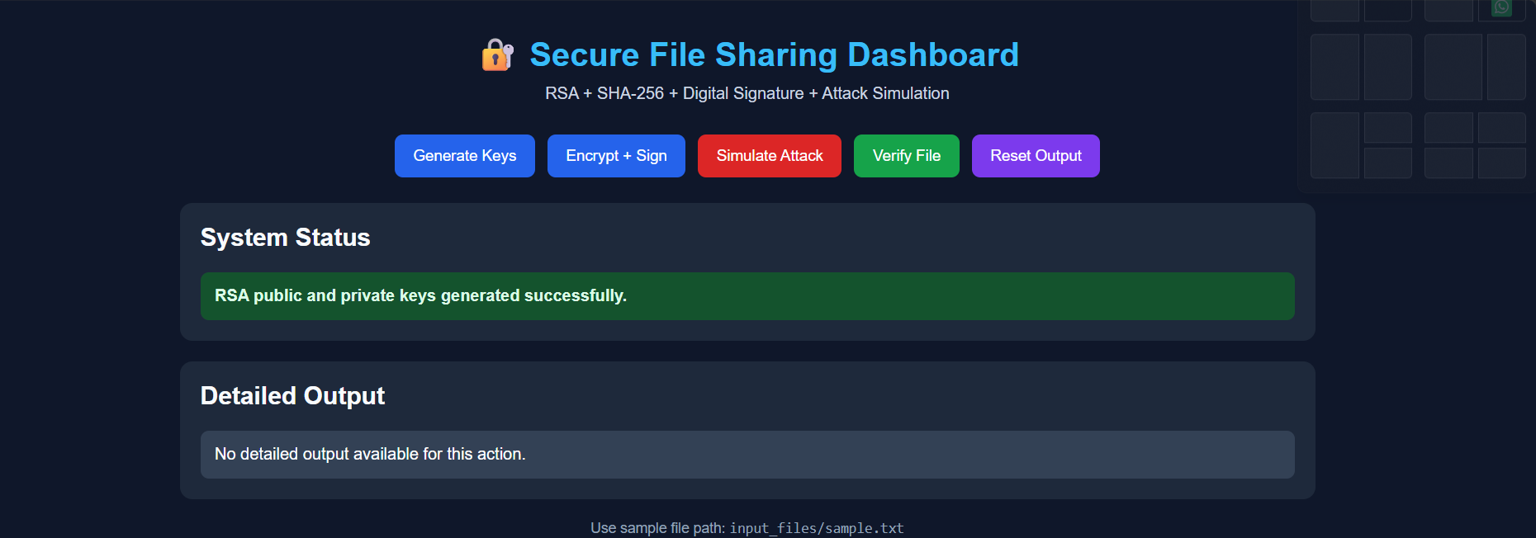
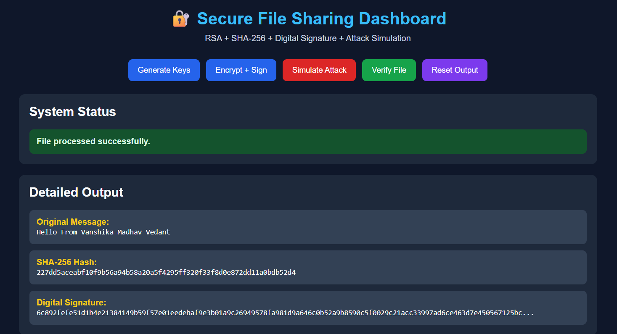
USER INTERFACE
The dashboard and its design system
FRONTEND DESIGN NOTES
▸ Five-stage control row — Generate Keys → Encrypt + Sign → Simulate Attack → Verify File → Reset Output, each bound to one fetch() call.
▸ Semantic status colours — success, warning, danger, error and reset each map to a dedicated CSS class and palette.
▸ Structured detail grid — message, hash, signature, received hash and attack byte details render as separate info cards.
▸ XSS-safe rendering — every dynamic value passes through escapeHtml() before being injected into innerHTML.
Landing state — control panel with status and detail panes
CLIENT-SIDE FLOW
callAPI(url) → fetch(url) → response.json() → updateStatus(data) + updateDetails(data)
After Encrypt + Sign — message digest and signature rendered as info cards
MITM Detection · Secure File Sharing Dashboard
17
Notes:
Point out the five-button control row, the colour-coded status box and the detailed output grid. Mention the escapeHtml() helper as a deliberate XSS defence.

Slide 18
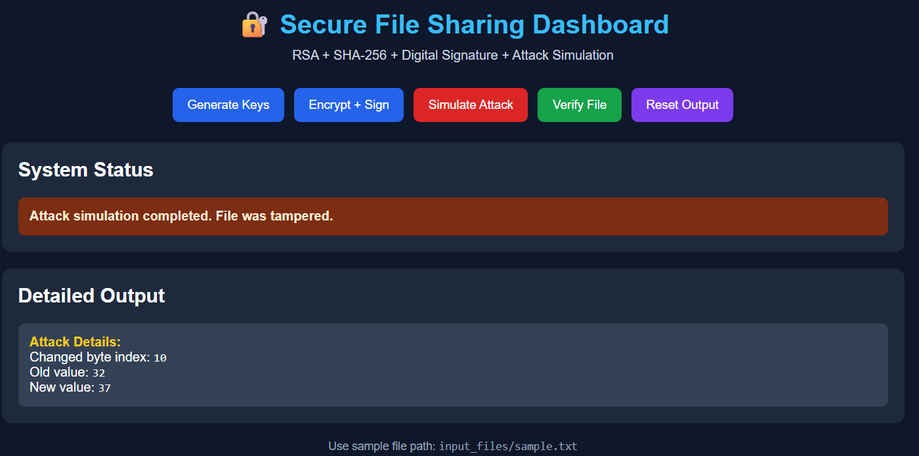
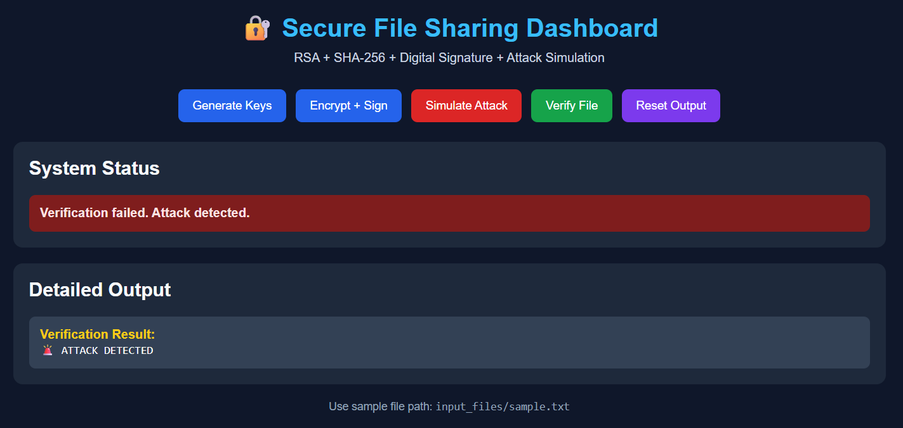
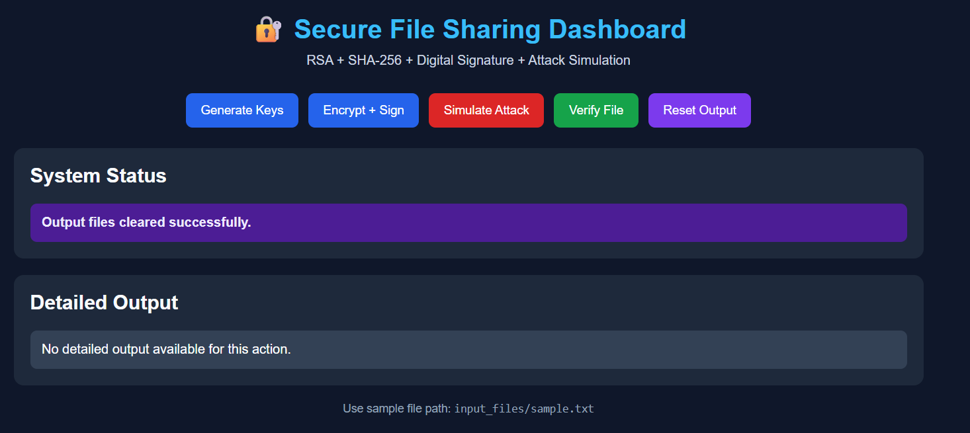
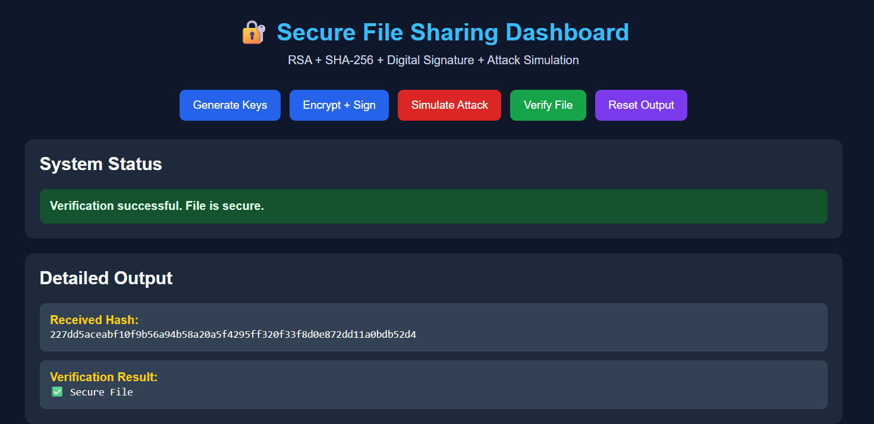
VALIDATION
Dashboard walkthrough — every captured state
STAGE 1 Generate Keys
Key pair written; green success banner.
STAGE 2 Encrypt + Sign
Message, SHA-256 digest and signature displayed.
STAGE 3 Simulate Attack
Amber warning; byte 10 changed from 32 to 37.
STAGE 4 Verify — Tampered
Red banner: ATTACK DETECTED.
STAGE 5 Reset Output
Purple banner; artefacts cleared for a clean re-run.
STAGE 6 Verify — Clean
Green banner: Secure File after a fresh encrypt.
MITM Detection · Secure File Sharing Dashboard
18
Notes:
These are the actual screenshots recorded during the live run. Each one corresponds to one stage of the pipeline, in order.

Slide 19
TESTING
Test matrix and observed results
# | Test case | Expected behaviour | Observed
T1 | Generate keys on a clean tree | Both PEM files created; key sizes 2048-bit | PASS
T2 | Encrypt before any key exists | Guarded error: "Private key not found" | PASS
T3 | Hash length after encrypt | SHA-256 digest is exactly 32 bytes | PASS
T4 | Signature length after encrypt | RSA-2048 signature is exactly 256 bytes | PASS
T5 | Verify an unmodified payload | "Verification successful" · Secure File | PASS
T6 | Simulate the MITM tamper | Byte 10 changes 32 → 37; status = warning | PASS
T7 | Verify the tampered payload | Signature check raises · ATTACK DETECTED | PASS
T8 | Reset the output directory | Payload and signature artefacts removed | PASS
T9 | Verify after a reset | Guarded error: "Encrypted file not found" | PASS
RESULT 9 of 9 test cases passed on the live run. The critical property under test is T7 — a single modified byte inside a 34-byte payload is reliably detected.
MITM Detection · Secure File Sharing Dashboard
19
Notes:
Nine tests covering both the happy path and the guarded error paths. Every case passed on the live run.

Slide 20
SECURITY ANALYSIS
Strengths, limitations and honest scope
STRENGTHS
LIMITATIONS · FUTURE HARDENING
▸ Detached signature — the attacker can rewrite the payload but cannot re-sign it without the private key.
▸ Audited primitives — RSA, PSS and SHA-256 come from the OpenSSL-backed cryptography package.
▸ Deterministic detection — a 1-byte change alters the digest, so detection is reliable, not probabilistic.
▸ Key rotation on demand — a fresh key pair can be generated for every demonstration run.
▸ Defensive coding — every crypto routine guards against missing files and empty inputs before acting.
▸ Clean separation — routing, cryptography, storage and presentation each live in their own module.
▸ Payload is signed, not encrypted — the file is stored in the clear; confidentiality would require an AEAD cipher such as AES-GCM.
▸ Private key is stored unencrypted — it should be protected with a passphrase, an HSM or a KMS-held key.
▸ Offline simulation only — the tamper runs locally instead of on a real proxied network path.
▸ Fixed tamper offset — offset 10 is targeted; a real adversary would randomise the mutation.
▸ No transport security — the Flask dev server runs in debug mode over plain HTTP on localhost.
▸ No access control — the endpoints are unauthenticated; a production build needs TLS, sessions and authorisation.
MITM Detection · Secure File Sharing Dashboard
20
Notes:
Be transparent about the limitations. This is a demonstration of a detection mechanism, not a production security product, and saying so builds credibility.

Slide 21
ROADMAP
Future enhancements
01
02
03
Add real confidentiality
Realistic network adversary
Randomised tamper injection
Encrypt the payload with AES-256-GCM and derive the key via RSA-OAEP, so the file is both secret and authentic.
Move the attack into a live TCP proxy between two hosts so the interception happens on the wire, not in-process.
Mutate a random offset and a random subset of bytes so no offset can be relied upon for bypass.
04
05
06
Key management & rotation
Certificates & trust
Harden the deployment
Encrypt the private key with a passphrase, add expiry metadata and support signed key revocation.
Issue self-signed X.509 certificates and validate them against a trust store to bind signatures to identities.
Serve over TLS with Gunicorn, disable debug mode, add authentication, rate limiting and structured audit logs.
MITM Detection · Secure File Sharing Dashboard
21
Notes:
Order these by value: encryption and network realism first, then operational hardening.

Slide 22
CONCLUSION
What the project proves
“If the payload changes in any way, the digest changes, and without the private key the signature can never be made to match again.”
A working detection mechanism
Primitives chosen deliberately
A complete, runnable pipeline that signs a file, allows it to be tampered with, and then proves the tampering is detected — not in theory, but through a live dashboard.
RSA-2048 for identity, SHA-256 for integrity, and RSA-PSS rather than PKCS#1 v1.5 for a provably unforgeable signature scheme.
Clear separation of concerns
Honest, measurable results
Flask routing, cryptographic services, storage and presentation are isolated in four modules, so the project can be extended or reused piece by piece.
Nine test cases pass on a live run, including the critical case where a single byte change inside a 34-byte file is reliably detected.
MITM Detection · Secure File Sharing Dashboard
22
Notes:
Close on the single sentence that captures the whole project, then recap the four deliverables.

Slide 23
THANK YOU FOR YOUR ATTENTION
Questions?
Man-in-the-Middle Detection · RSA-2048 · SHA-256 · RSA-PSS · Flask
Vanshika · Madhav · Vedant
Project source, keys, output artefacts and full screenshot set are included in the submitted repository.
Notes:
Thank the audience and invite questions. Offer to demo the live dashboard if time allows.

