Slide 1
Operating Systems UNIT-2 Process & IPC By Dr. Vikas Lamba Chitkara University Institute of Engineering and Technology Chitkara University, Punjab

Slide 2
UNIT II SYLLABUS
Process Concept:
Process
scheduling,
Operations on processes,
Inter-process communication,
Communication in client
server
models,
systems. Multithreaded Programming: Multithreading
Thread libraries, Threading issues, Examples.
Process Scheduling: Basic concepts, Scheduling criteria, Scheduling algorithms, Multiple processor scheduling, Thread scheduling, Examples.
Inter-process Communication: Race conditions, Critical Regions,
Mutual exclusion with busy waiting, Sleep and wakeup, Semaphores,
Mutexes, Problems problem
Monitors, Message
passing,
Barriers,
Classical IPC
- Dining philosophers problem, Readers and writers

Slide 3
Processes
Process Concept: Process scheduling,
Operations on processes,
Inter-process communication,
Communication in client server systems.
Multithreaded Programming: Multithreading models, Thread libraries, Threading issues, Examples.

Slide 4
Objectives
To introduce the notion of a process -- a program in execution, which forms the basis of all computation
To describe the various features of processes, including scheduling, creation and termination, and communication
To explore inter-process communication using shared memory and message passing
To describe communication in client-server systems

Slide 5
PROCESS CONCEPT
Process – a program in execution; process execution must progress in sequential fashion
Multiple parts
The program code, also called text section
Current activity including program counter, processor registers
Process includes :
Stack containing temporary data
Function parameters, return addresses, local variables
Data section containing global variables
Heap containing memory dynamically allocated during run time
Program is passive entity stored on disk (executable file), process is active
Program becomes process when executable file loaded into memory
Execution of program started via GUI mouse clicks, command line entry of its name, etc
One program can be several processes
Consider multiple users executing the same program

Slide 6
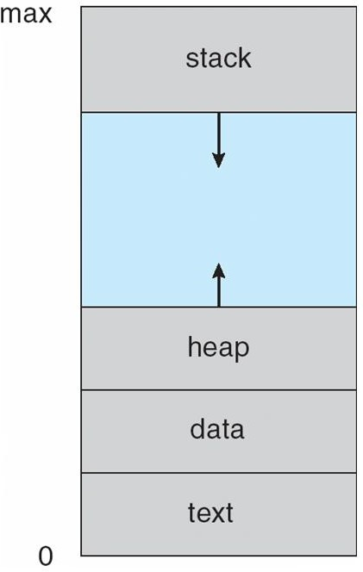
CONTD..
Process in Memory

Slide 7
Process State
As a process executes, it changes state
new: The process is being created
running: Instructions are being executed
waiting: The process is waiting for some event to occur
ready: The process is waiting to be assigned to a processor
terminated: The process has finished execution

Slide 8
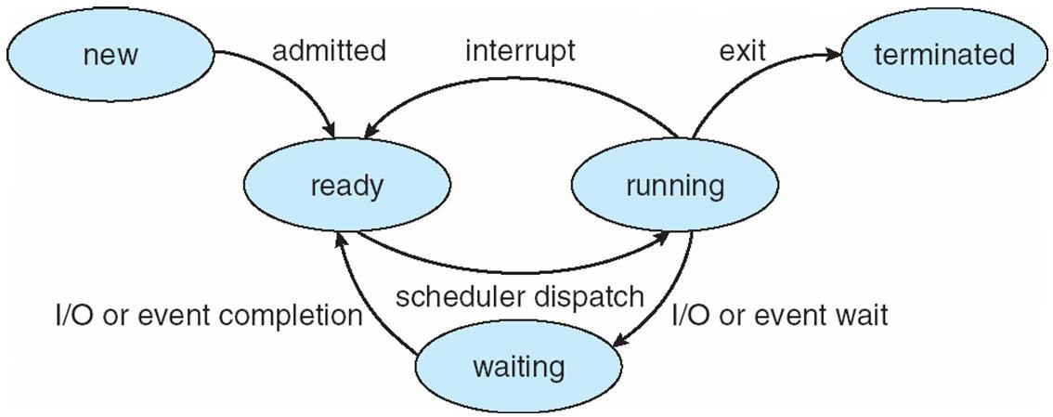
Diagram of Process State Or Lifecycle of a Process

Slide 9
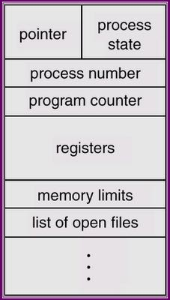
Process Control Block (PCB)
A process control block (PCB) is a data structure used by computer operating
systems to store all the information about a process.
When a process is created (initialized or installed), the operating system creates a corresponding process control block.
Process control block includes CPU scheduling, I/O resource management, file management information etc.
If that process gets suspended, the contents of the registers are saved on a stack and the pointer to the particular stack frame is stored in the PCB.
By this technique, the hardware state can be restored so that the process can be scheduled to run again.

Slide 10
Process Control Block (PCB)
Process control block includes CPU scheduling, I/O resource management, file management information etc.
If that process gets suspended, the contents of the registers are saved on a stack and the pointer to the particular stack frame is stored in the PCB.
By this technique, the hardware state can be restored so that the process can be scheduled to run again.

Slide 11
Process Control Block (PCB)
A Process Control Block is a data structure maintained by the Operating System for every process.
The PCB is identified by an integer process ID (PID). A PCB keeps all the information needed to keep track of a process as listed below in the table −

Slide 12
CONTD..
S.N. | Information & Description
1 | Process State The current state of the process i.e., whether it is ready, running, waiting, or whatever.
2 | Process privileges This is required to allow/disallow access to system resources.
3 | Process ID Unique identification for each of the process in the operating system.
4 | Pointer A pointer to parent process.
5 | Program Counter Program Counter is a pointer to the address of the next instruction to be executed for this process.
6 | CPU registers Various CPU registers where process need to be stored for execution for running state.
7 | CPU Scheduling Information Process priority and other scheduling information which is required to schedule the process.
8 | Memory management information This includes the information of page table, memory limits, Segment table depending on memory used by the operating system.
9 | Accounting information This includes the amount of CPU used for process execution, time limits, execution ID etc.
10 | IO status information This includes a list of I/O devices allocated to the process.

Slide 13
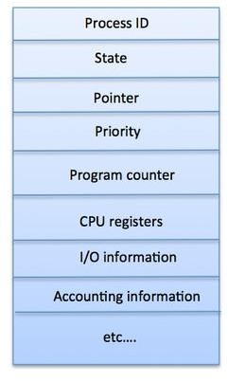
CONTD..
The architecture of a PCB is completely dependent on Operating System and may contain different information in different operating systems. Here is a simplified diagram of a PCB −
The PCB is maintained for a process throughout its lifetime, and is deleted once the process terminates.

Slide 14
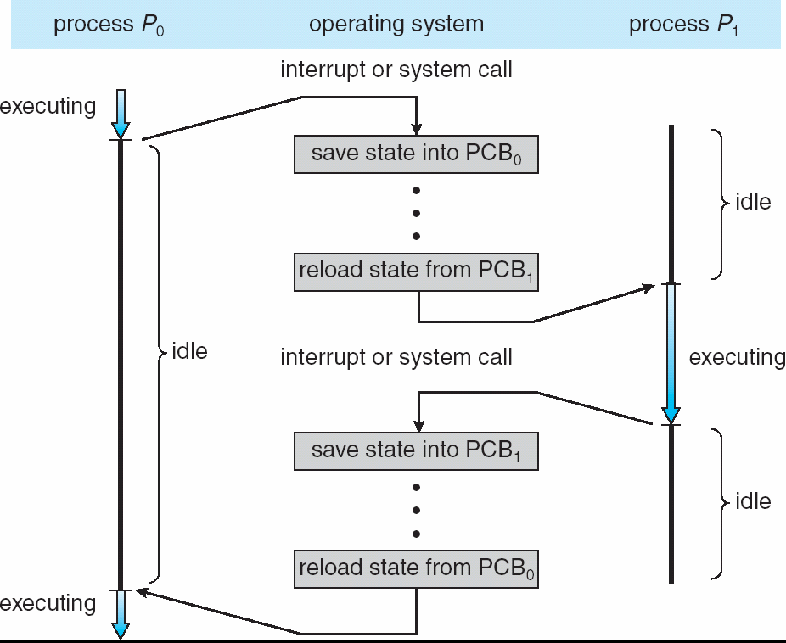
CONTD..
CPU Switch From Process to Process

Slide 15
Operating System - Process Scheduling
Definition
The process scheduling is the activity of the process manager that handles the removal of the running process from the CPU and the selection of another process on the basis of a particular strategy.
Process scheduling is an essential part of a Multiprogramming operating systems. Such operating systems allow more than one process to be loaded into the executable memory at a time and the loaded process shares the CPU using time multiplexing.

Slide 16
CONTD..
Process Scheduling Queues
The OS maintains all PCBs in Process Scheduling Queues. The OS maintains a separate queue for each of the process states and
PCBs of all processes in the same execution state are placed in the same queue. When the state of a process is changed, its PCB is unlinked from its current queue and moved to its new state queue.
The Operating System maintains the following important process
scheduling queues −
Job queue − This queue keeps all the processes in the system. Ready queue − This queue keeps a set of all processes residing in main memory, ready and waiting to execute. A new process is always put in this queue.
Device queues − The processes which are blocked due to unavailability of an I/O device constitute this queue.

Slide 17
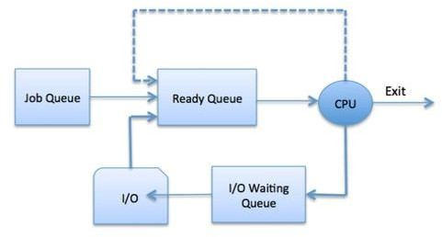
CONTD..

Slide 18
CONTD..
The OS can use different policies to manage each queue (FIFO, Round Robin, Priority, etc.). The OS scheduler determines how to move processes between the ready and run queues which can only have one entry per processor core on the system; in the above diagram, it has been merged with the CPU.

Slide 19
CONTD..
Two-State Process Model
Two-state process model refers to running and non-
running states which are described below −
S.No. | State & Description
1 | Running: When a new process is created, it enters into the system as in the running state.
2 | Not Running: Processes that are not running are kept in queue, waiting for their turn to execute. Each entry in the queue is a pointer to a particular process. Queue is implemented by using linked list. Use of dispatcher is as follows. When a process is interrupted, that process is transferred in the waiting queue. If the process has completed or aborted, the process is discarded. In either case, the dispatcher then selects a process from the queue to execute.

Slide 20
Schedulers
A scheduler in an Operating System (OS) is responsible for selecting which processes will run on the CPU and for how long. The main goal of a scheduler is to optimize system performance, maximize CPU utilization, and ensure fairness among processes.
Types of Schedulers in an OS
Schedulers are categorized based on their roles and the type of decisions they make. The three primary types are:
Schedulers are of three types −
Long-Term Scheduler
Medium-Term Scheduler
Short-Term Scheduler

Slide 21
Long-Term Scheduler (Job Scheduler)
Purpose: Controls the degree of multiprogramming by deciding which jobs or processes are admitted into the system for processing.
Role:
Selects processes from the job queue (stored in secondary storage).
Loads selected processes into the ready queue (main memory) for execution.
Balances the mix of CPU-bound and I/O-bound processes to optimize performance.
Frequency: Infrequently invoked (seconds to minutes).
Example: Batch processing systems where new jobs are added periodically.
Key Consideration: Ensures the system doesn't get overwhelmed by too many processes, which could lead to thrashing.

Slide 22
CONTD..
2. Medium-Term Scheduler
Purpose: Manages processes in memory and optimizes resource allocation by swapping processes in and out of memory.
Role:
Suspends processes (moves them to secondary storage) to free up memory during heavy loads.
Resumes suspended processes when resources are available.
Facilitates better memory utilization and system responsiveness.
Frequency: Invoked occasionally, depending on system load.
Example: In a time-sharing system, a process that hasn’t been active for a while may be swapped out to accommodate a more active process.

Slide 23
CONTD..
3. Short-Term Scheduler (CPU Scheduler)
Purpose: Decides which process in the ready queue will get the CPU next.
Role:
Executes most frequently (milliseconds to microseconds).
Responsible for context switching between processes.
Implements scheduling algorithms to ensure efficient CPU usage.
Frequency: Invoked frequently (whenever the CPU is idle or a process needs to be preempted).
Example: In a multitasking OS, this scheduler selects the next process for execution after a time slice expires.

Slide 24
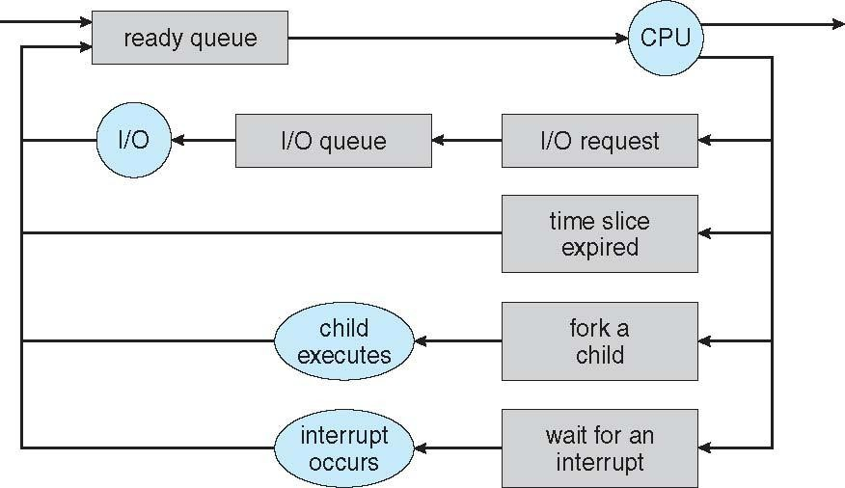
CONTD..
Representation of Process Scheduling
Queueing diagram represents queues, resources, flows

Slide 25
CONTD..
Context Switch
When CPU switches to another process, the system must save the state of the old process and load the saved state for the new process via a context switch
Context of a process represented in the PCB
Context-switch time is overhead; the system does no useful work while
switching
The more complex the OS and the PCB ➔ the longer the context switch
Time dependent on hardware support
Some hardware provides multiple sets of registers per CPU ➔
multiple contexts loaded at once

Slide 26
Operations on Processes
System must provide mechanisms for:
process creation,
process termination,

Slide 27
CONTD..
Process Creation
Parent process create children processes, which, in turn create other
processes, forming a tree of processes
Generally, process identified and managed via a process identifier (pid)
Resource sharing options
Parent and children share all resources
Children share subset of parent’s resources
Execution options
Parent and children execute concurrently
Parent waits until children terminate

Slide 28
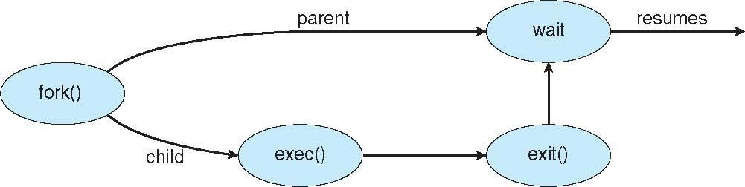
CONTD..
Address space
Child duplicate of parent
Child has a program loaded into it
UNIX examples
fork() system call creates new process
exec() system call used after a fork() to replace the process’
memory space with a new program

Slide 29
CONTD..
Process Termination
Process executes last statement and then asks the operating system to delete it using the exit() system call.
Returns status data from child to parent (via wait())
Process’ resources are deallocated by operating system
Parent may terminate the execution of children processes
abort() system call. Some reasons for doing so:
Child has exceeded allocated resources
Task assigned to child is no longer required
using the
The parent is exiting and the operating systems does not allow a
child to continue if its parent terminates

Slide 30
CONTD..
Some operating systems do not allow child to exists if its parent has terminated. If a process terminates, then all its children must also be terminated.
cascading termination. All children, grandchildren, etc. are terminated.
The termination is initiated by the operating system.
The parent process may wait for termination of a child process by using the wait()system call. The call returns status information and the pid of the terminated process
pid = wait(&status);
If no parent waiting (did not invoke wait()) process is a zombie
If parent terminated without invoking wait , process is an orphan

Slide 31
Interprocess Communication
Inter process communication (IPC) is a mechanism which allows processes to
communicate with each other and synchronize their actions.
Processes within a system may be:
1. Independent Process 2. Co-operating Process
Independent Process | Co-operating Process
1. A process is independent if it cannot affect or be affected by the other processes executing in the system | 1. A process is co-operating if it can affect or be affected by the other processes executing in the system.
2. Any process that does not share data with any other process is IP | 2. Any process that share data with any other process is CP
Reasons for cooperating processes:
Information sharing
Computation speedup
Modularity
Convenience

Slide 32
Client/Server communication involves two components, namely a client and a server. They are usually multiple clients in communication with a single server. The clients send requests to the server and the server responds to the client requests.
Operating Systems Client/Server
Communication
There are three main methods to client/server communication. These
are given as follows −
Sockets
Remote Procedure Calls
Pipes

Slide 33
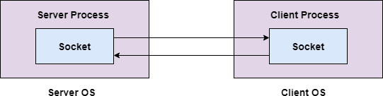
Operating Systems Client/Server Communication
SOCKET:
Sockets facilitate communication between two processes on the same machine or different machines. They are used in a client/server framework and consist of the IP address and port number. Many application protocols use sockets for data connection and data transfer between a client and a server.

Slide 34
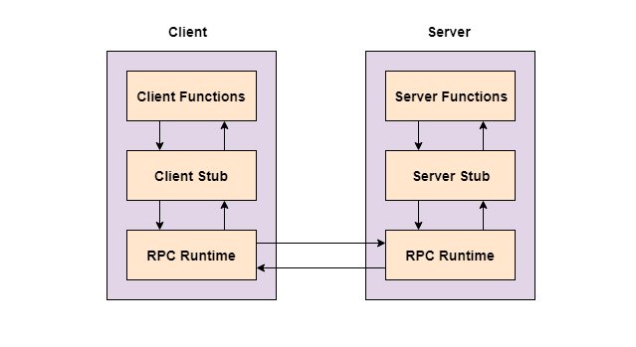
Operating Systems Client/Server Communication
Remote Procedure Calls
These are interprocess communication techniques that are used for client- server based applications. A remote procedure call is also known as a subroutine call or a function call.
A client has a request that the RPC translates and sends to the server. This request may be a procedure or a function call to a remote server. When the server receives the request, it sends the required response back to the client.

Slide 35

Operating Systems Client/Server Communication
Pipes
These are interprocess communication methods that contain two end points. Data is entered from one end of the pipe by a process and consumed from the other end by the other process.
The two different types of pipes are ordinary pipes and named pipes. Ordinary pipes only allow one way communication. For two way communication, two pipes are required. Ordinary pipes have a parent child relationship between the processes as the pipes can only be accessed by processes that created or inherited them

Slide 36
Process Scheduling Algorithms
A Process Scheduler schedules different processes to be assigned to the CPU based on particular scheduling algorithms. There are six popular process scheduling algorithms
First-Come, First-Served (FCFS) Scheduling-In this Process which requests
the cpu gets the cpu allocation first
Shortest-Job-Next (SJN) Scheduling—Execution time should be selected for execution next
Priority Scheduling-it selects the tasks to work as per the priority
Shortest Remaining Time-The process will be allocated to the task, which
is closest to its completion.
Round Robin(RR) Scheduling-it works on principle, where each person gets an equal share of something in turn(change the position)
Multiple-Level Queues Scheduling-it separate the queues. In this method processes are assigned to a queue based on a specific properity

