Slide 1
CPU Scheduling
Prepared By
Dr. Vikas Lamba
Chitkara University Institute of Engineering and Technology
Chitkara University, Punjab

Slide 2
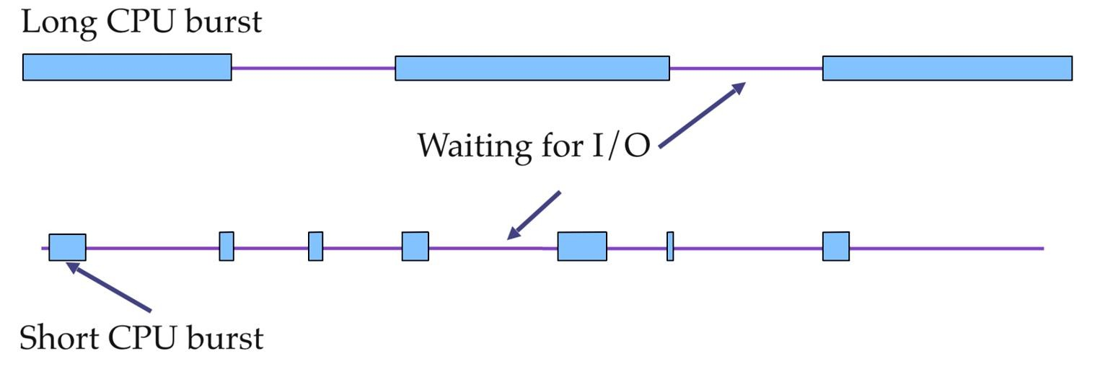
CPU Scheduling: Process Behavior
During its lifetime, a process goes through a sequence of CPU and I/O bursts.
In a multi-programmed computer system, multiple process compete for the CPU at a given time, to complete their current CPU bursts.

Slide 3
Basic Concepts
The CPU scheduler (a.k.a. short-term scheduler) will select one of the processes in the ready queue for execution.
The CPU scheduler algorithm may have tremendous effects on the system performance
– Interactive systems
– Real-time systems
Dispatcher module gives control of the CPU to the process selected by the short-term scheduler; this involves:
– switching context
– switching to user mode
– jumping to the proper location in the user program to restart the program

Slide 4
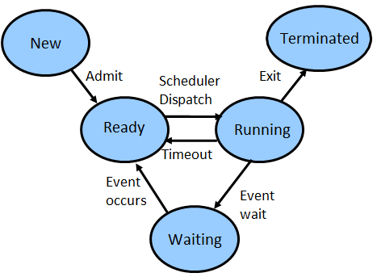
When to Schedule?
Under a simple process state transition model, CPU scheduler could be invoked at four different points:
When a process switches from running state to the waiting state.
When a process switches from the running state to the ready state.
When a process switches from the waiting state to the ready state.
When a process terminates.
Scheduling under 1 and 4 is non-preemptive.
All other scheduling is preemptive.

Slide 5
Non-preemptive vs. Preemptive Scheduling
Under non-preemptive scheduling, each running process keeps the CPU until it completes or it switches to the waiting (blocked) state.
Under preemptive scheduling, a running process may be also forced to release the CPU even though it is neither completed nor blocked.
In time-sharing systems, when the running process reaches the end of its time quantum (slice)
To allocate CPU to another higher-priority process

Slide 6
Scheduling Criteria
CPU utilization – keep the CPU as busy as possible.
Throughput – Number of processes that complete their execution per time unit.
Turnaround time – amount of time to execute a particular process (time from submission to termination).
Or
Time Difference between completion time and arrival time. Turn Around Time = Completion Time - Arrival Time
Waiting time – amount of time a process has been waiting in the ready queue.
Or
Time Difference between turn around time and burst time. Waiting Time = Turn Around Time - Burst Time
Response time – amount of time it takes from when a request was submitted until the first response is produced, not the complete output.
**Completion Time: Time at which process completes its execution.

Slide 7
Optimization Criteria
Maximize the CPU utilization
Maximize the throughput
Minimize the (average) turnaround time
Minimize the (average) waiting time
Minimize the (average) response time

Slide 8
Scheduling Algorithms
First Come, First Served (FCFS)
Shortest Job First (SJF)
Priority
Round Robin (RR)

Slide 9
First-Come, First-Served (FCFS) Scheduling
Single FIFO ready queue.
No-preemptive.
Not suitable for timesharing systems
Simple to implement and understand.
Average waiting time dependent on the order processes enter the system.

Slide 10
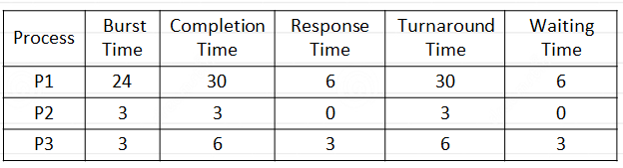
Example of FCFS Scheduling
Suppose that the processes arrive at time = 0 in the order P2 , P3 , P1
The Gantt chart for the schedule:
3 | 3 | 24
P2 | P3 | P1
0 | 3 | 6 | 30
Average response time: (6+0+3)/3 = 3
Average waiting time: (6+0+3)/3 = 3
Average turnaround time: (30+3+6)/3 = 13

Slide 11
Example of FCFS Scheduling (cont.)
Process | Burst Time | Completion Time | Response Time | Turnaround Time | Waiting Time
P1 | 24 | 30 | 6 | 30 | 6
P2 | 3 | 3 | 0 | 3 | 0
P3 | 3 | 6 | 3 | 6 | 3
Suppose that the processes arrive at time = 0 in the order P2 , P3 , P1
The Gantt chart for the schedule:
3 | 3 | 24
P2 | P3 | P1
0 | 3 | 6 | 30
Average response time: (6+0+3)/3 = 3
Average waiting time: (6+0+3)/3 = 3
Average turnaround time: (30+3+6)/3 = 13

Slide 12

Question
Consider the set of 5 processes whose arrival time and burst time are given below:
Process Id | Arrival time | Burst time | Completion Time | Turnaround Time | Waiting Time
P1 | 3 | 4 | 7 | 4 | 0
P2 | 5 | 3 | 13 | 8 | 5
P3 | 0 | 2 | 2 | 2 | 0
P4 | 5 | 1 | 14 | 9 | 8
P5 | 4 | 3 | 10 | 6 | 3
2 | 1 | 4 | 3 | 3 | 1
P3 |  | P1 | P5 | P2 | P4
0 | 2 | 3 | 7 | 10 | 13 | 14

Slide 13
Advantages and Disadvantages of FCFS
Advantages:
It is simple and easy to understand.
Disadvantages:
The process with less execution time suffer i.e. waiting time is often quite long.
Favors CPU Bound process then I/O bound process.
Convoy effect: If the first process has large burst time, and other processes have less burst time, then the processes will have to wait more unnecessarily, this will result in more average waiting time.
Not suitable for time-sharing systems, where it is important that each
user get a share of the CPU at regular intervals.

Slide 14
Shortest-Job-First (SJF) Scheduling
Associate with each process the length of its next CPU burst.
The CPU is assigned to the process with the smallest CPU burst (FCFS can
be used to break ties).
Two schemes:
non-preemptive
preemptive – Also known as the Shortest-Remaining-Time-First (SRTF).
Non-preemptive SJF is optimal if all the processes are ready simultaneously– gives minimum average waiting time for a given set of processes.
SRTF is optimal if the processes may arrive at different times.

Slide 15
Example for Non-Preemptive SJF
Process | Arrival Time | Burst Time | Completion Time | Response Time | Turnaround Time | Waiting Time
P1 | 0.0 | 7 | 7 | 0 | 7 | 0
P2 | 2.0 | 4 | 12 | 6 | 10 | 6
P3 | 4.0 | 1 | 8 | 3 | 4 | 3
P4 | 5.0 | 4 | 16 | 7 | 11 | 7
7
1
4
4
P1 | P3 | P2 | P4
0 | 7 | 8 | 12 | 16

Slide 16
Example for Preemptive SJF (SRTF)
Process | Arrival Time | Burst Time | Completion Time | Response Time | Turnaround Time | Waiting Time
P1 | 0.0 | 7 | 16 | 0 | 16 | 9
P2 | 2.0 | 4 | 7 | 0 | 5 | 1
P3 | 4.0 | 1 | 5 | 0 | 1 | 0
P4 | 5.0 | 4 | 11 | 2 | 6 | 2
2
2
1
2
4
5
P1 | P2 | P3 | P2 | P4 | P1
0 | 2 | 4 | 5 | 7 | 11 | 16

Slide 17
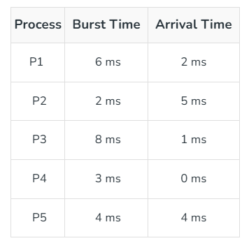
Question
Calculate Average Turnaround Time, Average Wafting Time.
https://www.geeksforgeeks.org/program-for-shortest-job-first-or-sjf-cpu-scheduling-set-1-non-preemptive/

Slide 18
Advantages and Disadvantages of SJF
Advantages:
Frequently used for long term scheduling.
Optimal for average waiting time.
Favors shorter jobs against long jobs.
Disadvantages:
Job completion time must be known earlier, but it is hard to predict.
May cause starvation, if shorter processes keep coming.
Cannot be implemented at the level of short term CPU scheduling.

Slide 19
Priority-based (PB) Scheduling
A priority number (integer) is associated with each process
The CPU is allocated to the process with the highest priority
(smallest integer  highest priority).
Preemptive
Non-preemptive
SJF is a priority scheme with the priority the remaining time.

Slide 20
Example for Priority-based Scheduling (Non-preemptive)
Process | Priority | Burst Time | C.T. | R.T. | T.T. | W.T.
P1 | 3 | 10 | 16 | 6 | 16 | 6
P2 | 1 | 1 | 1 | 0 | 1 | 0
P3 | 4 | 2 | 18 | 16 | 18 | 16
P4 | 5 | 1 | 19 | 18 | 19 | 18
P5 | 2 | 5 | 6 | 1 | 6 | 1
1
5
10
2
1
P2 | P5 | P1 | P3 | P4
0 | 1 | 6 | 16 | 18 | 19

Slide 21
Example for Priority-based Scheduling (Preemptive)
Process | Arrival Time | Priority | Burst Time | C.T. | R.T. | T.T. | W.T.
P1 | 0 | 2 | 4 | 15 | 0 | 15 | 9
P2 | 1 | 3 | 3 | 12 | 1 | 11 | 8
P3 | 2 | 4 | 1 | 3 | 2 | 1 | 0
P4 | 3 | 5 | 5 | 8 | 3 | 5 | 0
P5 | 4 | 5 | 2 | 10 | 8 | 6 | 8
(Higher number represents higher priority)
1 | 1 | 1 | 5 | 2 | 2 | 3
P1 | P2 | P3 | P4 | P5 | P2 | P3
0 | 1 | 2 | 3 | 8 | 10 | 12 | 15

Slide 22
Advantages and Disadvantages of PB
Advantages:
Provides a good mechanism where the relative importance of each
process maybe precisely defined.
Disadvantages:
If high priority processes use up a lot of CPU time, lower priority processes may starve and be postponed indefinitely. The situation where a process never gets scheduled to run is called starvation.
Solution: Aging – as time progresses, increase the priority of the processes that wait in the system for a long time.
Another problem is deciding which process gets which priority level
assigned to it.

Slide 23
Round Robin (RR) Scheduling
Each process gets a small unit of CPU time (time quantum).
After this time has elapsed, the process is preempted and added to
the end of the ready queue.
Newly-arriving processes (and processes that complete their I/O bursts) are added to the end of the ready queue.
If there are n processes in the ready queue and the time quantum is
q, then no process waits more than (n-1)q time units.
Performance
q large => FCFS
q small => Processor Sharing (The system appears to the users as though each of the n processes has its own processor running at the (1/n)^{th} of the speed of the real processor)

Slide 24
Example for Round-Robin
Process | Burst Time | C.T. | R.T. | T.T. | W.T.
P1 | 53 | 134 | 0 | 134 | 81
P2 | 17 | 37 | 20 | 37 | 20
P3 | 68 | 162 | 37 | 162 | 94
P4 | 24 | 121 | 57 | 121 | 97
Time Quantum (q) = 20
20
17
20
20
20
20
4
13
28
P1 | P2 | P3 | P4 | P1 | P3 | P4 | P1 | P3
0 | 20 | 37 | 57 | 77 | 97 | 117 | 121 | 134 | 162

Slide 25
Advantages and Disadvantages of RR
Advantages:
Every process gets an equal share of the CPU.
RR is cyclic in nature, so there is no starvation.
Disadvantages:
Setting the quantum too short, increases the overhead and lowers the CPU efficiency, but setting it too long may cause poor response to short processes.
Average waiting time under the RR policy is often long.

Slide 26
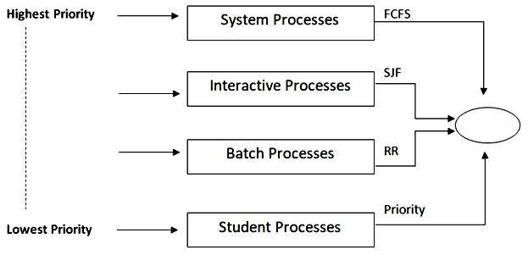
Multilevel Queue (MLQ) Scheduling
Ready queue is divided into various queues that are called subqueues.
Processes are permanently assigned to
subqueues based on some
property, such as memory size, process
priority, or process type
(background or foreground process).
Each queue has its own scheduling algorithm.

Slide 27
Example of MLQ
Consider a system with 6 processes where multilevel queue scheduling has been deployed using three queues labelled as Q1, Q2 and Q3, with priorities of queues are like, Q1 > Q2 > Q3. The Q1, Q2, and Q3 queues use the shortest remaining time first (SRTF), first come first serve (FCFS), and round robin (RR) scheduling with 2 ms time quantum, respectively. The arrival time (ms), burst time (ms), and execution queues of the processes are given in table below.
Process Id | Arrival Time | Burst Time | Queue No.
P1 | 0 | 3 | Q1
P2 | 0 | 4 | Q1
P3 | 7 | 2 | Q2
P4 | 6 | 4 | Q2
P5 | 10 | 5 | Q1
P6 | 5 | 3 | Q3

Slide 28
Example of MLQ
Considering scheduling and context switching overhead as negligible, answer the following:
Draw the Gantt chart showing the sequence of execution for the processes involved in the system, and also specify the status of Q1, Q2, and Q3 at time instance t=20, i.e. the processes that reside in the said queues.
What is the turn-around time of processes P4 and P6?
What are the number context of switches after execution of all
process?

Slide 29
Example of MLQ
Process Id | Arrival Time | Burst Time | Queue No.
P1 | 0 | 3 | Q1
P2 | 0 | 4 | Q1
P3 | 7 | 2 | Q2
P4 | 6 | 4 | Q2
P5 | 10 | 5 | Q1
P6 | 5 | 3 | Q3
Gantt Chart:
3
0 3
4
3
5
2
1
2
1
P1 | P2 | P4 | P5 | P3 | P4 | P6 | P6
7 10 15 17
18
20
21
At time instance t = 20 : Q1, Q2, Q3 will be empty.
Turnaround time of process P4 = 18-6 =12
Turnaround time of process P6 = 21- 5 = 16
Number of context switches = 7

Slide 30
Advantages and Disadvantages of MLQ
Advantages:
1. We can
apply various type of scheduling for different kind of
processes.
Disadvantages:
Due to starvation lower-level processes either never execute or have
to wait for a long amount of time.

