Slide 1
SCM Project
Team Details:
MADHAV SAKHUJA, 2410991371
MADHAV KANSAL, 2410991370
HARMANJIT,2410991313
LAKSH GOYAL,2410991364
Faculty Coordinator: Dr. Prabhjot Singh Manocha
:
Chitkara University Institute of Engineering and Technology,
Chitkara University, Punjab

Slide 2
Table of Contents
Introduction
Features
Technical Details
Code Structure
Project Highlights
Conclusion

Slide 3
Introduction
Title of our Project – TO DO LIST MANAGER
This To-Do List Manager helps users manage their daily tasks. It provides a simple, interactive interface to add, edit, and remove tasks with priority levels, filters, and notifications.

Slide 4
FEATURES
- Add and remove tasks
- Set task priorities (High, Medium, Low)
- Mark tasks as completed
- Filter tasks by priority and status
- Edit tasks
- Local storage support for saving tasks
- Notification for task updates

Slide 5
Technical Details
1) HTML, CSS, JavaScript
2) FontAwesome for icons
3) LocalStorage for task persistence
4) DOM Manipulation for interactive
UI

Slide 6
code structure
Main functionality resides in the `script.js` file
Divided into initialization, task management, and UI update functions
- Responsive UI for a seamless experience
- Tasks stored in the local storage to persist data

Slide 7
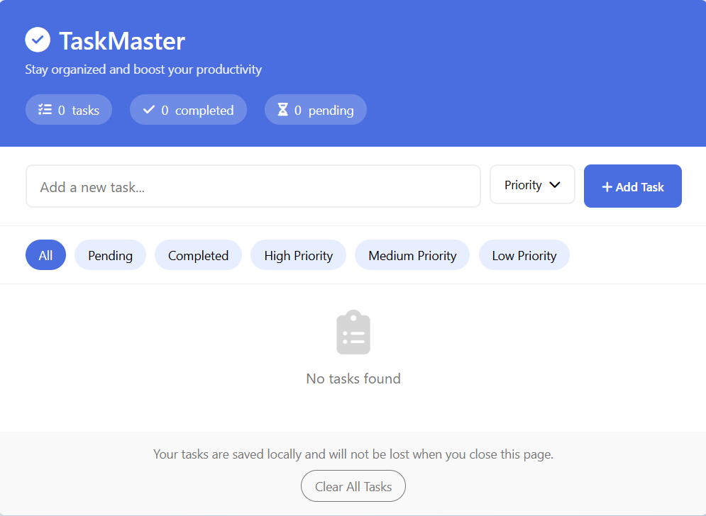
Project Highlights

Slide 8
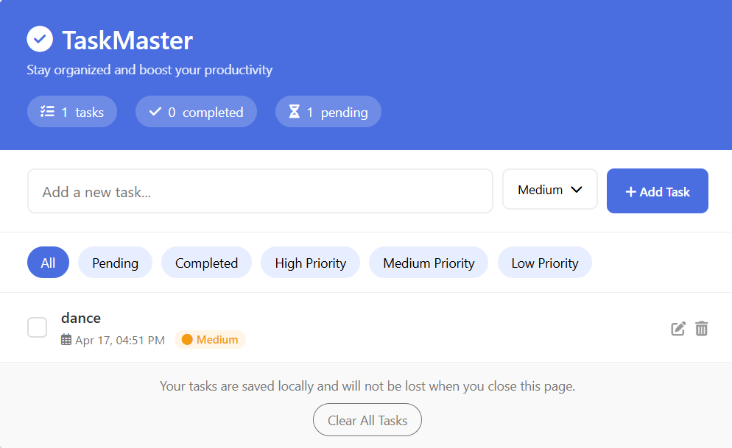
Project Highlights

Slide 9
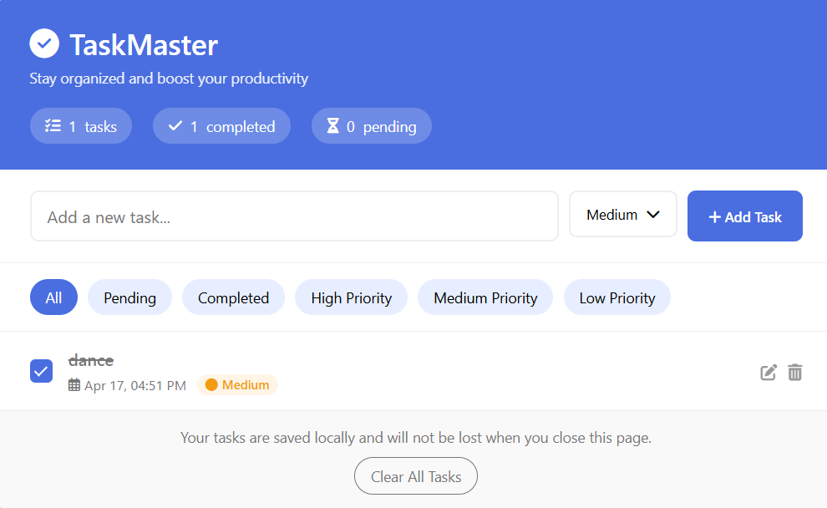
Project Highlights

Slide 10
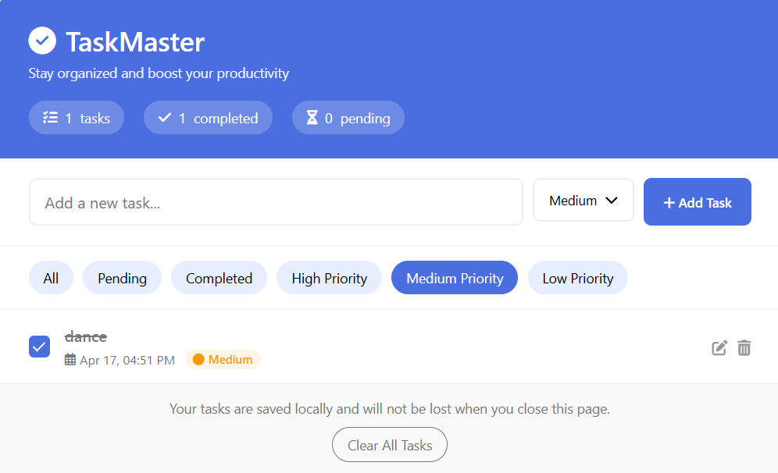
Project Highlights

Slide 11
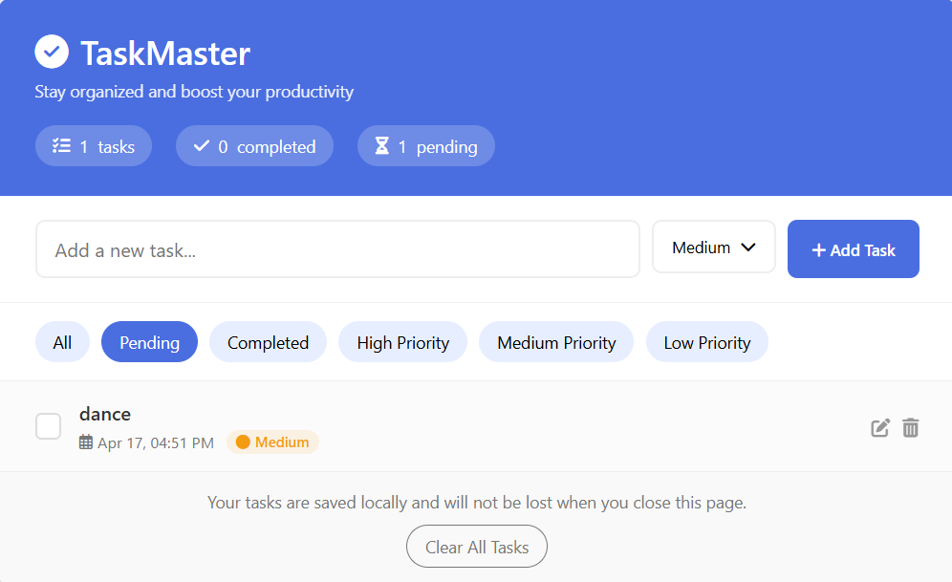
Project Highlights

Slide 12
Ui walkthrough
The app has a task input field, priority dropdown, and an 'Add Task' button.
Task stats are displayed (Total, Completed, Pending).
Filter buttons allow users to sort tasks by priority or status.
Modal to edit tasks.
Tasks are displayed dynamically.

Slide 13
How to Run
Download the files or clone the repository
- Open the `index.html` file in a browser
- The app runs locally in your browser, and tasks will persist across sessions using LocalStorage.

Slide 14
Conclusion
This To-Do List Manager is an easy-to-use, feature-rich app for managing your daily tasks. It provides essential features like task filtering, priority management, and task persistence, all in a clean interface.

Slide 15


