Slide 1
SOLINAS
Team ID : 40

Slide 2
Components
Mount
Spool
Shaft
Paddle

Slide 3
Design Principle
MOUNT DESIGN
SPOOL WORKING
SHAFT DESIGN
PADDLE DESIGN AND MECHANISM

Slide 4
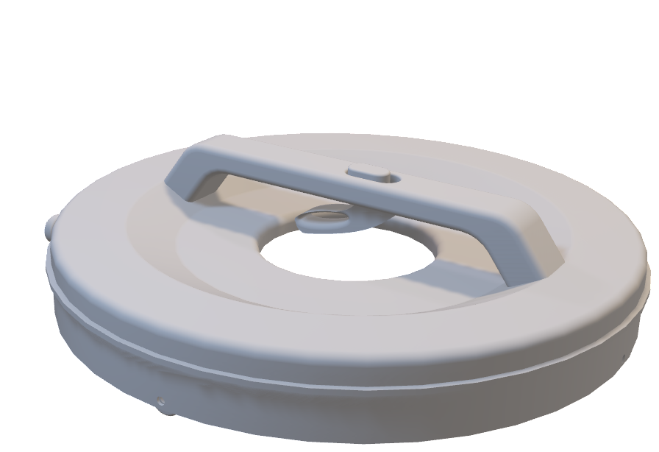
Mount
Mount : Main body of the product, providing stability and rigidity. - Cylindrical component with a handle - Thumb-operated power button. - Toggle button - Grip lever for the retraction and expansion
Can be handheld or placed on the container tank's rim.
Bottom has a peripheral groove containing wheels.
Extends the mount's ability to move on the tank's upper surface.
Center of the mount has a circular cutout housing the motor and spool.

Slide 5
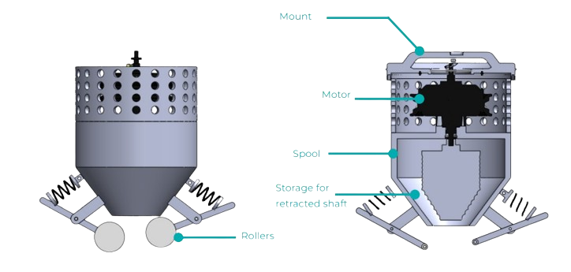
Spool Working
Acts as the home for the retracted shaft.
Responsible for retraction, storage, and expansion.
Conical frustum-like shape instead of a trivial cylindrical spool.
Two hulls - one inner and one outer, with grooves designed to fit the retracted shaft between both surfaces.
Bottom of the spool is the outlet for the shaft. -> Equipped with a waterproofing rubber ring.
Below the spool are two spring-attached feed rollers. -> Driven by two servo motors. -> Assist in the expansion and retraction of the shaft.

Slide 6
Shaft
Designed to be flexible, retractable, and rigid simultaneously.
Consists of a coaxial tube for solvent delivery
Solvent storage, facilitating the solvent delivery mechanism, is located at the mount body.
The coaxial tube is further wrapped with intertwined nylon fibers.
Provides strength and rigidity to the shaft.
Maintains flexibility and retractability of the shaft.

Slide 7
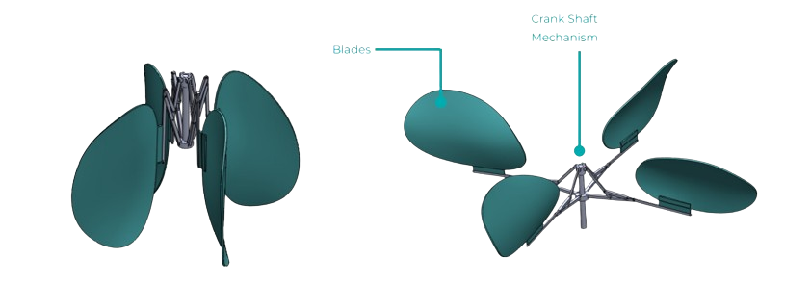
Paddle
Facilitates the mixing of the slurry
Consists of four blades connected to the main shaft via arms with a slider-crank mechanism.
Mimics the opening and closing of an umbrella.
This feature allows the user to control the span of paddle blades.
Blades can be folded, easing retraction in case of tank bottlenecks.
Enhances Portability.

Slide 8
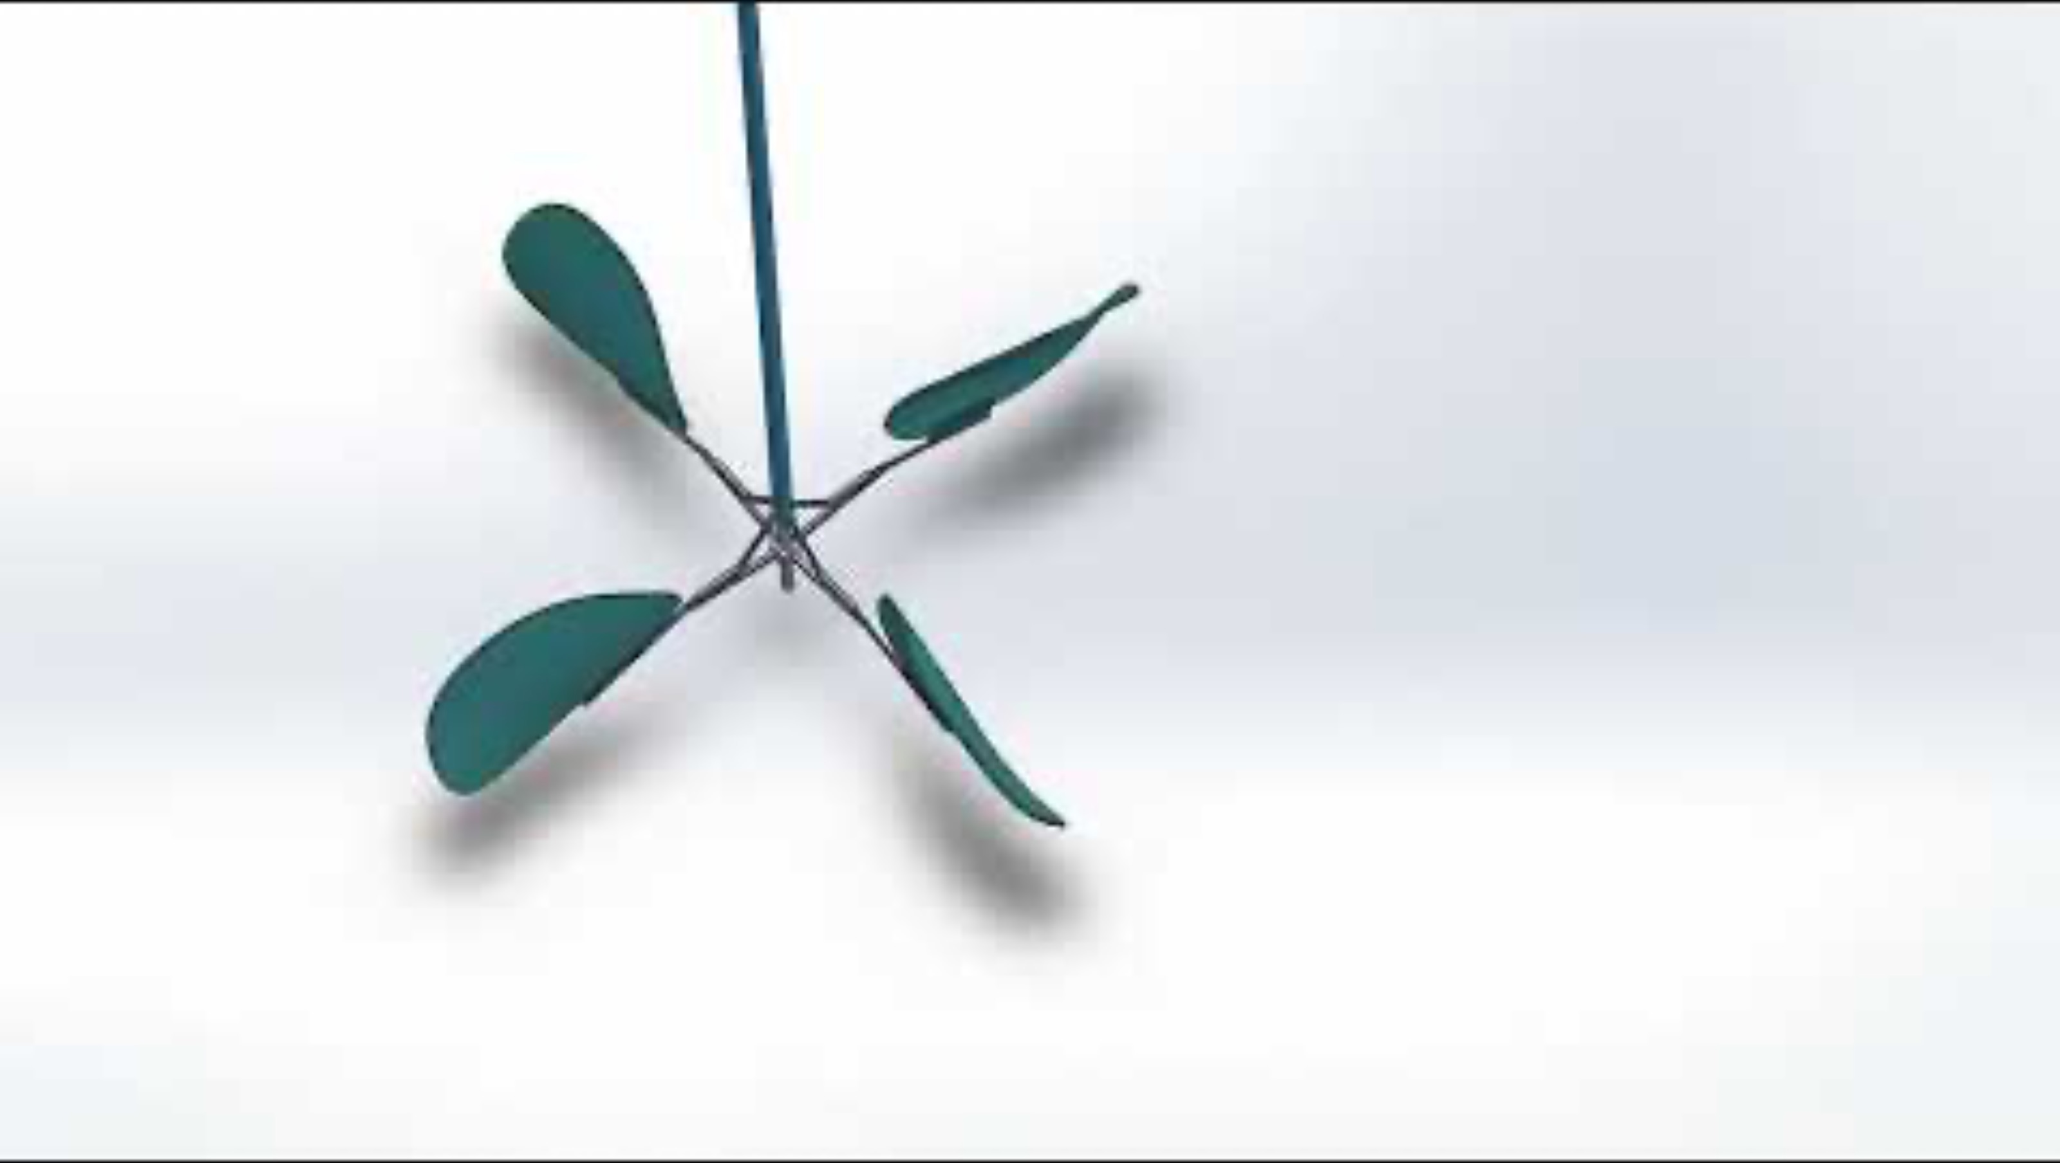
Paddle Mechanism
https://youtu.be/WeyvGlClmQo

Slide 9
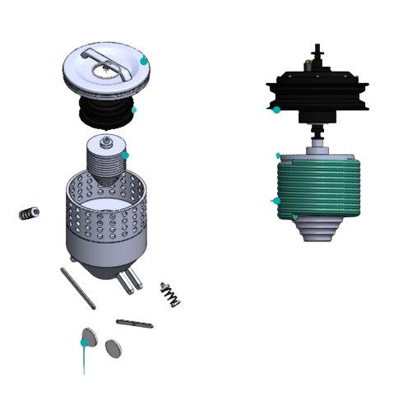
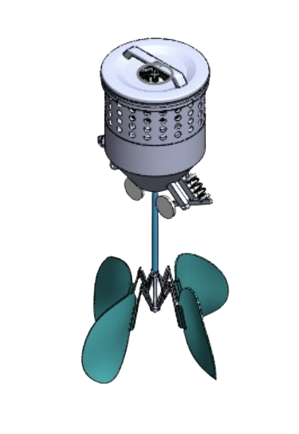
Assembly

Slide 10
Assembly details:
Mount: The main body, usable handheld or placed on the tank's rim.
The handle provides a power switch and control lever for operational tasks.
The cavity houses the motor and spool
Retraction and expansion are eased by rollers at the bottom of the spool.
Servo motors drive the feed rollers, enabling the protrusion and retraction of the shaft up and down the tank.
The bottom of the shaft bears a metallic extension with four blades, assisted by slider-crank arms.
The motor helps rotate the entire shaft and blades, facilitating the mixing.

Slide 11
Material Choise
 | PART | MATERIAL | REASON
1 | Mount Body | Aluminum 6061 | Provides high strength, durability & stability to entire structure. Aluminum is lightweight as well.
2 | Motor | QSMotor 205 - 500-4kW BLDC Motor 10 | This is chargeable and provides twice power efficiency.
3 | Spool & Slider Crank Mechanism | Stainless Steel (SS304) | Cost efficient.
4 | Paddle Blades | Stainless Steel (SS316) | Susceptible to wear and tear, highly ductile, anti corrosive, rigid and tough.

Slide 12
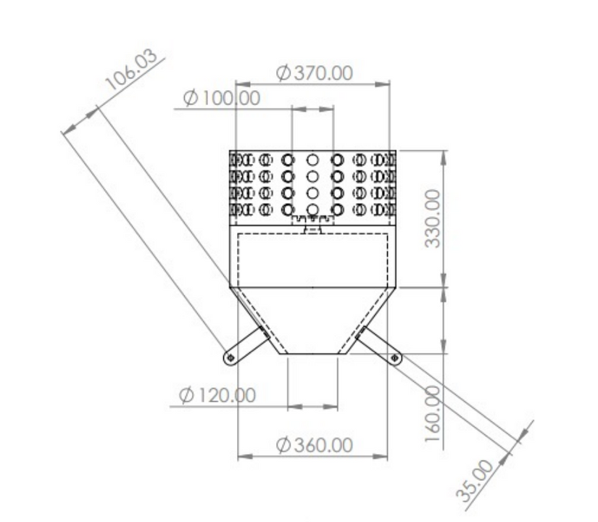
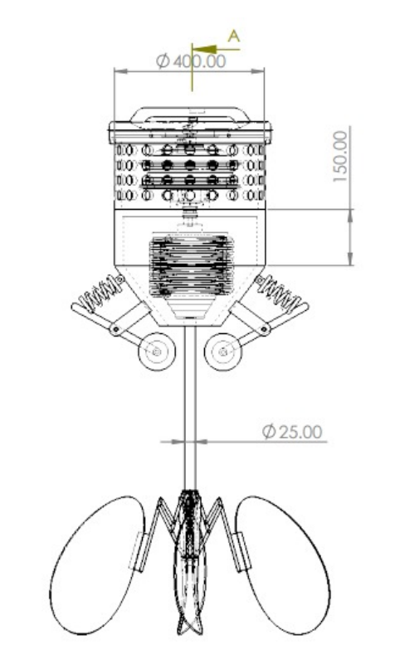
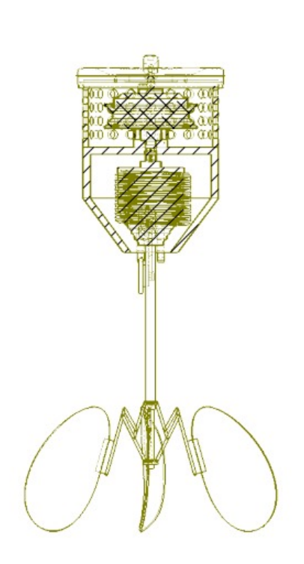
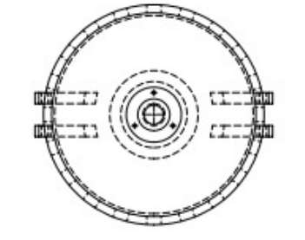
Dimensionality

Slide 13
Cost estimation
Aluminium 6061
QSMotor(BLDC) 10" rim dia
Shaft made up of Nylon 6,6
Paddle blades SS314
Spool mechanism SS304

Slide 14
Component | Material/Type | Quantity | Cost of material | volume | Weight | Total cost (Rupees)
Mount Body | Aluminum 6061 | 1 | 250 rupees/Kg | 0.00757 m^3 | 20.499kg | 6149.7
Motor | QSMotor 205 - 500-4kW | 1 | 30000 rupess/pic | N/A | N/A | 30000
Shaft (Nylon & Coaxial Tube) | Nylon66 | 1 | 150 rupees/Kg | 0.00157 | 1.7898kg | 268.47
Paddle Blades | Stainless Steel (SS316) | 4 | 260 rupees/kg | 0.001570796 | 12.566368 | 3267.25568
Spool & Slider Crank | Stainless Steel (SS304) | 1 | 150 rupees/Kg | 0.002400667 | 18.867 | 2830.05
Toggle Switch & Grip Lever | Thermoset Plastic | 1 | 150 rupees/kg | 0.000148608 m^3 | 0.141kg | 21.15
Spring | Various | 2 | 30/ pc | N/A | N/A | 60
Feed Rollers | Various | 2 | 550/pc | N/A | N/A | 110
Total price |  |  |  |  |  | 42706.6257

Slide 15
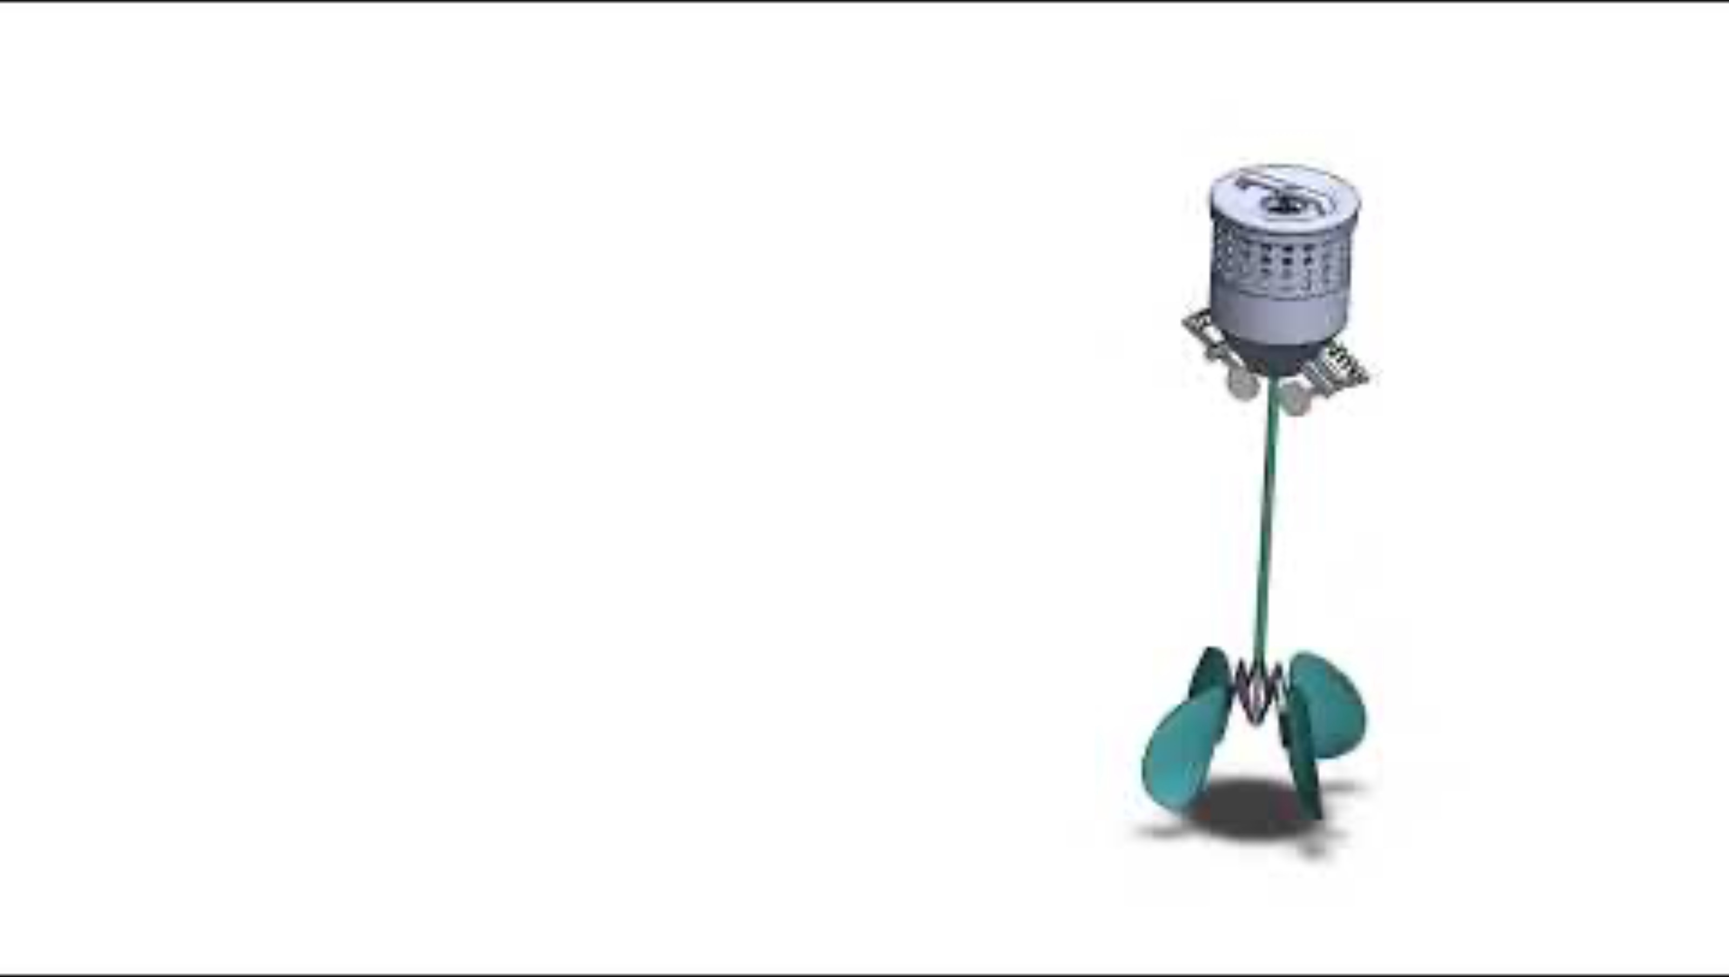
Product Animation
https://youtu.be/683onraQoYQ

Slide 16
THANK YOU

