Slide 1

FraudShield: Detecting Credit Card Fraud Using Machine Learning
DATA SCIENCE (21CSS303T)
Madhav K Mohan (RA2311026050003)
Manu Krishnan (RA2311026050065)

Slide 2
Introduction
With the rapid growth of digital payments and online financial systems, fraudulent activities have increased significantly. These frauds cause major financial losses and reduce trust in digital platforms. Traditional rule-based systems are not effective in identifying new and evolving fraud patterns. Therefore, there is a need for intelligent systems that can learn from data and detect anomalies automatically using machine learning techniques.

Slide 3
Problem Statement
Detecting fraudulent transactions is a challenging task due to the highly imbalanced nature of financial datasets. Fraud cases represent only a very small percentage of total transactions, making it difficult for models to identify them accurately. The objective is to develop a system that can analyze transaction data and accurately classify whether a transaction is fraudulent or legitimate.

Slide 4
Dataset Description
The dataset used in this project is obtained from Kaggle and contains approximately 1.29 million transaction records. It includes both numerical and categorical features such as transaction amount, merchant information, customer demographics, and geographic details. The target variable, is_fraud, indicates whether a transaction is fraudulent or not. The dataset is highly imbalanced, which makes preprocessing an essential step.

Slide 5
Methodology
The project follows a structured approach starting with data preprocessing, where unnecessary columns are removed and new features such as age and transaction time are created. Categorical variables are encoded into numerical form for model compatibility. To handle the imbalance in the dataset, the SMOTE technique is applied, which generates synthetic fraud samples. Finally, a machine learning model is trained on the processed data.

Slide 6
Model and Evaluation
The Random Forest algorithm is used for this project as it is an ensemble learning method that combines multiple decision trees to improve accuracy and reduce overfitting. The model is evaluated using precision, recall, and F1-score instead of accuracy, as the dataset is imbalanced. Recall is particularly important because it measures how many fraud cases are correctly detected.
20-04-2026

Slide 7
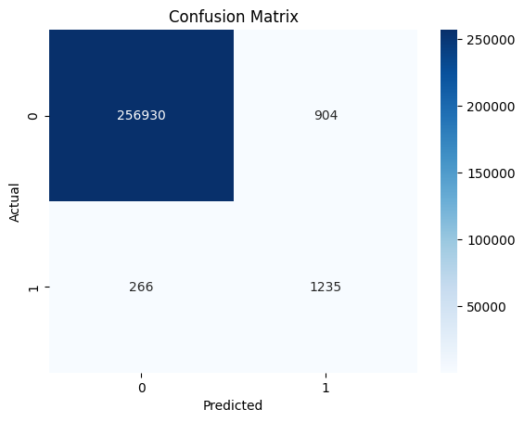
Results and Analysis
The model achieved a recall of approximately 82%, indicating that it successfully identified most fraudulent transactions. The confusion matrix shows that the number of missed fraud cases is relatively low, which is critical in fraud detection systems. Visualizations such as fraud distribution graphs and correlation heatmaps were used to better understand the dataset and model performance.

Slide 8
Conclusion and Future Scope
This project demonstrates the effectiveness of machine learning in detecting financial fraud. By combining data preprocessing, imbalance handling using SMOTE, and a Random Forest model, the system achieves strong performance. In the future, the model can be enhanced using deep learning techniques and deployed for real-time fraud detection systems to improve financial security. This project supports SDG Goal 16: Peace, Justice and Strong Institutions.

