Slide 1
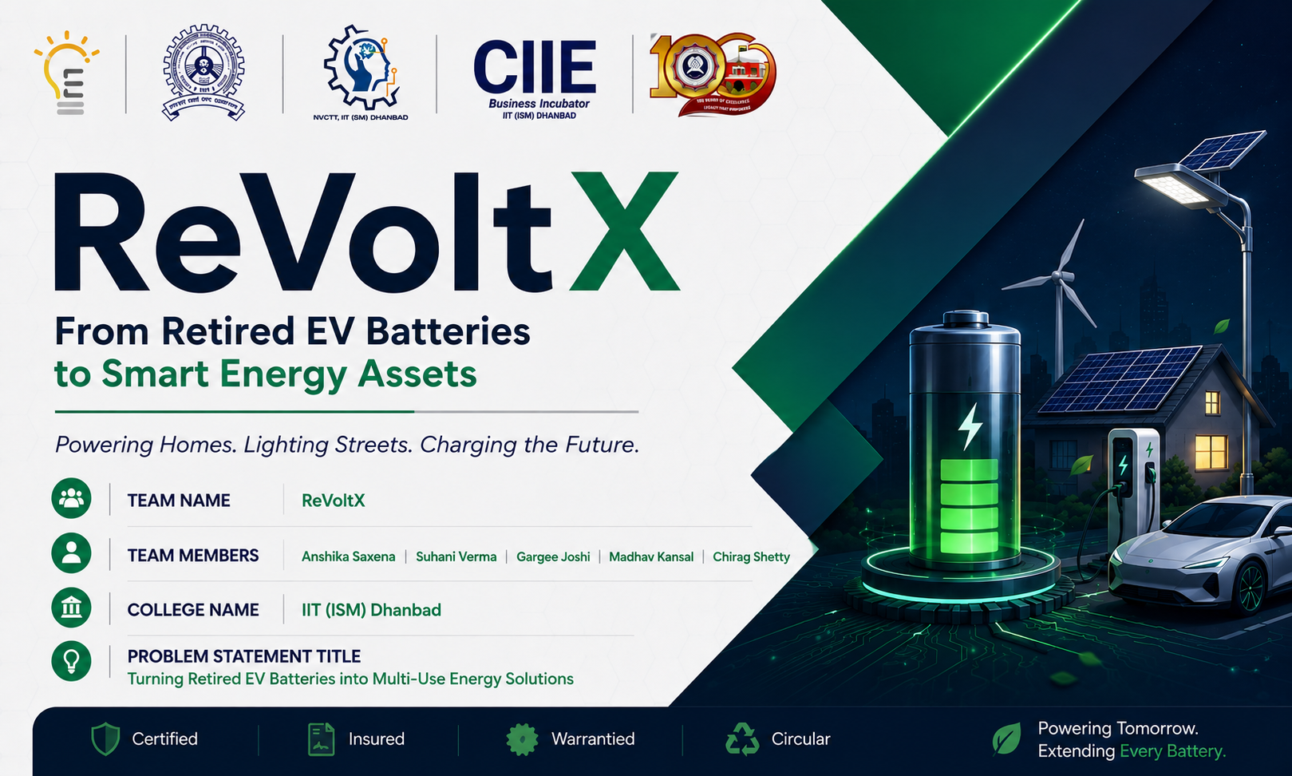

Slide 2







THE PROBLEM
India throws away energy, not just batteries.
EV packs retire with most of their value intact — and today, that value simply leaks away.
70–80%
₹3–4.4L
₹30–40K
Capacity still remaining
Original battery cost
What owners get today
at ~8 years, when packs are retired from vehicle use
typical EV pack price when new
flat, weight-based scrap payout — no health check
WHAT'S MISSING BETWEEN "RETIRED" AND "RECYCLED"
No health verification
No certification or passport
No warranty or insurance
Batteries are priced by age or weight, not measured condition.
No standard record of capacity, safety, or history follows the pack.
A repurposed battery that fails has nowhere to point the liability.
No trusted buyer network
No organized logistics
Value captured by informal channels
Telecom, solar and charging operators have no safe way to source "used" cells.
Collection is fragmented — batteries move ad hoc to whoever pays cash first.
Scrap dealers and dismantlers under-price residual capacity and under-deliver on safety.
Source: PS6 — EV Battery Second-Life Economics problem statement; ReVoltX market observation. ₹ figures are planning assumptions, not vendor quotations.
REVOLTX
02

Slide 3







STEP 1 — ACQUISITION
Every door to ReVoltX feels effortless.
MULTI-CHANNEL ENTRY
DOORSTEP CERTIFIED INSPECTION
Website
Mobile App
Physical & visual inspection
AI-assisted diagnostics
WhatsApp
Toll-Free Support
Complete BMS scan
Live Chat & Email
AI Chatbot
Thermal imaging analysis
Cell voltage balancing check
Cell health & consistency
WHY OWNERS SAY YES
Scheduled doorstep pickup slots — no waiting for a roving collector
Charging-cycle history
Battery diagnostic day + self-check guide before any commitment
Discount coupons on partner eco-brands & utility bills for every battery handed over
Insulation & safety inspection
Inspection checklist adapted from ReVoltX battery risk-assessment protocol (BMS interrogation + independent diagnostics).
REVOLTX
05

Slide 4
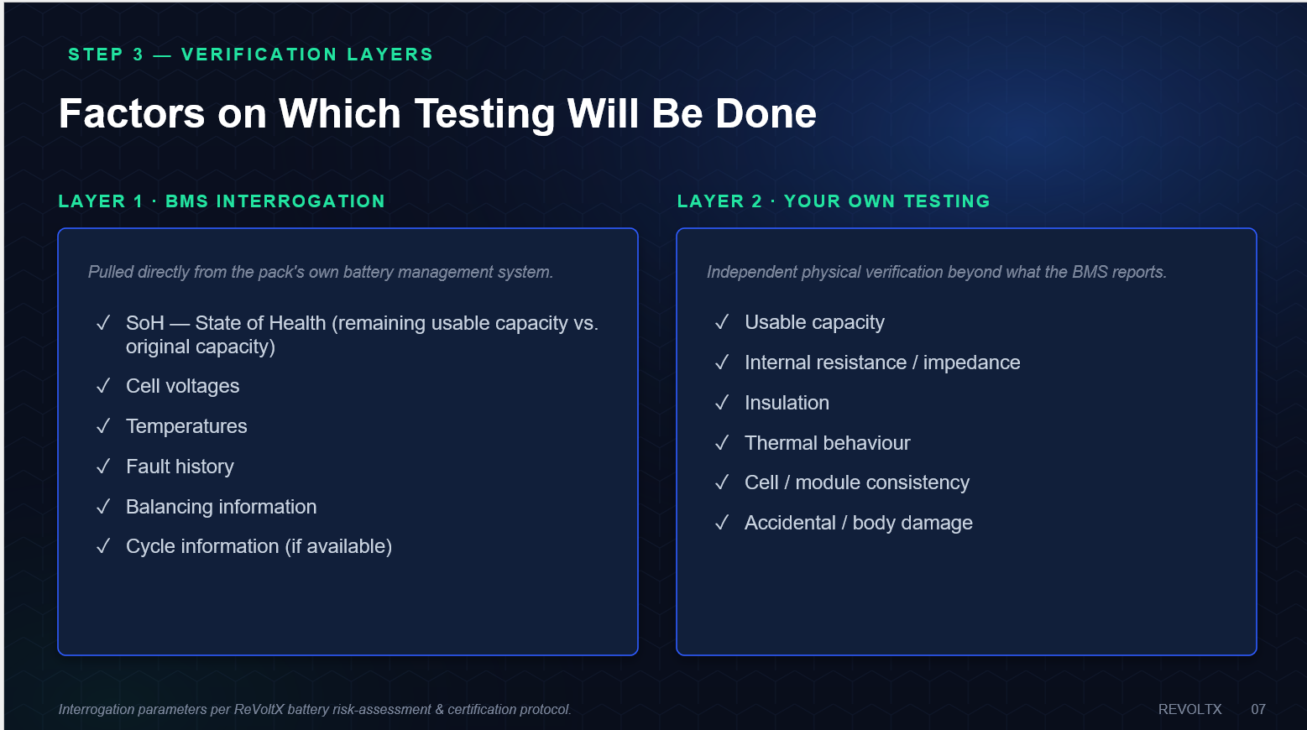
STEP 3 — VERIFICATION LAYERS
Factors on Which Testing Will Be Done
LAYER 1 · BMS INTERROGATION
LAYER 2 · YOUR OWN TESTING
Pulled directly from the pack's own battery management system.
Independent physical verification beyond what the BMS reports.
SoH — State of Health (remaining usable capacity vs. original capacity)
Cell voltages
Temperatures
Fault history
Balancing information
Cycle information (if available)
Usable capacity
Internal resistance / impedance
Insulation
Thermal behaviour
Cell / module consistency
Accidental / body damage
Interrogation parameters per ReVoltX battery risk-assessment & certification protocol.
REVOLTX
07

Slide 5

STEP 2 — TRUST LAYER
Two-layer grading turns "used" into "verified."
LAYER 1 · BATTERY GRADE (by measured SoH)
REVOLTX DIGITAL BATTERY PASSPORT
Grade | SoH Range | Best-Fit Second Life
A | > 80% | Second EV life / high-power BESS
B+ | 70–80% | Telecom tower backup
B | 60–70% | EV charging buffer / solar storage
C | 30–60% | Street, traffic & emergency lighting
D | < 30% / unsafe | No deployment — certified recycling only
BATTERY ID · RVX-2026-00184
Pack identity & chemistry
Original application & age
Charge-cycle history
Measured capacity & thermal behavior
LAYER 2 · PERFORMANCE INDEX
Module-level test results
Performance Index = State of Health × Maximum Output Power
Refurbishment date & operating limits
A single, sortable score the AI marketplace uses to auto-match every pack to its ideal buyer — not just its grade letter.
Warranty terms
Final disposition
Grade bands adapted from ReVoltX battery risk-assessment & certification protocol; passport fields per PS6 concept report.
REVOLTX
06

Slide 6



STEP 4 — REVERSE LOGISTICS
Aggregation, not a one-off courier run.
HOW BATTERIES REACH US
COMPLIANT, TRACKED TRANSIT
Dealer & service-centre referrals
GPS-tracked movement
Contact shared at the point of EV purchase / service
Tamper-proof, shock-proof packaging
In-transit battery insurance
Mobile collection vans
Certified hazmat-compliant carriers
Scheduled regional routes to reach owners directly
Digital chain-of-custody per pack
Kabadiwala network partnerships
Formalizing informal collectors already in the field
CONCEPTUAL LOGISTICS ECONOMICS
₹5,000–₹10,000
Photo + details upload
Owners self-register a battery on web or app before pickup
per 200 km move of a ~400 kg safe, retired-battery load — a pilot planning estimate, not a carrier quote
Lever: consolidating multiple batteries per route drives the effective cost per battery down.
Collection channels per ReVoltX aggregation strategy; transit cost per PS6 concept report §9 (pilot estimate).
REVOLTX
08

Slide 7




STEP 6 — AI SMART MARKETPLACE
One AI engine. Three energy-hungry buyers.
Solar Energy Storage
Telecom Towers
EV Charging Stations
Homes, campuses, factories & rural microgrids that need to bank daytime solar for the night.
~0.78M sites nationwide still leaning on diesel for backup power.
Fast chargers that spike grid demand and need a buffer to avoid costly upgrades.
MARKET 1
MARKET 2
MARKET 3
+ a 4th, lower-grade lane: street, traffic & emergency lighting for Grade-C packs (30–60% SoH).
REVOLTX
10

Slide 8
MARKET 1 — SOLAR ENERGY STORAGE
Every home has a battery-sized energy problem.
RESIDENTIAL LOAD MATCHING
41.65 GW
Home Type | Daily Need | Best-Fit Source
Small apartment | 5–10 kWh | 1–2 hybrid packs / single Leaf module
Medium home | 15–30 kWh | 1 compact BEV pack (~40 kWh)
Large home / villa | 30–50+ kWh | 1 long-range pack or parallel packs
India BESS requirement by FY30
Central Electricity Authority, Optimal Generation Mix 2030
WHERE THIS FITS
CHEMISTRY MATTERS
Residential rooftop solar
Commercial & industrial (C&I) sites
LFP (LiFePO₄)
NMC / NCA
Extremely safe, long cycle life, thermal-stable → preferred for indoor home storage
High energy density, compact → outdoor, well-ventilated cabinet installs with strict BMS control
Factories & schools
Rural microgrids & electrification
Home segment sizing per ReVoltX residential storage model; BESS target: CEA "Optimal Generation Mix 2030" / MNRE roadmap (41.65 GW BESS of 60.63 GW total storage by FY30).
REVOLTX
11

Slide 9



MARKET 2 — TELECOM TOWERS
India's diesel-powered towers are a captive market.
~0.78M
WHY GRADE B+/B PACKS ARE THE RIGHT FIT
Backup, not daily-cycling duty
Towers need standby energy for outage windows, not EV-grade power bursts — ideal for 70–80% SoH packs.
Telecom towers in India
DoT / Indiastat, telecom infrastructure data
Lower OPEX than diesel
Displaces recurring fuel + generator maintenance cost with a one-time storage asset.
WHY THIS IS URGENT NOW
Airtel and Indus Towers publicly reported (Q4 FY26) that they are intensifying efforts to cut diesel dependence by transitioning to high-powered batteries and alternate energy sources across their tower fleet.
Sustainability reporting
Diesel-to-battery conversion is a visible ESG win telcos already say they want.
Predictable, monitored load
Rising diesel prices and 4–6 hour daily grid outages in several states are only accelerating the shift.
Stationary, temperature-controlled cabinets — the safest second-life environment for a retired pack.
Tower count: DoT Telecom Statistics / Indiastat (~0.78M towers, FY24). Diesel-reduction context: Airtel–Indus Towers Q4 FY26 disclosures (Voice&Data, TelecomTalk).
REVOLTX
12

Slide 10



MARKET 3 — EV CHARGING STATIONS
Fast chargers need a buffer — retired packs are one.
WHY CHARGING STATIONS NEED STORAGE
52,718
Reduce grid load
A fast charger can spike demand instantly; buffer storage absorbs part of that peak.
Public EV charging stations in India (2026)
incl. 16,561 DC fast chargers
Avoid costly grid upgrades
Skips a higher-capacity transformer & connection at sites with limited grid capacity.
₹2,000 Cr
Bank solar for peak hours
PM E-DRIVE outlay
Store daytime solar generation, discharge it as vehicles arrive to charge.
72,300 new public chargers targeted by March 2028
Every new fast-charging site is a candidate for a graded, second-life buffer battery.
Faster site rollout
Storage supplements a weak grid connection — sites go live sooner.
Charging infrastructure: Government of India public charging data (2026); PM E-DRIVE scheme outlay for public charger expansion by March 2028.
REVOLTX
13

Slide 11

PROOF OF CONCEPT
The numbers behind the 4th lane: solar street lighting.
ONE PACK, WORKED THROUGH
1
20 kWh pack retires at 70% SoH → 14 kWh remaining
2
20% reserve held back for battery health → 11.2 kWh usable
Lighting-as-a-Service
3
40 W LED × 12 h/night ≈ 0.6 kWh/light/night (with system losses)
We don’t sell a used battery. We sell a guaranteed, monitored, warrantied night of light — and Grade-C packs (30–60% SoH) that don’t fit any other market finally have a home.
4
11.2 kWh ÷ 0.6 kWh ≈ 18 street lights, powered for one night
1,000-LIGHT PILOT
600 kWh
~50 packs
₹60L/yr
Also extends to traffic signals & emergency lighting — every remaining watt-hour finds a job before recycling.
nightly energy for 1,000 lights
20-kWh equivalents needed
illustrative revenue @ ₹500/light/mo
Worked example & pilot figures: PS6 concept report §5–7 — deliberately simple hackathon planning assumptions, not vendor quotations.
REVOLTX
14

Slide 12





REVENUE MODEL
Eight ways this platform earns — not just one sale.
Battery procurement margin
Refurbishment service fees
ILLUSTRATIVE ANCHOR CASE
Buy at a SoH-indexed price, resell certified at a premium
For OEMs & fleets that want their own packs refurbished
1,000 street lights
on a Lighting-as-a-Service contract
Marketplace commission
Standalone certification fee
A match fee between graded supply and enterprise buyers
Health-check & grading as a service, no sale required
₹500
per light, per month
Warranty & insurance plans
Enterprise battery sales
= ₹5,00,000/mo
Recurring protection revenue on every deployed unit
Bulk B2B sales to telecom, solar EPC & charging operators
= ₹60,00,000/yr
Conceptual pricing assumption — to be validated against municipal procurement rates and CAPEX.
Logistics-as-a-service
Recycling & EPR credit revenue
Reverse-logistics fee for OEM & fleet partners
Material recovery plus EPR-compliance certificates
Illustrative revenue scenario per PS6 concept report §10 (Lighting-as-a-Service) — a conceptual planning input, not a signed contract.
REVOLTX
16

Slide 13
COMPETITIVE POSITIONING
We don’t compete with the kabadiwala. We replace the gap he leaves.
Dimension | Scrap Dealer / Kabadiwala | ReVoltX
Pricing basis | Flat, by weight | SoH-indexed — up to 2–3× higher
Health testing | None | AI + BMS + thermal diagnostics
Certification | None | Digital Battery Passport + QR
Warranty | None | Grade-matched warranty
Insurance | None | In-transit + performance-backed
Traceability | Untracked | Full digital chain-of-custody
Buyer network | Informal, unverified | Telecom, solar & charging enterprises
Safety handling | Unregulated | Certified hazmat-compliant logistics
End-of-life path | Often improper disposal | EPR-compliant certified recycling
2–3×
9 of 9
0
higher payout than scrap
trust dimensions covered
used batteries sold blind
Comparison structure per PS6 concept report §13 — competitive positioning.
REVOLTX
17

Slide 14

LIABILITY & RISK MANAGEMENT
“Known Risks, Engineered Mitigations."
Risk | ReVoltX Mitigation
Battery failure after deployment | Certification, module-level testing, warranty reserve, remote monitoring
Thermal event | Unsafe packs rejected at intake; proper BMS/protection/thermal design; trained handling
Unknown battery history | Digital passport + full diagnostics + conservative operating limits
Low buyer trust in "used" batteries | Sell a certified, insured, warrantied asset or service — never a bare battery
Collection cost volatility | Route aggregation and regional hubs to consolidate loads
Inconsistent battery supply | Multi-OEM and multi-fleet sourcing, not one partner
End-of-life uncertainty | Predefined recycling pathway with chain-of-custody records
THE PRINCIPLE BEHIND EVERY MITIGATION
Insure and warranty the outcome — not the raw cell
Trace every pack, every hop, from vehicle to redeployment
Never let an unsafe pack reach a customer — reject it at intake
Risk framework per PS6 concept report §12 — liability & risk management.
REVOLTX
19

Slide 15
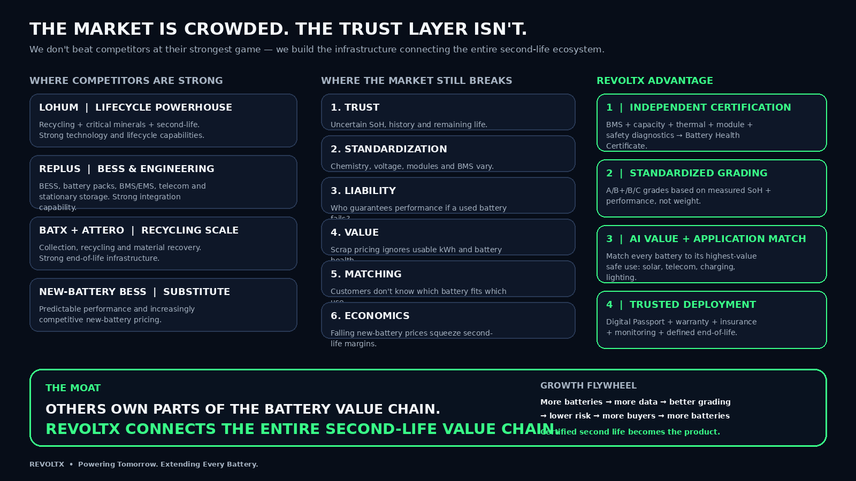

Slide 16

ENVIRONMENTAL IMPACT
Recycling later beats recycling first — for the planet too.
Defers virgin mining
INDIA'S EPR MANDATE
Every extended pack life reduces near-term demand for freshly mined lithium, cobalt and nickel.
90%
Lower embodied carbon
recovery of EV & portable batteries required by FY26–27
Reuse avoids the manufacturing carbon cost of a brand-new pack for the same job.
70%
Displaces diesel
Every telecom site moved off diesel backup cuts local emissions directly.
collection of EV batteries placed in the market required by FY27–28
A real circular economy
ReVoltX turns this compliance obligation into a supply pipeline for OEMs.
Materials stay in productive use longer — recycling becomes the last step, not the first.
India's Battery Waste Management Rules, 2022 (EPR targets) — PIB / IEA policy database.
REVOLTX
20

Slide 17




SCALE STRATEGY
From pilot to India’s largest second-life marketplace.
2026
2027
2028
2030
Pilot Launch
10,000 Batteries
Pan-India Expansion
Market Leadership
Validate grading, logistics & buyer willingness to pay
Regional aggregation hubs, standardized second-life products
Multi-city hubs near dense EV, fleet & service clusters
India's largest second-life EV battery marketplace
REVOLTX
21

Slide 18

Our Website : https://revoltx.vercel.app/
Our Instagram ID: https://www.instagram.com/revoltx.iitians?igsh=ZHA0eHoxN2FlOHly
GitHub: https://github.com/madhavknsl/ReVoltX
ReVoltX
Powering Tomorrow. Extending Every Battery.
Every retired battery has a second life. We make sure India is the one who captures it.
THANK YOU ·

