Slide 1
SANJEEVANI AI MEDCARE
Bridging India's Healthcare Divide
Multilingual Regional Voice AI, Clinical Safety Triage & E-Pharmacy Logistics
22 Indian Languages + EN
Clinical Safety Screening
Emergency Doctor Referral
Live Courier Fleet Dispatch
Comprehensive Technical & Operational Architecture Presentation
Developed for Pan-India Accessibility & Real-World Clinical Impact

Slide 2
PROBLEM STATEMENT: HEALTHCARE IN INDIA
The Accessibility, Language & Prescription Crisis
Severe Doctor Shortage
Linguistic Exclusion
Medication Illiteracy
0.7 : 1,000
22 Official Languages
68% Misuse Rate
Doctor-to-patient ratio in rural India is critically below WHO norms (1:1,000). Patients travel 20-50 km just for basic OTC consultation and initial advice.
90%+ of healthcare apps operate in English or Hindi only. Over 600 million Indians speaking Telugu, Tamil, Bengali, Marathi, etc. are digitally disenfranchised.
Patients cannot read complex English prescription labels. Severe confusion over before/after food timing, tablet sequences, and dangerous self-medication.
Sanjeevani AI — Multilingual Voice Healthcare & Pharmacy Logistics
2 / 12

Slide 3
PROBLEM STATEMENT: CRITICAL CARE GAPS
The "Dr. Google" Hazard & Logistics Disconnect
01
The Dangerous "Dr. Google" Self-Diagnosis Trap
Patients search mild symptoms online and misinterpret red-flag emergencies (e.g. Myocardial Infarction misdiagnosed as acidity). Delaying hospital arrival past the "Golden Hour" results in preventable mortality.
02
Contraindication Ignorance (NSAID Triggers)
Standard web searches suggest Combiflam or Ibuprofen for fever/headache without checking if the patient has Asthma or Gastric Ulcers, triggering life-threatening bronchospasms or stomach bleeding.
03
Broken Last-Mile E-Pharmacy Logistics
E-pharmacy in Tier 2/3 towns lacks real-time courier visibility, assigned rider contacts, transparent multi-item packaging status, or delivery notifications over SMS/WhatsApp.
04
Complete Post-Consultation Blind Spot
Healthcare platforms disappear after consultation. Zero automated check-ins occur at 48–72 hours to verify if the illness resolved or has worsened into severe pneumonia, dengue, or sepsis.
Sanjeevani AI — Multilingual Voice Healthcare & Pharmacy Logistics
3 / 12

Slide 4
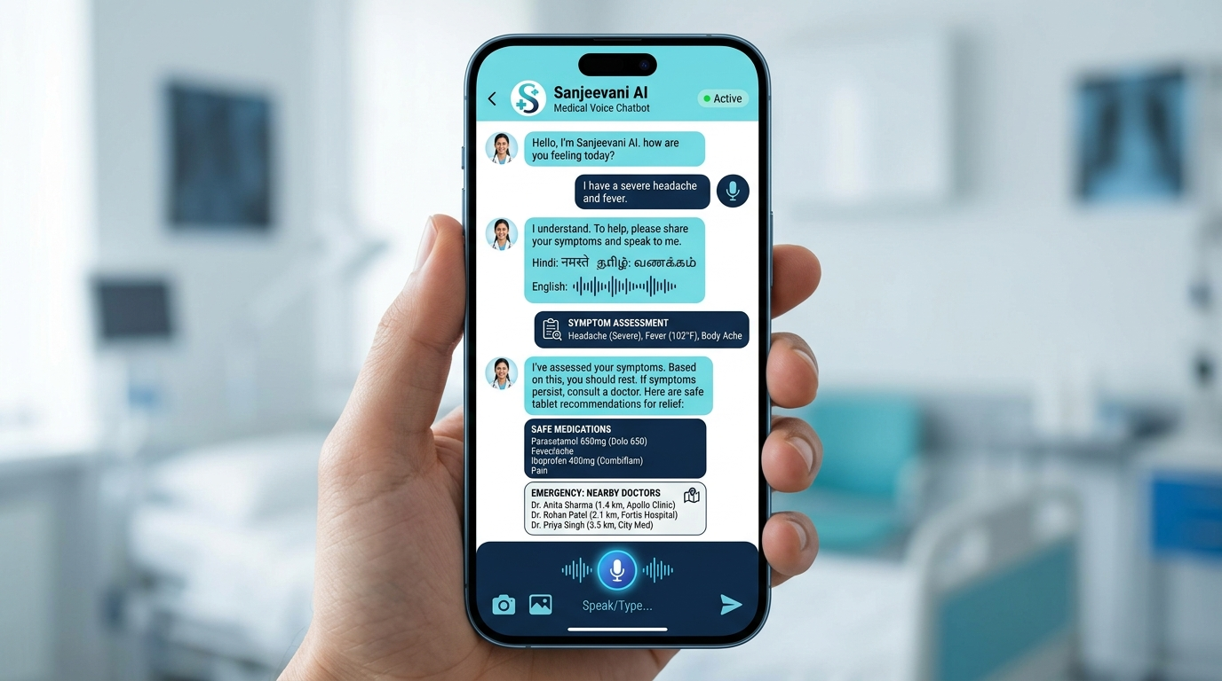
THE SOLUTION: COMPREHENSIVE ARCHITECTURE
Sanjeevani AI: End-to-End Healthcare & Logistics
1. Regional Voice AI (22 Languages + EN)
Web Speech STT & TTS allowing spoken interaction in native Indian dialects.
2. Clinical Safety Engine (Triage)
Multi-turn inquiries screening age, medications, and asthma/ulcers before dispensing.
3. Geodesic Doctor Referral
Haversine formula mapping GPS coordinates to nearest emergency specialists.
4. E-Pharmacy & Fleet Logistics CRM
Multi-item carts, 5-stage live courier tracking, verified rider assignment, and follow-ups.
Sanjeevani AI — Multilingual Voice Healthcare & Pharmacy Logistics
4 / 12

Slide 5
SOLUTION DEEP-DIVE: PATIENT SAFETY
Multi-Turn Clinical Screening & Contraindication Guard
Never blindly dispense pills: Sanjeevani pauses and interrogates clinical risk factors first.
Step 1: Clinical Risk Inquiry
Step 2: Contraindication Filtering
When symptoms are reported, bot asks: "What is patient age?", "Any daily medications?", "History of Asthma, High BP, Ulcers, or Allergies?"
If Asthma or Stomach Ulcers are indicated, NSAIDs (Combiflam/Ibuprofen) are strictly blocked to prevent bronchospasms. Paracetamol (Dolo 650) is safely retained.
✓ Interactive Quick-Reply Chips (Adult, High BP, Asthma, Senior Citizen)
✓ Prevents Iatrogenic Complications & Drug Clashes
Step 3: Age-Specific Dosage Gates
Step 4: Conversational Memory
Pediatric (<12 yrs): Adult solid tablets suppressed; warns against choking and advises pediatric syrup. Geriatric (≥65 yrs): Avoid daytime sedating antihistamines.
Multi-turn session memory preserves reported symptoms across subsequent turns so the patient never has to repeat themselves.
✓ Pediatric & Geriatric Safe Prescription Protocol
✓ Human-like Clinical Empathy & Conversation Continuity
Sanjeevani AI — Multilingual Voice Healthcare & Pharmacy Logistics
5 / 12

Slide 6
SOLUTION DEEP-DIVE: MEDICATION GUIDANCE
Chronological Multi-Tablet Scheduling & Meal Relations
STEP 1
STEP 2
STEP 3
STEP 4
Pantoprazole / Omeprazole
Paracetamol 650mg (Dolo 650)
Cetirizine 10mg (Zyrtec)
ORS Hydration Solution
Proton Pump Inhibitor (Antacid)
Analgesic & Antipyretic
2nd Gen Antihistamine
Electrolyte Salts & Glucose
⏰ 30 Mins Before Breakfast
⏰ Strictly After Meals
⏰ Before Bedtime at Night
⏰ Continuous Sips Throughout Day
Coats stomach lining and reduces acid secretion before taking analgesics or antibiotics.
Provides safe pain and fever reduction without causing gastric erosion when taken post-food.
Relieves allergic rhinitis, runny nose, and sneezing. Nighttime dosing prevents daytime sleepiness.
Dissolve 1 sachet in 1 liter clean drinking water to prevent dehydration and electrolyte loss.
Sanjeevani AI — Multilingual Voice Healthcare & Pharmacy Logistics
6 / 12

Slide 7
SOLUTION DEEP-DIVE: VERNACULAR INCLUSIVITY
22 Eighth-Schedule Indian Languages Voice Engine
Enabling illiterate and regional language speakers to simply speak and listen to health advice.
Language | Script | Locale Code | Language | Script | Locale Code
Hindi (हिन्दी) | Devanagari | hi-IN | Assamese (অসমীয়া) | Bengali-Assamese | as-IN
Bengali (বাংলা) | Bengali | bn-IN | Maithili (मैथिली) | Devanagari | mai-IN
Telugu (తెలుగు) | Telugu | te-IN | Santali (ᱥᱟᱱᱛᱟᱲᱤ) | Ol Chiki | sat-IN
Marathi (मराठी) | Devanagari | mr-IN | Kashmiri (کٲشُر) | Perso-Arabic | ks-IN
Tamil (தமிழ்) | Tamil | ta-IN | Nepali (नेपाली) | Devanagari | ne-IN
Urdu (اردو) | Perso-Arabic | ur-IN | Konkani (कोंकणी) | Devanagari | kok-IN
Gujarati (ગુજરાતી) | Gujarati | gu-IN | Sindhi (سنڌي) | Perso-Arabic | sd-IN
Kannada (ಕನ್ನಡ) | Kannada | kn-IN | Dogri (डोगरी) | Devanagari | doi-IN
Odia (ଓଡ଼ିଆ) | Odia | or-IN | Manipuri (মৈতৈলোন্) | Meitei | mni-IN
Malayalam (മലയാളം) | Malayalam | ml-IN | Bodo (बर') | Devanagari | brx-IN
Punjabi (ਪੰਜਾਬੀ) | Gurmukhi | pa-IN | Sanskrit (संस्कृतम्) | Devanagari | sa-IN
Sanjeevani AI — Multilingual Voice Healthcare & Pharmacy Logistics
7 / 12

Slide 8
SOLUTION DEEP-DIVE: EMERGENCY CARE
Deterministic Red-Flag Detection & Geodesic Doctor Routing
CRITICAL EMERGENCY DETECTION
GEODESIC HAVERSINE DISTANCE ENGINE
Sanjeevani immediately detects life-threatening emergency symptoms:
• Crushing chest pain radiating to left arm or jaw
• Acute shortness of breath / severe dyspnea
• Sudden weakness, facial drooping, or slurred speech (Stroke)
• Severe uncontrollable bleeding or head trauma
• Loss of consciousness, delirium, or severe allergic anaphylaxis
• HTML5 GPS Geolocation captures exact patient Lat/Lng coordinates.
• Great-Circle Haversine Formula calculates straight-line distance in kilometers:
d = 2R × arcsin(√(sin²(Δφ/2) + cos φ1 cos φ2 sin²(Δλ/2)))
• Ranks nearby verified emergency doctors, cardiologists & hospitals.
• Provides instant 1-click telephone dialer buttons (`tel:+91...`).
• Automatic fallback to city central coordinates if GPS permission is denied.
🚨 SAFETY ACTION: OTC tablet recommendations are 100% suppressed. Emergency protocol triggers nearest hospital referral.
Sanjeevani AI — Multilingual Voice Healthcare & Pharmacy Logistics
8 / 12

Slide 9
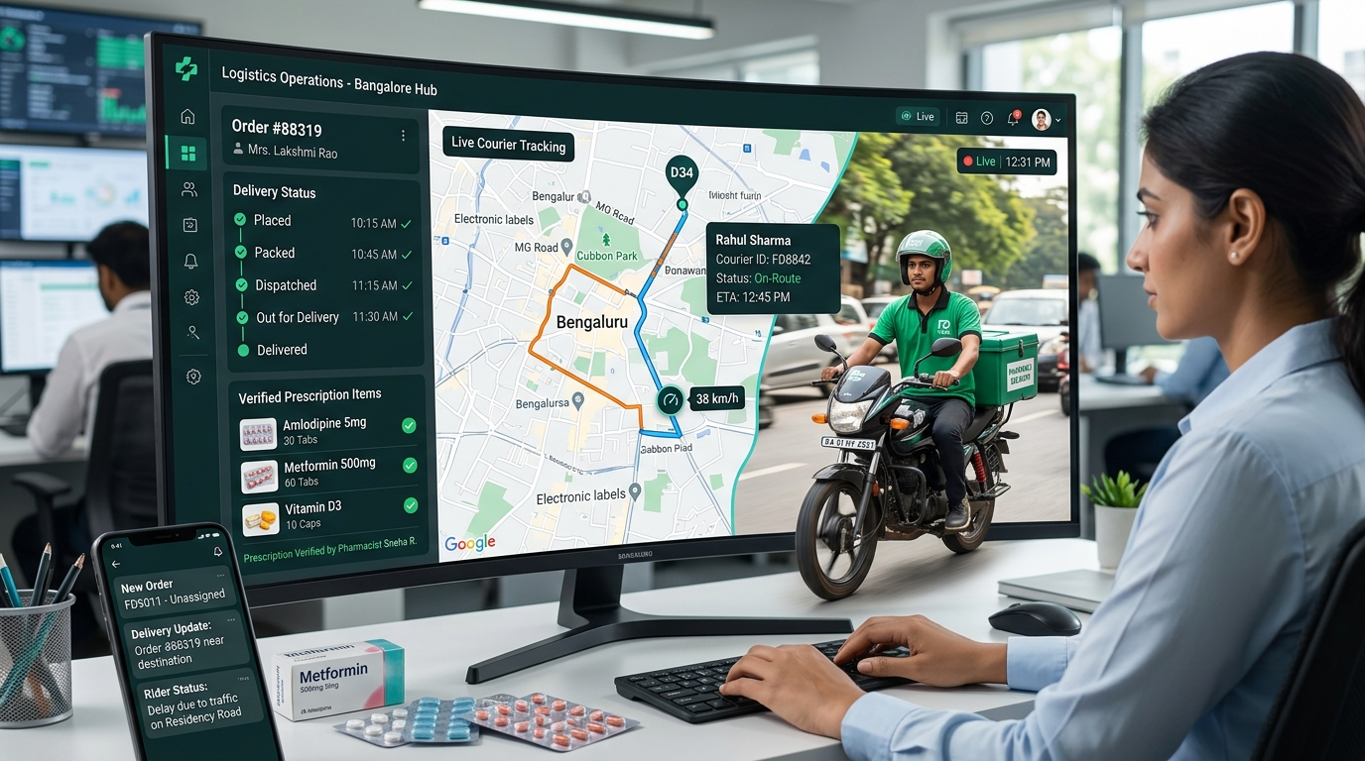
SOLUTION DEEP-DIVE: E-PHARMACY LOGISTICS
Multi-Item Deliveries & Courier Fleet Management
Multi-Item Prescription Basket
Itemized quantities, dosage tags, meal instructions, and dynamic subtotal + delivery fee calculation.
Live 5-Stage Courier Tracking
Visual timeline: Placed → Packed → Dispatched → Out for Delivery → Delivered, with timestamped notes.
Verified Rider Fleet Management
Admin CRM pre-loaded with verified riders (Hero Splendor, Ather EV, Bajaj Pulsar) + custom courier dispatch.
Multi-Channel Alert Dispatch
Automated SMS, WhatsApp, and Email tracking notifications with instant on-demand resend options.
Sanjeevani AI — Multilingual Voice Healthcare & Pharmacy Logistics
9 / 12

Slide 10
SOLUTION DEEP-DIVE: POST-CARE CONTINUITY
Automated 48–72 Hour Recovery Tracking & Follow-ups
DAY 0: INGESTION
DAY 2-3: CHECK-IN
IF RECOVERED
IF UNRESOLVED
Episode Registration
Automated Bot Message
Discharge & Archive
Emergency Escalation
Symptom inquiry creates an active disease tracking record with target follow-up timestamp set to +48 to +72 hours.
Bot proactively reaches out via SMS/WhatsApp or Portal: "Namaste! Checking on your fever and headache from 2 days ago. How are you feeling today?"
Patient replies "Feeling better" -> Status updated to RECOVERED in Admin CRM. Preventive wellness advice provided.
Patient replies "Still having high fever" -> Bot immediately escalates to DOCTOR_ESCALATED and maps nearest emergency physician.
Sanjeevani AI — Multilingual Voice Healthcare & Pharmacy Logistics
10 / 12

Slide 11
TECHNICAL IMPLEMENTATION & DEVOPS
Full-Stack JavaScript Architecture & Render Cloud CI/CD
Architecture Layer | Core Technology | Key Architectural Role
Runtime & Backend | Node.js LTS + Express.js 4.x | High-throughput async event loop, RESTful APIs, and SPA wildcard router.
Frontend Client | HTML5, CSS3, Vanilla ES6+ JS | Zero-framework build overhead, sub-second load times, responsive UI.
Speech STT & TTS | Web Speech API (Recognition/Synthesis) | Real-time multilingual voice input & audio response across 22 languages.
Geospatial Engine | HTML5 Geolocation + Haversine | GPS latitude/longitude extraction & great-circle distance computation.
Persistence Store | Atomic JSON Document Store | Embedded transaction-safe data/db-store.json with file-locking guards.
Admin CRM Security | Token Middleware & Env Salt | Protected routes via x-admin-token and private ADMIN_PASS variables.
Cloud Deployment | Render.com PaaS + GitHub CI/CD | Automated webhook deployments on git push to main, SSL/TLS, and health checks.
Sanjeevani AI — Multilingual Voice Healthcare & Pharmacy Logistics
11 / 12

Slide 12
STRATEGIC IMPACT & VISION
Transforming Healthcare Accessibility for 1.4 Billion Citizens
ZERO LANGUAGE EXCLUSION
IATROGENIC HARM REDUCTION
22 Indian Languages
100% Contraindication Gate
No Indian is denied emergency care or medical guidance due to illiteracy or regional language barriers.
Eliminating accidental NSAID-induced asthma attacks and peptic ulcer hemorrhages before purchase.
LAST-MILE PHARMACY
NATIONAL DIGITAL HEALTH
Hyperlocal Logistics
ABDM & ABHA Aligned
Connecting verified local courier riders with timestamped 5-stage tracking and transparent delivery.
Architected to easily bridge into Ayushman Bharat Digital Mission electronic health records.
Sanjeevani AI: Medical Intelligence for Every Voice, in Every Village.

