Slide 1
Asymptotic Analysis: Big-O Notation Time and Space Complexity

Slide 2
Asymptotic Analysis
The efficiency of an algorithm depends on the amount of time, storage and other resources required to execute the algorithm.
The efficiency is measured with the help of asymptotic notations.
An algorithm may not have the same performance for different types of inputs.
With the increase in the input size, the performance will change.
The study of change in performance of the algorithm with the change in the order of the input size is defined as asymptotic analysis.

Slide 3
Asymptotic Notations
Asymptotic notations are the mathematical notations used to describe the running time of an algorithm when the input tends towards a particular value or a limiting value.
For example: In bubble sort, when the input array is already sorted, the time taken by the algorithm is linear i.e. the best case.
But, when the input array is in reverse condition, the algorithm takes the maximum time (quadratic) to sort the elements i.e. the worst case.
When the input array is neither sorted nor in reverse order, then it takes average time.
These durations are denoted using asymptotic notations.

Slide 4
Big O Notation: Understanding Time and Space Complexity in Algorithms

Slide 5
Big O Notation
In the field of computer science and algorithm analysis, understanding the performance characteristics of algorithms is of paramount importance.
How fast it runs? Time Complexity
How much space does it consume? Space Complexity
The Big O notation is a powerful tool used to express the time and space complexity of algorithms.
It allows us to compare and contrast different algorithms, predicting how they will scale with larger inputs and identifying potential bottlenecks in their execution.

Slide 6
What is Big O Notation?
Big O Notation is a way of describing the efficiency of a piece of code (usually a function).
It helps us have a standardized way of answering the following questions:
How fast is this piece of code (function)?
How much additional space does this piece of code (function) consume?
The “O” in Big O stands for “order of” and the “f(n)” represents the function that defines the growth rate of the algorithm as a function of the input size.
The function f(n) can be any mathematical expression or formula that represents the number of operations performed or the amount of memory used by the algorithm.

Slide 7
Time Complexity
Time complexity in Big O notation is a measure of how an algorithm’s running time increases with the size of its input.
It provides an estimate of the worst-case time required to execute an algorithm as a function of the input size.
In other words, it gives us an upper bound on the time taken by the algorithm to complete its task.
There are several common time complexities expressed using Big O notation

Slide 8
Time Complexity
O(1) — Constant Time: The algorithm’s running time does not depend on the size of the input; it performs a fixed number of operations.
O(log n) — Logarithmic Time: The algorithm’s running time grows logarithmically with the size of the input.
O(n) — Linear Time: The algorithm’s running time scales linearly with the size of the input.
O(n log n) — Linearithmic Time: The algorithm’s running time grows in proportion to n times the logarithm of n.
O(n²) — Quadratic Time: The algorithm’s running time is directly proportional to the square of the input size.
O(2^n) — Exponential Time: The algorithm’s running time doubles with each increase in the input size.

Slide 9
Space Complexity
Space complexity in Big O notation measures the amount of memory used by an algorithm with respect to the size of its input.
It represents the worst-case memory consumption as the input size increases.
Similar to time complexity, space complexity also has different notations:

Slide 10
Space Complexity
O(1) — Constant Space: The algorithm uses a fixed amount of memory that does not depend on the input size.
O(n) — Linear Space: The algorithm’s memory usage grows linearly with the input size.
O(n²) — Quadratic Space: The algorithm’s memory usage increases proportionally to the square of the input size.

Slide 11
Counting Analysis
A method to calculate the time and space complexity of a function with respect to the input.
It makes some assumptions to simplify Big O calculation.
Mathematical, relational, assignment and return statement count as 1 operation. In reality, they are multiple operations but from the perspective of computing Big O, they are constant, thus we ignore the details.

Slide 12
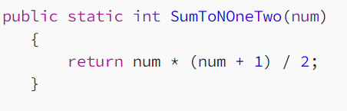
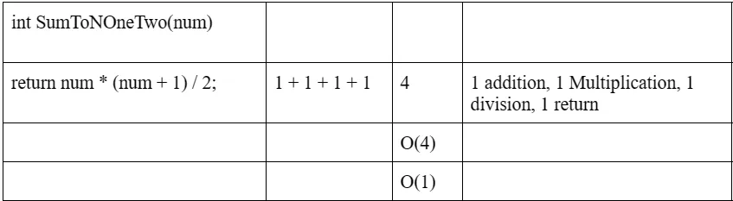
Example
Time complexity -> O(1)
Space complexity -> O(1). Space used by num is constant with respect the input (num)

Slide 13
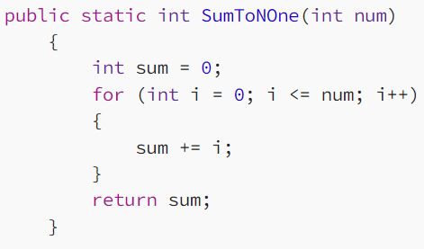
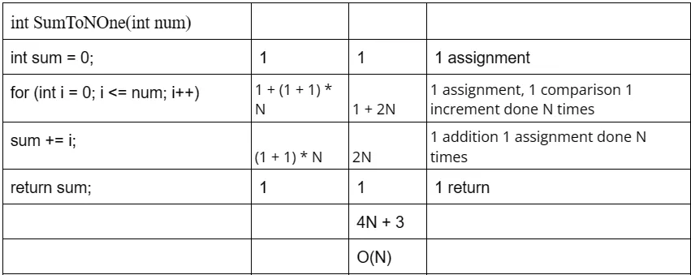
Example
Time complexity -> O(N). N refers to the input here.
Space complexity -> O(1). Spaces used by variables sum, i are constant with respect the input (N).

Slide 14
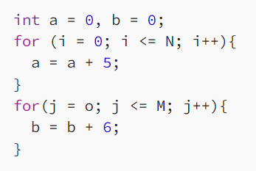
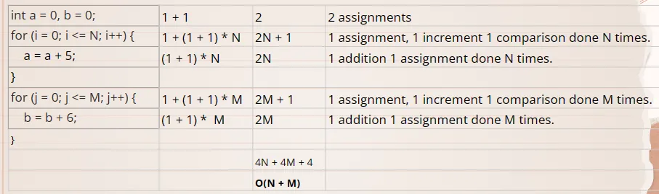
Example
Time complexity -> O(N + M)
Space complexity -> O(1). Spaces used by a, b, i, j, N, M are constant with respect to inputs (N, M)

