Slide 1
Continuous integration with Jenkins

Slide 2
Continuous integration
Continuous Integration is a development practice that requires developers to integrate code into a shared repository at regular intervals.
This concept was meant to remove the problem of finding later occurrence of issues in the build lifecycle.
Continuous integration requires the developers to have frequent builds.
The common practice is that whenever a code commit occurs, a build should be triggered.

Slide 3
Jenkins
Jenkins is a self-contained, open source automation server, which can be used to automate the building, testing and deployment of software.
Jenkins can be installed standalone, through native system packages, or using Docker.
The basic functionality of Jenkins is to execute a predefined list of steps, e.g. to compile Java source code and build a JAR from the resulting classes.
Jenkins monitors the execution of the steps and allows to stop the process, if one of the steps fails.
Jenkins can also send out notifications in case of a build success or failure.
Jenkins can be extended by additional plug-ins.

Slide 4
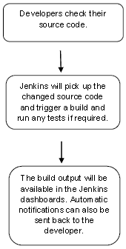

Slide 5
Jenkins Job
In Jenkins, you work with projects or jobs.
Each job is a repeatable set of steps that automate a task, such as building, testing, and deploying your software.
In Jenkins, it is possible for a job to be triggered manually, externally (via a REST endpoint or a push to a repository), or even by another job.
When a job is triggered, Jenkins creates a build of the project.
Jobs have a status called Health, represented by a weather condition, and builds have a more traditional status.
Each build has a colored circle that represents the success or failure of a build. The health of a job is a status that is dependent on the status of the most recent builds.
Build Statuses
Blue - Success
Yellow - Unstable (usually indicates failed tests)
Red - Failure
Grey - No builds or aborted build

Slide 6
Pipeline
Jenkins Pipeline (or simply "Pipeline" with a capital "P") is a suite of plugins which supports implementing and integrating continuous delivery pipelines into Jenkins.

Slide 7
Pipeline
A continuous delivery (CD) pipeline is an automated expression of your process for getting software from version control right through to your users and customers.
Every change to your software (committed in source control) goes through a complex process on its way to being released.
This process involves building the software in a reliable and repeatable manner, as well as progressing the built software (called a "build") through multiple stages of testing and deployment.

Slide 8
Pipeline
Pipeline provides an extensible set of tools for modeling simple-to-complex delivery pipelines "as code".
The definition of a Jenkins Pipeline is written into a text file (called a Jenkinsfile) which in turn can be committed to a project’s source control repository.
This is the foundation of "Pipeline-as-code"; treating the CD pipeline a part of the application to be versioned and reviewed like any other code.

Slide 9
Why Pipeline
Jenkins is, fundamentally, an automation engine which supports a number of automation patterns.
Pipeline adds a powerful set of automation tools onto Jenkins, supporting use cases that span from simple continuous integration to comprehensive CD pipelines

Slide 10
Features of Pipeline
Code: Pipelines are implemented in code and typically checked into source control, giving teams the ability to edit, review, and iterate upon their delivery pipeline.
Durable: Pipelines can survive both planned and unplanned restarts of the Jenkins master.
Pausable: Pipelines can optionally stop and wait for human input or approval before continuing the Pipeline run.
Versatile: Pipelines support complex real-world CD requirements, including the ability to fork/join, loop, and perform work in parallel.
Extensible: The Pipeline plugin supports custom extensions to its DSL and multiple options for integration with other plugins.

Slide 11
Pipeline concepts
Pipeline
A Pipeline is a user-defined model of a CD pipeline.
A Pipeline’s code defines your entire build process, which typically includes stages for building an application, testing it and then delivering it.
Also, a pipeline block is a key part of Declarative Pipeline syntax.
Node
A node is a machine which is part of the Jenkins environment and is capable of executing a Pipeline.
Also, a node block is a key part of Scripted Pipeline syntax.

Slide 12
Pipeline concepts
Stage
A stage block defines a conceptually distinct subset of tasks performed through the entire Pipeline (e.g. "Build", "Test" and "Deploy" stages), which is used by many plugins to visualize or present Jenkins Pipeline status/progress.
Step
A single task. Fundamentally, a step tells Jenkins what to do at a particular point in time (or "step" in the process).
For example, to execute the shell command make use the sh step: sh 'make’

Slide 13
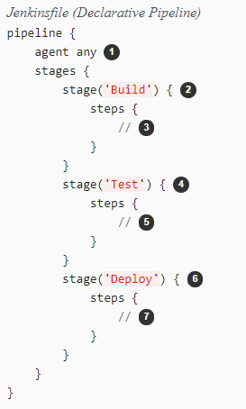
Declarative Pipeline

