Slide 1
Software Development Lifecycle (SDLC)

Slide 2
Software Development Life Cycle (SDLC)
Software Development Life Cycle (SDLC) is a process used by the software industry to design, develop and test high quality softwares.
The SDLC aims to produce a high-quality software that meets or exceeds customer expectations, reaches completion within times and cost estimates.
SDLC is the acronym of Software Development Life Cycle.
It is also called as Software Development Process.
SDLC is a framework defining tasks performed at each step in the software development process.
ISO/IEC 12207 is an international standard for software life-cycle processes. It aims to be the standard that defines all the tasks required for developing and maintaining software.

Slide 3
What is SDLC?
SDLC is a process followed for a software project, within a software organization.
It consists of a detailed plan describing how to develop, maintain, replace and alter or enhance specific software.
The life cycle defines a methodology for improving the quality of software and the overall development process.

Slide 4
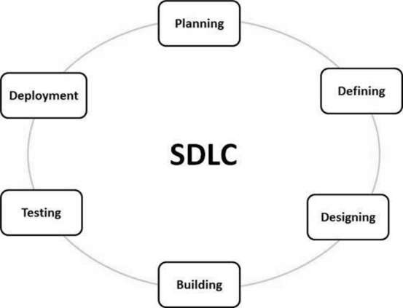
What is SDLC?

Slide 5
SDLC - Stages
Planning and Requirement Analysis
Defining Requirements
Designing the Product Architecture
Building or Developing the Product
Testing the Product
Deployment in the Market and Maintenance

Slide 6
SDLC Models
Waterfall Model
Iterative Model
Spiral Model
V-Model
Big Bang Model

Slide 7
SDLC - Waterfall Model
The Waterfall Model was the first Process Model to be introduced.
It is also referred to as a linear-sequential life cycle model.
It is very simple to understand and use.
In a waterfall model, each phase must be completed before the next phase can begin and there is no overlapping in the phases.

Slide 8
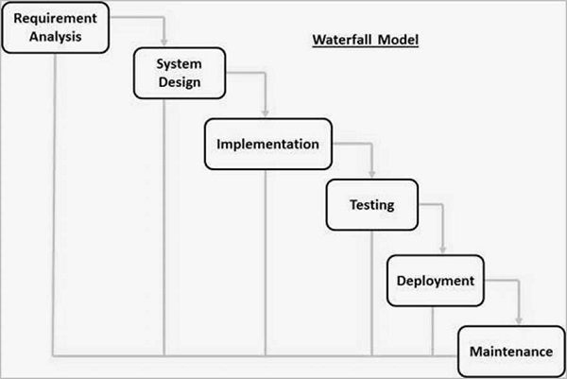
SDLC - Waterfall Model

Slide 9
Waterfall Model - Advantages
Simple and easy to understand and use
Easy to manage due to the rigidity of the model. Each phase has specific deliverables and a review process.
Phases are processed and completed one at a time.
Works well for smaller projects where requirements are very well understood.
Clearly defined stages.
Well understood milestones.
Easy to arrange tasks.
Process and results are well documented.

Slide 10
Waterfall Model - Disadvantages
No working software is produced until late during the life cycle.
High amounts of risk and uncertainty.
Not a good model for complex and object-oriented projects.
Poor model for long and ongoing projects.
Not suitable for the projects where requirements are at a moderate to high risk of changing. So, risk and uncertainty is high with this process model.
It is difficult to measure progress within stages.
Cannot accommodate changing requirements.
Adjusting scope during the life cycle can end a project.
Integration is done as a "big-bang. at the very end, which doesn't allow identifying any technological or business bottleneck or challenges early.

Slide 11
Agile - Term Definitions
User Story: An individual feature of/requirement for a project in Agile development.
Epic: A group of related features that is broken down into multiple user stories.
Story Point: A level of difficulty assigned to a user story through use of a sequence of numbers that increase with increasing difficulty.
Sprint: A brief period of development (almost always less than four weeks, sometimes as short as one week) generally culminating in a release of related features.
Velocity: The sum of story points of all user stories completed during a sprint. Velocity allows Agile teams to more accurately predict how many user stories can be completed in future sprints.

Slide 12
Agile Overview
Agile SDLC model is a combination of iterative and incremental process models with focus on process adaptability and customer satisfaction by rapid delivery of working software product.
Agile Methods break the product into small incremental builds.
These builds are provided in iterations.
Each iteration typically lasts from about one to three weeks.
Every iteration involves cross functional teams working simultaneously on various areas like −
Planning
Requirements Analysis
Design
Coding
Unit Testing and
Acceptance Testing.
At the end of the iteration, a working product is displayed to the customer and important stakeholders.

Slide 13
What is Agile?
Agile model believes that every project needs to be handled differently and the existing methods need to be tailored to best suit the project requirements.
In Agile, the tasks are divided into time boxes (small time frames) to deliver specific features for a release.
Iterative approach is taken and working software build is delivered after each iteration.
Each build is incremental in terms of features; the final build holds all the features required by the customer.

Slide 14
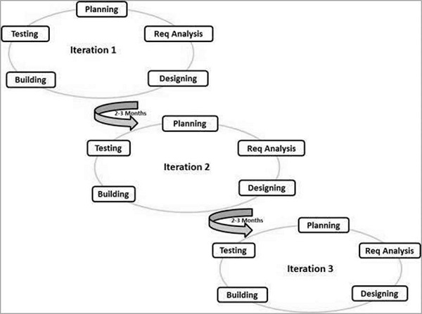
What is Agile?

Slide 15
SDLC Agile Model
The Agile thought process had started early in the software development and started becoming popular with time due to its flexibility and adaptability.
The most popular Agile methods include Rational Unified Process (1994), Scrum (1995), Crystal Clear, Extreme Programming (1996), Adaptive Software Development, Feature Driven Development, and Dynamic Systems Development Method (DSDM) (1995).
These are now collectively referred to as Agile Methodologies, after the Agile Manifesto was published in 2001.

Slide 16
Agile Manifesto principles
Individuals and interactions − In Agile development, self-organization and motivation are important, as are interactions like co-location and pair programming.
Working software − Demo working software is considered the best means of communication with the customers to understand their requirements, instead of just depending on documentation.
Customer collaboration − As the requirements cannot be gathered completely in the beginning of the project due to various factors, continuous customer interaction is very important to get proper product requirements.
Responding to change − Agile Development is focused on quick responses to change and continuous development.

Slide 17
Agile Vs Traditional SDLC Models
Agile is based on the adaptive software development methods, whereas the traditional SDLC models like the waterfall model is based on a predictive approach.
Predictive teams in the traditional SDLC models usually work with detailed planning and have a complete forecast of the exact tasks and features to be delivered in the next few months or during the product life cycle.
Predictive methods entirely depend on the requirement analysis and planning done in the beginning of cycle.
Any changes to be incorporated go through a strict change control management and prioritization.

Slide 18
Agile Vs Traditional SDLC Models
Agile uses an adaptive approach where there is no detailed planning and there is clarity on future tasks only in respect of what features need to be developed.
There is feature driven development and the team adapts to the changing product requirements dynamically.
The product is tested very frequently, through the release iterations, minimizing the risk of any major failures in the future.
Customer Interaction is the backbone of this Agile methodology, and open communication with minimum documentation are the typical features of Agile development environment.
The agile teams work in close collaboration with each other and are most often located in the same geographical location.

Slide 19
Advantages of the Agile Model
Is a very realistic approach to software development
Promotes teamwork and cross training.
Functionality can be developed rapidly and demonstrated.
Resource requirements are minimum.
Suitable for fixed or changing requirements
Delivers early partial working solutions.
Good model for environments that change steadily.
Minimal rules, documentation easily employed.
Enables concurrent development and delivery within an overall planned context.
Little or no planning required.
Easy to manage.
Gives flexibility to developers.

Slide 20
Disadvantages of the Agile Model
Not suitable for handling complex dependencies.
More risk of sustainability, maintainability and extensibility.
An overall plan, an agile leader and agile PM practice is a must without which it will not work
Strict delivery management dictates the scope, functionality to be delivered, and adjustments to meet the deadlines.
Depends heavily on customer interaction, so if the customer is not clear, team can be driven in the wrong direction.
There is a very high individual dependency, since there is minimum documentation generated.
Transfer of technology to new team members may be quite challenging due to lack of documentation.

Slide 21
Scrum
Scrum is a framework within which people can address complex adaptive problems, while productively and creatively delivering products of the highest possible value.
Scrum is:
A framework
Lightweight
Simple to understand
Difficult to master
Scrum is not:
A process
A technique
A definitive method
The Scrum framework consists of Scrum Teams and their associated roles, events, artifacts, and rules.

Slide 22
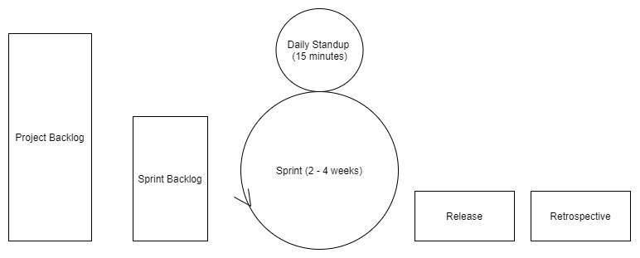
Scrum

Slide 23
Scrum Theory
The roots Scrum theory are embedded in empiricism.
Empiricism states that all knowledge is derived from sense-experience and our decisions should be based on what is known.
Scrum employs an iterative, incremental approach to optimize predictability and control risk.
To understand Scrum it is important to understand how the framework implements the three pillars of empirical process control:
Transparency
Inspection
Adaptation

Slide 24
Transparency
This means that the important aspects of the process must be visible to those responsible for the outcome.
The way that we can accomplish this in Scrum:
A common language referring to the process which is shared by all participants
All participants share a common definition of what "done" means.

Slide 25
Inspection
Scrum teams must frequently assess the framework's artifacts and overall progress towards a goal to detect undesirable variances.
This inspection process should not be so frequent that inspection gets in the way of work.

Slide 26
Adaptation
In the event that the rate of our progress, or retrospection on a previous sprint, is unsatisfactory, the framework provides mechanisms that help teams adjust any processes related to those goals, which helps to minimize further deviation.
Scrum has four formal events that help teams inspect their processes and adapt to change:
Sprint Planning
Daily Scrum
Sprint Review
Sprint Retrospective

Slide 27
Scrum Values
Each member of a Scrum Team must embody the five values:
Commitment (to achieving the goals of the Scrum Team)
Courage (to do the right thing and work on tough problems)
Focus (on the work of the Sprint and the goals of the Scrum Team)
Openness (about all the work and the challenges with performing the work)
Respect (for other members as capable and independent people)

Slide 28
Scrum Team Structure
The Product Owner
The Development Team
Scrum Master

Slide 29
The Product Owner
The Product Owner is responsible for maximizing the value of the product resulting from work of the Development Team.
How this is done may vary widely across organizations, Scrum Teams, and individuals.
The Product Owner is the sole person responsible for managing the Product Backlog.
Product Backlog management includes:
Clearly expressing Product Backlog items;
Ordering the items in the Product Backlog to best achieve goals and missions;
Optimizing the value of the work the Development Team performs;
Ensuring that the Product Backlog is visible, transparent, and clear to all, and shows what the Scrum Team will work on next; and,
Ensuring the Development Team understands items in the Product Backlog to the level needed.

Slide 30
The Development Team
The Development Team consists of professionals who do the work of delivering a potentially releasable Increment of "Done" product at the end of each Sprint.
A "Done" increment is required at the Sprint Review. Only members of the Development Team create the Increment.
Development Teams are structured and empowered by the organization to organize and manage their own work.
The resulting synergy optimizes the Development Team’s overall efficiency and effectiveness.

Slide 31
The Development Team
Development Teams have the following characteristics:
They are self-organizing. No one (not even the Scrum Master) tells the Development Team how to turn Product Backlog into Increments of potentially releasable functionality;
Development Teams are cross-functional, with all the skills as a team necessary to create a product Increment;
Scrum recognizes no titles for Development Team members, regardless of the work being performed by the person;
Scrum recognizes no sub-teams in the Development Team, regardless of domains that need to be addressed like testing, architecture, operations, or business analysis; and,
Individual Development Team members may have specialized skills and areas of focus, but accountability belongs to the Development Team as a whole.

Slide 32
Scrum Master
The Scrum Master is responsible for promoting and supporting Scrum as defined in the Scrum Guide.
Scrum Masters do this by helping everyone understand Scrum theory, practices, rules, and values.
The Scrum Master is a servant-leader for the Scrum Team.
The Scrum Master helps those outside the Scrum Team understand which of their interactions with the Scrum Team are helpful and which aren’t.
The Scrum Master helps everyone change these interactions to maximize the value created by the Scrum Team.

Slide 33
Scrum Master Service to the Product Owner
Ensuring that goals, scope, and product domain are understood by everyone on the Scrum Team as well as possible
Finding techniques for effective Product Backlog management
Helping the Scrum Team understand the need for clear and concise Product Backlog items
Understanding product planning in an empirical environment
Ensuring the Product Owner knows how to arrange the Product Backlog to maximize value
Understanding and practicing agility
Facilitating Scrum events as requested or needed

Slide 34
Scrum Master Service to the Development Team
Coaching the Development Team in self-organization and cross-functionality
Helping the Development Team to create high-value products
Removing impediments to the Development Team’s progress
Facilitating Scrum events as requested or needed
Coaching the Development Team in organizational environments in which Scrum is not yet fully adopted and understood.

Slide 35
Scrum Master Service to the Organization
Leading and coaching the organization in its Scrum adoption
Planning Scrum implementations within the organization
Helping employees and stakeholders understand and enact Scrum and empirical product development
Causing change that increases the productivity of the Scrum Team
Working with other Scrum Masters to increase the effectiveness of the application of Scrum in the organization.

Slide 36
Scrum Events
There are well-defined events in the Scrum framework that create a routine for the team to follow while also minimizing the need for meetings.
All events have a maximum duration that must be adhered to, it cannot be shortened or lengthened:
The Sprint
Sprint Planning
Daily Scrum
Sprint Review
Sprint Retrospective

Slide 37
The Sprint
The heart of Scrum is a Sprint, a time-box of one month or less during which a "Done", useable, and potentially releasable product Increment is created.
Sprints have consistent durations throughout a development effort. A new Sprint starts immediately after the conclusion of the previous Sprint.
Sprints contain and consist of the Sprint Planning, Daily Scrums, the development work, the Sprint Review, and the Sprint Retrospective.
During the Sprint:
No changes are made that would endanger the Sprint Goal;
Quality goals do not decrease; and,
Scope may be clarified and re-negotiated between the Product Owner and Development Team as more is learned.
Duration: Maximum of 1 month

Slide 38
Sprint Planning
The work to be performed in the Sprint is planned at the Sprint Planning.
This plan is created by the collaborative work of the entire Scrum Team.
The purpose of Sprint Planning is to answer the following questions:
What can be delivered in the Increment resulting from the upcoming Sprint?
How will the work needed to deliver the Increment be achieved?
Duration: Two hours for each week of the Sprint (1 week Sprint = 2-hour meeting, 2 week Sprint = 4-hour meeting, etc.)

Slide 39
Daily Scrum
The Daily Scrum is held every day of the Sprint. At it, the Development Team plans work for the next 24 hours.
This optimizes team collaboration and performance by inspecting the work since the last Daily Scrum and forecasting upcoming Sprint work.
The Daily Scrum is held at the same time and place each day to reduce complexity.
The purpose of the Daily Scrum is to:
Inspect progress towards the Sprint Goal
Inspect how progress is trending toward completing the work in the Sprint Backlog
Duration: 15-minutes

Slide 40
Sprint Review
A Sprint Review is held at the end of the Sprint to inspect the Increment and adapt the Product Backlog if needed.
During the Sprint Review, the Scrum Team and stakeholders collaborate about what was done in the Sprint.
Based on that and any changes to the Product Backlog during the Sprint, attendees collaborate on the next things that could be done to optimize value.
This is an informal meeting, not a status meeting, and the presentation of the Increment is intended to elicit feedback and foster collaboration.
Duration: One hour for each week of the Sprint (1 week Sprint = 1-hour meeting, 2 week Sprint = 2-hour meeting, etc.)

Slide 41
Sprint Retrospective
The Sprint Retrospective is an opportunity for the Scrum Team to inspect itself and create a plan for improvements to be enacted during the next Sprint.
It occurs after the Sprint Review and prior to the next Sprint Planning.
The purpose of the Sprint Retrospective is to:
Inspect how the last Sprint went with regards to people, relationships, process, and tools
Identify and order the major items that went well and potential improvements
Create a plan for implementing improvements to the way the Scrum Team does its work

Slide 42
Sprint Artifacts
Scrum’s artifacts represent work or value to provide transparency and opportunities for inspection and adaptation.
Artifacts defined by Scrum are specifically designed to maximize transparency of key information so that everybody has the same understanding of the artifact.
The following a core artifacts to the Scrum framework:
Product Backlog
Sprint Backlog
Increment

Slide 43
Product Backlog
The Product Backlog is an ordered list of everything that is known to be needed in the product.
It is the single source of requirements for any changes to be made to the product.
The Product Owner is responsible for the Product Backlog, including its content, availability, and ordering.

Slide 44
Sprint Backlog
The Sprint Backlog is the set of Product Backlog items selected for the Sprint, plus a plan for delivering the product Increment and realizing the Sprint Goal.
The Sprint Backlog is a forecast by the Development Team about what functionality will be in the next Increment and the work needed to deliver that functionality into a "Done" Increment.

Slide 45
Increment
The Increment is the sum of all the Product Backlog items completed during a Sprint and the value of the increments of all previous Sprints.
At the end of a Sprint, the new Increment must be "Done," which means it must be in useable condition and meet the Scrum Team’s definition of "Done".
An increment is a body of inspectable, done work that supports empiricism at the end of the Sprint.
The increment is a step toward a vision or goal.
The increment must be in useable condition regardless of whether the Product Owner decides to release it.

Slide 46
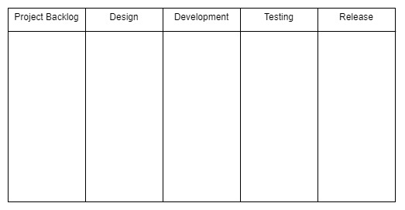
Kanban
The Kanban board, a vehicle for a visual representation of the progress of a project, is the hallmark trait of the Kanban framework.
The image below shows an empty example Kanban board.

Slide 47
Kanban Advantages
Kanban is event-driven, removing even the small pressure of sprint deadlines found in the Scrum framework.
It also allows for specialists; for example, one team member can be a testing specialist.
In this scenario, once user stories have been moved into the testing/equivalent column, the testing specialist can begin working on them and the developer who had previously been responsible for that task can start work on another card in the backlog.
Specialization can result in developers building a stronger expertise in a particular area.
Additionally, the Kanban board can always take new client requirements and is persistent throughout releases.
Finally, it allows the entire team to view the current state and progress of the project.

Slide 48
Kanban Disadvantages
The capacity of the Kanban board also brings drawbacks, particularly the danger that the board's size will grow to the point where it becomes unnecessarily complex and difficult to understand/navigate.
Like Scrum, Kanban also requires commitment from its devotees - an out-of-date Kanban board doesn't help (and can even hurt) the team because developers will end up working on the same tasks and will not have an accurate picture of the evolution of the project.
But unlike Scrum (with timed sprints) and Waterfall (with a set project deadline from the beginning), this framework has no timing element, which can result in an even more extreme version of feature creep and constant release delays/uncertainty.

Slide 49
eXtreme Programming (XP)
XP is the most verbose of the Agile frameworks we have examined.
There are strict procedures designed to encourage XP's values of communication, simplicity, feedback, courage, and respect.
As these values would suggest, this framework seeks to go beyond improving product quality by also improving team cohesion and the lives and happiness of individual members.

Slide 50
eXtreme Programming (XP)
XP procedures include weekly cycles (one-week sprints), quarterly cycles (i.e. quarterly releases), continuous integration (ensuring that code from new sprints can easily be assimilated into the existing code base), incremental design (initial high-level design of features and functionalities, leaving the specifics for later), the use of user stories and epics, test-driven development (TDD), pair programming, and other practices.
In addition, the XP team includes a member of the customer in order to fulfill the goal of faster feedback.

Slide 51
Pair Programming
Pair programming is an approach where teams are broken into groups of two while developing.
Each group includes a pilot and a navigator.
The pilot is actively writing code, while the navigator is planning how the code that the pilot is writing at that moment will tie into the larger user story, epic, and project code base.
Although this may seem like it will double development time, pair programming is actually more efficient than you may expect because the pairs can collaborate and solve issues faster and narrow their focus due to lessened responsibility.

