Slide 1
CSS Selectors

Slide 2
CSS Selectors
CSS selectors are used for selecting the content/text you want to style in our site.
Selectors are the part of CSS ruleset.
CSS selectors select the HTML elements according to its id, class, type, attribute, etc.

Slide 3
CSS Selectors
There are several different types of selectors in CSS, some of them are listed below
Element Selector
Id Selector
Class Selector
Universal Selector
Attribute selectors
Grouping Selector
Child and descendent selectors
General and adjacent sibling selectors
Pseudo-element and pseudo-class selectors

Slide 4
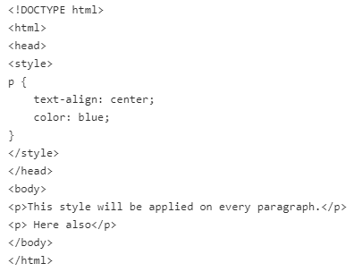
Element Selector
The element selector selects HTML elements by their name / tag name like a, h1, div, p etc.

Slide 5
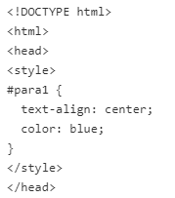
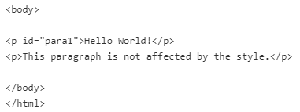
ID Selector
In the CSS, the ID selector is a name preceded by a hash character (“#”).
It uses the id attribute of an HTML element to match the specific HTML element.
The id of an element should be unique within a page, so the id selector is used to select one unique element.

Slide 6
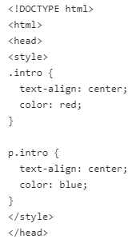
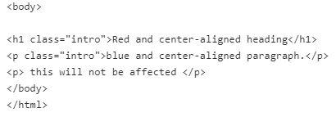
Class Selector
In the CSS, the class selector is a name preceded by a period (“.”).
It uses the class attribute of an HTML element to match the specific HTML element.
We can have a Class selector specific to an HTML element like we have p.class in the below example.

Slide 7
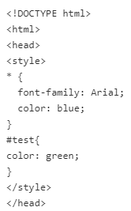
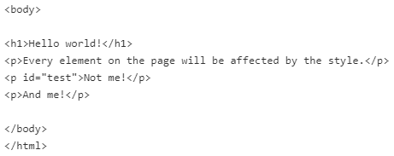
Universal Selector
The universal selector denoted by an asterisk (*), matches all the elements on the page.
If any other specific selector exists on the element, then the universal selector will be omitted.

Slide 8
Attribute Selector
An attribute selector selects the HTML elements that has a specific attribute or attribute with a specified value.
You can create an attribute selector by having the attribute in a pair of square brackets [attribute].
The most commonly used attribute selectors are listed below:
[attribute] Selector - applies the style rule for all the element which has a specified attribute.
[attribute="value"] Selector - uses the = operator to select the element whose attribute value is exactly equal to the given value.
[attribute~="value"] Selector - uses the ~= operator to select elements that have the specified attribute with a value containing a given word, delimited by spaces.

Slide 9
Attribute Selector
[attribute|="value"] Selector - uses the |= operator to select elements that have the specified attribute with a value either equal to a given string or starting with that string followed by a hyphen (-).
[attribute^="value"] Selector - uses the ^= operator to select elements that have the specified attribute with a value beginning exactly with a given string.
[attribute$="value"] Selector uses the $= operator to select elements that have the specified attribute with a value ending exactly with a given string. The comparison is case sensitive.
[attribute*="value"] Selector - uses the *= operator to select elements that have the specified attribute with a value containing a given substring.

Slide 10
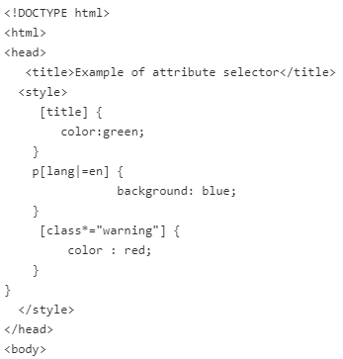
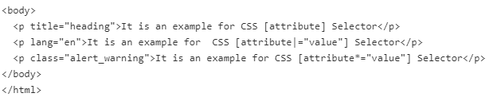
Attribute Selector

Slide 11
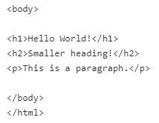
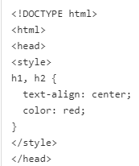
Grouping Selector
The CSS grouping selector is used to apply a common style for the number of elements on the page.
You can group the selector using comma (,) separator.
It allows you to specify the same properties and rules for more than one element at the same time.
This reduces the code and extra effort to declare common styles for each element.

Slide 12
Child selectors
Child Selector selects all the elements that are the children of a specified element.
The Syntax of Child Selector is element > element { property: value;} which selects those elements which are the children of specific parent.
The left side of > is a parent element and on the right is the children element.

Slide 13
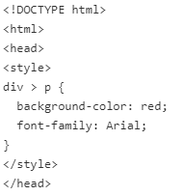
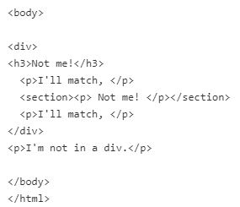
Child selectors

Slide 14
Descendent selectors
The descendant selector selects all the elements which are a child of the element.
It allows you to limit the targeted elements to the ones who are descendants of another element.
The syntax is element { property: value; } you simply write the parent(s), separate with space, and then the actual element you want to target.

Slide 15
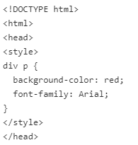
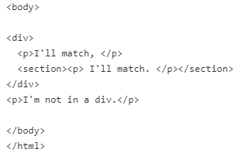
Descendent selectors

Slide 16
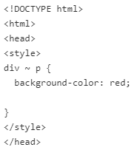
General Sibling Selector
The General Sibling selector selects all the elements which are siblings of a specified element.
The syntax is element ~ element { property: value; }, which selects all the sibling elements that are in same hierarchy level

Slide 17
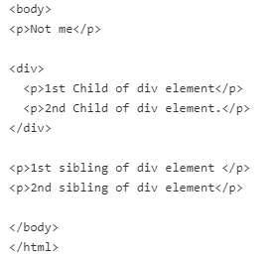
General Sibling Selector

Slide 18
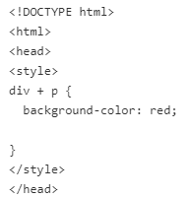
Adjacent Sibling Selector
The Adjacent Sibling selector selects the element that are the adjacent sibling of a specified element.
The syntax is element + element { property: value; }, which selects the second one, if it immediately follows the first one in order of appearance in an HTML page.

Slide 19
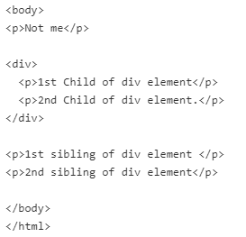
Adjacent Sibling Selector

Slide 20
Pseudo Class Selector
Pseudo Class Selector is used to specify the state of an element.
It let us to apply a style to an element which are related with external factors like the history of the navigator ( like :visited), the status of its content (like :checked on certain form elements), or the position of the mouse (like :hover, which lets you know if the mouse is over an element or not).
The syntax for Pseudo Class Selector is selector:pseudo-class { property: value; } .
These pseudo- classes are used with the selector to style the element on a specific state.

Slide 21
Pseudo Class Selector
:link - Used to select only <a> element with href attributes and applies the style for unvisted link.
:visited - Used to select only <a> element with href attributes and applies the style for visited link.
:active - selects an element which is activated by user clicks
:hover - selects the style when the element is in its hover state (mouse cursor rolls over the element).
:focus - selects the form input element that has received focus. It is generally triggered when the user clicks or taps on an element or selects it with the keyboard's "tab" key.
:lang - Used to specify a language to use in a element.
:first-child - selects the first element among a group of sibling elements.

Slide 22
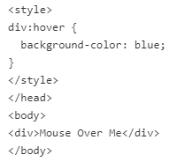
Pseudo Class Selector

Slide 23
Pseudo Element Selector
Pseudo-elements allows to style the specified parts of an element that is not available under DOM tree.
It let us to apply to style the first letter or first line of an element's content, change the font of the first line of a paragraph, etc.
The syntax for Pseudo Element Selector is selector::pseudo-element { property:value; }.

Slide 24
Pseudo Element Selector
::first-letter - Selects the first letter of the text contents inside an element.
::first-line - Selects the first line of the text contents inside an element.
::before - Used to insert generated content immediately before an element.
::after - Used to insert generated content either before or after an element on the page generate content immediately after an element.

Slide 25
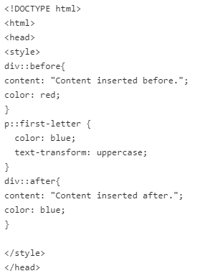
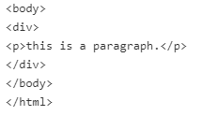
Pseudo Element Selector

Slide 26
Specificity in CSS
When we have more than one CSS style rule for an element, the browser selects one style rule for that element based upon a specificity as a score/rank/priority.
Specificity only applies when the same element is targeted by multiple CSS declarations.
Specificity is the set of the rules applied to CSS selectors to determine which style is applied to an element. More specific selector will have higher Precedence.

Slide 27
Specificity in CSS
The specificity level of a selector has 4 categories listed below:
Inline CSS - Example: <h1 style="color: #ffffff;">
ID Selector
Class Attribute and Pseudo-Classes Selectors.
Element and Pseudo-Elements Selector.
Inline CSS have higher priority and Element and Pseudo-Elements Selector have lowest priority.
When we have 2 CSS Style rule which has same priority, then the lower priority will be selected by the browser.

