Slide 1
CSS3

Slide 2
CSS3
CSS3 is the latest version of CSS.
CSS3 supports responsive web design, all kinds of transitions, transformations, and animations and provides box-sizing tools that enable the user to adjust the size of any element without changing the dimensions or padding of the element.

Slide 3
Responsive Web design
Responsive Web design is the approach that allows websites and pages to render (or display) on all devices and screen sizes by automatically adapting to the screen, whether it’s a desktop, laptop, tablet, or smartphone.
Responsive web design works through CSS, using various settings to serve different style properties depending on the screen size, orientation, resolution, color capability, and other characteristics of the user’s device.
It is a combination of flexible grids, flex boxes, flexible images, and media queries.

Slide 4
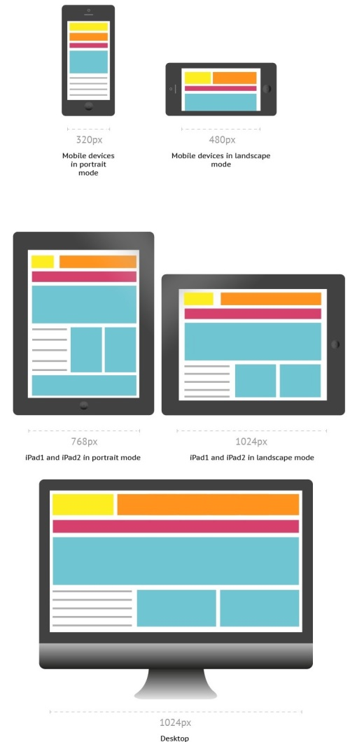
Responsive Web design

Slide 5
Media Queries
Media queries allow you to customize the presentation of your web pages for a specific range of devices like mobile phones, tablets, desktops, etc. without any change in markups.
It composed of a media type and expressions that check for the conditions of particular media features.
It is a logical expression that is either true or false.

Slide 6

Media Queries - Syntax
A media query consists of an optional media type and any number of media feature expressions.
Multiple queries are often combined in various ways by using logical operators.
Media queries are case-insensitive.
A media query is true if the media sort of the media query matches the media sort of the device and every one expression within the media query are true.
It uses the @media rule to incorporate a block of CSS properties as long as a particular condition is true.
Queries involving unknown media types are always false.

Slide 7
Media Queries - Syntax
Media Types - It describes the category of a device.
all - used for all media type devices
print - used for printers
screen - used primarily for screens like computer screens, tablets, smart-phones, etc.
speech - used for screenreaders that "reads" the page aloud
Media features - It describe specific characteristics of the user agent, output device, or environment. Some of the media features are grid, height, width, hover, max-aspect-ratio, max-color,max-color-index, max-height,etc.
Logical Operators - It used to compose a media query . Logical Operators used in media queries are not, and, and only.

Slide 8
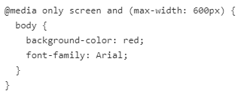
Media Queries - Example
It changes the background color of the <body> element to "red" and the font style to "Arial" when the browser window is 600px wide or less.

Slide 9
Flexbox
Flexbox, short for "Flexible Box Layout," is a CSS layout module that provides a flexible and efficient way to arrange and align elements within a container.
Flexbox introduces a one-dimensional layout model, allowing you to align items along a single axis (either horizontally or vertically).
The main idea behind Flexbox is to distribute available space within the container and control the alignment and positioning of its child elements, also known as flex items.

Slide 10
Flex Container and Flex items
In any flexbox layout, the first step is to create a flex container.
The flex container is an area of document laid out using flexbox.
We can define the flex container by setting the display property to flex or inline-flex.
The direct children of the flex container are called flex items.

Slide 11
Grid
CSS Grid Layout brings a two-dimensional grid system to CSS unlike Flexbox, which is one-dimensional.
A grid is comprised of columns and rows in which we can place our items.
Items can be positioned on the grid explicitly using numbers.
CSS Grid will also calculate where items go when they are not given specific positions.
By setting the display property of an HTMl element to grid, we turn that element into a grid container. All direct children of the grid container are grid items.

Slide 12
CSS Variables
The var() function is used to insert the value of a CSS variable.
CSS variables have access to the DOM, which means that you can create variables with local or global scope, change the variables with JavaScript, and change the variables based on media queries.
A good way to use CSS variables is when it comes to the colors of your design. Instead of copy and paste the same colors over and over again, you can place them in variables.

Slide 13
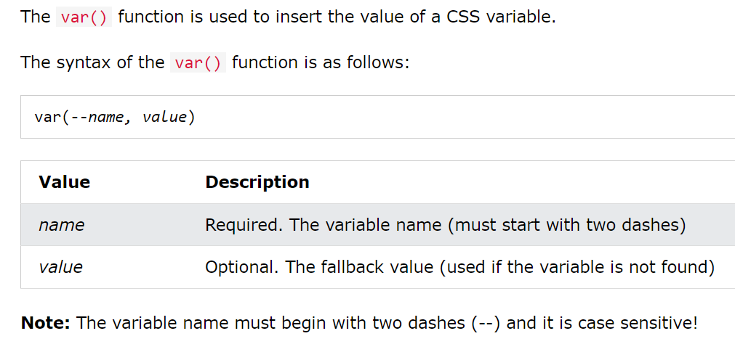
Syntax of the var() Function

Slide 14
How var() Works
CSS variables can have a global or local scope.
Global variables can be accessed/used through the entire document, while local variables can be used only inside the selector where it is declared.
To create a variable with global scope, declare it inside the :root selector. The :root selector matches the document's root element.
To create a variable with local scope, declare it inside the selector that is going to use it.
The following example is equal to the example above, but here we use the var() function.
First, we declare two global variables (--blue and --white).
Then, we use the var() function to insert the value of the variables later in the style sheet:

Slide 15
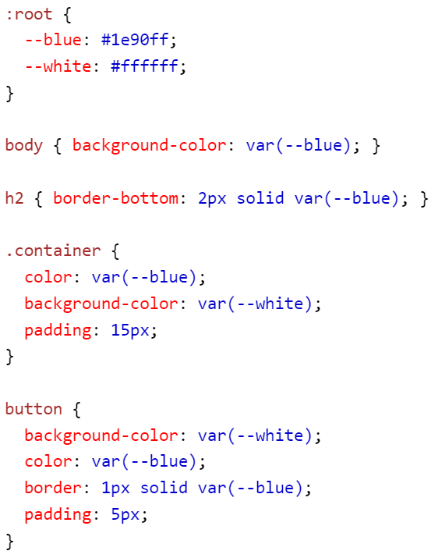
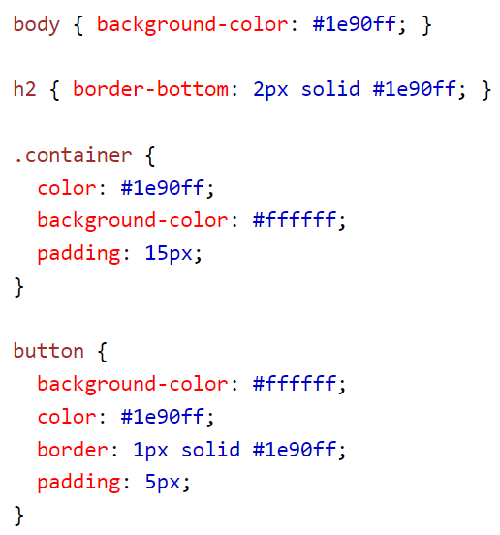
CSS Variables

