Slide 1
HTTP
Hypertext Transfer Protocol

Slide 2
HTTP
Hypertext Transfer Protocol (HTTP) is a client-server protocol.
This means the client or consumer must initiate the communication.
Information is transferred via multiple messages.
The HTTP protocol is part of the application layer and thus requires some underlying communication protocol to transmit data- that protocol is TCP.

Slide 3
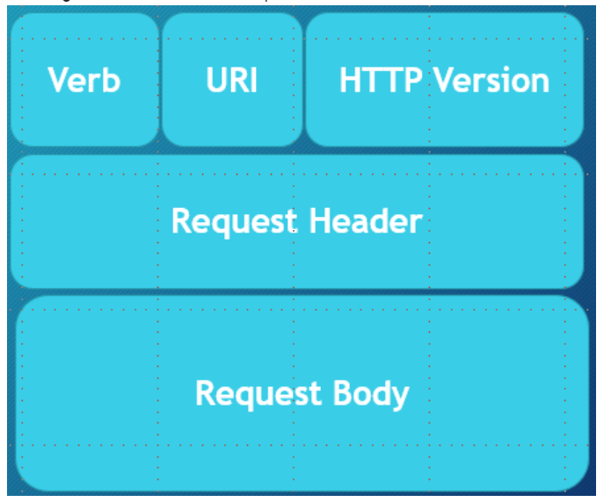
HTTP Requests
Verb
Indicates the executing HTTP method.
URI
Specifies the endpoint where the resource is located.
HTTP Version.
Request Header
META-DATA (information) of the Request as key-value pairs such as format supported by the client, browser type, etc.
Request Body
Message content or resource representation.

Slide 4
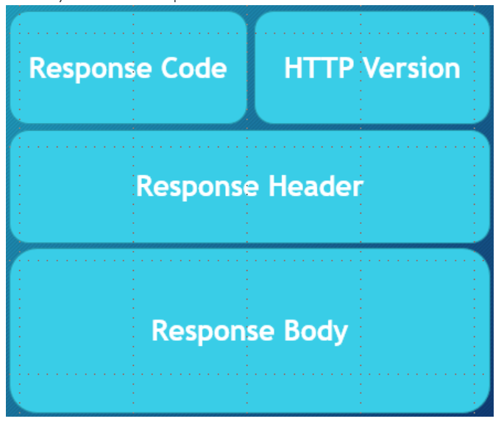
HTTP Responses
HTTP Response
Response Code
200 (OK), 403 (Forbidden), 404 (Not Found), 500 (Internal Error), etc.
HTTP Version.
Response Header
META-DATA for the Response such as: content length, content type, date, etc.
Response Body
Some kind of payload in the case where HTTP is used in the context of a RESTful service then the body is a resource representation.

Slide 5
HTTP Verbs

Slide 6
HTTP Verbs
HTTP request verbs or methods indicate the action that a client hopes to perform.
Characteristics of requests: (Basically, a request either is or isn't each of these)
idempotent
"identical request can be made once or several times in a row with the same effect while leaving the server in the same state"- MDN
safe
doesn't alter the server's state
read-only
cacheable
Determines if there is a chance the response to the corresponding method can be cached
allowed in HTML forms
request has a body

Slide 7
GET
Used to retrieve data
NO request body
safe
idempotent
cacheable
allowed in HTML forms

Slide 8
HEAD
Essentially the same as GET, but the server's response should not include a body.
Let's say you are planning to request a large amount of info and you want to test out the response without the risk of wasting bandwidth resources--> HEAD
Used to retrieve data
NO request body
safe
idempotent
cacheable
NOT allowed in HTML forms
NO response body

Slide 9
POST
"sends data to the server"
will often be used to create or update data
it is NOT idempotent
technically there are ways it can be cacheable, but typically isn't thought of as cacheable
NOT safe
allowed in HTML forms
request has a body
response has a body

Slide 10
PUT
updates a target resource such that it replaces the current representations with the one included in the PUT request
it is idempotent
Not safe
Not cacheable
Not allowed in HTML forms
response does NOT have a body
request does have a body
not supported by HTML forms

Slide 11
DELETE
used to delete a resource
might have a request and/or response body
Not safe
Not cacheable
Not allowed in HTML forms
is idempotent

Slide 12
CONNECT
starts a "tunnel"-- two-way communication with the resource
No request body
Receives a response body
Not safe, idempotent, cacheable, or supported by HTML forms

Slide 13
OPTIONS
Get the options for communication with a particular resource
safe, idempotent
request has no body
response has a body
Not cacheable or available in HTML forms

Slide 14
TRACE
message loop-back test between client and resource
useful for debugging
no request body or response body
not safe, cacheable, or allowed in HTML forms
idempotent

Slide 15
PATCH
similar to update
changes partial aspects of a resource
request and response have a body
not safe, idempotent, allowed in HTML forms, or cacheable

Slide 16
HTTP - Status Codes

Slide 17
HTTP - Status Codes
HTTP response status codes indicate whether a specific HTTP request has been successfully completed.
Status codes are issued by a server in response to a client's request made to the server.
Responses are grouped in five classes
1xx informational response (100–199) – the request was received, continuing process
2xx successful (200–299) – the request was successfully received, understood, and accepted
3xx redirection (300–399) – further action needs to be taken in order to complete the request
4xx client error (400–499) – the request contains bad syntax or cannot be fulfilled
5xx server error (500–599) – the server failed to fulfil an apparently valid request
https://en.wikipedia.org/wiki/List_of_HTTP_status_codes

