Slide 1
JAVASCRIPT

Slide 2
INTRODUCTION TO JAVASCRIPT
JavaScript is the programming language of HTML and the Web.
It is used to program the behaviour of web pages
In HTML, JavaScript code must be inserted between <script> and </script> tags.
You can place any number of scripts in an HTML document.
Scripts can be placed in the <body>, or in the <head> section of an HTML page, or in both.

Slide 3
Simple snippet
<!DOCTYPE html>
<html lang="en">
<head>
<title>JS Demo</title>
</head>
<body>
<h2>JavaScript Demo</h2>
<button type="button"
onclick="alert('Hello From JS')">
Click Me
</button>
</body>
</html>

Slide 4
JavaScript Functions and Events
A JavaScript function is a block of JavaScript code, that can be executed when "called" for.
For example, a function can be called when an event occurs, like when the user clicks a button.
<!DOCTYPE html>
<html lang="en">
<head>
<title>JS Demo 2</title>
<script>
function alertFunction(){
alert("Second Demo")
}
</script>
</head>
<body>
<h2>Second JavaScript Demo</h2>
<button type="button" onclick="alertFunction()">Click Me</button>
</body>
</html>

Slide 5
External JavaScript
Scripts can also be placed in external files.
External scripts are practical when the same code is used in many different web pages.
JavaScript files have the file extension .js.
To use an external script, put the name of the script file in the src (source) attribute of a <script> tag:
Where myScript.js is an external file as
External file: myScript.js
function alertFunction(){
alert("Third Demo")
}
<!DOCTYPE html>
<html lang="en">
<head>
<title>JS Demo 3</title>
<script src="myscript.js"> </script>
</head>
<body>
<h2>Third JavaScript Demo</h2>
<button type="button" onclick="alertFunction()">Click Me</button>
</body>
</html>

Slide 6
JavaScript Data Types
JavaScript variables can hold many data types: numbers, strings, objects and more:
var length = 16; // Number var lastName = "Johnson"; // String var x = {firstName:"John", lastName:"Doe"};
JavaScript evaluates expressions from left to right.
var x = 16 + 4 + "Volvo";
Result : 20Volvo
When adding a number and a string, JavaScript will treat the number as a string.
var x = 16 + "Volvo"; Result : 16volvo

Slide 7
JavaScript Types
JavaScript Dynamics
JavaScript has dynamic types.
This means that the same variable can be used to hold different data types.
Example
var x; // Now x is undefined x = 5; // Now x is a Number x = "John"; // Now x is a String
JavaScript Strings
A string (or a text string) is a series of characters like "John Doe".
Strings are written with quotes. You can use single or double quotes:
Example
var carName = "Volvo XC60"; // Using double quotes var carName = 'Volvo XC60'; // Using single quotes

Slide 8
JavaScript Types
JavaScript Numbers
JavaScript has only one type of numbers.
Numbers can be written with, or without decimals:
Example
var x1 = 34.00; // Written with decimals var x2 = 34; // Written without decimals
Extra large or extra small numbers can be written with scientific (exponential) notation:
var y = 123e5; // 12300000 var z = 123e-5; // 0.00123
JavaScript Booleans
Booleans can only have two values: true or false.
Booleans are often used in conditional testing.
Example
var x = 5; var y = 5; // (x==y) Returns True var z = 6; //(x==z) Returns False

Slide 9
JavaScript Types
JavaScript Objects
JavaScript objects are written with curly braces.
Object properties are written as name:value pairs, separated by commas.
The object (person) in the example below has 4 properties: firstName, lastName, age, and eyeColor.
Example
var person = {firstName:"John", lastName:"Doe", age:50, eyeColor:"blue"};
The typeof Operator
You can use the JavaScript typeof operator to find the type of a JavaScript variable.
The typeof operator returns the type of a variable or an expression:
Example
typeof "" // Returns "string" typeof "John" // Returns "string" typeof 314 // Returns "number" typeof 3.14 // Returns "number"

Slide 10
JavaScript Types
Undefined
In JavaScript, a variable without a value, has the value undefined.
The typeof is also undefined.
Example
var car; // Value is undefined, type is undefined
Any variable can be emptied, by setting the value to undefined. The type will also be undefined.
car = undefined; // Value is undefined, type is undefined
Empty Values
An empty value has nothing to do with undefined.
An empty string has both a legal value and a type.
Example
var car = ""; // The value is "", the typeof is "string"

Slide 11
JavaScript Types
Null
In JavaScript null is "nothing".
It is supposed to be something that doesn't exist.
Unfortunately, in JavaScript, the data type of null is an object.
You can empty an object by setting it to null
Example
var person = {firstName:"John", lastName:"Doe", age:50, eyeColor:"blue"}; person = null;
// Now value is null, but type is still an object

Slide 12
Variable Scope
The Variable scope defines the lifetime and visibility of a variable.
Each variable associated with a scope.
The variable can be accessed only within its scope.

Slide 13
Variable Scope - Global Scope
Variables defined outside any function, block, or module have global scope.
The global scope variables are accessed everywhere in the application.
The global variable's lifetime is throughout the application.
var a = 'Hello World!'; // This is a global variable
function greeting() {
console.log(a);
}
greeting(); // Outputs 'Hello World!'

Slide 14
Variable Scope - Local Scope
Local Scope used to refer to Function-local scope, but following the introduction of block scope, this term is considered ambiguous and should not be used.
The local scope has divided into the function scope, the block scope and the lexical scope.
The block scope concept is introduced in ECMA Script 6 (ES6) together with the new ways to declare variables - const and let.

Slide 15
Variable Scope - Function Scope
The variable declared in a function is only visible inside that function.
var is the keyword to define variable for a function-scope accessibility.
function func(){
var animal ='Lion'; //exist in function scope
console.log('inside function: ',animal);
}
func(); //Output: "inside function: Lion"
console.log(animal); //error: animal is not defined

Slide 16
Variable Scope - Block Scope
Block scope is the scope of the variables declared inside the {} (curly brackets).
In ES6, const and let keywords allow developers to declare variables in the block scope, which means those variables exist only within the corresponding block.
console.log("Hello, World!");function func(){
if(true){
var fruit1 = 'apple'; //exist in function scope
const fruit2 = 'banana'; //exist in block scope
let fruit3 = 'strawberry'; //exist in block scope
}
console.log(fruit1);
console.log(fruit2); // results error - due to it exist in block scope
console.log(fruit3); // results error - due to it exist in block scope
}
func();

Slide 17
Variable Scope - Lexical Scope
Lexical scope is that a variable defined outside a function can access the inside another function defined after the variable declaration.
The inner functions are lexically bound to the execution context of their outer functions.
function func1(){
var animal1 = "Lion"; //exist in Lexical scope
function func2(){ //Inner Function
var animal2 = "Tiger"; //exist in function scope
console.log(animal1);
console.log(animal2);
}
func2();
console.log(animal2); // results error - due to it exist in function scope
}
func1();

Slide 18
Hoisting of Functions and Variables
Hoisting is a JavaScript mechanism where variables and function declarations are moved to the top of their scope before code execution.
JavaScript Hositing only moves the variable declaration to the top, not the variables that are declared and initialized in a single line.
JavaScript compiler moves the function definition to the top in the same way as a variable declaration.
JavaScript compiler moves only the Function declaration to the top, not the function expression.

Slide 19
Type coercion
Type coercion is the process of converting value from one type to another (such as string to number, object to boolean, and so on).
Types :
1.Implicit
2.Explicit

Slide 20
Type coercion
Implicit type coercion :
values can also be converted between different types automatically, and it is called implicit type coercion.
Explicit type coercion :
Converting between types by writing a appropriate code like Number(value).
String(123) // explicit
123 + '' // implicit

Slide 21
== vs ===
=== : strict equality operator
Checks for both datatype and value
Eg: 77 ==='77’ // false
== : loose equality operator
Checks for only value
Eg: 77 == '77’ // true

Slide 22
Truthy and Fasly in JavaScript

Slide 23
Falsy value
In JavaScript, any expressions or value that results in boolean false value, are considered as Falsy.
The falsy values/expressions in javascript are:
Obviously boolean false is false.
Any empty string will be evaluated to false.
Any undefined variable will be equal to false.
Any null variable will be equal to false.
Any numerical expression with result in NaN (not a number) will be equal to false.
Any numerical expression with result in zero will be equal to false.

Slide 24
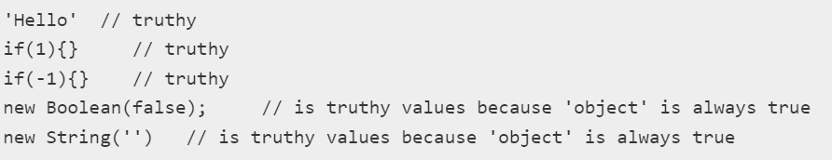
Truthy value
In JavaScript, any expressions or value that results in Boolean true value, are considered as Truthy.
Any expression or value other than above listed falsy values – is considered truthy.

Slide 25
Functions
A JavaScript function is a block of code designed to perform a particular task.
A JavaScript function is executed when "something" invokes it (calls it).
Syntax
function name(parameter1, parameter2, parameter3) { code to be executed }

Slide 26
Functions
Example
function myFunction(p1, p2)
{ return p1 * p2;
}
Note : The function returns the product of p1 and p2

Slide 27
Function Expression
JavaScript allows us to assign a function to a variable and then use that variable as a function. It is called function expression.
var add = function sum(val1, val2) {
return val1 + val2;
};
var result1 = add(10,20);
var result2 = sum(10,20); // not valid

Slide 28
Anonymous Function
JavaScript allows us to define a function without any name. This unnamed function is called anonymous function. Anonymous function must be assigned to a variable.
var showMessage = function (){ alert("Hello World!"); };
showMessage();
var sayHello = function (firstName) { alert("Hello " + firstName); }; showMessage();
sayHello("Bill");

Slide 29
Callback functions
A callback is a function that is to be executed after another function has finished executing .
In JavaScript, functions are objects
functions can take functions as arguments.
Functions that do this are called higher-order functions
function that is passed as an argument is called a callback function

Slide 30
Callback functions
A callback function is a function that gets executed after another function completes the execution.
It helps us develop asynchronous JavaScript code and keeps us safe from problems and errors.
JavaScript runs the code in sequential order (from top to down).
If there is a case that code runs after some other execution, which is not happening in a sequence is called asynchronous programming.
All functions in JavaScript are objects and a JavaScript function can be passed another function as an argument.
A callback function can be created by using the callback keyword as the last parameter.

Slide 31
Callback functions
function doHomework(subject, callback)
{
// use ` ` (ticks) Template literals alert(`Starting my ${subject} homework.`); callback(); }
function alertFinished(){ alert('Finished my homework'); }
doHomework('math', alertFinished);

Slide 32
Self-invoking (IIFE)
IIFE - Immediately Invoked Function Expression.
It is s a JavaScript function that runs as soon as it is defined.
Syntax :
(function () {
statements
})();

Slide 33
Closures
A closure is a function that remembers and accesses the variables and arguments of its outer function even after the function return.
The closure able to access the variables defined between its curly brackets, the outer function’s variables and the global variables.

Slide 34
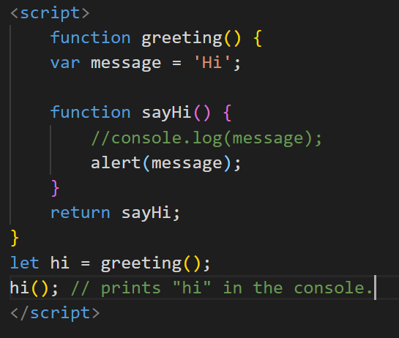
Closures
Normally, when the greeting() function has completed executing, the message variable is no longer accessible.
In this case, we execute the hi() function that references the sayHi() function, the message variable still exists.
Hence, the sayHi() function is a closure.

Slide 35
Arrow Functions
Arrow functions, introduced in ES6, provides a concise way to write functions in JavaScript.
They save developers time and simplify function scope.

Slide 36

One-line arrow functions
One-line arrow functions have implicit return and defined without curly braces.
let func = (arg1, arg2, ...argN) => expression;

Slide 37
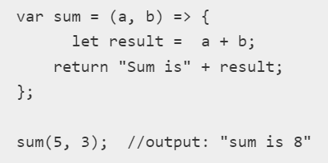
Multiline arrow functions
Multiline arrow functions have multiple statements inside the function, enclosed with curly braces and need an explicit return to return something.

Slide 38
"strict" mode
You can use strict mode in all your programs. It helps you to write cleaner code, like preventing you from using undeclared variables.
"use strict"; Defines that JavaScript code should be executed in "strict mode".
Eg :
"use strict"; x = 3.14;
Throws an error as the variable is not declared.

Slide 39
this keyword
The this keyword is a reference variable that refers to the current object.
this alone: refers to a global Object.
var y = this;
this in function: refers to the Global object.
function myFunction() {
return this;
}
Notes:
A global object is an object that always exists in the global scope.
In JavaScript, there's always a global object defined

Slide 40
this keyword
this in strict mode.
"use strict";
var x = this; //Here, this refers to the Global object [object Window]
"use strict";
function myFunction() {
return this; //Here, this is undefined.
}
this in Event Handlers: refers to the HTML element that received the event
<button onclick="this.style.backgroundColor= 'green'">
Click Me!
</button>

Slide 41
this keyword
this in Object Method Binding: refers to the object. In the below example, this refers to people object.
let people = function(name, age) {
this.name = name;
this.age = age;
this.displayInfo = function() {
document.write(this.name + " is " + this.age + " years old");
}
}

Slide 42
this keyword
var person = { firstName: "John", lastName : "Doe", id : 5566, fullName : function() { return this.firstName + " " + this.lastName; } };

