Slide 1
CREATE YOUR FIRST APP

Slide 2
Create a Next.js App
To build a complete web application with React from scratch, there are many important details you need to consider:
Code has to be bundled using a bundler like webpack and transformed using a compiler like Babel.
You need to do production optimizations such as code splitting.
You might want to statically pre-render some pages for performance and SEO. You might also want to use server-side rendering or client-side rendering.
You might have to write some server-side code to connect your React app to your data store.
A framework can solve these problems. But such a framework must have the right level of abstraction — otherwise it won’t be very useful. It also needs to have great "Developer Experience", ensuring you and your team have an amazing experience while writing code.

Slide 3
Next.js: The React Framework
Next.js provides a solution to all of the above problems. But more importantly, it puts you and your team in the pit of success when building React applications.
Next.js aims to have best-in-class developer experience and many built-in features, such as:
An intuitive page-based routing system (with support for dynamic routes)
Pre-rendering, both static generation (SSG) and server-side rendering (SSR) are supported on a per-page basis
Automatic code splitting for faster page loads
Client-side routing with optimized prefetching
Built-in CSS and Sass support, and support for any CSS-in-JS library
Development environment with Fast Refresh support
API routes to build API endpoints with Serverless Functions
Fully extendable

Slide 4
Setup
Node JS
IDE of your choice (VS Code)

Slide 5
Create a Next.js app
To create a Next.js app, open your terminal, cd into the directory you’d like to create the app in, and run the following command:
npx create-next-app@latest <OPTIONAL app-name>
Run the development server
CD into the project directory and run the following command npm run dev
This starts your Next.js app’s "development server" on port 3000.
Open http://localhost:3000 from your browser.

Slide 6
Editing the Page
Make sure the Next.js development server is still running.
Open pages/index.js with your text editor.
Make some changes
Save the file

Slide 7
Navigate Between Pages

Slide 8
Pages in Next.js
In Next.js, a page is a React Component exported from a file in the pages directory.
Pages are associated with a route based on their file name. For example, in development:
pages/index.js is associated with the / route.
pages/posts/first-post.js is associated with the /posts/first-post route.

Slide 9


Create a New Page
Create the posts directory under pages.
Create a file called first-post.js inside the posts directory with the following content:
The component can have any name, but you must export it as a default export.
Now, make sure that the development server is running and visit http://localhost:3000/posts/first-post. You should see the page:

Slide 10
Link Component
When linking between pages on websites, you use the <a> HTML tag.
In Next.js, you can use the Link Component next/link to link between pages in your application.
<Link> allows you to do client-side navigation and accepts props that give you better control over the navigation behavior.

Slide 11


Using <Link>

Slide 12
Assets, Metadata, and CSS

Slide 13
Assets
Next.js can serve static assets, like images, under the top-level public directory.
Files inside public can be referenced from the root of the application similar to pages.
The public directory is also useful for robots.txt, Google Site Verification, and any other static assets.

Slide 14
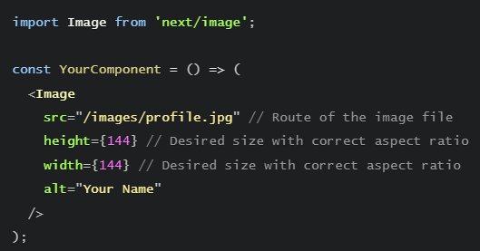
Using the Image Component
next/image is an extension of the HTML <img> element, evolved for the modern web.
Next.js also has support for Image Optimization by default. This allows for resizing, optimizing, and serving images in modern formats like WebP when the browser supports it. This avoids shipping large images to devices with a smaller viewport. It also allows Next.js to automatically adopt future image formats and serve them to browsers that support those formats.
Automatic Image Optimization works with any image source.
Even if the image is hosted by an external data source, like a CMS, it can still be optimized.

Slide 15
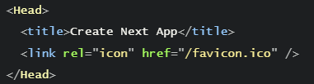
Metadata
What if we wanted to modify the metadata of the page, such as the <title> HTML tag?
<title> is part of the <head> HTML tag, so let's dive into how we can modify the <head> tag in a Next.js page.
Open pages/index.js in your editor and find the following lines:
Notice that <Head> is used instead of the lowercase <head>. <Head> is a React Component that is built into Next.js. It allows you to modify the <head> of a page.
You can import the Head component from the next/head module.

Slide 16

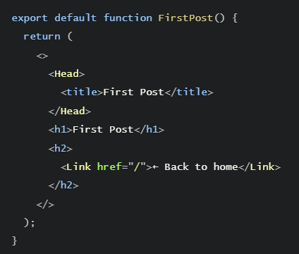
Using Head

Slide 17
Global Styles
CSS Modules are useful for component-level styles. But if you want some CSS to be loaded by every page, Next.js has support for that as well.

Slide 18
Pre-rendering and Data Fetching

Slide 19
Pre-rendering
By default, Next.js pre-renders every page.
This means that Next.js generates HTML for each page in advance, instead of having it all done by client-side JavaScript.
Pre-rendering can result in better performance and SEO.
Each generated HTML is associated with minimal JavaScript code necessary for that page.
When a page is loaded by the browser, its JavaScript code runs and makes the page fully interactive. (This process is called hydration.)

Slide 20
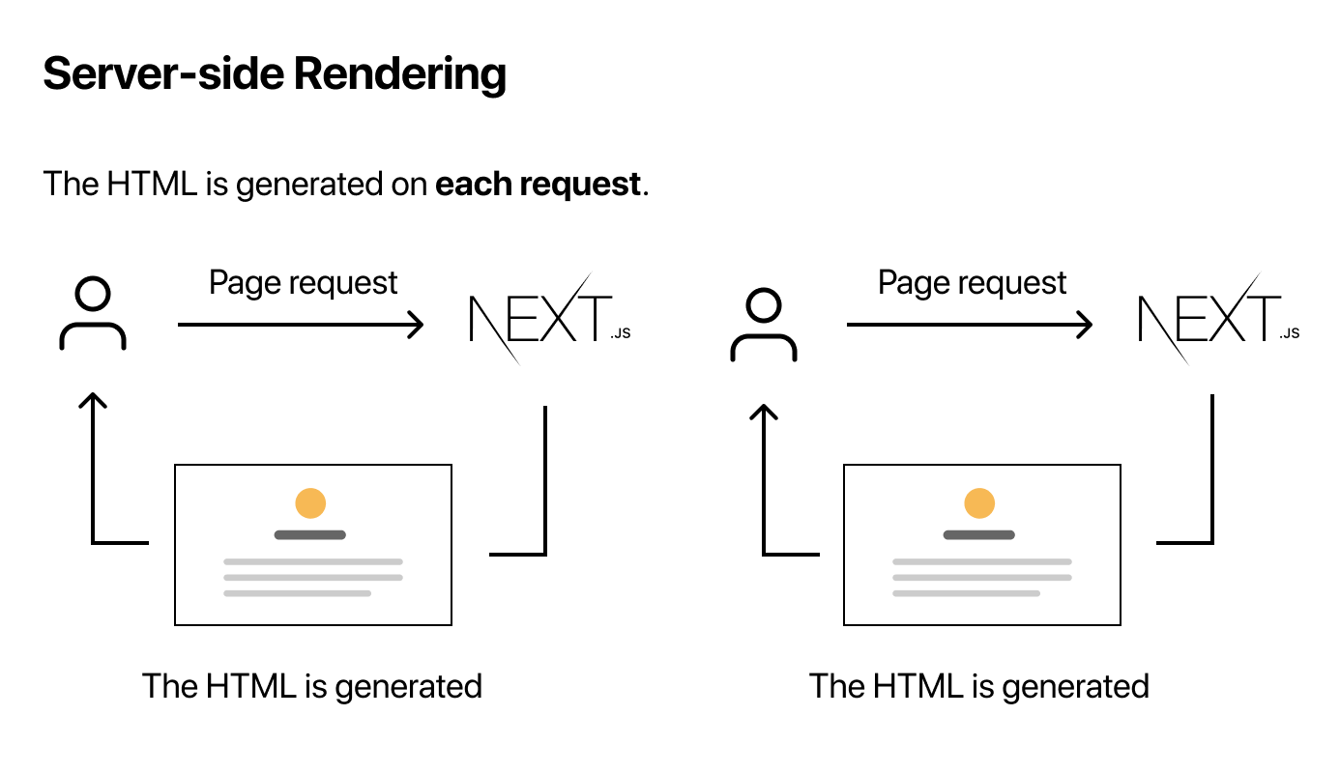
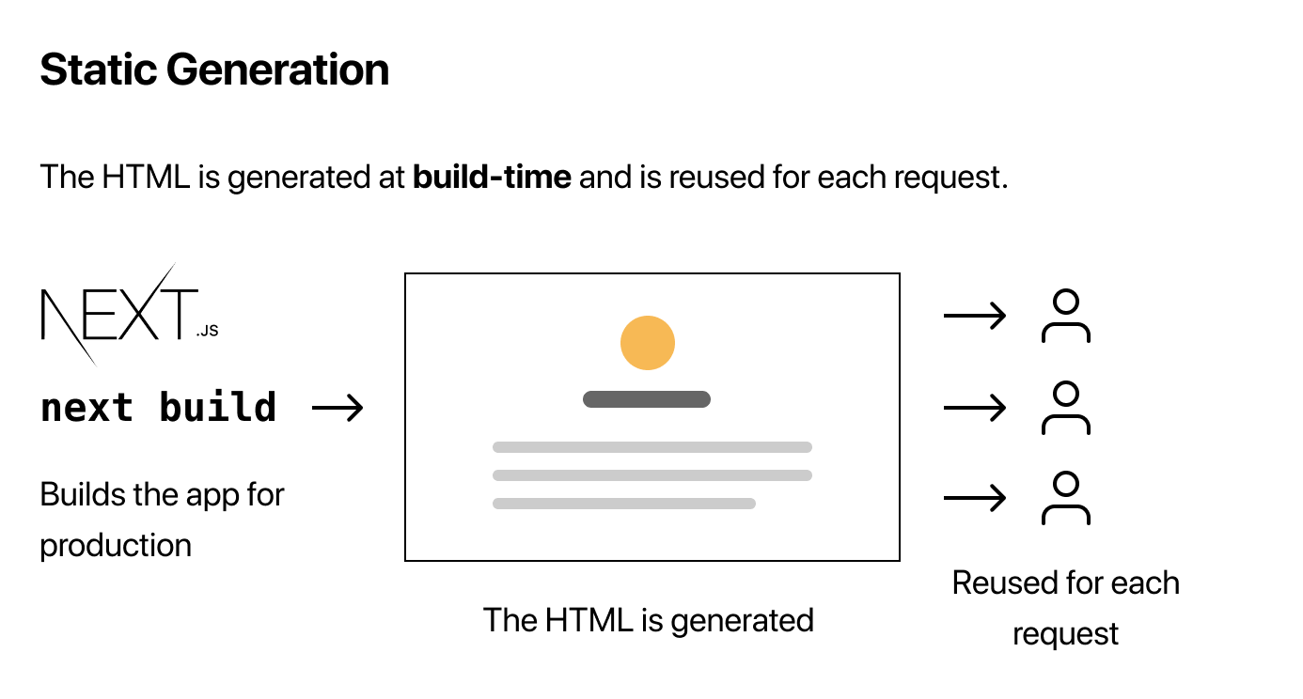
Two Forms of Pre-rendering
Next.js has two forms of pre-rendering: Static Generation and Server-side Rendering. The difference is in when it generates the HTML for a page.
Static Generation is the pre-rendering method that generates the HTML at build time. The pre-rendered HTML is then reused on each request.
Server-side Rendering is the pre-rendering method that generates the HTML on each request.

Slide 21
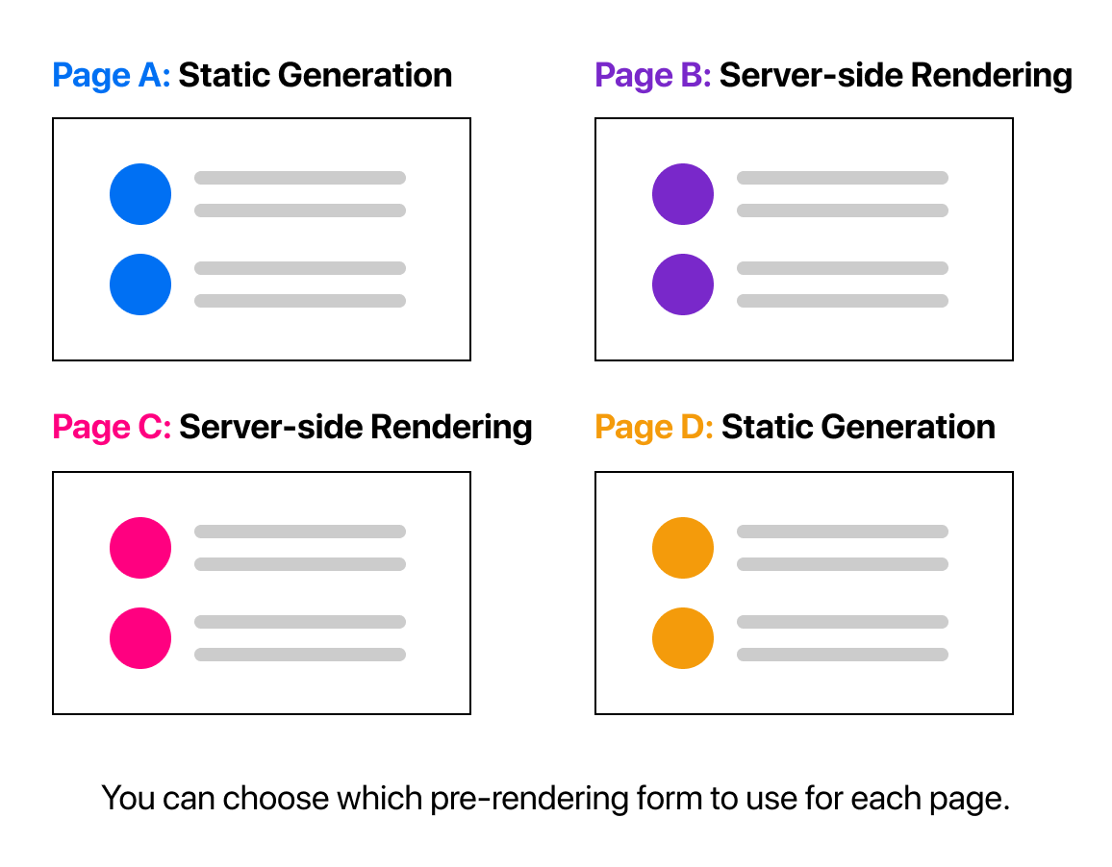
Per-page Basis
Importantly, Next.js lets you choose which pre-rendering form to use for each page.
You can create a "hybrid" Next.js app by using Static Generation for most pages and using Server-side Rendering for others.

Slide 22
When to Use Static Generation v.s. Server-side Rendering
We recommend using Static Generation (with and without data) whenever possible because your page can be built once and served by CDN, which makes it much faster than having a server render the page on every request.
You can use Static Generation for many types of pages, including:
Marketing pages
Blog posts
E-commerce product listings
Help and documentation

Slide 23
When to Use Static Generation v.s. Server-side Rendering
On the other hand, Static Generation is not a good idea if you cannot pre-render a page ahead of a user's request.
Maybe your page shows frequently updated data, and the page content changes on every request.
In that case, you can use Server-side Rendering.
It will be slower, but the pre-rendered page will always be up-to-date.
Or you can skip pre-rendering and use client-side JavaScript to populate frequently updated data.

Slide 24
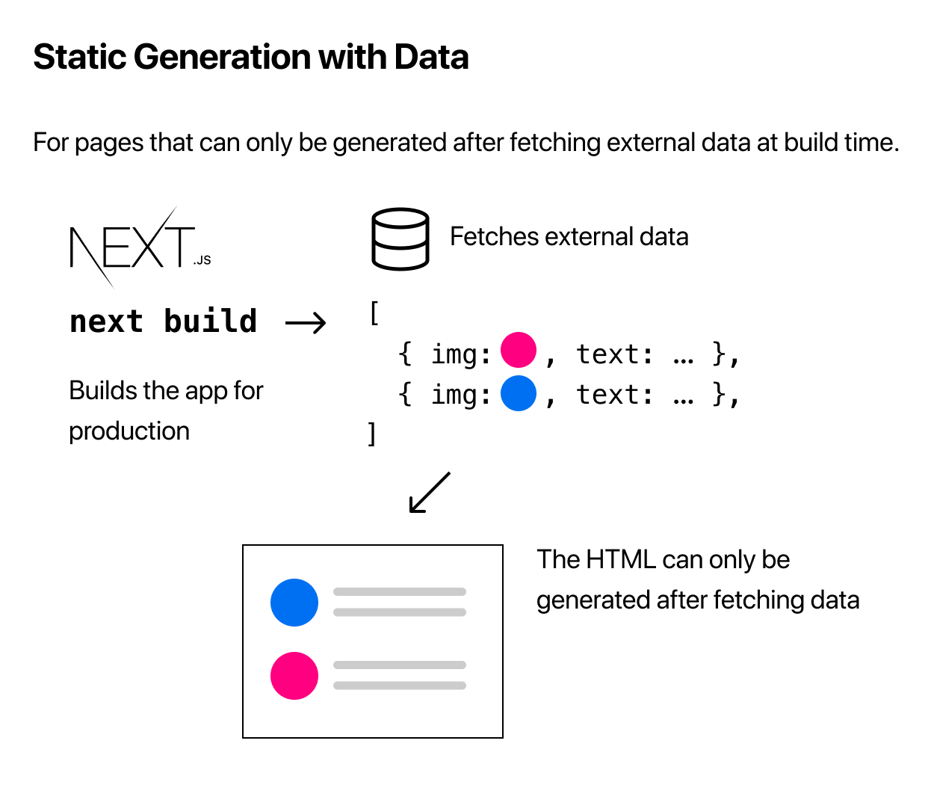
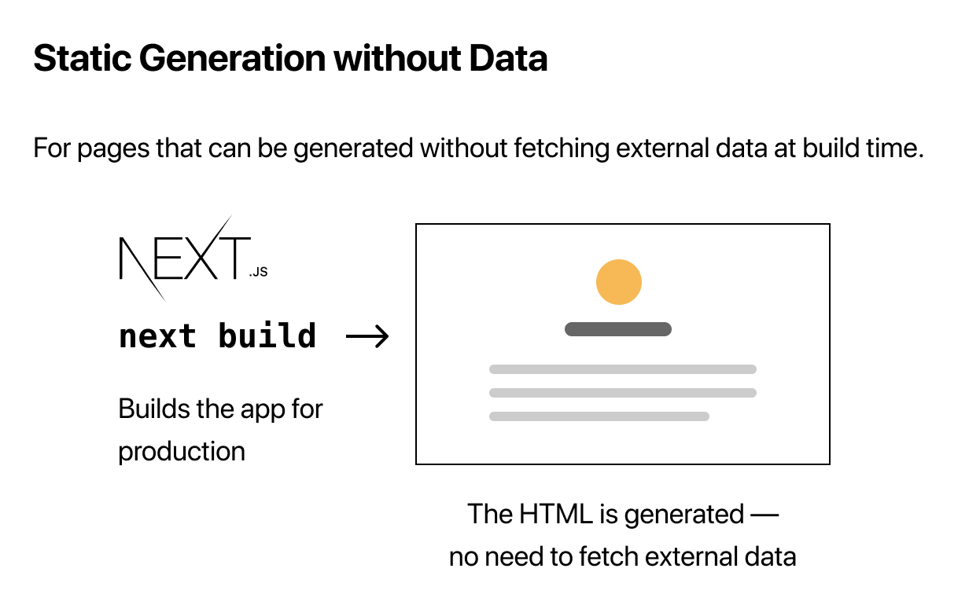
Static Generation with and without Data

Slide 25
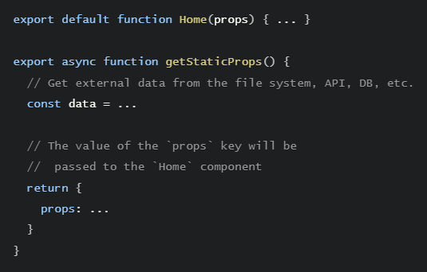
Static Generation with Data using getStaticProps
In Next.js, when you export a page component, you can also export an async function called getStaticProps. If you do this, then:
getStaticProps runs at build time in production, and…
Inside the function, you can fetch external data and send it as props to the page.
Essentially, getStaticProps allows you to tell Next.js: “Hey, this page has some data dependencies — so when you pre-render this page at build time, make sure to resolve them first!”

Slide 26
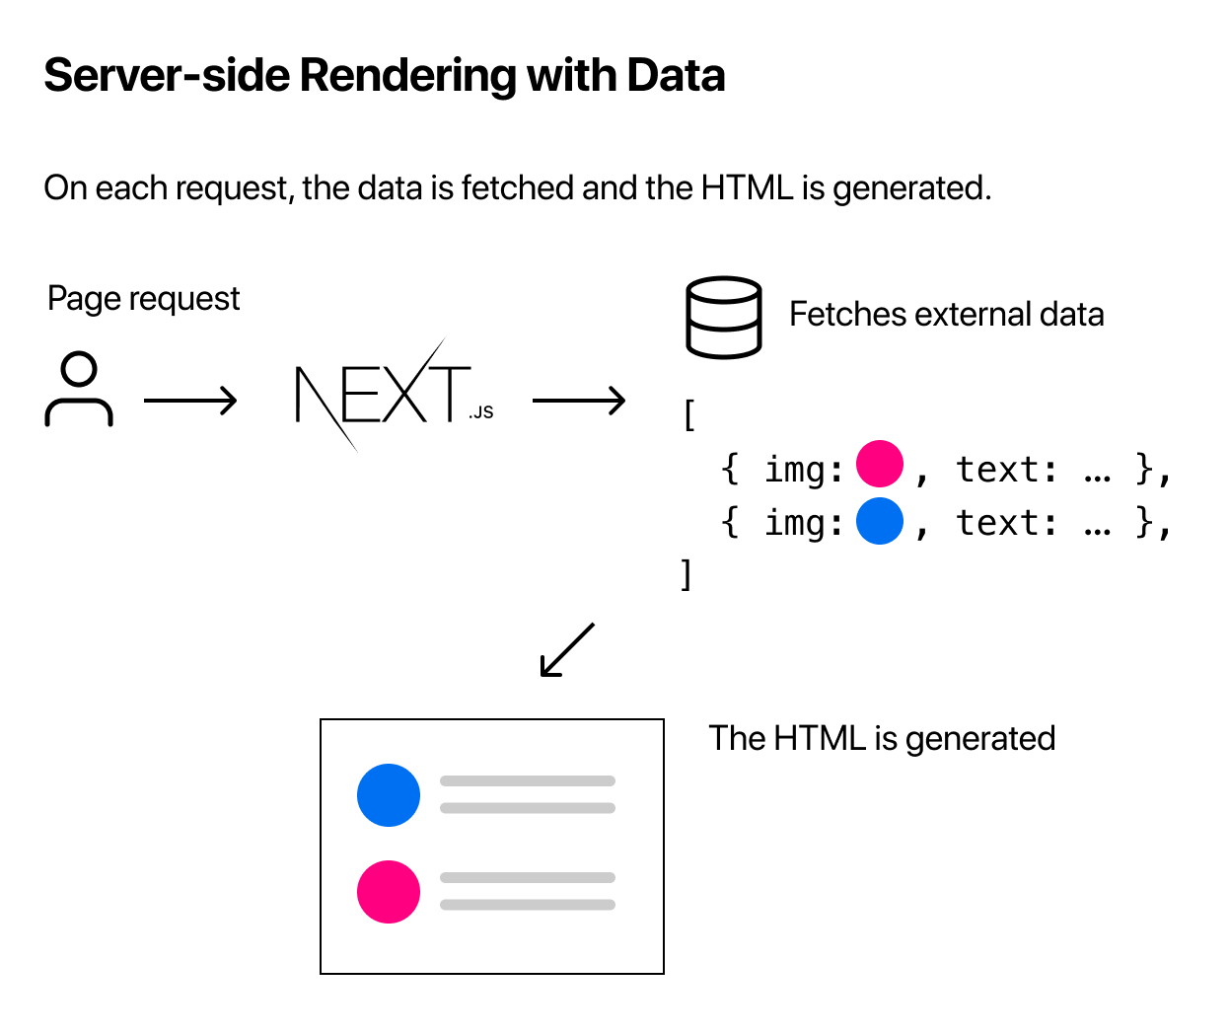
Fetching Data at Request Time
If you need to fetch data at request time instead of at build time, you can try Server-side Rendering:
To use Server-side Rendering, you need to export getServerSideProps instead of getStaticProps from your page.

Slide 27
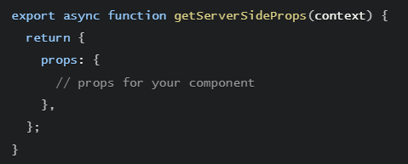
Using getServerSideProps
Because getServerSideProps is called at request time, its parameter (context) contains request specific parameters.
You should use getServerSideProps only if you need to pre-render a page whose data must be fetched at request time.
Time to first byte (TTFB) will be slower than getStaticProps because the server must compute the result on every request, and the result cannot be cached by a CDN without extra configuration.

Slide 28
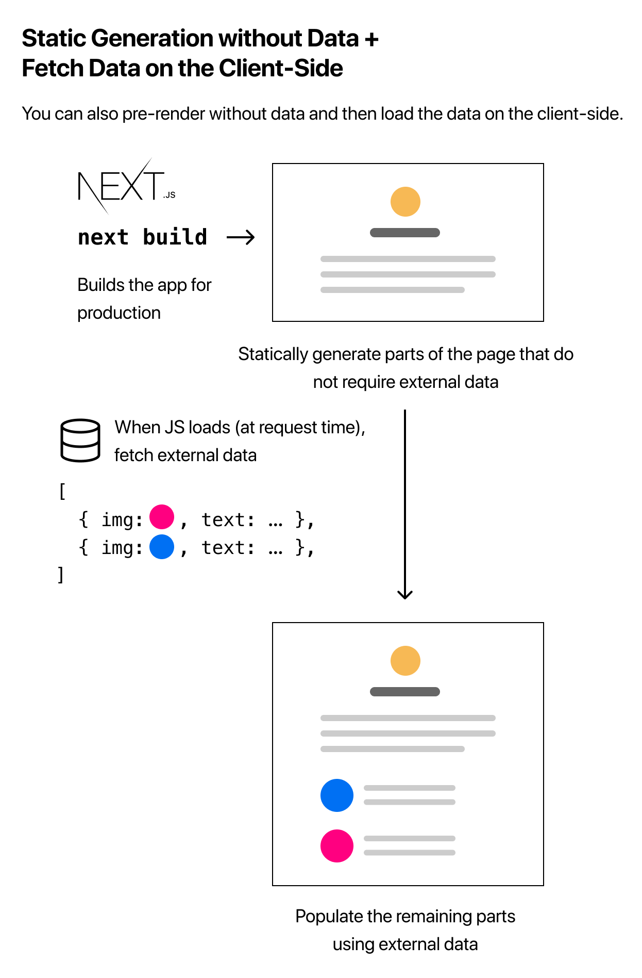
Client-side Rendering
If you do not need to pre-render the data, you can also use the following strategy (called Client-side Rendering):
Statically generate (pre-render) parts of the page that do not require external data.
When the page loads, fetch external data from the client using JavaScript and populate the remaining parts.
This approach works well for user dashboard pages, for example. Because a dashboard is a private, user-specific page, SEO is not relevant, and the page doesn’t need to be pre-rendered. The data is frequently updated, which requires request-time data fetching.

Slide 29
Dynamic Routes
The URL for the pages depends on some data, which means we need to use dynamic routes.

Slide 30
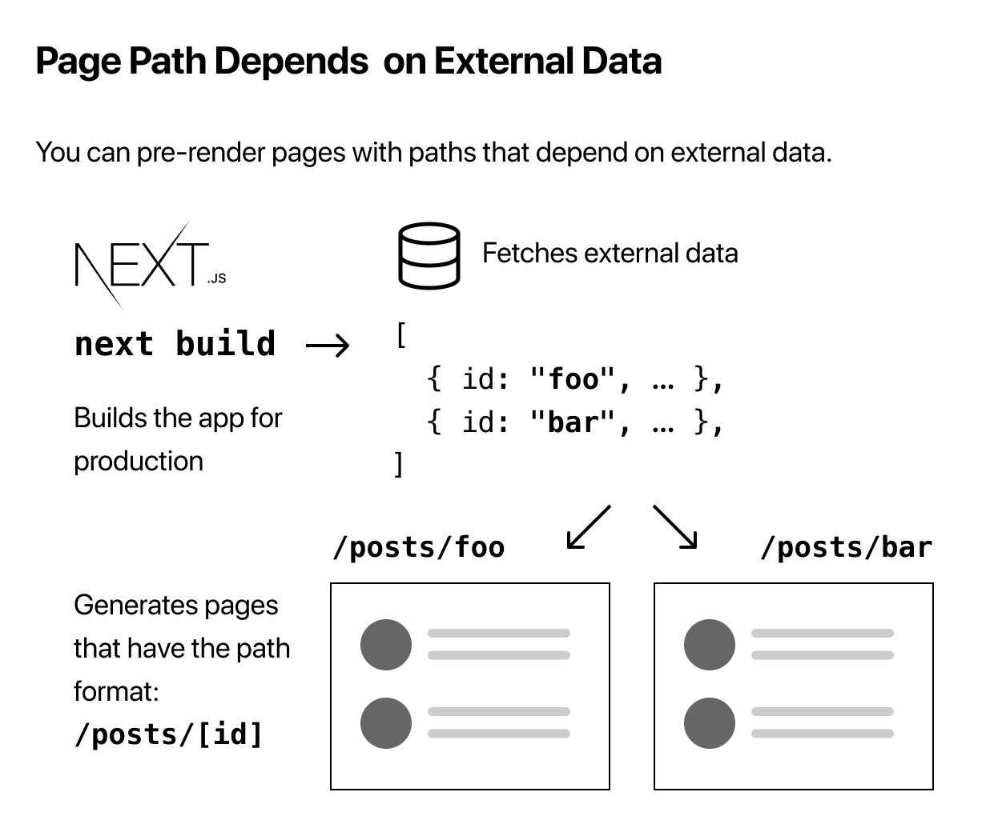
Page Path Depends on External Data
Let’s talk about the case where each page path depends on external data.
Next.js allows you to statically generate pages with paths that depend on external data.
This enables dynamic URLs in Next.js.
Pages that begin with [ and end with ] are dynamic routes in Next.js.
For Example :
[id].js

Slide 31
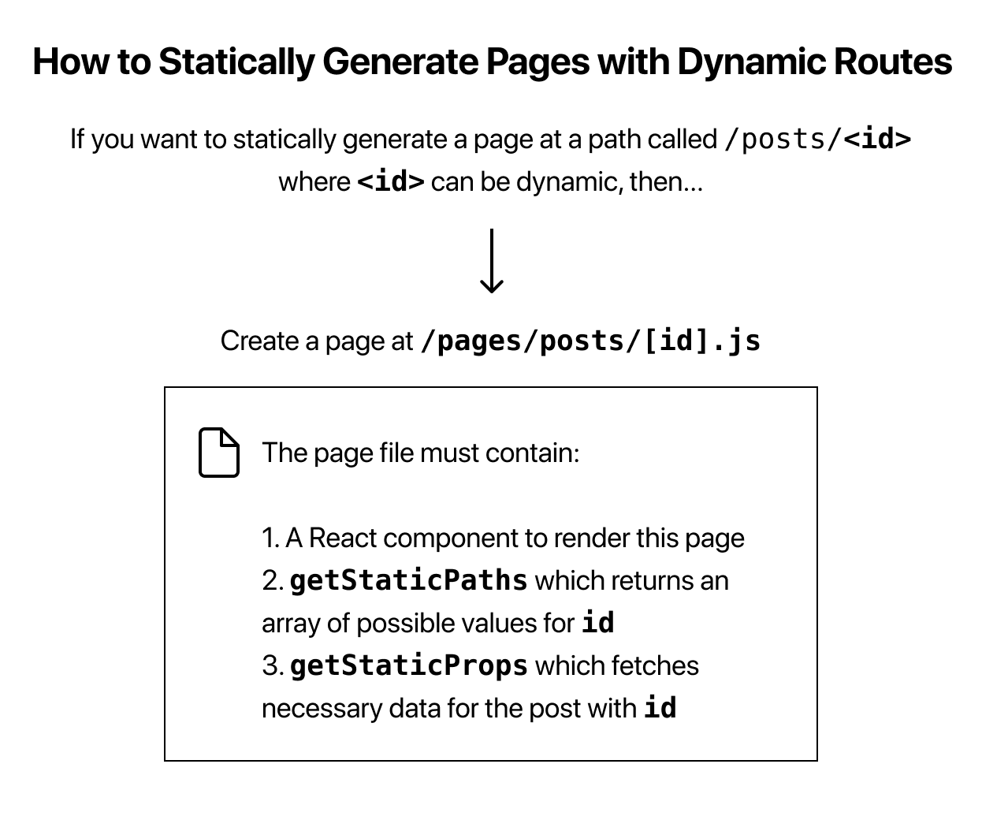
Dynamic Routes

Slide 32
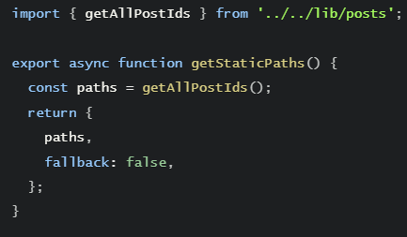
Fallback
we returned fallback: false from getStaticPaths.
If fallback is false, then any paths not returned by getStaticPaths will result in a 404 page.
If fallback is true, then the behavior of getStaticProps changes:
The paths returned from getStaticPaths will be rendered to HTML at build time.
The paths that have not been generated at build time will not result in a 404 page. Instead, Next.js will serve a “fallback” version of the page on the first request to such a path.
In the background, Next.js will statically generate the requested path. Subsequent requests to the same path will serve the generated page, just like other pages pre-rendered at build time.

Slide 33
Catch-all Routes
Dynamic routes can be extended to catch all paths by adding three dots (...) inside the brackets. For example:
pages/posts/[...id].js matches /posts/a, but also /posts/a/b, /posts/a/b/c and so on.

Slide 34
Router
If you want to access the Next.js router, you can do so by importing the useRouter hook from next/router.

Slide 35
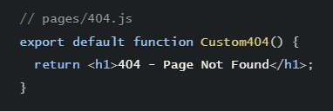
404 Pages
To create a custom 404 page, create pages/404.js. This file is statically generated at build time.

Slide 36
API Routes
Next.js has support for API Routes, which let you easily create an API endpoint as a Node.js serverless function.

Slide 37
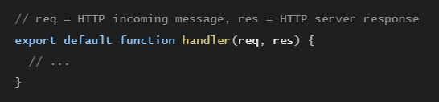
Creating API Routes
API Routes let you create an API endpoint inside a Next.js app. You can do so by creating a function inside the pages/api directory that has the following format:
They can be deployed as Serverless Functions (also known as Lambdas).

Slide 38
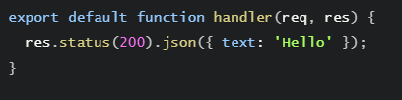
Creating a simple API endpoint
Let’s try it out. Create a file called hello.js in pages/api with the following code:
Try accessing it at http://localhost:3000/api/hello. You should see {"text":"Hello"}. Note that:
req is an instance of http.IncomingMessage, plus some pre-built middlewares.
res is an instance of http.ServerResponse, plus some helper functions.

Slide 39
Deploying Your Next.js App
Deploy Next.js to Vercel, the platform built by the creators of Next.js

Slide 40
Push to GitHub
Before we deploy, let’s push our Next.js app to GitHub if you haven’t done so already. This will make deployment easier.

Slide 41
Deploy to Vercel
The easiest way to deploy Next.js to production is to use the Vercel platform developed by the creators of Next.js.
Vercel is a serverless platform for static and hybrid applications built to integrate with your headless content, commerce, or database.
We make it easy for frontend teams to develop, preview, and ship delightful user experiences, where performance is the default. You can start using it for free — no credit card required.

Slide 42
Deploy to Vercel
Create a Vercel Account
Import your project repository

