Slide 1
SEARCH ENGINE OPTIMIZATION

Slide 2
What is SEO?
SEO stands for Search Engine Optimization.
The goal of SEO is to create a strategy that will increase your rankings position in search engine results.
The higher the ranking, the more organic traffic to your site, which ultimately leads to more business for you!

Slide 3
Why is SEO so important?
SEO is the key to increased conversion and confidence in your brand.
Higher search ranking placement equates to more organic visitors.
Search engine organic traffic – visitors who come to your site through clicking a result in a search engine – is key to many businesses for three reasons:
Qualitative – Increased chance that visitors turn into customers.
Trustable – Higher confidence in your brand or mission.
Low-Cost – Aside from the time and effort spent, having good SEO practices that result in higher search engine ranking is free. There is no direct cost to appear in top organic search results positions.

Slide 4
Three Pillars of Optimization
Technical – Optimize your website for crawling and web performance.
Creation – Create a content strategy to target specific keywords.
Popularity – Boost your site's presence online so search engines know you are a trusted source. This is done through the use of backlinks – third-party sites that link back to your site.
The SEO discipline is broad and has many facets, but as a Next.js developer, the first step is to understand how you can make your web app SEO-ready with some best practices.

Slide 5
Search Systems
Search Systems are what you typically refer to as Search Engines (Google, Bing, DuckDuckGo, etc.). They are massively complex systems that tackle some of the biggest challenges in technology history.
Search Systems have four main responsibilities:
Crawling – the process of going through the Web and parsing the content in all websites. This is a massive task as there are over 350 million domains available.
Indexing – finding places to store all of the data gathered during the crawling stage so it can be accessed.
Rendering – executing any resources on the page such as JavaScript that might enhance the features and enrich content on the site. This process doesn't happen for all pages that are crawled and sometimes it happens before the content is actually indexed. Rendering might happen after indexing if there are no available resources to perform the task at the time.
Ranking – querying data to craft relevant results pages based on user input. This is where the different ranking criteria are applied in Search engines to give users the best answer to fulfill their intent.

Slide 6
What are Web Crawlers?
In order for your website to appear in search results, Google (as well as other search engines such as Bing, Yandex, Baidu, Naver, Yahoo or DuckDuckGo) use web crawlers to navigate the website to discover websites and its web pages.
Web crawlers are a type of bot that emulate users and navigate through links found on the websites to index the pages. Web crawlers identify themselves using custom user-agents. Google has several web crawlers, but the ones that are used more often are Googlebot Desktop and Googlebot Smartphone.

Slide 7
Crawling and Indexing

Slide 8
What are HTTP Status Codes?
HTTP response status codes indicate whether a specific HTTP request has been successfully completed.
There are many status codes, but only a handful are meaningful in an SEO context.
200 : HTTP 200 OK
301 : HTTP 301 Moved Permanently
308 : Permanent Redirect
302 : HTTP 302 Found
404 : HTTP 404 Not Found
410 : HTTP 410 Gone
500 : HTTP 500 Internal Server Error
503 : HTTP 503 Service Unavailable

Slide 9
What is a robots.txt File?
A robots.txt file tells search engine crawlers which pages or files the crawler can or can't request from your site. The robots.txt file is a web standard file that most good bots consume before requesting anything from a specific domain.
You might want to protect certain areas from your website from being crawled, and therefore indexed, such as your CMS or admin, user accounts in your e-commerce, or some API routes, to name a few.
These files must be served at the root of each host, or alternatively you can redirect the root /robots.txt path to a destination URL and most bots will follow.

Slide 10
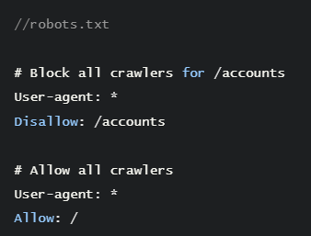
How to add a robots.txt file to a Next.js project
Thanks to static file serving in Next.js we can easily add a `robots.txt` file. , we would create a new file named `robots.txt` the public folder in the root directory.
An example of what you could put in this file would be:

Slide 11
XML Sitemaps
Sitemaps are the easiest way to communicate with Google.
They indicate the URLs that belong to your website and when they update so that Google can easily detect new content and crawl your website more efficiently.
Even though XML Sitemaps are the most known and used ones, they can also be created via RSS or Atom, or even via Text files if you prefer maximum simplicity.
A sitemap is a file where you provide information about the pages, videos, and other files on your site, and the relationships between them. Search engines like Google read this file to more intelligently crawl your site.

Slide 12
How to Add Sitemaps to a Next.js Project
Manual
If you have a relatively simple and static site, you can manually create a sitemap.xml in the public directory of your project:
getServerSideProps
It's more likely your site will be dynamic. In this case, we can leverage getServerSideProps to generate an XML sitemap on-demand.
We can create a new page inside the pages directory such as pages/sitemap.xml.js. The goal of this page will be to hit our API to get data that will allow us to know the URLs of our dynamic pages. We will then write an XML file as the response for /sitemap.xml

Slide 13
Special Meta Tags for Search Engines
Meta robot tags are directives that search engines will always respect. Adding these robots tags can make the indexation of your website easier.
There is a difference between directives and suggestions. Meta robots tags orrobots.txt files are directives and will always be obeyed. Canonical tags are recommendations that Google can decide to obey or not.

Slide 14
Special Meta Tags for Search Engines
noindex
To not show this page in search results. Omitting noindex will indicate the page can be indexed and shown in search results.
When building a website, you might not want to index certain pages. Common use cases include settings pages, internal search pages, policies, and more.
nofollow
To not follow links on this page. Omitting this will allow robots to crawl and follow links on this page. Links found on other pages may enable crawling, so if link A appears in pagesX and Y, and X has a nofollow robots tag, but Y doesn't, Google may decide to crawl the link.

Slide 15
Rendering and Ranking

Slide 16
Rendering and Ranking
JavaScript is an important part of the web development ecosystem. In the past, most programming languages were sending all content directly from the server.
With technology like JavaScript, fetching information from the browser became more popular than ever. This, in turn, affected search engines and their ability to understand pages, as most bots were only parsing the initial HTML from the server and loading it to the browser.

Slide 17
Rendering Strategies

Slide 18
Static Site Generation (SSG)
Static site generation is where your HTML is generated at build time.
This HTML is then used for each request.
Static site generation is probably the best type of rendering strategy for SEO as not only do you have all the HTML on page load because it's pre-rendered, but it also helps with page performance – now another ranking factor when it comes to SEO.

Slide 19
Server-Side Rendering (SSR)
Like SSG, Server-Side Rendering (SSR) is pre-rendered, which also makes it great for SEO.
Instead of being generated at build time, as in SSG, SSR's HTML is generated at request time.
This is great for when you have pages that are very dynamic.

Slide 20
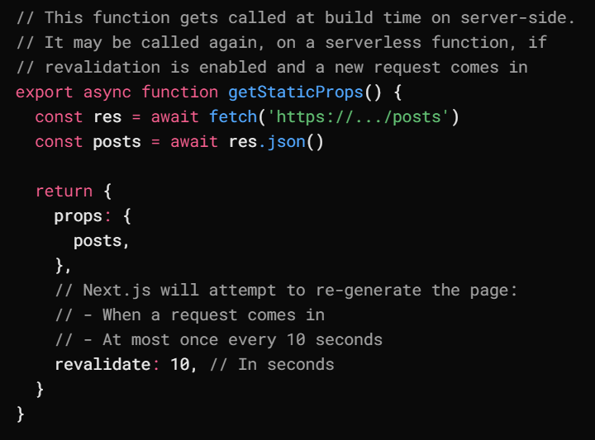
Incremental Static Regeneration (ISR)
If you have a very large number of pages, generating them all at build time may not be feasible.
Next.js allows you to create or update static pages after you have built your site.
Incremental Static Regeneration enables developers and content editors to use static generation on a per-page basis, without needing to rebuild the entire site.
With ISR, you can retain the benefits of static while scaling to millions of pages.
To use ISR, add the revalidate prop to getStaticProps

Slide 21
Client Side Rendering (CSR)
Client-Side Rendering allows developers to make their websites entirely rendered in the browser with JavaScript.
On initial page load a single HTML file is generally served with little to no content until you fetch the JavaScript and the browser compiles everything.
As we commented above, in general Client-Side Rendering is not recommended for optimal SEO.
CSR is perfect for data heavy dashboards, account pages or any page that you do not require to be in any search engine index.

Slide 22
URL Structure
URL Structure is an important part of an SEO strategy.
You might want to follow some principles:
Semantic: It's best to use URLs that are semantic, meaning that they use words instead of IDs or random numbers. Example: /learn/basics/create-nextjs-app is better than /learn/course-1/lesson-1
Patterns that are logical and consistent: URLs should follow some sort of pattern that is consistent among pages. For example, you want to have a folder that groups all product pages, instead of having different paths for each product that you have.
Keyword focused: Google still bases a considerable part of their systems on the keywords a website contains. You might want to use keywords in your URLs to facilitate understanding the purpose of the pages.
Not parameter-based: Using parameters to build your URLs is generally not a good idea. They are not semantic in most cases, and search engines might confuse them and demote their rankings in results.

Slide 23
How are Routes Defined in Next.js?
Next.js uses file-system routing built on the concept of pages. When a file is added to the pages directory, it is automatically available as a route. The files and folders inside the pages directory can be used to define most common patterns.
Let's take a look at a couple of simple URLs and how you would add them to your Next.js router:
Homepage: https://www.example.com → pages/index.js
Listings: https://www.example.com/products → pages/products.js or pages/products/index.js
Detail: https://www.example.com/products/product → pages/products/product.js
For a blog or e-commerce site you will likely want to use the product ID or blog name as the slug for the URL. This is called dynamic routing:
Product:https://www.example.com/products/nextjs-shirt → pages/products/[product].js
Blog:https://www.example.com/blog/seo-in-nextjs → pages/blog/[blog-name].js
To use dynamic routing, you can add brackets to a page name inside your products or blogs subfolder.

Slide 24
Metadata
Metadata is the abstract of the website's content and is used to attach a title, a description, and an image to the site.

Slide 25
Title
The title tag is one of the most important SEO elements for two main reasons:
Firstly, it's what users see when they click to enter your website from search results.
Secondly, it's one of the main elements Google uses to understand what your page is about. Using keywords in the title is recommended because it usually leads to increased improved ranking positions in search engines.

Slide 26
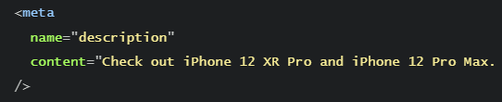
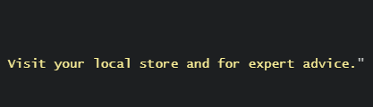
Description
The description meta tag is another important SEO element, but less so than the title. According to Google, this element is not taken into account for ranking purposes, but it can affect your click-through-rate on search results.
Use the description meta tag to complement the information in your title. Work in more keywords to the content here if there are some that didn't fit in the title. These keywords will appear in bold if a user's search contains them.

Slide 27
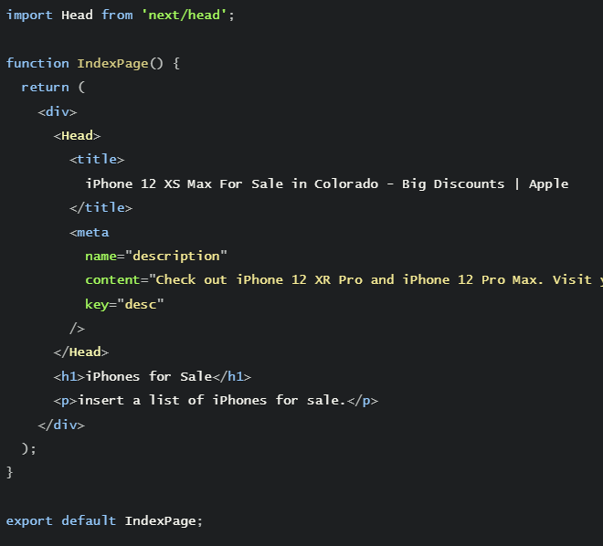
Description
In Next.js, we set the title and description in the Head component.
The Head component can be used on any page in your application to describe or provide information about the page's contents.

Slide 28
On Page SEO
At a high level, on page SEO refers to the headings and links that make up the overall structure of the page. Headings indicate importance in the document and links connect the web together.

Slide 29
Headings and H1
Headings help users understand the structure of a page and what they are going to read in the next paragraphs. They also facilitate the search engine's job of understanding which parts of the page are the most important.
Headings go from 1-6 and Heading 1 tends to be thought of as the most important. It's recommended to use the H1 heading tag in each page. H1 should represent what the page is about and be similar to your title tag

Slide 30
Internal Links
The internet is connected by links. Without links from one website to another, the internet probably wouldn't exist. Websites that receive more links tend to represent websites that are more trusted by users.
Google started this principle with the invention of the PageRank Algorithm.
The PageRank algorithm, at a high level, is an algorithm that goes through every link on a database and scores domains based on how many links they receive (quantity) and from which domains (quality). Lots of links from spam websites most likely have little to no value.

Slide 31
next/link
Next.js provides the Link component that enables client-side transitions between routes.
The href prop is required and will correctly add the link to the anchor tag, which is vital for SEO.
When Google crawls a page, it will crawl and follow this link without relying on JavaScript.

