Slide 1
Web Performance & Core Web Vital

Slide 2
Web Performance & Core Web Vital
Web Vitals is an initiative created by Google to provide unified guidance and metrics to measure end-user page experience on the web.
Core Web Vitals is a subset of Web Vitals, and currently consists of three metrics that measure loading, interactivity, and visual stability. These metrics are Largest Contentful Paint (LCP), First Input Delay (FID), and Cumulative Layout Shift (CLS).
Achieving a great score in these three metrics will create a smoother website experience for your users.
Websites scoring poorly in each of the Core Web Vitals metrics will impact its search engine ranking as Google starts to use Core Web Vitals as a ranking factor for their search algorithm. Poor vitals can have an impact on your web traffic and business.

Slide 3
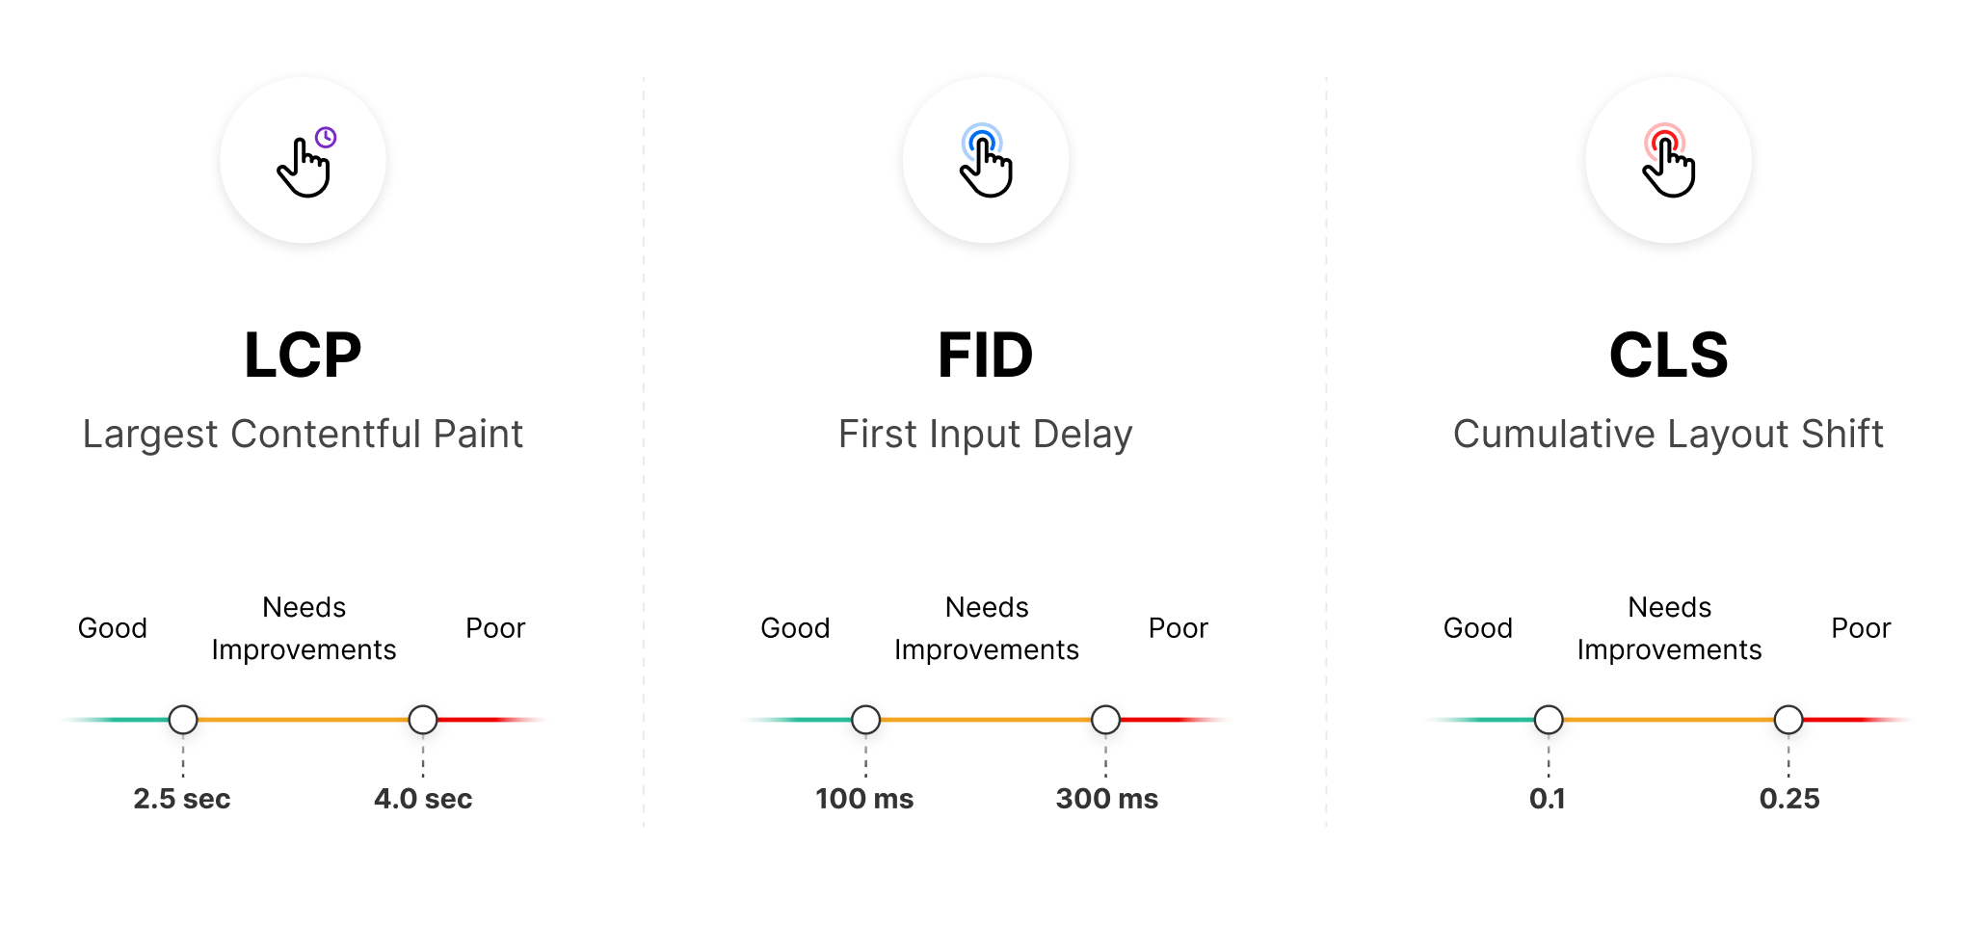
Core Web Vitals
There are three different values when measuring Core Web Vitals: "Good", "Needs Improvement", and "Poor".
These values differ based on the vital being measured:

Slide 4
Core Web Vitals
You can approach Core Web Vitals in two different ways:
Try to achieve the highest score possible on each metric. Striving for perfection is great, but it might be tricky on large websites with many dependencies.
Benchmark against competitors in your industry. You are not competing with every perfectly optimized website in Google search, but with others ranking for your target keywords.

Slide 5
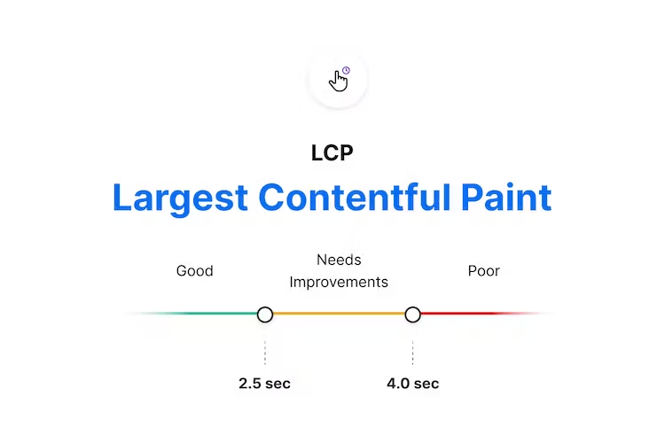
Largest Contentful Paint (LCP)
The Largest Contentful Paint (LCP) metric looks at the loading performance of your page. LCP measures the time it takes to get the largest element on the page visible within the viewport.
This could be a large text block, video, or image that takes up the primary real estate on the page.
As the DOM is rendered, the largest element on the page may change.
The Largest Contentful Paint doesn't stop counting until the largest image or element is seen on-screen.

Slide 6
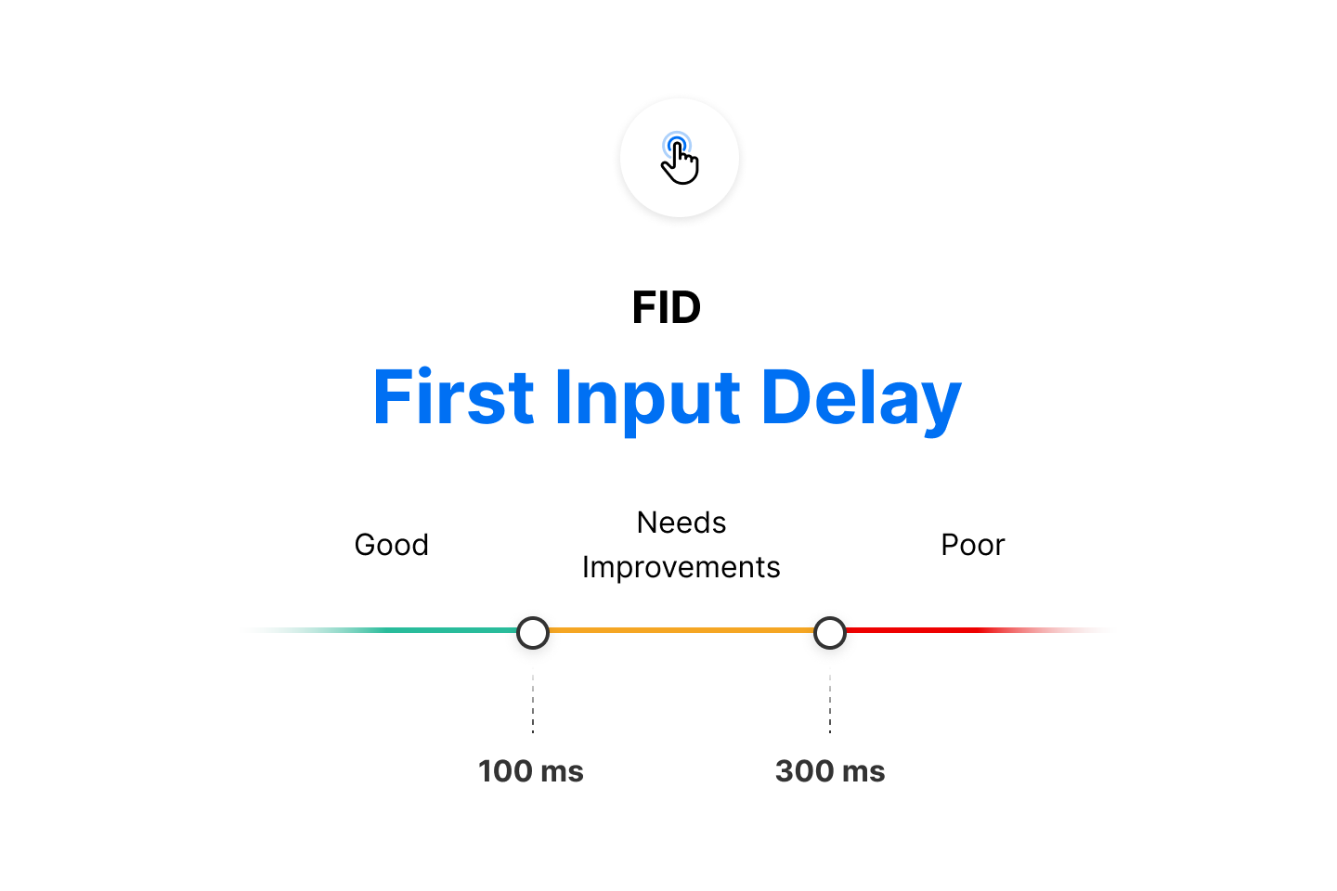
First Input Delay (FID)
The First Input Delay (FID) metric is the perception of an end user’s experience while interacting with a web page.
Imagine clicking inside an input box only for nothing to happen – this frustration with the interactivity and responsiveness of a site is caused by large input delays.

Slide 7
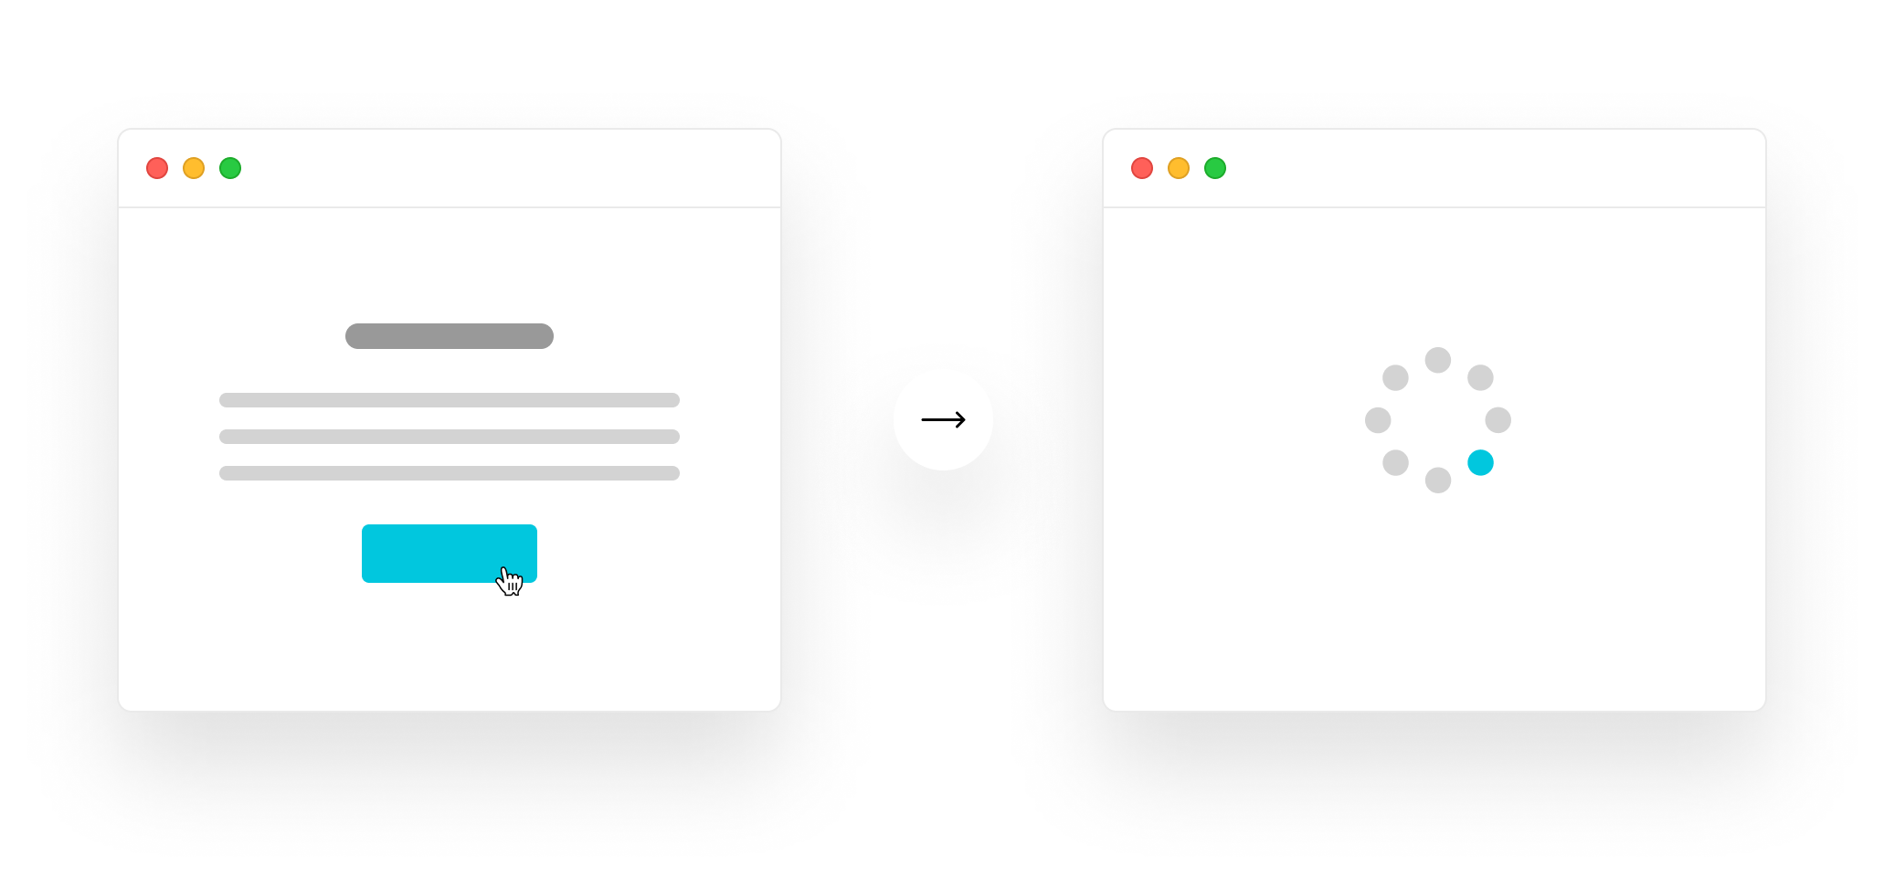
First Input Delay (FID)
FID requires real user data and cannot be measured in the lab (e.g. Google Lighthouse).
However, the Total Blocking Time (TBT) metric is lab-measurable and captures issues that affect interactivity.
FID happens when the browser’s main thread is performing other tasks and is unable to respond to the user’s request.

Slide 8
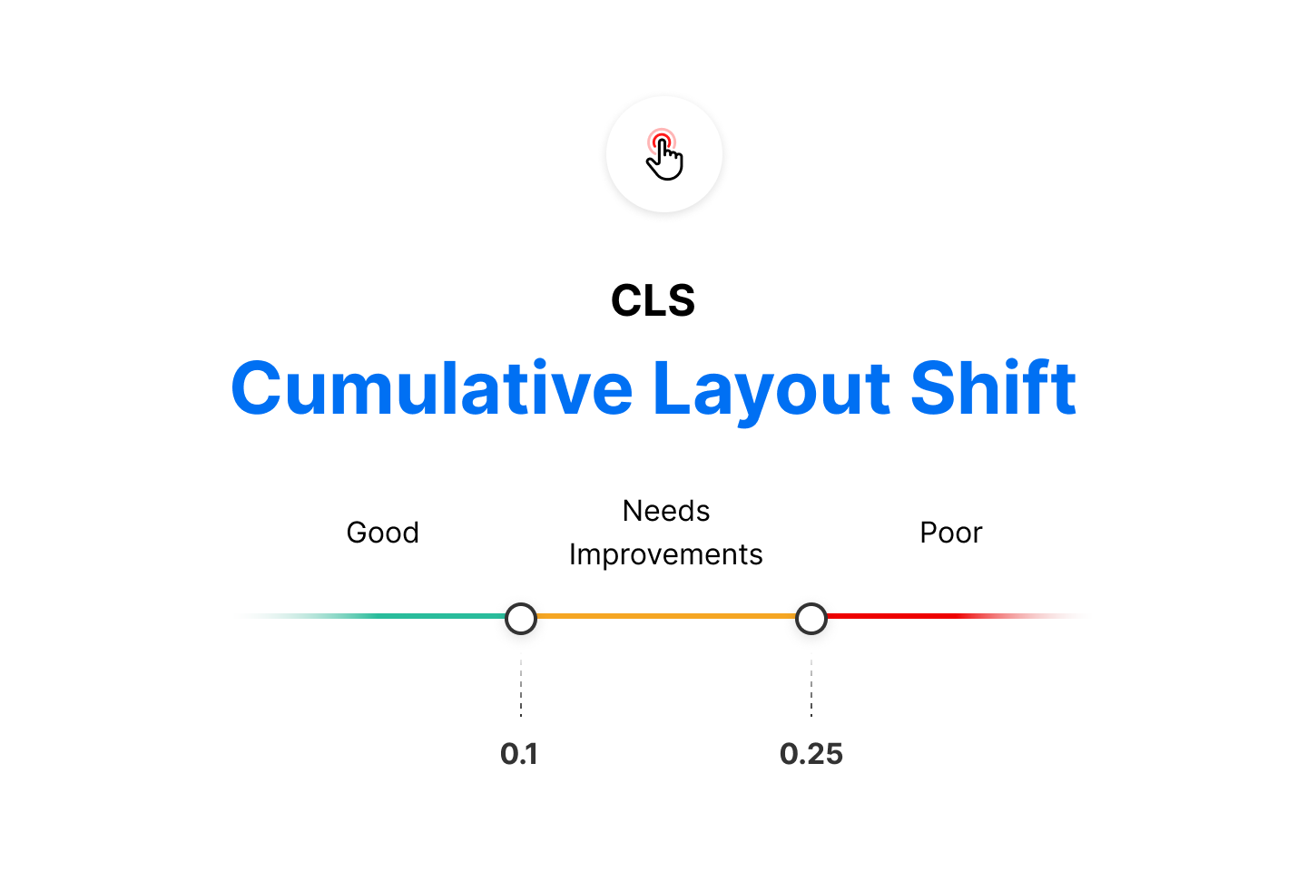
Cumulative Layout Shift (CLS)
The Cumulative Layout Shift (CLS) metric is a measure of your site’s overall layout stability.
A site that unexpectedly shifts layout as the page loads can lead to accidental user error and distraction.
Cumulative Layout Shift (CLS) occurs when elements have been shifted after initially being rendered by the DOM.
Here, a button was rendered to the screen after the text block, causing the block to shift downward.
A combination of impact and distance is considered when calculating CLS.

Slide 9

Cumulative Layout Shift (CLS)
Each element’s individual layout shift score is only counted toward CLS if unexpected movement occurs.
If a new element is added to the DOM or an existing element changes size, it doesn’t count toward layout shift if the loaded elements maintain their position.
Elements that shift position when new elements render to screen affect CLS.

Slide 10
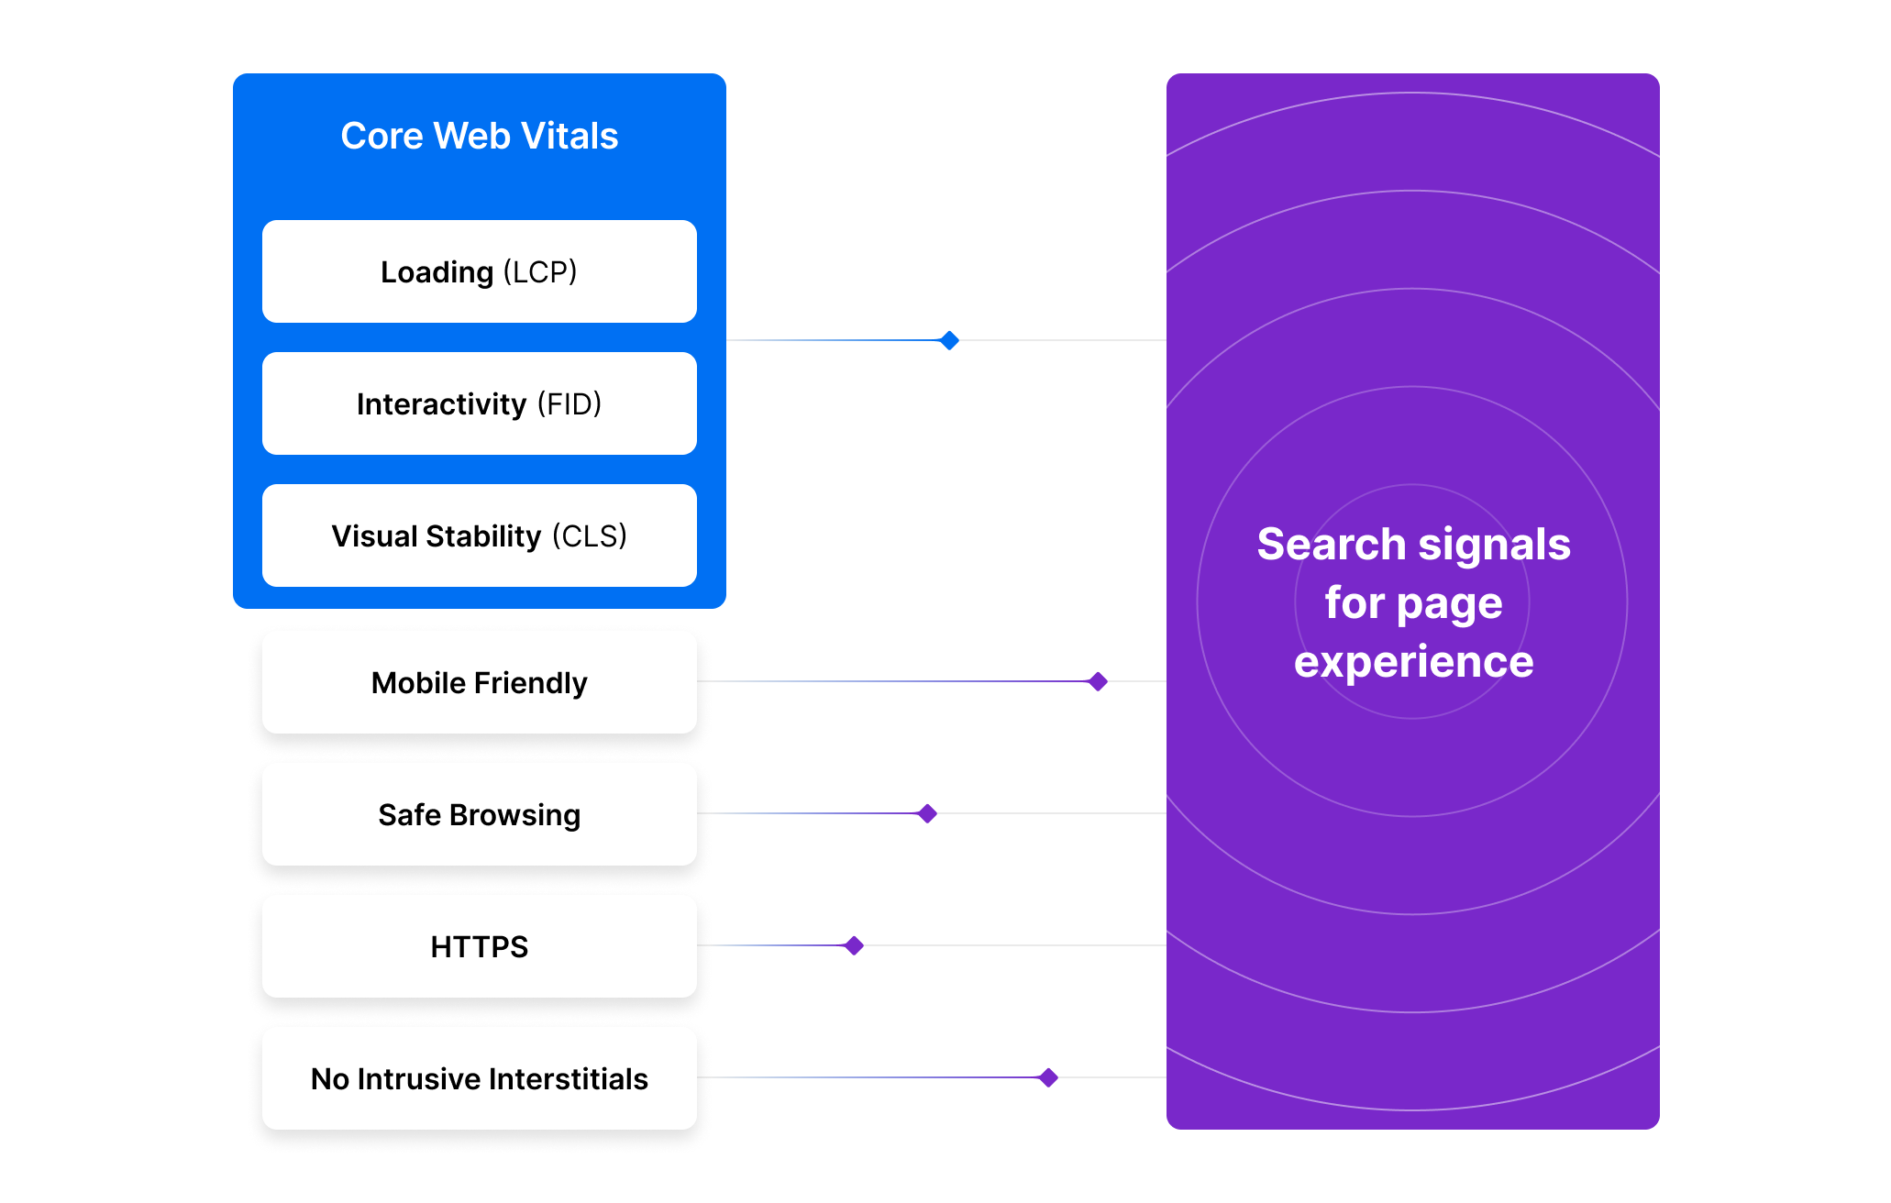
SEO Impact
The main objective of Google's search engine is to give users the best results possible while taking localization and misspellings into account. In every case, Google cares about giving users a fast and smooth result with great website experience.

Slide 11
Lighthouse (v6) Weights for Vitals
The three metrics are not necessarily valued equally.
In Lighthouse, different weights are assigned to each of the Core Web Vitals:
Largest Contentful Paint: 25%
Total Blocking Time*: 25%
First Contentful Paint: 15%
Speed Index: 15%
Time to Interactive: 15%
Cumulative Layout Shift: 5%
*This is similar to First Input Delay.
Lighthouse is an open-source, automated tool for improving the quality of web pages.
You can run it against any web page, public or requiring authentication.
It has audits for performance, accessibility, progressive web apps, SEO, and more.

Slide 12
Improving your Core Web Vitals

Slide 13
Introducing Lighthouse
Core Web Vitals focus on aspects of the user experience via loading performance (Largest Contentful Paint), interactivity (First Input Delay), and visual stability (Cumulative Layout Shift).
Lighthouse works by running a series of audits on a provided URL. Based on these audits, it generates a report on how well the page performed. If there are areas that need improvement, the report will provide insight on how to improve.

Slide 14
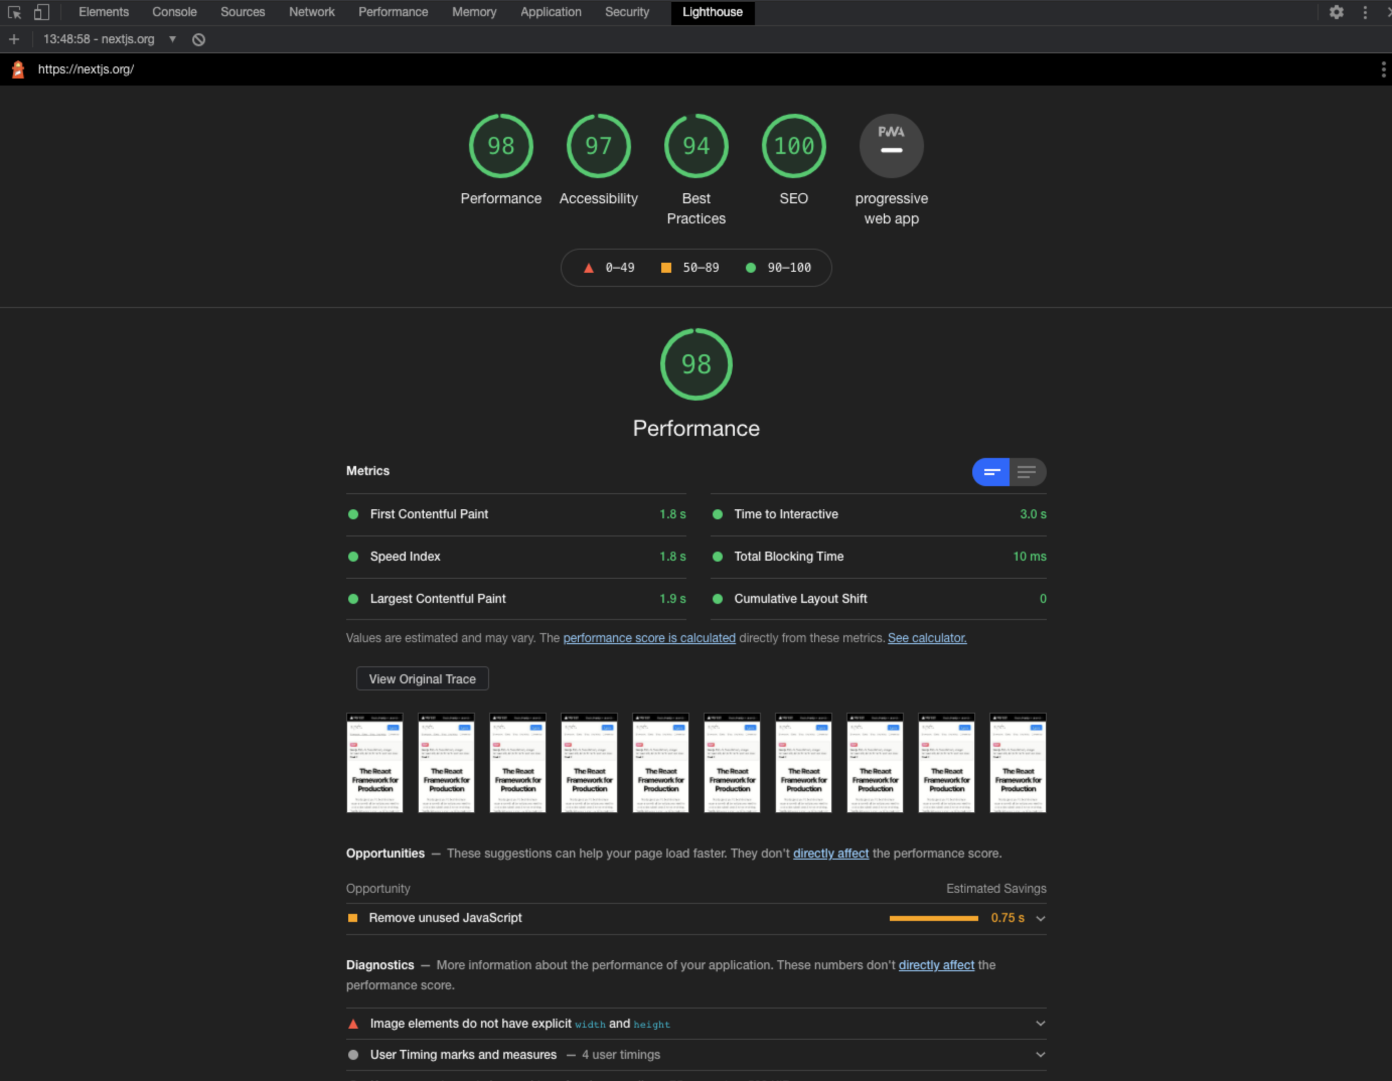
To see an example of how Lighthouse works, we will use our homepage: https://nextjs.org.
Open Chrome.
In an incognito window, navigate to https://nextjs.org.
Open DevTools and click on Lighthouse tab.
Click Generate Report.

Slide 15
Image Component and Automatic Image Optimization
Unoptimized Images
Using regular HTML
However, this means we have to manually optimize a few things like:
Ensuring our image is responsive on different screen sizes.
Optimizing our images with a third-party tool or library.
Lazy-loading images as they enter the viewport

Slide 16
The Image Component
Next provides a Image component that can handle these optimizations out-of-the-box for us.
next/image is an extension of the HTML img element, evolved for the modern web.
This means that resizing, optimizing, and serving images in modern formats like WebP (when the browser supports it) can be done automatically using next/image.
The component avoids shipping large images to devices with a smaller viewport and allows Next.js to adopt future image formats and serve those images to browsers that support them.
Automatic Image Optimization works with any image source. Even if the image is hosted by an external data source, like a CMS, it can still be optimized.

Slide 17
Dynamic Imports
Next.js supports ES2020 dynamic `import()` for JavaScript. With it, you can import JavaScript modules dynamically and work with them. They also work with server-side rendering (SSR).
Think of dynamic imports as another way to split your code into manageable chunks.

Slide 18
Dynamic Imports for Components
React components can also be imported using dynamic imports, but in this case we use it in conjunction with next/dynamic to make sure it works just like any other React Component.

Slide 19
Optimizing Fonts
82% of web pages for desktop use web fonts. Custom fonts are important for the branding, design, and cross-browser/device consistency of your site. However, using a web font should not come at the cost of performance.
Next.js has built-in Automatic Webfont Optimization. By default, Next.js will automatically inline font CSS at build time, eliminating an extra round trip to fetch font declarations. This results in improvements to First Contentful Paint (FCP) and Largest Contentful Paint (LCP).

Slide 20
Optimizing Third-Party Scripts
Many applications rely on third-party JavaScript to include different types of functionality, such as analytics, ads, and customer support widgets. However, embedding third-party authored code can delay page content from rendering and affect user performance if it is loaded too early.
Next.js provides a built-in Script component that optimizes loading for any third-party script, while giving developers the option to decide when to fetch and execute it.

Slide 21
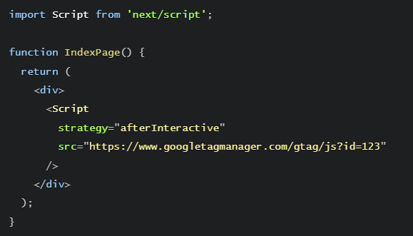
Optimizing Third-Party Scripts
With the Next.js Script component, you can add it anywhere in the component
The Script component introduces a strategy property that allows you to decide when to fetch and execute a script for optimal loading. To not negatively affect Largest Contentful Paint (LCP), most third-party scripts should be deferred to load after all the contents of a page has finished loading, either immediately after the page becomes interactive (strategy="afterInteractive") or lazily during browser idle time (strategy="lazyOnload").

Slide 22
Monitoring your Core Web Vitals
When monitoring Core Web Vitals, tracking over time is key rather than relying on one-off lab tests.

Slide 23
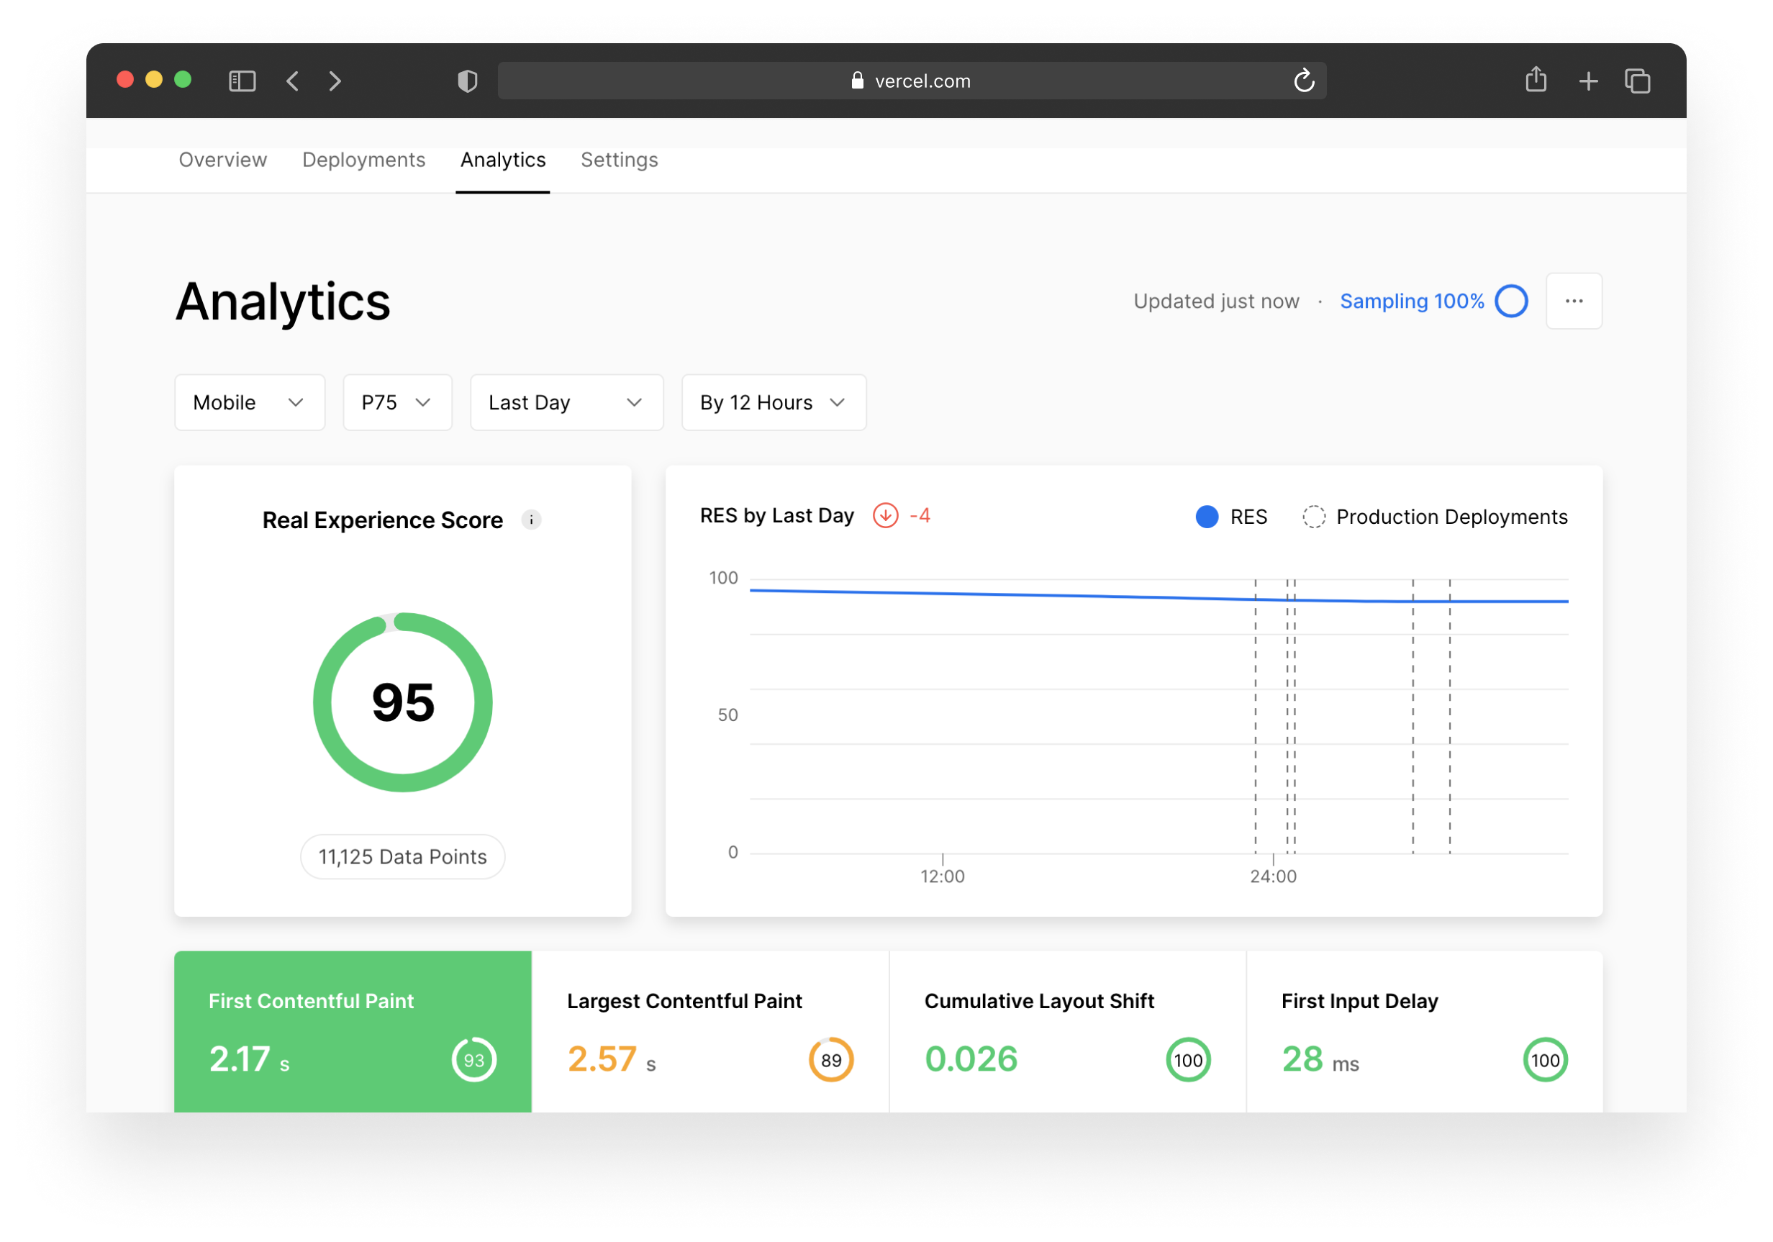
Next.js Speed Insights
Next.js Speed Insights allows you to analyze and measure the performance of pages using Core Web Vitals.
You can start collecting your Real Experience Score with zero-configuration on Vercel deployments.

Slide 24
Data Studio (Chrome User Experience Report)
Another great free and open-source way of measuring your performance is to use the Chrome User Experience Report dataset.
The Chrome User Experience Report provides user experience metrics for how real-world Chrome users experience popular destinations on the web.
This dataset is publicly available under BigQuery and you can also consume it under Google Data Studio completely for free.

Slide 25
Custom Reporting / reportWebVitals()
It is also possible to use the built-in relayer Next.js Speed Insights uses and send the data to your own service or push them to Google Analytics.
To do this we can leverage the reportWebVitals function provided by Next.js

Slide 26

Using reportWebVitals()
Open pages/_app.js and export the following function:
Then build and start your application
If you open up Chrome, you will see the metrics inside the DevTools console. You will also notice that FID will only trigger once you interact with the page.

