Slide 1
React Fundamentals

Slide 2
React Components
In React, a component is a reusable piece of your UI.
The idea is that grouping your front end into reusable pieces, will help with the maintainability of your code.
Components should be architected based on the single responsibility principle and should be broken apart if they grow beyond that scope.
Conceptually, components are like JavaScript functions.
They accept arbitrary inputs (called “props”) and return React elements describing what should appear on the screen.
React has the ability to render components in order to display the view.
There are two main ways that Components are created nowadays.

Slide 3
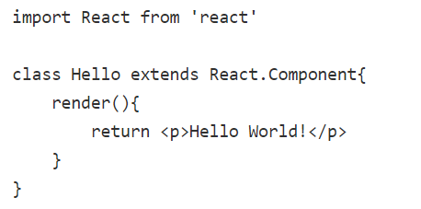
Class-based component
The traditional way of creating components was through declaring a Class-based component

Slide 4
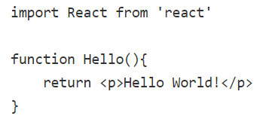
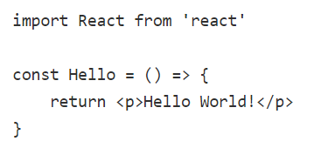
functions - based component
The alternative way of declaring an equivalent component is through using functions instead
note that you can also use arrow functions to create functional components
Not needed from React 17 onwards

Slide 5
React Components
Class-based components used to be considered as more powerful, but in recent releases of React, functional components should be able to achieve most of the same use cases as class-based components (functional components used to not have the ability to deal with state, but that changed with React Hooks).
In general, functional components can be used for almost every scenario where a class-based component is needed and are the preferred way of creating components in React because it requires less typing and is more concise (there is also some speculation that class-based components might be deprecated at some point in the future).

Slide 6
JSX
This tag syntax is neither a string nor HTML.
It is called JSX, and it is a syntax extension to JavaScript.
We recommend using it with React to describe what the UI should look like.
JSX produces React “elements”.

Slide 7
Why JSX?
React embraces the fact that rendering logic is inherently coupled with other UI logic: how events are handled, how the state changes over time, and how the data is prepared for display.
Instead of artificially separating technologies by putting markup and logic in separate files, React separates concerns with loosely coupled units called “components” that contain both.

Slide 8
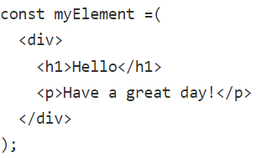
JSX
JSX stands for JavaScript XML and it allows you to write what looks like HTML inside of your JS code in React.
Think of it as a convenient way of conceptualizing what your view will look like without having to leave your JS file.
Here is equivalent JS for a situation where you wanted to create an element without JSX
const myElement = React.createElement("div", null, React.createElement("h1", null, "Hello"), React.createElement("p", null, "Have a great day!"));

Slide 9
JSX
you can either create an element using HTML, or by using the createElement() DOM function to achieve the same goal.
In addition, JSX works by utilizing Babel to compile the JSX into regular ES5 or ES6 JavaScript before everything is rendered.
Note that if you want to write any JS in JSX, you must enclose it in curly braces {}.
JSX will render each tag provided with an HTML element or with another component.
This is determined based on the casing of the tag.
HTML itself is not case sensitive, although it's good practice to always use lowercase.
JSX is case sensitive, in that if the tag provided is capitalized, it will be rendered as a component, while if it's lowercase, it'll be rendered as an HTML element.

Slide 10
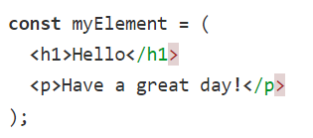
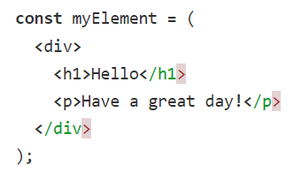
JSX
When using JSX, it's important to remember, that only one root tag can be returned from a component.
This is the case because of the way React handles reconciling the DOM.
This element cannot be returned from a component
this element can be returned from a component

Slide 11
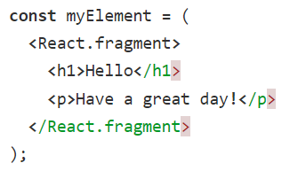
JSX
Because of this, there may be times where you need to wrap your JSX fragment in a <div> or a <span>.
If you don't want to do this, React actually provides a React.fragment component which provides the ability to return multiple elements without any explicit wrapper element.

Slide 12
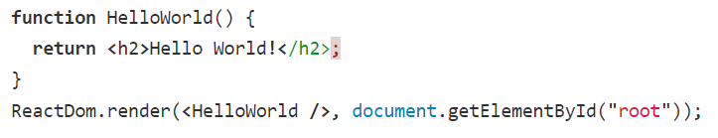
Rendering Elements on the DOM
With traditional JavaScript and HTML, we need a base HTML file, and we may have elements we can dynamically create using JavaScript.
This rendering process still holds true for React.
In fact, we'll still need to use a document element selector method at least once to access an element in our HTML file to insert our React components.
When we create a SPA, this render method need only be invoked once.
Otherwise, we nest components within each other and use a router to navigate between them.

Slide 13
Conditional Rendering
In React, you can create several different components and then only render the components that you want the user to see.
It is like conditional rendering with plain JS.
Because the template for each component is returned in the scope of a function (either a functional component or the render method), you can include any rendering logic you'd like.
With conditional rendering, the state of your application determines whether components render.
More on conditional rendering

Slide 14
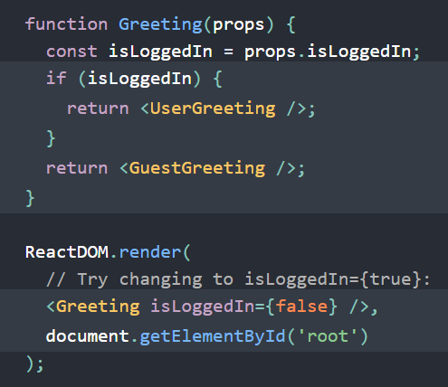
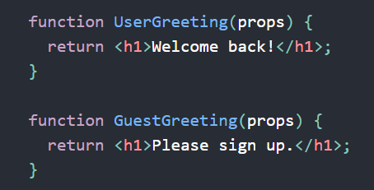
Conditional Rendering
In React, you can create distinct components that encapsulate behavior you need.
Then, you can render only some of them, depending on the state of your application.

Slide 15
Virtual DOM
React uses a Virtual DOM.
Technically, with React, you don't write HTML.
Instead, you generate HTML views using JS.
For every DOM object, react has a corresponding "virtual DOM object" that represents the actual DOM object.
React greatly improves performance by minimizing changes to the DOM - it only updates what's necessary.
The Virtual DOM much more lightweight than the actual DOM, so the virtual DOM is updated whenever we make a change, but React will decide when it is most efficient to make the real DOM reflect the changes seen in the Virtual DOM.
Since rendering the page is costly (performance wise), minimizing unnecessary renders is one way that React improves performance.
This update process is referred to as reconciliation

Slide 16
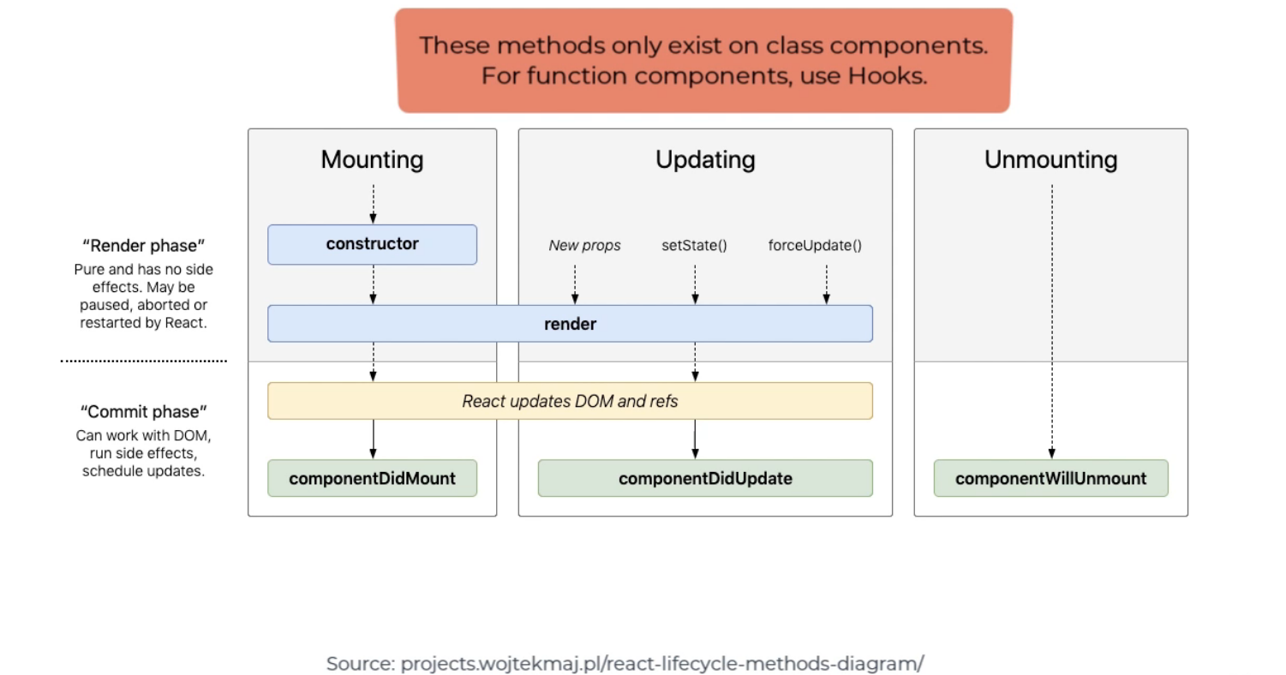
Component Lifecycle
There are several lifecycle steps that a component will go through. Knowing the names of methods or hooks that correspond to certain phases in the component lifecycle is useful for functions that you want to call during certain steps of the lifecycle.
https://reactjs.org/docs/react-component.html

Slide 17
The Component Lifecycle
Each component has several “lifecycle methods” that you can override to run code at particular times in the process.

Slide 18
The Component Lifecycle - Mounting
Mounting
The mounting means to put elements into the DOM. React uses virtual DOM to put all the elements into the memory.
These methods are called in the following order when an instance of a component is being created and inserted into the DOM:
constructor()
static getDerivedStateFromProps()
render()
componentDidMount()

Slide 19
The Component Lifecycle - Updating
Updating
An update can be caused by changes to props or state.
These methods are called in the following order when a component is being re-rendered:
static getDerivedStateFromProps()
shouldComponentUpdate()
render()
getSnapshotBeforeUpdate()
componentDidUpdate()

Slide 20
The Component Lifecycle - Unmounting
Unmounting
This method is called when a component is being removed from the DOM:
componentWillUnmount()

Slide 21
The Component Lifecycle – Error Handling
Error Handling
These methods are called when there is an error during rendering, in a lifecycle method, or in the constructor of any child component.
static getDerivedStateFromError()
componentDidCatch()

Slide 22
Lists and Keys
A key is a specific attribute that react uses while rendering collection of elements.
Keys help React identify which items have been changed, added, or removed, playing a significant part in the DOM reconciliation process.
Keys must be unique among sibling elements but need not be globally unique.
A unique ID associated with the element is the best choice to act as its key.
If a unique key is not available, you may be able to add a new ID property to your model or hash some parts of the content to generate a key.
Only if there is no better option should an index be used and is an especially bad choice if you expect data to be reordered.

Slide 23
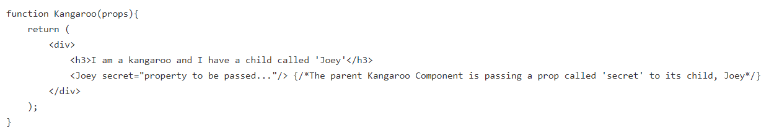
Props
In React, components can be nested in other components (often referred to as parent and child components).
Props are passed from parent to child.
For example, here is a Kangaroo component that had a child component called Joey:

Slide 24
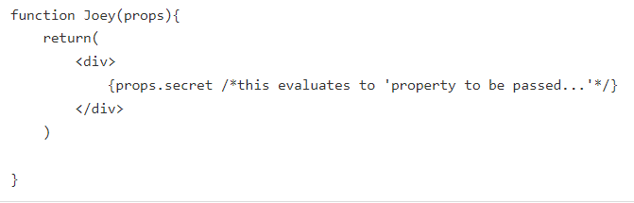
Props
Joey is receiving a prop called 'secret' with a value 'property to be passed...' from its parent, Kangaroo.
In React, props are immutable, and cannot be changed by the child.

Slide 25
State
If there was a situation where you wanted to change data that is being used, you would use state.
You can set state in class components by either using a constructor or by declaring a field called 'state' inside of the class.
In general, you do not mutate state directly.
To change state in a class component, you would use this.setState().
If you wanted to use state inside of a functional component, you would need to use hooks.
To mutate state, you would need to use the mutator function that you declare while using the hook.

Slide 26
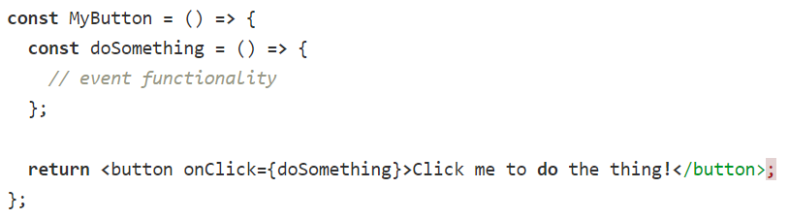
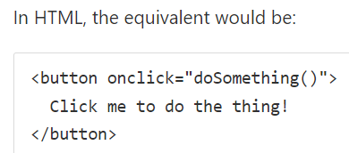
Events in React
Handling events is syntactically similar to handling events with inline HTML.
When using JSX, however, event names use camelCase, rather than lowercase, and the event handler is passed in as a JavaScript reference rather than just a string.

Slide 27
Passing Event Handlers as Props
Generally, you cannot modify state in a parent component, but by passing an event handler into a child component, the handler method has access to the parent's state.
This behavior is like that of a closure.

Slide 28
Routing in React
A common misconception is that you React apps are SPA by default, but the truth is that it does not.
There are multiple ways you can make your React application an SPA.
The most popular way currently is to use React Router.

Slide 29
React Router
React Router is a declarative model for navigational components within your application.
It provides support for web applications (react-router-dom) or applications using react native (react-router-native).

Slide 30
React Router DOM
React Router DOM provides several solutions for creating a router in your application, depending on the relationship you want your UI to have with the URL.
The BrowserRouter uses the HTML5 history API to keep the UI in sync with the URL.
We can wrap this tag around Route tags, where each Route represents a renderable component.

Slide 31
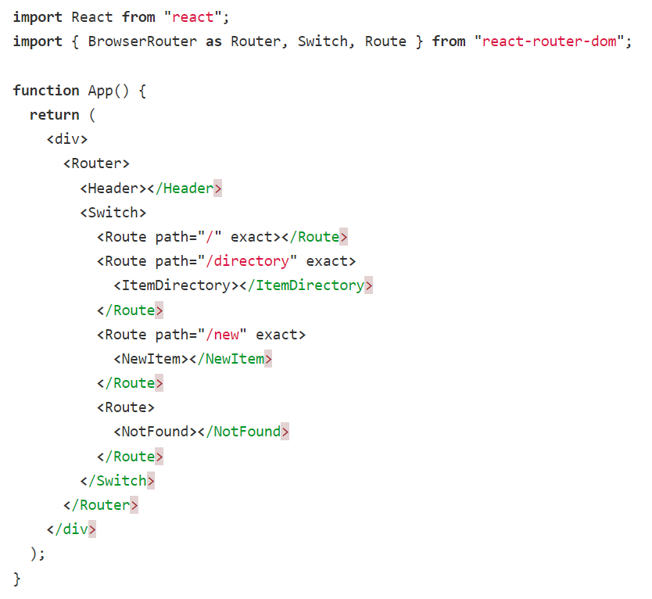

Slide 32
React Router DOM
When using a Route, the corresponding component can be provided using nested children, like is seen in the example above.
This is the recommended way, but you may also see a children, component, or render prop provided to a Route.
In the example above, Switch is used to assure that a single route is rendered exclusively.
Without it, a request to "/new" would render both the NewItem component and the NotFound component.
Other issues arise without using a Switch when using parameterized routes and they are satisfied by static routes.
Once the Router is set up, we are able to link to these different URL’s.
The Link tag can then be used to refer to the URL.
You may have <Link to="/new">New</Link> or <Link to="/">Home</Link> in your Header component.

