Slide 1
Handling State

Slide 2
Immutability
State is defined either by declaring a property of this.state (class components) or by defining state using a lifecycle hook (function components).
In either case, you should never be mutating state directly.
This value, while able to be changed, should only ever be done so by the appropriate mutator.

Slide 3
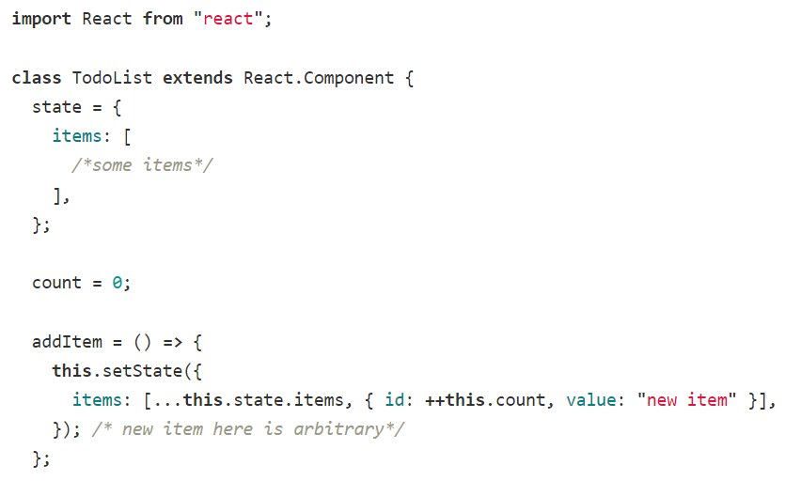
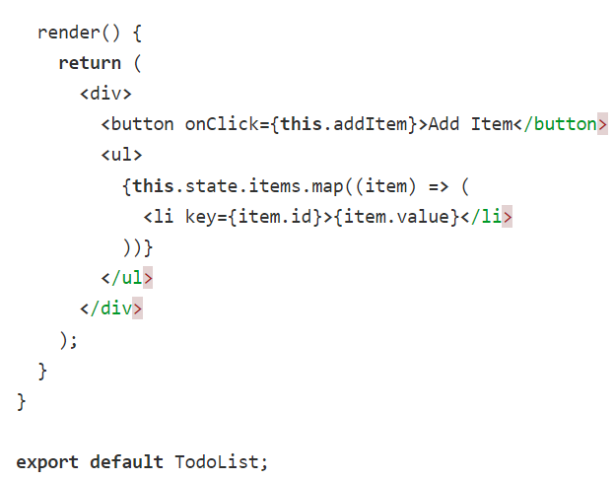
How to Mutate State Class Based Components

Slide 4
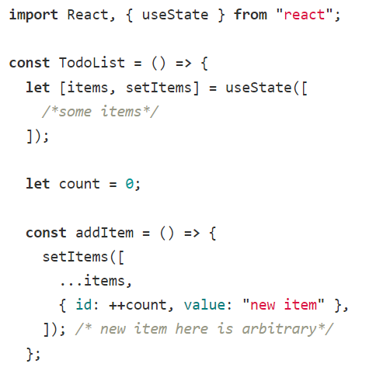
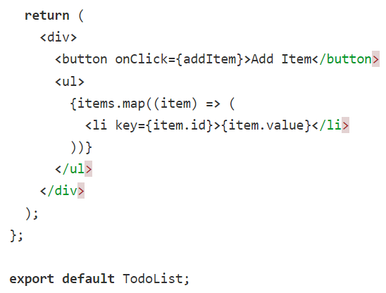
How to Mutate State Function Based Components

Slide 5
Why not just change state directly?
Mutating state directly can lead to components which are buggy or difficult to optimize.
For example, you make your component more efficient by making it pure, which means it will only re-render when its props change.
But say, for instance, you add or remove elements from an array stored in the component's state.
The array itself will not be seen as changed so the component will not re-render.
This update will not be reflected in the view.
Immutability also allows for changes to more easily be detected, because a reference comparison is a lot more efficient than a value comparison.
No traversing objects needs to be done to detect a change.
Complex features to become much easier to implement because of immutability as well.

Slide 6
One Way Data Flow
In React, data only moves in one direction.
Each component is functional, meaning just like how a function is provided everything it needs to execute through its parameters, components are provided everything it should need to render based on its props.
For a component to be parameterized it is passed read-only properties from a parent component.
However, things get a little more complicated when you want something in a child component to affect a parent component.

Slide 7
One Way Data Flow
Just as parent's variables can be passed down to their children using props, so can parent functions.
When we pass a parent component's functions to a child, it's used as a callback and can affect change in the parent function.
Like any closure, the inner executing function has access to the variables declared in its own declared scope.
For this reason, functions passed to child components from a parent component have access to parent variables, including their state.
This allows us to modify state of a parent component, even though we are not able to manipulate the values through props directly.

Slide 8
Lifting State Up
Often, several components need to reflect the same changing data.
We recommend lifting the shared state up to their closest common ancestor.

Slide 9
Lifting State Up
State is encapsulated by the component that contains it.
Because of this, a component cannot access the state of another component directly.
However, as we've seen from the one way data flow, we can pass state from a parent component to a child component.
Using this strategy, we are able to have components share data if they are provided this data from a shared parent or "ancestor."
Because of the one way data flow, though, this data passed down as props is read-only; props are used to handle data that isn't expected to be changed by the component.

Slide 10
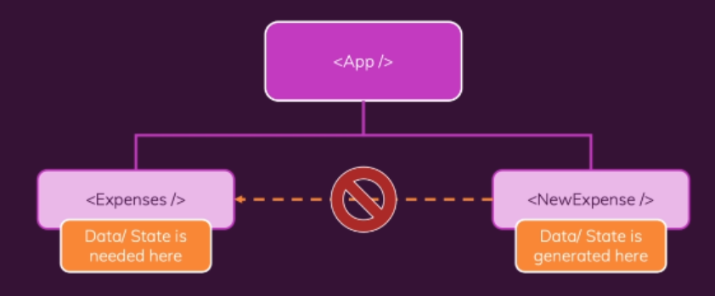
Lifting State Up
We know how content(data) is passed from a parent component to its child component.
But what if you want to do it the other way round, thus passing content from “Child Component” to its “Parent Component” so that the other “Child Components” who are directly related to the parent Component get access to the data.
This brings in the concept of “Lifting State Up”.
Lifting state up enables you to pass state data generated by a "Child Component" to its closest “Parent Component”.

Slide 11
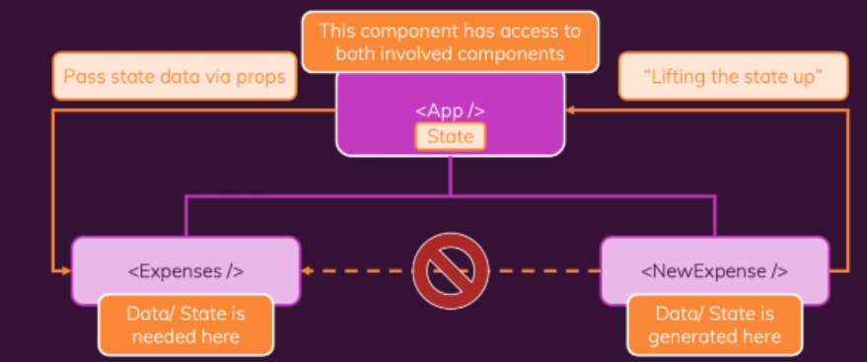
Lifting State Up
To be able to communicate between these two components, the data needs to pass through the closest parent which has access to these two child components.
The App Component in our case has direct access to both the “New Expense Component” and the “Expense Component”.
So now we can pass our generated state data from “New Expense Component” to the “App Component”.
Then subsequently pass the state data generated by the “New Expense ” to the “Expense Data” through the “App Component”.

