Slide 1
Software Development Lifecycle (SDLC)

Slide 2
Software Development Life Cycle (SDLC)
Software Development Life Cycle (SDLC) is a process used by the software industry to design, develop and test high quality software.
The SDLC aims to produce a high-quality software that meets or exceeds customer expectations, reaches completion within times and cost estimates.
SDLC is the acronym of Software Development Life Cycle.
It is also called as Software Development Process.
SDLC is a framework defining tasks performed at each step in the software development process.
ISO/IEC 12207 is an international standard for software life-cycle processes. It aims to be the standard that defines all the tasks required for developing and maintaining software.

Slide 3
What is SDLC?
SDLC is a process followed for a software project, within a software organization.
It consists of a detailed plan describing how to develop, maintain, replace and alter or enhance specific software.
The life cycle defines a methodology for improving the quality of software and the overall development process.

Slide 4
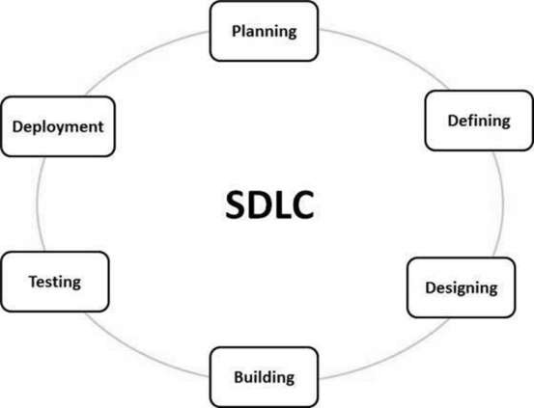
What is SDLC?

Slide 5
SDLC - Stages
Planning and Requirement Analysis
Defining Requirements
Designing the Product Architecture
Building or Developing the Product
Testing the Product
Deployment in the Market and Maintenance

Slide 6
SDLC Models
Waterfall Model
Iterative Model
Spiral Model
V-Model
Big Bang Model

Slide 7
SDLC - Waterfall Model
The Waterfall Model was the first Process Model to be introduced.
It is also referred to as a linear-sequential life cycle model.
It is very simple to understand and use.
In a waterfall model, each phase must be completed before the next phase can begin and there is no overlapping in the phases.

Slide 8
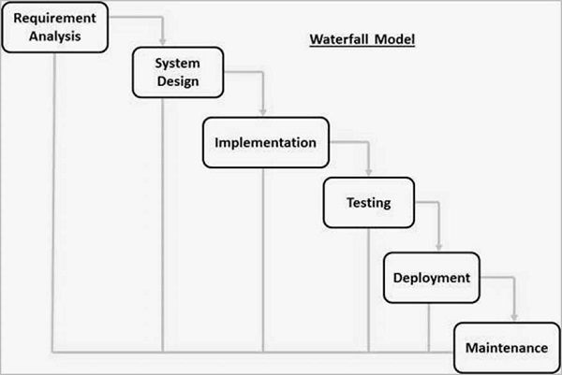
SDLC - Waterfall Model

Slide 9
Waterfall Model - Advantages
Simple and easy to understand and use
Easy to manage due to the rigidity of the model. Each phase has specific deliverables and a review process.
Phases are processed and completed one at a time.
Works well for smaller projects where requirements are very well understood.
Clearly defined stages.
Well understood milestones.
Easy to arrange tasks.
Process and results are well documented.

Slide 10
Waterfall Model - Disadvantages
No working software is produced until late during the life cycle.
Not a good model for complex and object-oriented projects.
Poor model for long and ongoing projects.
Not suitable for the projects where requirements are at a moderate to high risk of changing.
So, risk and uncertainty is high with this process model.
It is difficult to measure progress within stages.
Cannot accommodate changing requirements.
Adjusting scope during the life cycle can end a project.
Integration is done as a "big-bang. at the very end, which doesn't allow identifying any technological or business bottleneck or challenges early.

Slide 11
Agile

Slide 12
What is the Agile methodology?
The Agile methodology is a project management approach that involves breaking the project into phases and emphasizes continuous collaboration and improvement.
Teams follow a cycle of planning, executing, and evaluating.

Slide 13
Agile Overview
Agile SDLC model is a combination of iterative and incremental process models with focus on process adaptability and customer satisfaction by rapid delivery of working software product.
Agile Methods break the product into small incremental builds.
These builds are provided in iterations.
Each iteration typically lasts from about one to three weeks.
Every iteration involves cross functional teams working simultaneously on various areas like −
Planning
Requirements Analysis
Design
Coding
Unit Testing and
Acceptance Testing.
At the end of the iteration, a working product is displayed to the customer and important stakeholders.

Slide 14
What is Agile?
Agile model believes that every project needs to be handled differently and the existing methods need to be tailored to best suit the project requirements.
In Agile, the tasks are divided into time boxes (small time frames) to deliver specific features for a release.
Iterative approach is taken and working software build is delivered after each iteration.
Each build is incremental in terms of features; the final build holds all the features required by the customer.

Slide 15
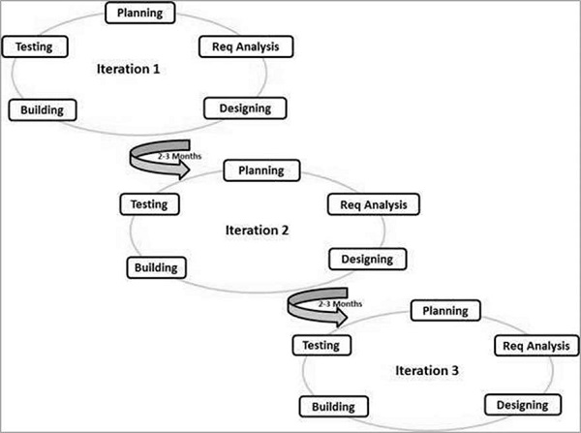
What is Agile?

Slide 16
SDLC Agile Model
The Agile thought process had started early in the software development and started becoming popular with time due to its flexibility and adaptability.
The most popular Agile methods include Rational Unified Process (1994), Scrum (1995), Crystal Clear, Extreme Programming (1996), Adaptive Software Development, Feature Driven Development, and Dynamic Systems Development Method (DSDM) (1995).
These are now collectively referred to as Agile Methodologies, after the Agile Manifesto was published in 2001.

Slide 17
Agile Manifesto principles
Individuals and interactions − In Agile development, self-organization and motivation are important, as are interactions like co-location and pair programming.
Working software − Demo working software is considered the best means of communication with the customers to understand their requirements, instead of just depending on documentation.
Customer collaboration − As the requirements cannot be gathered completely in the beginning of the project due to various factors, continuous customer interaction is very important to get proper product requirements.
Responding to change − Agile Development is focused on quick responses to change and continuous development.

Slide 18
Agile Vs Traditional SDLC Models
Agile is based on the adaptive software development methods, whereas the traditional SDLC models like the waterfall model is based on a predictive approach.
Predictive teams in the traditional SDLC models usually work with detailed planning and have a complete forecast of the exact tasks and features to be delivered in the next few months or during the product life cycle.
Predictive methods entirely depend on the requirement analysis and planning done in the beginning of cycle.
Any changes to be incorporated go through a strict change control management and prioritization.

Slide 19
Agile Vs Traditional SDLC Models
Agile uses an adaptive approach where there is no detailed planning and there is clarity on future tasks only in respect of what features need to be developed.
There is feature driven development and the team adapts to the changing product requirements dynamically.
The product is tested very frequently, through the release iterations, minimizing the risk of any major failures in the future.
Customer Interaction is the backbone of this Agile methodology, and open communication with minimum documentation are the typical features of Agile development environment.
The agile teams work in close collaboration with each other and are most often located in the same geographical location.

Slide 20
Advantages of the Agile Model
Is a very realistic approach to software development
Promotes teamwork and cross training.
Functionality can be developed rapidly and demonstrated.
Resource requirements are minimum.
Suitable for fixed or changing requirements
Delivers early partial working solutions.
Good model for environments that change steadily.
Minimal rules, documentation easily employed.
Enables concurrent development and delivery within an overall planned context.
Little or no planning required.
Easy to manage.
Gives flexibility to developers.

Slide 21
Disadvantages of the Agile Model
Not suitable for handling complex dependencies.
More risk of sustainability, maintainability and extensibility.
An overall plan, an agile leader and agile PM practice is a must without which it will not work
Strict delivery management dictates the scope, functionality to be delivered, and adjustments to meet the deadlines.
Depends heavily on customer interaction, so if the customer is not clear, team can be driven in the wrong direction.
There is a very high individual dependency, since there is minimum documentation generated.
Transfer of technology to new team members may be quite challenging due to lack of documentation.

Slide 22
Scrum
Scrum is a framework within which people can address complex adaptive problems, while productively and creatively delivering products of the highest possible value.
Scrum is:
A framework
Lightweight
Simple to understand
Difficult to master
Scrum is not:
A process
A technique
A definitive method
The Scrum framework consists of Scrum Teams and their associated roles, events, artifacts, and rules.

Slide 23
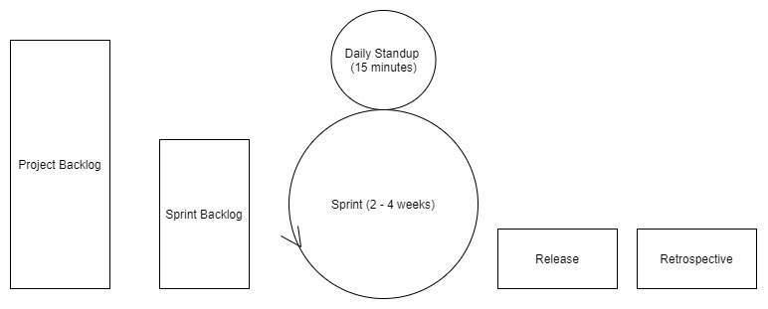
Scrum

Slide 24
Scrum Theory
The roots Scrum theory are embedded in empiricism.
Empiricism states that all knowledge is derived from sense-experience and our decisions should be based on what is known.
Scrum employs an iterative, incremental approach to optimize predictability and control risk.
To understand Scrum it is important to understand how the framework implements the three pillars of empirical process control:
Transparency
Inspection
Adaptation

Slide 25
Transparency
This means that the important aspects of the process must be visible to those responsible for the outcome.
The way that we can accomplish this in Scrum:
A common language referring to the process which is shared by all participants
All participants share a common definition of what "done" means.

Slide 26
Inspection
Scrum teams must frequently assess the framework's artifacts and overall progress towards a goal to detect undesirable variances.
This inspection process should not be so frequent that inspection gets in the way of work.

Slide 27
Adaptation
In the event that the rate of our progress, or retrospection on a previous sprint, is unsatisfactory, the framework provides mechanisms that help teams adjust any processes related to those goals, which helps to minimize further deviation.
Scrum has four formal events that help teams inspect their processes and adapt to change:
Sprint Planning
Daily Scrum
Sprint Review
Sprint Retrospective

Slide 28
Scrum Values
Each member of a Scrum Team must embody the five values:
Commitment (to achieving the goals of the Scrum Team)
Courage (to do the right thing and work on tough problems)
Focus (on the work of the Sprint and the goals of the Scrum Team)
Openness (about all the work and the challenges with performing the work)
Respect (for other members as capable and independent people)

Slide 29
Scrum Team Structure
The Product Owner
The Development Team
Scrum Master

Slide 30
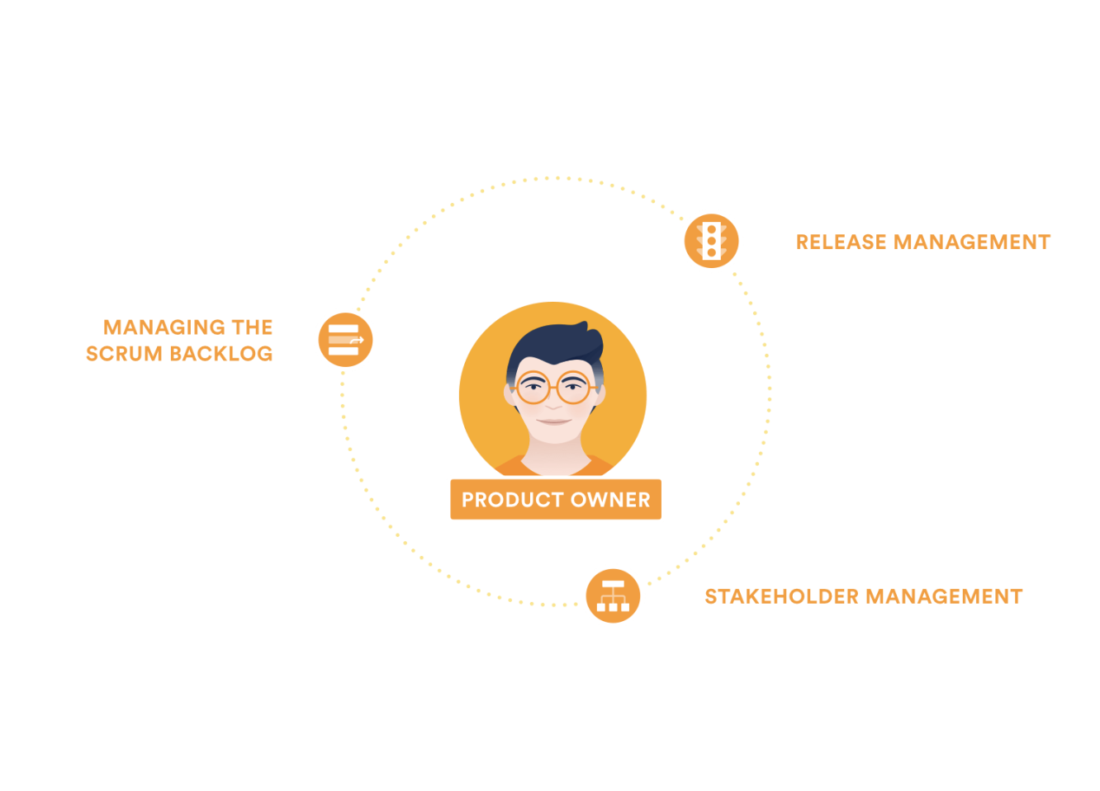
The Product Owner
The Product Owner is responsible for maximizing the value of the product resulting from work of the Development Team.
How this is done may vary widely across organizations, Scrum Teams, and individuals.
The Product Owner is the sole person responsible for managing the Product Backlog.
Product Backlog management includes:
Clearly expressing Product Backlog items;
Ordering the items in the Product Backlog to best achieve goals and missions;
Optimizing the value of the work the Development Team performs;
Ensuring that the Product Backlog is visible, transparent, and clear to all, and shows what the Scrum Team will work on next; and,
Ensuring the Development Team understands items in the Product Backlog to the level needed.

Slide 31
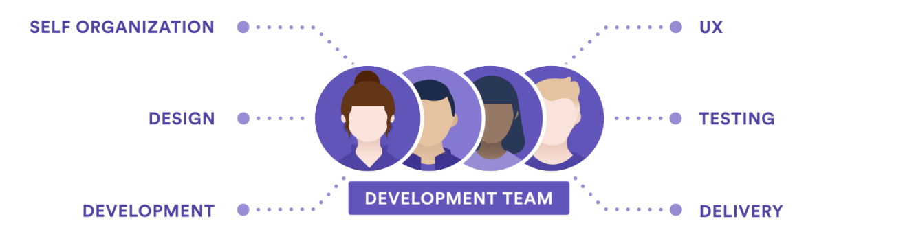
The Development Team
The Development Team consists of professionals who do the work of delivering a potentially releasable Increment of "Done" product at the end of each Sprint.
A "Done" increment is required at the Sprint Review. Only members of the Development Team create the Increment.
Development Teams are structured and empowered by the organization to organize and manage their own work.
The resulting synergy optimizes the Development Team’s overall efficiency and effectiveness.

Slide 32
The Development Team
Development Teams have the following characteristics:
They are self-organizing. No one (not even the Scrum Master) tells the Development Team how to turn Product Backlog into Increments of potentially releasable functionality;
Development Teams are cross-functional, with all the skills as a team necessary to create a product Increment;
Scrum recognizes no titles for Development Team members, regardless of the work being performed by the person;
Scrum recognizes no sub-teams in the Development Team, regardless of domains that need to be addressed like testing, architecture, operations, or business analysis; and,
Individual Development Team members may have specialized skills and areas of focus, but accountability belongs to the Development Team as a whole.

Slide 33
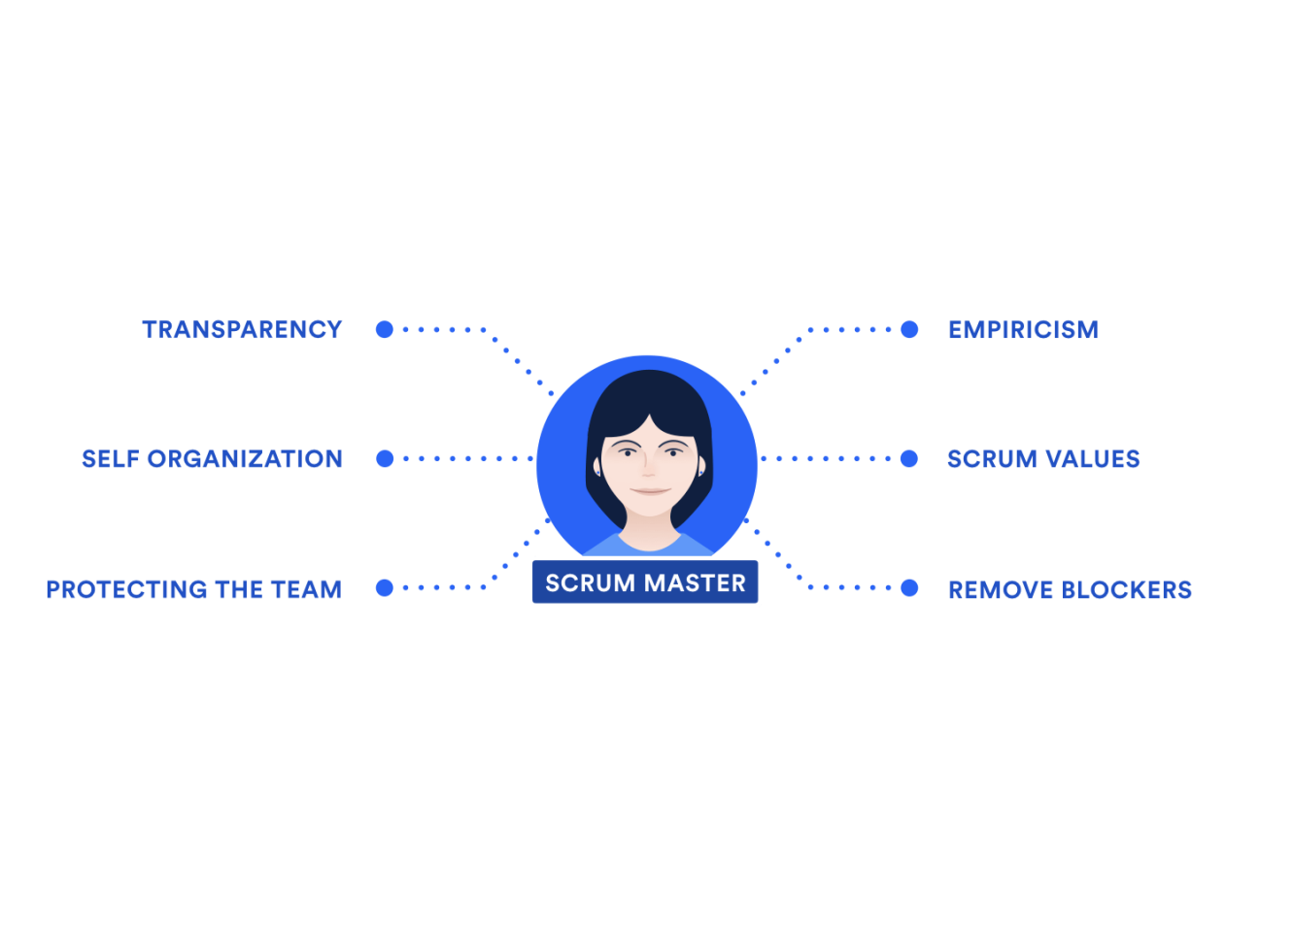
Scrum Master
The Scrum Master is responsible for promoting and supporting Scrum as defined in the Scrum Guide.
Scrum Masters do this by helping everyone understand Scrum theory, practices, rules, and values.
The Scrum Master is a servant-leader for the Scrum Team.
The Scrum Master helps those outside the Scrum Team understand which of their interactions with the Scrum Team are helpful and which aren’t.
The Scrum Master helps everyone change these interactions to maximize the value created by the Scrum Team.

Slide 34
Scrum Ceremonies
An essential part of putting agile into practice is meetings, or “ceremonies”

Slide 35
What are Scrum Ceremonies?
Scrum meetings are when the scrum master, product owner, and development team meet to plan work, discuss work in progress, gather feedback, and more.
Not every agile scrum team needs to practice all scrum meetings, and a team doesn’t necessarily have to be a scrum team to practice scrum meetings.

Slide 36
What are Scrum Ceremonies?
Sprint Planning
Daily stand-up
Sprint review
Sprint retrospective

Slide 37
The Sprint
The heart of Scrum is a Sprint, a time-box of one month or less during which a "Done", useable, and potentially releasable product Increment is created.
Sprints have consistent durations throughout a development effort. A new Sprint starts immediately after the conclusion of the previous Sprint.
Sprints contain and consist of the Sprint Planning, Daily Scrums, the development work, the Sprint Review, and the Sprint Retrospective.
During the Sprint:
No changes are made that would endanger the Sprint Goal;
Quality goals do not decrease; and,
Scope may be clarified and re-negotiated between the Product Owner and Development Team as more is learned.
Duration: Maximum of 1 month

Slide 38
Sprint Planning
Sprint planning is an event in scrum that kicks off the sprint.
The purpose of sprint planning is to define what can be delivered in the sprint and how that work will be achieved.
The work to be performed in the Sprint is planned at the Sprint Planning.
This plan is created by the collaborative work of the entire Scrum Team.
The purpose of Sprint Planning is to answer the following questions:
What can be delivered in the Increment resulting from the upcoming Sprint?
How will the work needed to deliver the Increment be achieved?
Duration: Two hours for each week of the Sprint (1 week Sprint = 2-hour meeting, 2 week Sprint = 4-hour meeting, etc.)

Slide 39
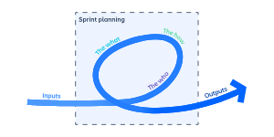
Sprint Planning
The What – The product owner describes the objective(or goal) of the sprint and what backlog items contribute to that goal. The scrum team decides what can be done in the coming sprint and what they will do during the sprint to make that happen.
The How – The development team plans the work necessary to deliver the sprint goal. Ultimately, the resulting sprint plan is a negotiation between the development team and product owner based on value and effort.
The Who – You cannot do sprint planning without the product owner or the development team. The product owner defines the goal based on the value that they seek. The development team needs to understand how they can or cannot deliver that goal. If either is missing from this event it makes planning the sprint almost impossible.
The Inputs – A great starting point for the sprint plan is the product backlog as it provides a list of ‘stuff’ that could potentially be part of the current sprint. The team should also look at the existing work done in the increment and have a view to capacity.
The Outputs – The most important outcome for the sprint planning meeting is that the team can describe the goal of the sprint and how it will start working toward that goal. This is made visible in the sprint backlog.

Slide 40
Sprint Planning – User Stories
The sprint goal describes the objective of the sprint at a high level, but the backlog Items can also be written with an outcome in mind.
User stories are one great way of describing the work from a customer point of view.
By adding clear, measurable results to the user story, the outcomes can be clearly measured, and you know when you are done.
By getting as much up-front clarity as possible on the work the team is focusing on, everyone gets the transparency needed to get started on the work.

Slide 41
Sprint Planning - Estimation
Sprint planning requires some level of estimation.
The team needs to define what can or cannot be done in the sprint: estimated effort vs capacity.
Estimation is often confused with commitments.
Estimates are by their very nature forecasts based on the knowledge at hand.
Techniques such as story points or t-shirt sizing add value to the process by giving the team a different way of looking at the problem.
They are not, however, magical tools that can find out the truth when there is none to be found.
The more unknowns, the less likely the estimate will be correct.

Slide 42
Daily Scrum - Stand up
The daily stand-up is a short, daily meeting to discuss progress and identify blockers.
The reason it’s called a “stand-up” is because if attendees participate while standing, the meeting should be kept short.
The Daily Scrum is held every day of the Sprint. At it, the Development Team plans work for the next 24 hours.
This optimizes team collaboration and performance by inspecting the work since the last Daily Scrum and forecasting upcoming Sprint work.
The Daily Scrum is held at the same time and place each day to reduce complexity.
The purpose of the Daily Scrum is to:
Inspect progress towards the Sprint Goal
Inspect how progress is trending toward completing the work in the Sprint Backlog
Duration: 15-minutes

Slide 43
Daily Scrum - Stand up
A stand-up is a daily meeting that involves the core team: product owners, developers, and the scrum master.
We use three simple questions
What did I work on yesterday?
What am I working on today?
What issues are blocking me?
These questions highlight progress and help flag team blockers.
Also, it strengthens the team when everyone shares the progress they’re contributing to the team.
The daily reinforcement of sharing individual successes and plans keeps everyone excited about the team’s overall contribution to the organization.

Slide 44
Sprint Review
A Sprint Review is held at the end of the Sprint to inspect the Increment and adapt the Product Backlog if needed.
During the Sprint Review, the Scrum Team and stakeholders collaborate about what was done in the Sprint.
Based on that and any changes to the Product Backlog during the Sprint, attendees collaborate on the next things that could be done to optimize value.
This is an informal meeting, not a status meeting, and the presentation of the Increment is intended to elicit feedback and foster collaboration.
Duration: One hour for each week of the Sprint (1 week Sprint = 1-hour meeting, 2 week Sprint = 2-hour meeting, etc.)

Slide 45
Purpose of a Sprint Review
The main goal of a sprint review is to gather feedback and ensure transparency in the next steps of the development process.
It has several key objectives:
Demonstration of completed work: The development team demonstrates the features completed during the sprint to key stakeholders, including the product owner, customers, and other relevant parties.
Feedback collection: Stakeholders provide feedback on the demonstrated features, enabling the team to adjust and prioritize work effectively in subsequent sprints.

Slide 46
Purpose of a Sprint Review
Alignment with product vision: The sprint review ensures the work completed aligns with the overall product vision and objectives. It helps validate that the development efforts and sprint goals are moving in the right direction.
Celebration of achievements: It provides an opportunity to celebrate the development team's accomplishments and acknowledge their hard work and dedication.
Identification of improvements: Through discussions and observations during the sprint review, areas for improvement in the development process can be identified and addressed in future iterations.
In short, the sprint review promotes collaboration, transparency, and continuous improvement within the Agile development framework.
It fosters a culture of open communication, collaborative working sessions, and shared responsibility for the product's success.

Slide 47
Benefits of a sprint review
One significant benefit of incorporating sprint reviews into the Agile development process is the enhanced adaptability and flexibility it provides for the product.
By regularly reviewing completed work, teams gain valuable insights into stakeholders' evolving needs and preferences.
Iterative feedback loop : Sprint reviews establish an iterative feedback loop between the development team and stakeholders. This iterative nature allows for rapid adjustments and refinements to the product based on real-time feedback, ensuring that it remains aligned with evolving market demands and user requirements.
Early detection of issues : By showcasing work-in-progress during sprint reviews, teams can identify potential issues or misunderstandings early in the development cycle. This early detection enables prompt resolution of issues, preventing them from escalating into larger problems later.

Slide 48
Benefits of a sprint review
Opportunity for iterative refinement : Sprint reviews provide a platform for iterative product refinement. Gathering stakeholder feedback enables teams to prioritize features, make course corrections, and pivot the product direction if necessary, ensuring its relevance and competitiveness in the market.
Adaptation to changing priorities : In today's dynamic business environment, priorities and market conditions can change rapidly. Sprint reviews enable teams to adapt to these changes by allowing for the reprioritization of work and adjustment of project goals based on emerging opportunities or challenges.
Empowerment of stakeholders : Sprint reviews empower stakeholders by giving them a voice in the development process. By actively participating in reviews and providing feedback, stakeholders feel a sense of ownership and investment in the product's success, leading to greater engagement and collaboration.

Slide 49
Sprint Retrospective
The Sprint Retrospective is an opportunity for the Scrum Team to inspect itself and create a plan for improvements to be enacted during the next Sprint.
It occurs after the Sprint Review and prior to the next Sprint Planning.
The purpose of the Sprint Retrospective is to:
Inspect how the last Sprint went with regards to people, relationships, process, and tools
Identify and order the major items that went well and potential improvements
Create a plan for implementing improvements to the way the Scrum Team does its work

Slide 50
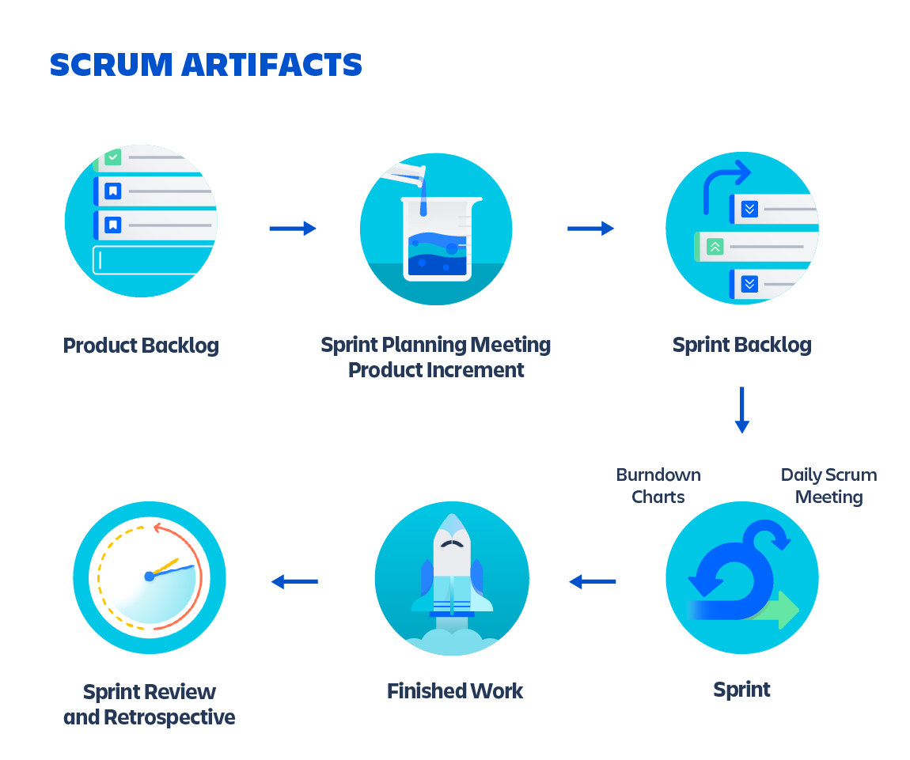
Sprint Artifacts
Scrum’s artifacts represent work or value to provide transparency and opportunities for inspection and adaptation.
Artifacts defined by Scrum are specifically designed to maximize transparency of key information so that everybody has the same understanding of the artifact.
The following a core artifacts to the Scrum framework:
Product Backlog
Sprint Backlog
Increment

Slide 51
Product Backlog
The Product Backlog is an ordered list of everything that is known to be needed in the product.
It is the single source of requirements for any changes to be made to the product.
The Product Owner is responsible for the Product Backlog, including its content, availability, and ordering.

Slide 52
Sprint Backlog
The Sprint Backlog is the set of Product Backlog items selected for the Sprint, plus a plan for delivering the product Increment and realizing the Sprint Goal.
The Sprint Backlog is a forecast by the Development Team about what functionality will be in the next Increment and the work needed to deliver that functionality into a "Done" Increment.

Slide 53
Increment
The Increment is the sum of all the Product Backlog items completed during a Sprint and the value of the increments of all previous Sprints.
At the end of a Sprint, the new Increment must be "Done," which means it must be in useable condition and meet the Scrum Team’s definition of "Done".
An increment is a body of inspectable, done work that supports empiricism at the end of the Sprint.
The increment is a step toward a vision or goal.
The increment must be in useable condition regardless of whether the Product Owner decides to release it.

Slide 54
Agile - Term Definitions
User Story: An individual feature of/requirement for a project in Agile development.
Epic: A group of related features that is broken down into multiple user stories.
Story Point: A level of difficulty assigned to a user story through use of a sequence of numbers that increase with increasing difficulty.
Sprint: A brief period of development (almost always less than four weeks, sometimes as short as one week) generally culminating in a release of related features.
Velocity: The sum of story points of all user stories completed during a sprint. Velocity allows Agile teams to more accurately predict how many user stories can be completed in future sprints.
Burndown charts are very useful in helping to gauge the active execution velocity of a team so they know whether they will complete what is planned or need to reprioritize the sprint tasks.

Slide 55
Kanban

Slide 56
What is Kanban?
Kanban is a popular framework used to implement Agile and DevOps software development.
It requires real-time communication of capacity and full transparency of work.
Work items are represented visually on a kanban board, allowing team members to see the state of every piece of work at any time.

Slide 57
What is a kanban board?
A kanban board is an agile project management tool designed to help visualize work, limit work-in-progress, and maximize efficiency (or flow).
It can help both agile and DevOps teams establish order in their daily work.
Kanban boards use cards, columns, and continuous improvement to help technology and service teams commit to the right amount of work, and get it done!

Slide 58
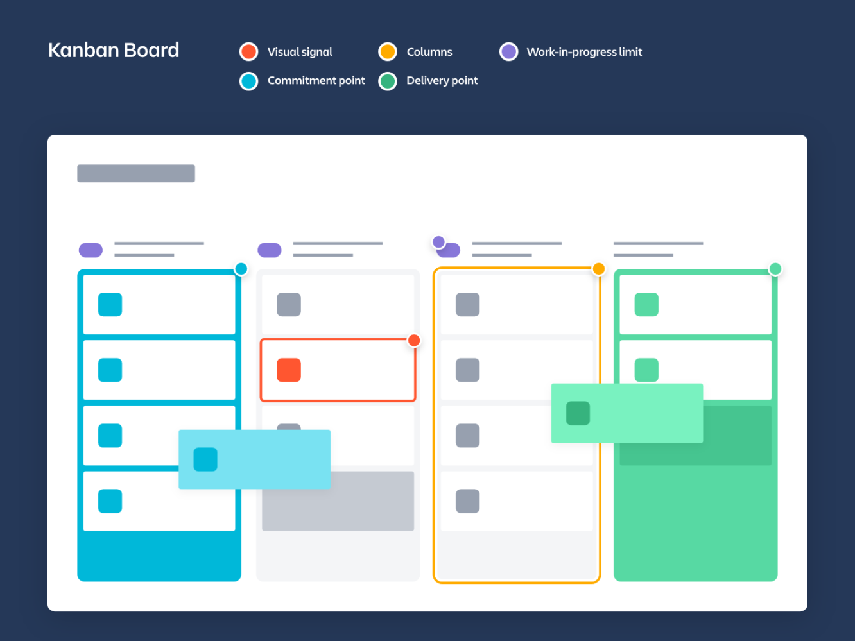
Elements of a kanban board
David Anderson established that kanban boards can be broken down into five components:
Visual signals
Columns
work-in-progress limits
a commitment point
a delivery point.

Slide 59
Elements of a kanban board
Visual Signals — One of the first things you’ll notice about a kanban board are the visual cards (stickies, tickets, or otherwise). Kanban teams write all of their projects and work items onto cards, usually one per card. For agile teams, each card could encapsulate one user story. Once on the board, these visual signals help teammates and stakeholders quickly understand what the team is working on.
Columns — Another hallmark of the kanban board are the columns. Each column represents a specific activity that together compose a “workflow”. Cards flow through the workflow until completion. Workflows can be as simple as “To Do,” “In Progress,” “Complete,” or much more complex.
Work In Progress (WIP) Limits — WIP limits are the maximum number of cards that can be in one column at any given time. A column with a WIP limit of three cannot have more than three cards in it. When the column is “maxed-out” the team needs to swarm on those cards and move them forward before new cards can move into that stage of the workflow. These WIP limits are critical for exposing bottlenecks in the workflow and maximizing flow. WIP limits give you an early warning sign that you committed to too much work.

Slide 60
Elements of a kanban board
Commitment point — Kanban teams often have a backlog for their board. This is where customers and teammates put ideas for projects that the team can pick up when they are ready. The commitment point is the moment when an idea is picked up by the team and work starts on the project.
Delivery point — The delivery point is the end of a kanban team’s workflow. For most teams, the delivery point is when the product or service is in the hands of the customer. The team’s goal is to take cards from the commitment point to the delivery point as fast as possible. The elapsed time between the two is the called Lead Time. Kanban teams are continuously improving to decrease their lead time as much as possible.

Slide 61
Types and examples of kanban boards

Slide 62

Physical boards
The simplest kanban boards are physical boards divided into vertical columns.
Teams mark up a whiteboard or blackboard and place sticky notes onto the board.
These sticky notes move through the workflow and demonstrate progress.

Slide 63
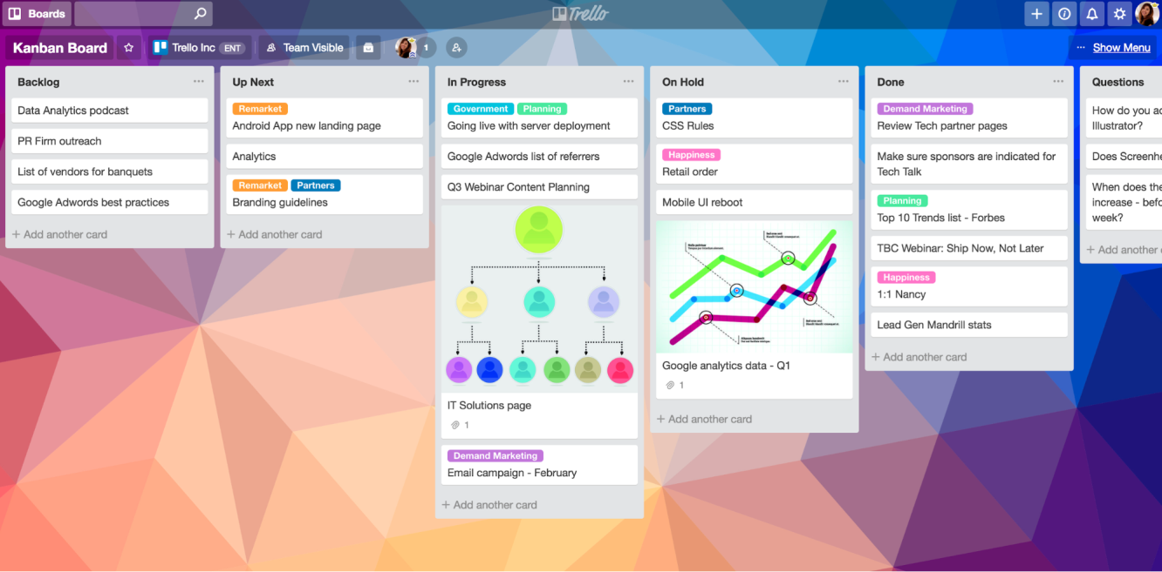
Digital boards
As the kanban system gained favor with software and engineering teams, kanban boards underwent a digital transformation.
Digital boards allow teams that do not share a physical office space to use kanban boards remotely and asynchronously.

Slide 64
Kanban cards
When using kanban, visualize your work in progress with kanban cards.

Slide 65
What is a kanban card?
A kanban card is a visual representation of an item of work.
It’s an essential component of the kanban method, a work management framework that helps visualize work, limit work in progress (WIP), and maximize efficiency (or flow).
Each kanban card represents a single work item as it moves through various stages of completion which are represented on either a physical or virtual kanban board.
To get an idea of what kanban cards are, imagine a software development team using sticky notes on a whiteboard to represent their work items.
As they work on bugs and features, the team moves the sticky notes through columns labeled Prioritized, Design, Development, Testing, Blocked, and Done.

Slide 66
The purpose of kanban cards
The kanban card quickly evolved into a visual artifact that tracks a work item as it flows through a workflow.
At its core, the kanban card encourages teamwork by helping team members communicate and share information visually.

Slide 67
The purpose of kanban cards
Kanban cards allow teams to:
View important details about work items at a glance. Each kanban card typically features a brief description of a work item, along with its owner, due date, and status. The card can include other information, like pointers to source documentation or a list of issues blocking the item's progress.
Hand off deliverables smoothly and efficiently. Kanban cards encourage teams to establish clear and consistent expectations for each functional area. When it comes time to pass a work item from one state to the next—say, from the planning stage to implementation—these explicit policies clarify who takes ownership, and what the next steps are.
Improve efficiency. Kanban cards make it easy to keep track of lead time, which is the time it takes for a work item to go from start to finish. Kanban cards, together with a kanban board, can help teams identify bottlenecks in their workflow and streamline their process. Most teams work to decrease their lead time, which means getting work done faster!

Slide 68
Kanban vs. Scrum

Slide 69
Kanban vs. Scrum
Kanban is a project management framework that relies on visual tasks to manage workflows, while Scrum is a project management framework that helps teams' structure and manage their work through a set of values, principles, and practices.

Slide 70
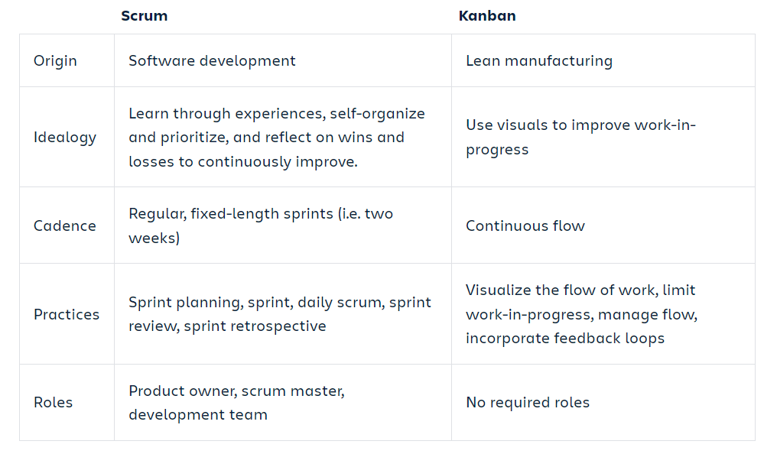
Kanban vs. Scrum

