Slide 1
Microservices

Slide 2
What are microservices
Microservice Architecture describes a way of designing software applications as suites of independently deployable services.
Microservices are small, autonomous services that work together. -- Sam Newman

Slide 3
What are microservices
The microservice architectural style is an approach to developing a single application as a suite of small services, each running in its own process and communicating with lightweight mechanisms, often an HTTP resource API.
These services are built around business capabilities and independently deployable by fully automated deployment machinery.
There is a bare minimum of centralized management of these services, which may be written in different programming languages and use different data storage technologies.

Slide 4
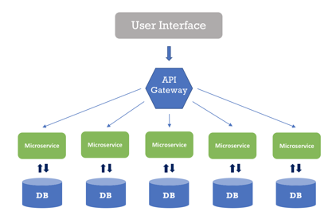
What are microservices
In a microservice architecture, we divide an application into services. Each service runs a unique process and manages its database.
A service can generate alerts, log data, support user interfaces (UIs), handle user identification or authentication, and perform various other tasks.

Slide 5
What are microservices
The microservice paradigm provides development teams with a more decentralized approach for building software.
Most companies in the world – like Amazon, Netflix, Uber, Etsy, etc., have adopted the microservices architecture for developing their applications.
Over time, these enterprises dismantled their monolithic applications and refactored them into microservice-based architectures.
This has given them scaling advantages, greater business agility, and increased profits.

Slide 6
Netflix uses a microservices architecture
Netflix started as a website that allowed us to select DVDs and delivers that to our mailbox.
It also began as a monolithic application, built and managed with a traditional development model by a single team of over 100 engineers.
As the company transitioned to a product that delivers streaming content to millions of viewers all over the world, 24 hours a day
Netflix also had to switch to a microservice architecture that facilitates receiving content from various sources, getting it into its systems, processing it, and distributing it to users seamlessly.

Slide 7
Netflix uses a microservices architecture
Each day, Netflix’s API receives hundreds of millions of calls, which travel between microservices to accomplish a task.
When you click the play button on a movie, you might trigger a chain of five API calls which keep track of playback, collect content for the user interface, manage streaming, and more.
Netflix also leverages serverless architectures, which fits well with microservices, to encode this content, backup files, secure their assets, and monitor their IT environment.

Slide 8
Microservice Architecture vs Monolithic Applications

Slide 9
Microservice Architecture vs Monolithic Applications
We build monolithic applications as a single unit.
They usually develop these Enterprise Applications in three major parts:
User Interface - might consist of HTML pages and JavaScript running on the user’s browser.
Server-Side application - handles incoming data (like HTTP requests), executes domain logic, retrieves and updates data from the database, and updates the user interface
Databases - stores data on the tables of an RDBMS.

Slide 10
Microservice Architecture vs Monolithic Applications
Any minor changes in the system require building and deploying a new version of the server-side application.
Over time, it’s often hard to keep a good modular structure, making it harder to manage changes that ought to only affect one module within that application.
Scaling requires scaling of the entire application rather than the parts of it that require the most resources.

Slide 11
Microservice Architecture vs Monolithic Applications
These frustrations have led to the microservice architectural style, building applications as suites of services.
When services are independently deployable and scalable, each service provides a firm module boundary.
We can develop services in distinct programming languages.

Slide 12
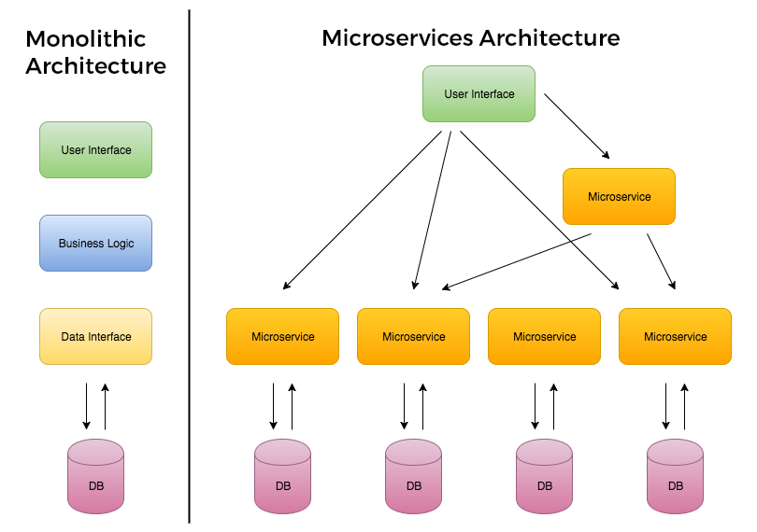
Microservice Architecture vs Monolithic Applications

Slide 13
Microservice Architecture vs Monolithic Applications
Services are deployed and updated independently, which gives more flexibility.
Monolithic uses a shared database.
Each microservice uses a single database. Each service can use any database system (MySQL, Oracle, NoSQL) depending on its business logic.
Monolithic applications are tightly coupled. Here, it is difficult to change technology or language or framework. MSA ensures that the services are loosely coupled, so it's easy to make changes since services are independent to each other.
Monolithic applications are more compatible with Waterfall Model.
MSA is adaptable with Agile Methodology for developing applications.

Slide 14
Microservice Architecture vs Monolithic Applications
Monolithic | MSA
Simple to develop and deploy. | Complex and hard to develop and deploy.
Code changes affect the entire system. | Only the microservice that is changed would be affected.
One codebase and one shared database. | A codebase and database for each microservice.
Hard to scale or upgrade. | Easy to scale and upgrade.
Less expensive and faster to develop. | More expensive and takes more time to develop.
Monolithic uses a shared database. | Each microservice uses a single database. Each service can use any database system (MySQL, Oracle, NoSQL) depending on its business logic.
Monolithic applications are tightly coupled. Here, it is difficult to change technology or language or framework. | MSA ensures that the services are loosely coupled, so it's easy to make changes since services are independent to each other.
The entire system can be affected by a single error or bug. | The entire system is shielded from the error or bug on one microservice.

Slide 15
Characteristic of Microservices Architecture
Microservice architecture encourages us to break our application into multiple individually deployable components.
Here, a component refers to a unit of software that is independently replaceable and upgradeable.
These components expose their functionality as services and serve a business purpose.
Components are loosely coupled and communicate with each other through pre-defined protocols, such as message queues, HTTP request/response models, and so on.
Services are organized based on the business capabilities, not by the technology.

Slide 16
Characteristic of Microservices Architecture
Each service has its own database, either different instances of the same database technology, or entirely independent database systems - an approach called Polyglot Persistence.
MSA provides infrastructure automation with continuous delivery and automated testing.
Any service’s failure should be in isolation.
Failure of one service should not make the whole application go down. Since services can fail, it’s important to detect the failures and, if possible, restore the service.

Slide 17
Challenges of Microservices Architecture
Microservice architecture is much more complex than legacy systems.
This environment becomes more complicated because teams have to manage and support many moving parts. Some of the challenges that an organization faces are:
Bounded Context - The bounded context is a central pattern in Domain-Driven Design(DDD). DDD deals with large models by dividing them into different Bounded Contexts and being explicit about their interrelationships.
Bounded context defines our domain boundaries in the business context.

Slide 18
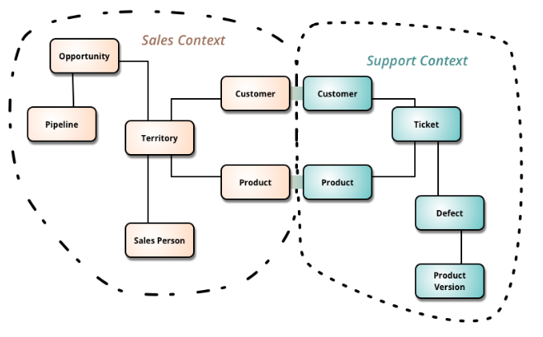
Challenges of Microservices Architecture
For example, a product in the sales context refers to an item in the process of being sold. A product in the support context refers to the item that is already sold to the customer which has some defects, so the customer contacts the support team.

Slide 19
Challenges of Microservices Architecture
Finding a root cause for problems – Distributed logic with distributed data increases the effort of finding a root cause.
Version management and cyclic dependencies between services.
Logging is distributed between services.
An issue that’s caused by one service can cause trouble elsewhere.

Slide 20
Advantages of Microservices
Microservices follow the Single Responsibility Principle.
Fault isolation - If one service crashes, it’s quite possible the rest of the application can continue to operate until that service recovers.
Microservices are language and platform independent.
Dynamic scaling - we can dynamically scale up/down the service instances whenever required.
Developers have the freedom to develop and deploy services independently.
Use of containers allowing for a quick deployment and development of the application.

Slide 21
Disadvantages of Microservices
Microservice architecture is complex.
Harder to test and monitor because of the complexity of the architecture.
Large numbers of microservices are harder to manage and secure.

