Slide 1
Service Discovery

Slide 2
Service Discovery
In a microservice architecture, applications are built up of self-sufficient units, which can be deployed and updated independently, and communicate with each other via REST APIs.
One of the challenges in a microservices application is how services discover and connect to each other, because service instances are constantly being created and destroyed according to scaling needs.
Fixed IP addresses don't work, so we need a service registry to track the dynamic changes in the network locations of service instances.
Service discovery is a method for application components to locate each other.

Slide 3
Service Registry
The service registry is a key part of service discovery.
A database containing the network locations of service instances.
It contains the currently-available instances of each service and their connection details.
Services query the service registry to retrieve the details for the required microservice and then connect to it.
The registry maintains a heartbeat mechanism to see if services are still up and if not, removes them from the registry.

Slide 4
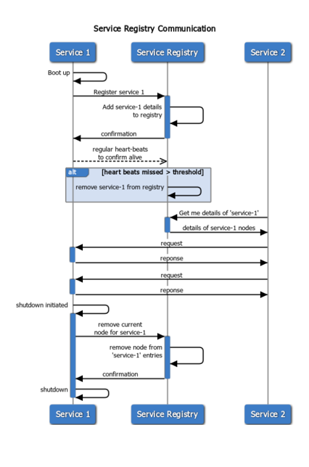
Service Registry

Slide 5
Service Registry
Netflix Eureka is a good example of a service registry.
It provides a REST API for registering and querying service instances.
A service instance registers its network location using a POST request.
Every 30 seconds it must refresh its registration using a PUT request.
A registration is removed by either using an HTTP DELETE request or by the instance registration timing out.
A client can retrieve the registered service instances by using an HTTP GET request.
Other examples of service registries - etcd, consul, Apache Zookeeper

Slide 6
Microservice Registration Patterns
There are two primary microservice registration patterns to handle the registration and deregistration of service instances in the Service Registry.
Self-Registration Pattern
Third-party registration Pattern

Slide 7
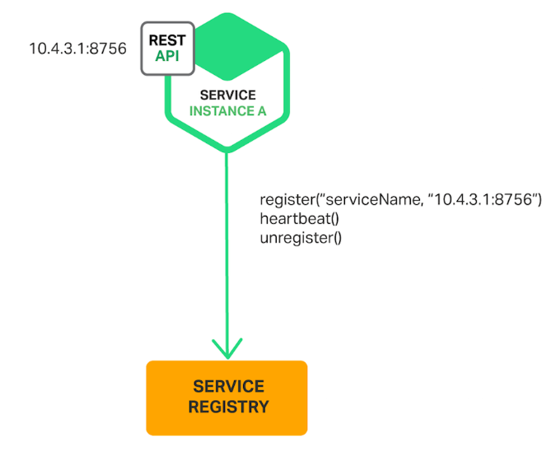
Self-Registration Pattern
When using the self-registration pattern, a service instance is responsible for registering and deregistering itself with the service registry.
Also, service instances send heartbeat requests to prevent their registration from expiring.

Slide 8
Self-Registration Pattern
A good example of this approach is the Netflix OSS Eureka client.
The Eureka client handles all aspects of service instance registration and deregistration.
The Spring Cloud project, which implements various patterns including service discovery, makes it easy to automatically register a service instance with Eureka.
We simply annotate our Java Configuration class with an @EnableEurekaClient annotation.

Slide 9
Self-Registration Pattern
Benefit - This pattern is relatively simple and doesn’t require any other system components.
Drawback - This pattern couples the service instances to the service registry. We must implement the registration code in each programming language and framework used by our services.

Slide 10
Third-party registration Pattern
When using the third-party registration pattern, service instances aren’t responsible for registering themselves with the service registry.
Instead, another system component known as the service registrar handles the registration and deregistration.
A service registrar is responsible for identifying that a service has started, registering the service, and unregistering the service when it shuts down or crashes.

Slide 11
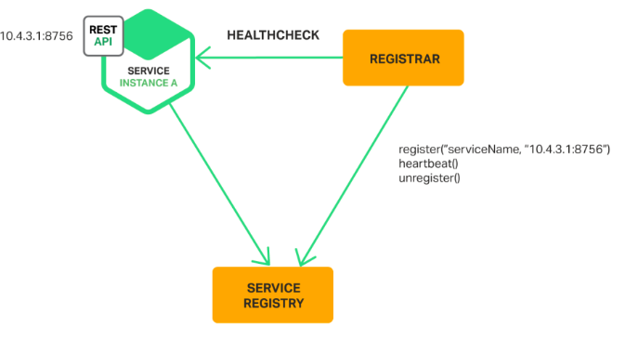
Third-party registration Pattern

Slide 12
Third-party registration Pattern
Example of a service registrar - Netflix OSS Prana,
The service registrar is a built-in component of deployment environments. The EC2 instances created by an Autoscaling Group can be automatically registered with an AWS Elastic Load Balancing (ELB).
Kubernetes services are automatically registered and made available for discovery.

Slide 13
Third-party registration Pattern
Benefit - Services are decoupled from the service registry. We don’t need to implement service‑registration logic for each programming language and framework used by our developers. Instead, service instance registration is handled in a centralized manner within a dedicated service.
Drawbrack - Unless it’s built into the deployment environment, it is yet another highly available system component that we need to set up and manage.

Slide 14
Service discovery patterns
There are two main service discovery patterns:
Client-side discovery pattern
Server-side discovery pattern

Slide 15
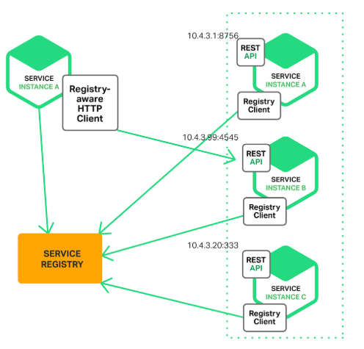
Client-Side Discovery Pattern
The client contacts a service registry, receives details for available services, and contacts one of them using a load balancing algorithm.
Netflix OSS provides a great example of the client-side discovery pattern.

Slide 16
Server-Side Discovery Pattern
The client contacts a load balancer, making a request that indicates which type of service it needs.
The load balancer consults the service registry, selects the optimal service (for example, the least loaded one) and routes the request to it.
An example of a server-side discovery mechanism is AWS Elastic Load Balancing (ELB). A client makes requests (HTTP or TCP) via the ELB using its DNS name.
The ELB load balances the traffic among a set of registered Elastic Compute Cloud (EC2) instances or EC2 Container Service (ECS) containers.
There isn’t a separate service registry.
Instead, EC2 instances and ECS containers are registered with the ELB itself.

Slide 17
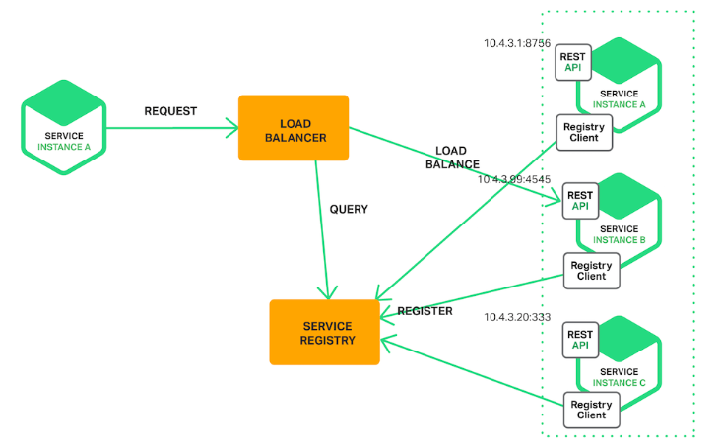
Server-Side Discovery Pattern

Slide 18
Example – Netflix Eureka Server
Eureka Server is an application that acts as a service registry.
Every Microservice will register itself into the Eureka server and the Eureka server knows all the client applications running on each port and IP address.

