Slide 1
Consul

Slide 2
Consul
Microservices and other distributed systems can enable faster, simpler software development.
But there's a trade-off resulting in greater operational complexity around inter-service communication, configuration management, and network segmentation.
HashiCorp Consul is an open source tool that solves these new complexities by providing service discovery, health checks, load balancing, a service graph, mutual TLS identity enforcement, and a configuration key-value store.
These features make Consul an ideal control panel for a Service Mesh.

Slide 3
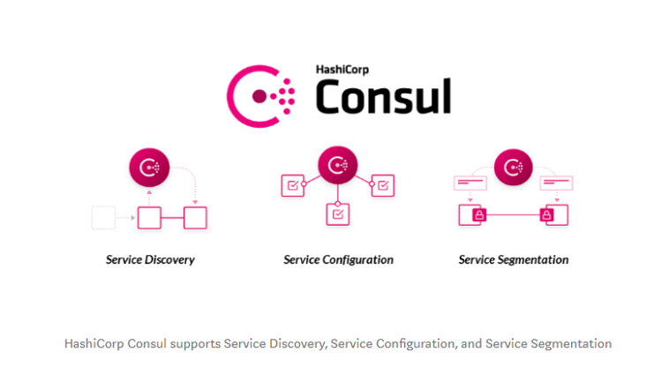
Consul

Slide 4
Consul Agent
The Consul agent is the core process of Consul.
The agent maintains membership information, registers services, runs checks, responds to queries, and more.
The agent must run on every node that is part of a Consul cluster.
consul agent -server -bootstrap-expect=1 -data-dir=consul-data -ui -bind=<IP>

Slide 5
Consul Service Mesh
Service mesh solves the networking and security challenges of operating microservices and cloud infrastructure.
Consul is a service mesh solution that offers a software-driven approach to routing and segmentation.
It also brings additional benefits such as failure handling, retries, and network observability.

Slide 6
Service Discovery
Service Discovery in a monolithic application | Service Discovery in MSA -
Let's say service A wants to call service B. So, we would expose a method, mark it as public, in service B and then service A can just call it. They're in the same application. It's just an in-memory function call. In a monolithic application, the services would expose public functions and it would simply call the function across services. | Here, we deploy service A and service B as an independent deployable units in a distributed environment. If service A wants to call service B, then service A needs to know the location (IP address) of the service B. So, the challenge here is: "How do these different services discover one another in our distributed environment?"

Slide 7
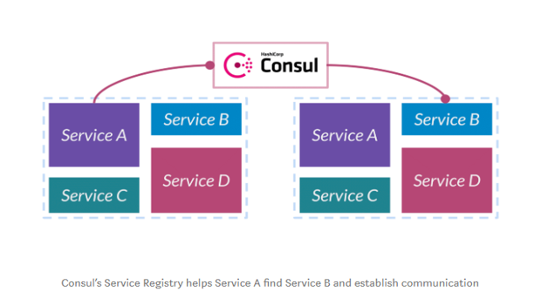
Service Discovery
Consul’s solution for this service discovery problem is a central service registry.
Consul maintains a central registry that contains the entry for all the upstream services.
When a service instance starts, it gets registered on the central registry.
The registry is populated with all the upstream instances of the service.

Slide 8
Service Discovery
When a service A wants to talk to service B, it will discover and communicate with B by querying the registry about the upstream service instances of B.
Consul also provides health-checks on these service instances.
If one of the service instances or services itself is unhealthy or fails its health-check, the registry would then know about this scenario and would avoid returning the service’s address.
Consul programmatically manages registry, which gets updated when any new service registers itself and becomes available for receiving traffic.

Slide 9
Service Configuration
Configuration management in a monolith application - In monolithic application, we would have all our configuration in a single XML file that configures the whole thing. The advantage of this is that all of our different subsystems, all of our components, had a consistent view of the configuration.
As an example, suppose we wanted to put our application in maintenance mode. We wanted to prevent it from writing to the database so that we could do some upgrades in the background. We would change this configuration file and then all of these subsystems would believe that we're in maintenance mode simultaneously.
Configuration management in a MSA - The challenge here is: "How do we think about configuration in our distributed environment?"

Slide 10
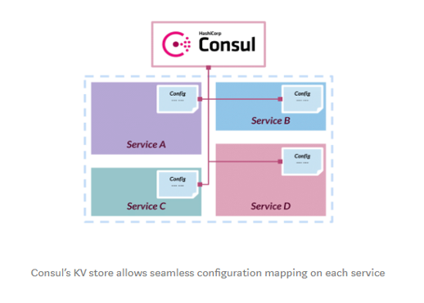
Service Configuration
Consul’s solution for this configuration management is the central Key-Value store.
Instead of trying to define the configuration in each service distributed throughout our infrastructure, Consul uses a key-value store to capture it centrally.

Slide 11
Service Configuration
We can define a key centrally that says whether our system is in maintenance mode or not , "Are we in maintenance mode?" and the values can be "true or false".
Also, we have to change some default configuration in each service depending upon the state of our system.
When the system is in maintenance mode, we change the "Are we in maintenance mode?" key's value centrally from "false to true".
Then, push out the changed state to all our services and configure them.
Thus, gives consistent view of configuration across all the services.

Slide 12
Service Segmentation
In microservice environment, we have hundreds of unique services across different network zone.
Traffic pattern between these services are much more complicated.
Many services have complicated east-west traffic flow.
The challenge here is: "How do we think about segmenting this network?" and "How do we partition which services are allowed to talk to which other services?"
The third challenge we run into is segmentation.
Consul deals with this is with a feature called Connect.

Slide 13
Service Segmentation
Consul Connect establishes inter-service communication polices by using service graph.
With the Service Graph, we can define - which service can talk to which other service.
So, we might say, "A is able to talk to B" and "C is allowed to talk to D". Here, we're not talking about IP to IP.
We're not saying IP 1 can talk to IP 2. We're talking about "service A can talk to service B".
The higher benefit of this is, it is not IP restricted.
Rather it’s service level. This makes scalable independent of our distributed network.
The policy will be enforced on all instances of service also, there won't be any hardbound firewall rules specific to a service’s IP.

Slide 14
Service Segmentation
when we say "service A can talk to service B", how do we know what is service A and what is service B? and how do we authorize the identity of each service?.
Consul Connect provides service-to-service connection authorization and encryption using mutual Transport Layer Security (TLS).
We issue TLS certificates that uniquely identify these services. So we can uniquely say, "This is service A and this is service B. Unlike saying, "There's an IP and we don't actually know what's running at that IP with any strong guarantee."

Slide 15
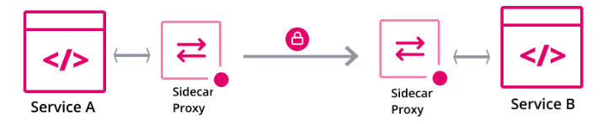
Service Segmentation
Consul enforces TLS using an agent-based proxy attached to each service instance.
This proxy acts as a sidecar.
Applications can use sidecar proxies in a service mesh configuration to establish TLS connections for inbound and outbound connections without being aware of Connect at all.
Applications may also natively integrate with Connect for optimal performance and security. Connect can help you secure your services and provide data about service-to-service communications.

Slide 16
Consul Service Mesh
Consul addresses the new microservices architecture challenges with service discovery and allowing operators to deploy applications into a zero-trust network.
Consul offers us a service catalog, health checks, automatic load balancing, and geo-failover across multiple instances of the same service.
Consul service mesh uses mutual TLS (mTLS) and will automatically generate and distribute the TLS certificates for every service in the mesh. The certificates are used for both:
service identity verification
service communication encryption

Slide 17
Consul Service Mesh
Consul service mesh deploys sidecar proxies locally alongside each service instance, which transparently handles inbound and outbound service connections, automatically verifying and encrypting TLS connections between services.
Consul also helps us to secure service communication at the network level by enabling us to manage service-to-service communication permissions using intentions.
Intentions define service based access control for services in the Consul service mesh and are used to control which services are allowed or not allowed to establish connections.
In addition to securing our services, Consul service mesh can also intercept data about service-to-service communications and surface it to monitoring tools.

Slide 18
Spring Cloud Consul
The Spring Cloud Consul project provides easy integration with Consul for Spring Boot applications.
With a few simple annotations we can quickly enable and configure the common patterns inside our application and build large distributed systems with Hashicorp’s Consul.
The patterns provided include Service Discovery, Control Bus and Configuration, Intelligent Routing (Zuul) and Client Side Load Balancing (Ribbon), Circuit Breaker (Hystrix) are provided by integration with Spring Cloud Netflix.

