Slide 1
Spring MVC

Slide 2
Spring - MVC Framework
Framework for building web applications in Java
Based on Model-View-Controller and Front Controller design pattern
Leverages features of the Core Spring Framework (IoC, DI)

Slide 3
Components of a Spring MVC Application
A set of web pages to layout UI components
A collection of Spring beans (controllers, services, etc…)
Spring configuration (XML, Annotations or Java)

Slide 4
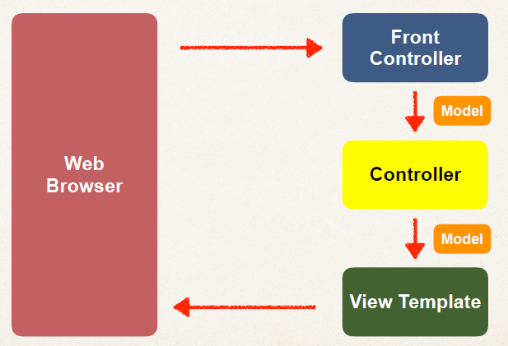
Spring MVC

Slide 5
Spring MVC Front Controller
Front controller known as DispatcherServlet
Part of the Spring Framework
Already developed by Spring Dev Team

Slide 6
Controller
Code created by developer
Contains your business logic
Handle the request
Store/retrieve data (db, web service…)
Place data in model
Send to appropriate view template

Slide 7
Model
Model: contains your data
Store/retrieve data via backend systems
database, web service, etc…
Use a Spring bean if you like
Place your data in the model
Data can be any Java object/collection

Slide 8
View Template
Spring MVC is flexible
Supports many view templates
Most common is JSP + JSTL
Developer creates a page
Displays data

Slide 9
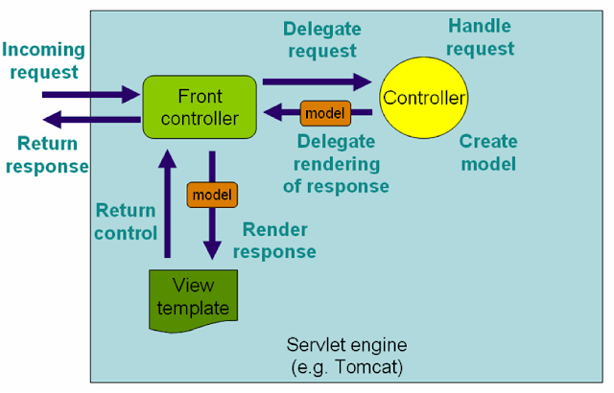
Spring MVC work Flow

Slide 10
Spring MVC work Flow
The client sends an HTTP request to a specific URL
DispatcherServlet of Spring MVC receives the request
It passes the request to a specific controller depending on the URL requested using @Controller and @RequestMapping annotations.
Spring MVC Controller then returns a logical view name and model to DispatcherServlet.
DispatcherServlet consults view resolvers until actual View is determined to render the output
DispatcherServlet contacts the chosen view (like Thymeleaf, Freemarker, JSP) with model data and it renders the output depending on the model data
The rendered output is returned to the client as a response

Slide 11
Spring MVC Using XML Configuration
In spring MVC all requests go through DispatcherServlet which acts as a front controller.
You need to configure DispatcherServlet in web.xml with the Servlet mapping for the URL pattern to indicate the URLs served by the DispatcherServlet.

Slide 12
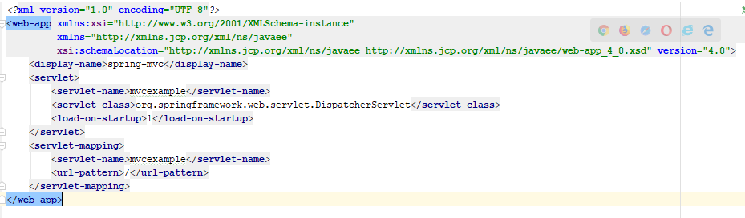
web.xml

Slide 13
Configuration file for Spring Web MVC
Here <servlet-name> is important because DispatcherServlet tries to load the Spring application context from the XML file whose name is <servlet-name>-servlet.xml.
For example here name is mvcexample so DispatcherServlet will look for the xml named mvcexample-servlet.xml in WEB-INF directory.
So you need to create mvcexample-servlet.xml file

Slide 14
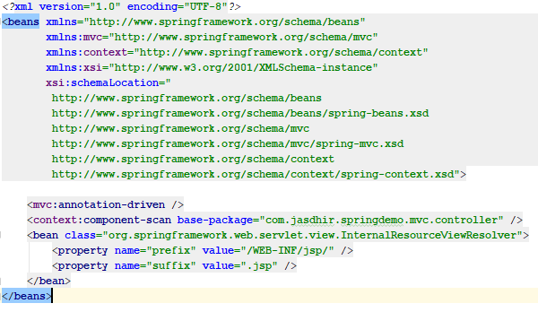
mvcexample-servlet.xml

Slide 15
InternalResourceViewResolver
The InternalResourceViewResolver is an implementation of ViewResolver
In the Spring MVC framework which resolves logical view names like "hello" to internal physical resources like Servlet and JSP files e.g. jsp files placed under the WEB-INF folder.
It is a subclass of UrlBasedViewResolver, which uses "prefix" and "suffix" to convert a logical view name returned from the Spring controller to map to actual, physical views.

Slide 16
Spring MVC Using Java Configuration
To enable Spring MVC support through a Java configuration class, all we have to do is add the @EnableWebMvc annotation
This will set up the basic support we need for an MVC project, such as registering controllers and mappings, type converters, validation support, message converters and exception handling.
If we want to customize this configuration, we need to implement the WebMvcConfigurer interface

Slide 17
WebMvcConfigurer
Defines callback methods to customize the Java-based configuration for Spring MVC enabled via @EnableWebMvc.
@EnableWebMvc-annotated configuration classes may implement this interface to be called back and given a chance to customize the default configuration.

Slide 18
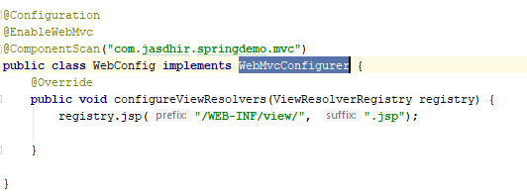
WebMvcConfigurer

Slide 19
AbstractAnnotationConfigDispatcherServletInitializer
WebApplicationInitializer to register a DispatcherServlet and use Java-based Spring configuration.
Implementations are required to implement:
getRootConfigClasses() -- for "root" application context (non-web infrastructure) configuration.
getServletConfigClasses() -- for DispatcherServlet application context (Spring MVC infrastructure) configuration.
getServletMappings() - Specify the servlet mapping(s) for the DispatcherServlet — for example "/", "/app", etc.

Slide 20
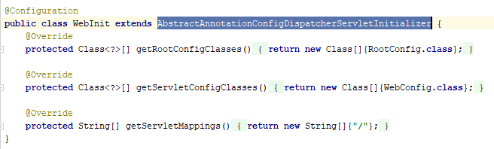
AbstractAnnotationConfigDispatcherServletInitializer

Slide 21
The Need for Validation
Check the user input form for
required fields
valid numbers in a range
valid format (postal code)
custom business rule

Slide 22
Java’s Standard Bean Validation API
Java has a standard Bean Validation API
Defines a metadata model and API for entity validation
Not tied to either the web tier or the persistence tier
Available for server-side apps and also client-side JavaFX/Swing apps

Slide 23
Bean Validation Features
Validation Feature
required
validate length
validate numbers
validate with regular expressions
custom validation

Slide 24
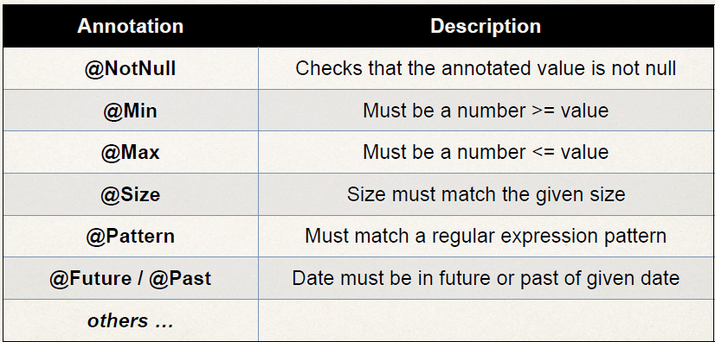
Validation Annotations

