Slide 1
Spring - MVC Framework

Slide 2
Spring - MVC Framework
Framework for building web applications in Java
Based on Model-View-Controller and Front Controller design pattern
Leverages features of the Core Spring Framework (IoC, DI)

Slide 3
Components of a Spring MVC Application
A set of web pages to layout UI components
A collection of Spring beans (controllers, services, etc…)
Spring configuration (XML, Annotations or Java)

Slide 4
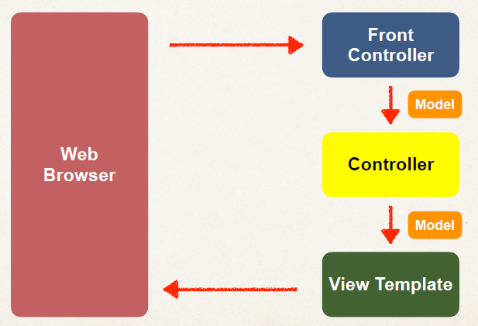
Spring MVC

Slide 5
Spring MVC Front Controller
Front controller known as DispatcherServlet
Part of the Spring Framework
Already developed by Spring Dev Team

Slide 6
Controller
Code created by developer
Contains your business logic
Handle the request
Store/retrieve data (db, web service…)
Place data in model
Send to appropriate view template

Slide 7
Model
Model: contains your data
Store/retrieve data via backend systems
database, web service, etc…
Use a Spring bean if you like
Place your data in the model
Data can be any Java object/collection

Slide 8
View Template
Spring MVC is flexible
Supports many view templates
Most common is JSP + JSTL
Developer creates a page
Displays data

Slide 9
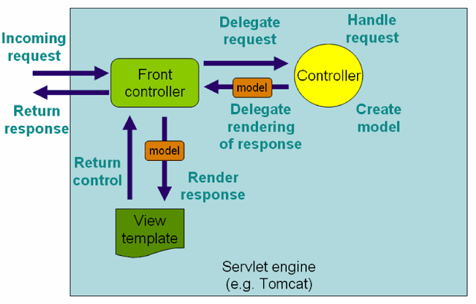
Spring MVC work Flow

Slide 10
Spring MVC work Flow
The client sends an HTTP request to a specific URL
DispatcherServlet of Spring MVC receives the request
It passes the request to a specific controller depending on the URL requested using @Controller and @RequestMapping annotations.
Spring MVC Controller then returns a logical view name and model to DispatcherServlet.
DispatcherServlet consults view resolvers until actual View is determined to render the output
DispatcherServlet contacts the chosen view (like Thymeleaf, Freemarker, JSP) with model data and it renders the output depending on the model data
The rendered output is returned to the client as a response

Slide 11
Spring MVC Using XML Configuration
In spring MVC all requests go through DispatcherServlet which acts as a front controller.
You need to configure DispatcherServlet in web.xml with the Servlet mapping for the URL pattern to indicate the URLs served by the DispatcherServlet.

Slide 12
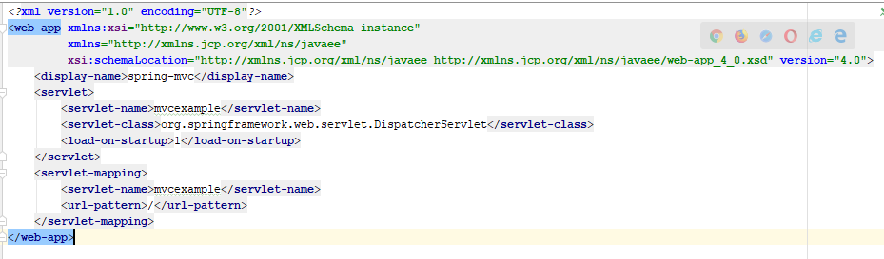
web.xml

Slide 13
Configuration file for Spring Web MVC
Here <servlet-name> is important because DispatcherServlet tries to load the Spring application context from the XML file whose name is <servlet-name>-servlet.xml.
For example here name is mvcexample so DispatcherServlet will look for the xml named mvcexample-servlet.xml in WEB-INF directory.
So you need to create mvcexample-servlet.xml file

Slide 14
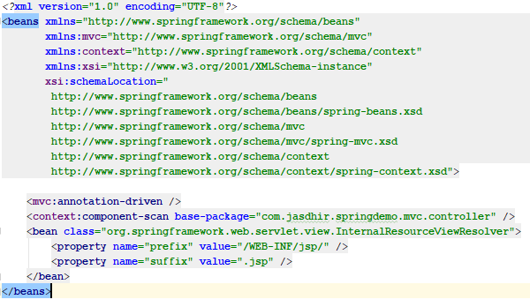
mvcexample-servlet.xml

Slide 15
InternalResourceViewResolver
The InternalResourceViewResolver is an implementation of ViewResolver
In the Spring MVC framework which resolves logical view names like "hello" to internal physical resources like Servlet and JSP files e.g. jsp files placed under the WEB-INF folder.
It is a subclass of UrlBasedViewResolver, which uses "prefix" and "suffix" to convert a logical view name returned from the Spring controller to map to actual, physical views.

Slide 16
Spring MVC Using Java Configuration
To enable Spring MVC support through a Java configuration class, all we have to do is add the @EnableWebMvc annotation
This will set up the basic support we need for an MVC project, such as registering controllers and mappings, type converters, validation support, message converters and exception handling.
If we want to customize this configuration, we need to implement the WebMvcConfigurer interface

Slide 17
WebMvcConfigurer
Defines callback methods to customize the Java-based configuration for Spring MVC enabled via @EnableWebMvc.
@EnableWebMvc-annotated configuration classes may implement this interface to be called back and given a chance to customize the default configuration.

Slide 18
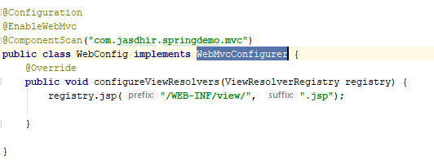
WebMvcConfigurer

Slide 19
AbstractAnnotationConfigDispatcherServletInitializer
WebApplicationInitializer to register a DispatcherServlet and use Java-based Spring configuration.
Implementations are required to implement:
getRootConfigClasses() -- for "root" application context (non-web infrastructure) configuration.
getServletConfigClasses() -- for DispatcherServlet application context (Spring MVC infrastructure) configuration.
getServletMappings() - Specify the servlet mapping(s) for the DispatcherServlet — for example "/", "/app", etc.

Slide 20
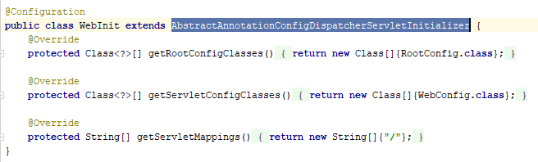
AbstractAnnotationConfigDispatcherServletInitializer

Slide 21
Spring MVC Using Spring Boot
While developing Spring MVC applications without Spring Boot, it requires writing pretty much boiler-plate code just for the configuration which is the same for almost projects.
This is a repeated task which consume programmer’s time which should be spent on developing business logic for the application.
With Spring Boot, things get a lot easier.
All the configurations are automatically done for you (auto configuration) with sensible defaults.
So you can quickly jump on coding the business logic without worrying about the configuration details.

Slide 22

Spring Boot MVC Maven dependencies
The dependency spring-boot-starter-web enables web development with Spring MVC and embedded Tomcat server.
It requires all common dependencies (Spring framework, logging, validation, JSON, …) with proper versions so you don’t have to struggle with a lot of dependencies and their versions like normal Spring MVC application development.

Slide 23
Spring Boot MVC
The @SpringBootApplication annotation does the magic work to start the embedded Tomcat server, configure Spring Dispatcher Servlet, etc.
There are two default directories and one properties file in the src/main/resources folder.
static: put your static files here, e.g. HTML files.
templates: put your template files here, e.g. ThymeLeaf files.
application.properties: specify additional configurations here, e.g. logging, Spring MVC view resolver, server port number, etc.

Slide 24
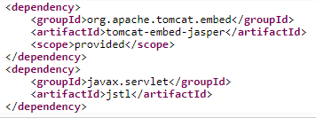
How to use JSP with Spring Boot
Add the following two dependencies in the pom.xml file
The dependency tomcat-embed-jasper is JSP Engine for Tomcat. It is required to enable JSP with Spring Boot.

Slide 25

View Resolver Configuration
To configure Spring MVC view resolver, open the application.properties file and put the following properties

Slide 26
ViewController
View controllers are used to forward a request to the views without any controllers written either using ViewControllerRegistry or <mvc:view-controller> element.
Normally in applications view-controllers are used in static cases when there is no Controller Logic (like getting data for dropdowns) to execute before the view generates the response.

Slide 27

ViewControllerRegistry
ViewControllerRegistry is a registry for all the view controllers.
We do not need to create a Controller class to handle requests, if we are using the ViewControllerRegistry.
You can register a view into the ViewControllerRegistry as shown below.

Slide 28
Serve Static Resources
Spring Boot comes with a pre-configured implementation of ResourceHttpRequestHandler to facilitate serving static resources.
By default, this handler serves static content from any of /static, /public, /resources, and /META-INF/resources directories that are on the classpath.
Since src/main/resources is typically on the classpath by default, we can place any of these directories there.

Slide 29
ResourceHandlerRegistry
Stores registrations of resource handlers for serving static resources such as images, css files and others through Spring MVC including setting cache headers optimized for efficient loading in a web browser.
Resources can be served out of locations under web application root, from the classpath, and others.

Slide 30
ResourceHandlerRegistry
To create a resource handler, use addResourceHandler(String...) providing the URL path patterns for which the handler should be invoked to serve static resources (e.g. "/resources/**").
Then use additional methods on the returned ResourceHandlerRegistration to add one or more locations from which to serve static content from (e.g. {"/", "classpath:/META-INF/public-web-resources/"})

Slide 31
Spring MVC Interceptor
Spring’s web MVC framework is request-driven and designed based on a central Servlet that dispatches requests to controllers and invokes other functionality that facilitates the development of web applications.
Interceptors, are special web programming constructs which gets invoked every time when a certain pre-configured web request is made.
Interceptors are generally used do some processing before handing it over to the controller handler methods.

Slide 32
Spring MVC Interceptor
Spring mvc interceptor is implemented by HandlerInterceptor
HandlerInterceptor interface defined 3 methods.
preHandle(request, response, handler) – Used to intercept the request before handed over to the handler method. Here handler is the chosen handler object to handle the request.
postHandle(request, response, handler, modelAndView) – Used to intercept the request after handler has completed request processing but DispatcherServlet is yet to render the view.
afterCompletion(request, response, handler, exception) – It is called once the handler execution is complete and view is rendered as well.

Slide 33
