Slide 1
Spring Data JPA
Spring Data JPA is a powerful framework that allows users to easily interact with their database while minimizing boilerplate code.

Slide 2
Spring Data
We have already utilized the Data Access Object (DAO) Layer to handle communication of data between our application and our repository.
This DAO layer usually consists of a lot of boilerplate code, and as such can and should be simplified.
There are numerous reasons to simplify this code, including a decrease in the number of artifacts that need to be defined and maintained, consistency of data access patterns, consistency of configuration, and quicker implementation for updated repository data.

Slide 3
Spring Data
The Spring Data module takes this simplification one step further by providing standard implementation for common DAO methods allowing for the removal of the DAO implementation and only requiring the definition of the DAO interface methods.
In order to leverage the Sping Data programming model with JPA, a DAO interface should extend the Spring JpaRepository interface from the org.springframework.data.jpa.repository package

Slide 4
Spring Data
Note that it is possible to create a basic CRUD application by extending the spring CrudRepository interface (from the org.springframework.data.repository package), though this only provides an interface for generic CRUD operations on a repository, and does not leverage the JPA.

Slide 5
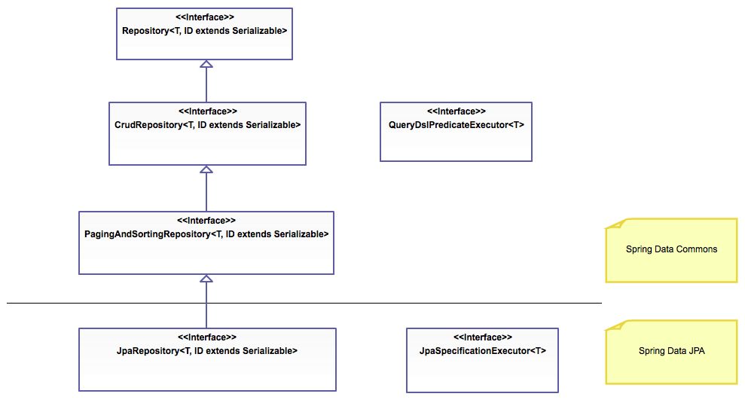
Spring Data

Slide 6
Spring Data
Implementation of the Spring JpaRepository provides the following:
Sophisticated support to build repositories based on Spring and JPA
Support for QueryDSL predicates and thus type-safe JPA queries
QueryDSL is a framework which enables statically typed SQL-like queries, instead of requiring inline string queries or external XML files.

Slide 7
Spring Data
Pagination (sequential numbering) support
Dynamic query execution
Support for integration of custom data access code
Validation of @Query annotated queries during bootstrapping
Support for XML based entity mapping
JavaConfig based repository configuration by introducing @EnableJpaRepositories

Slide 8
Spring Data Annotations
Annotation | Purpose
@Transactional | Configure how the database transaction behaves.
@NoRepositoryBean | Creates and interface that provides common methods for child repositories
@param | Parameters can be passed to queries defined with @query
@id | Marks a field in a model class as the primary key
@transient | Mark a field as transient, to be ignored by the data store engine during reads and writes
@CreatedBy, @LastModifiedBy | Auditing annotations that will automatically filled with the current principal
@CreatedDate, @LastModifiedDate | Auditing annotations that will automatically fill with current date
@query | Supply a JPQL query for repository methods

Slide 9
Transaction Management
When designing database, transactions to be performed in Java or any other programming language other than SQL, it is important to consider that multiple transactions will performed simultaneously.
Managing all these transactions can be tedious and cumbersome because it requires complicated strategies for read/write locking and thread management.
JDBC and connection pool utilities like Hikari have built-in tools for handling these issues, but still will require a lot of boiler plate code to achieve the consistency required for your data.

Slide 10
@Transactional
When using Spring and Spring ORM or Spring Data your chosen ORM can be configured to use a transaction manager that will automatically handle transaction propagation, and isolation, commit, and rollback.

Slide 11
@Transactional
For best practice usage @Transactional should be used on your @Service beans since a transaction is a unit of work with its success or failure directly tied to the requirements of the application and not necessarily to the model.
The side-effects of a transaction can be assumed to be either commit or rollback therefore the model will be consistent, but the @Service will be required to react accordingly.

Slide 12
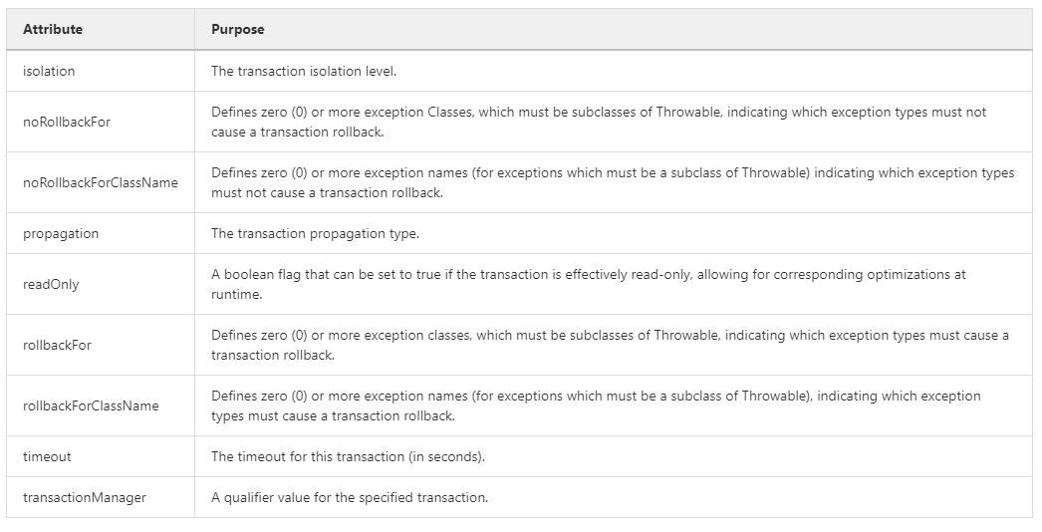
@Transactional - attributes

Slide 13
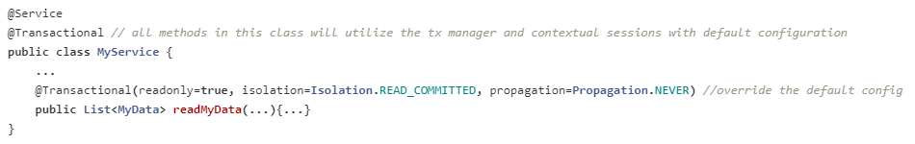
@Transactional Usage
@Transactional can be used on classes or methods or both. In this example, the class uses the transaction manager with default configuration, but the method overrides the default configuration.

Slide 14
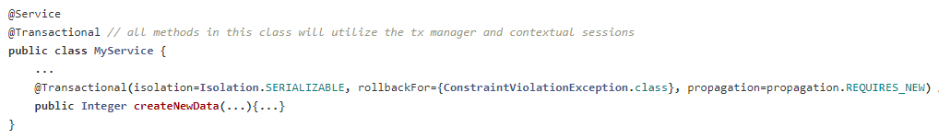
@Transactional Usage
The code demonstrates how to configure the transaction manager with a list of exceptions that must cause a rollback to be triggered.
Normally the transaction manager will always rollback for any RuntimeException or RuntimeException subclass (unchecked exceptions) however, the transaction manager will not automatically rollback for Exception (checked exceptions)

Slide 15
Transaction propagation
When designing database transactions to be performed in Java or any other programming language other than SQL, it is important to ask this question, "How will transactions behave over multiple method calls"? If Method1 calls `Method2, how will transactions propagate.

Slide 16
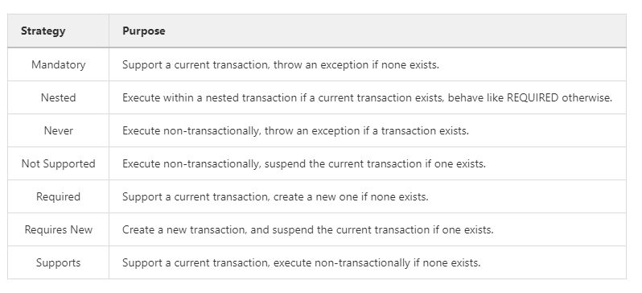
Transaction propagation - Strategy

Slide 17
Spring Transaction Management
Designing transactions and ensuring consistency isn't necessarily trivial, but using a transaction manager can help aleviate some of the more complex tasks such as read/write locking and thread management.
As we know Spring integrates with Hibernate with reasonable ease and integrating a transaction manager is a matter of configuring Hibernate to do so.
So how is transaction propagation performed?

Slide 18
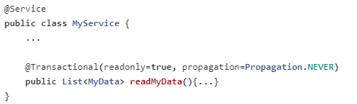
Propagation Usage
The code use the transaction manager to create a read only, transaction less transaction state.
Generally speaking, readonly operations are idempotent and safe so an argument for never having a transaction present can be made.

