Slide 1
Java Persistence API

Slide 2
Object Relational Mapping (ORM)
Most object-oriented applications use a relational database to store and manage the application data.
The relational database represents data in a table, whereas the data in object-oriented applications encapsulated in an object.
We can access a class by using its objects.
However, to access the tabular data, we need to use a query language.
Using tabular data in an object-oriented application requires a conversion between the two types of data.
As a result, it is not possible to store the objects directly in a relational database.
These differences between object-oriented and relational database paradigms are called impedance mismatch.

Slide 3
Impedance Mismatch
Granularity - refers to the mismatch in the number of classes that are mapped with a certain number of tables in the database.
Inheritance - Java classes in the application are commonly related to each other through an inheritance hierarchy. However, the tables within the database can't be represented through an inheritance hierarchy.
Identity - The relational database distinguishes an object instance on the basis of their primary key. However, an object model distinguishes an object on the basis of object identity and object equality.
Association - In the object model, two classes are linked by association. However, in relational databases, the linking of tables is achieved with the help of foreign keys.
Navigation - The ways of accessing objects in Java and in RDBMS are fundamentally different.

Slide 4
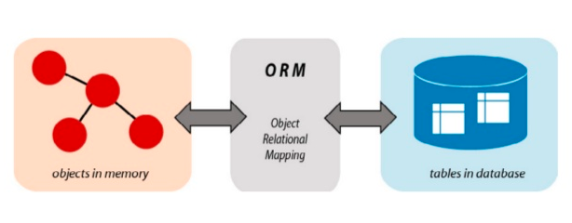
Impedance Mismatch
To solve the impedance mismatch, we use an ORM tool that converts the data between relational databases and object oriented programming languages.
ORM stands for Object-Relational Mapping, uses objects to connect the Object-Oriented programming language and the database systems, which facilitates the SQL to work along with the object-oriented programming concepts.

Slide 5
Benefits of ORM
ORM maps an class to the table.
We can hide the details of SQL queries from OO logic. This propagates the idea of data abstraction.
It provides methods for automatic versioning and timestamping.
It provides caching support for better performance.
Best suited for large projects
Injected transaction management
Configurable logging
Faster development of applications

Slide 6
ORM Tools
There are lots of ORM tools available such as
Hibernate
JPA
Active JPA
iBATIS
IBM Pure Query, etc.

Slide 7
Java Persistence API(JPA)
The Java Persistence API(JPA) is a standard API for accessing, persisting and managing data between Java objects/classes and a relational database.
It is defined in the javax.persistence package.
It uses Java Persistence Query Language (JPQL), which is an object-oriented query language to perform database operations.
It uses the EntityManager interface to create, read, and delete operations for instances of mapped entity classes.

Slide 8
Annotations
Annotations are used to provide metadata configuration inside the POJO class, so we can understand the table structure and POJO class simultaneously.
All the JPA annotations are defined in the javax.persistence package.

Slide 9
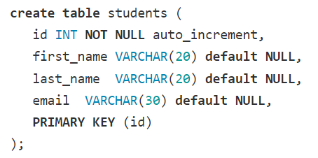
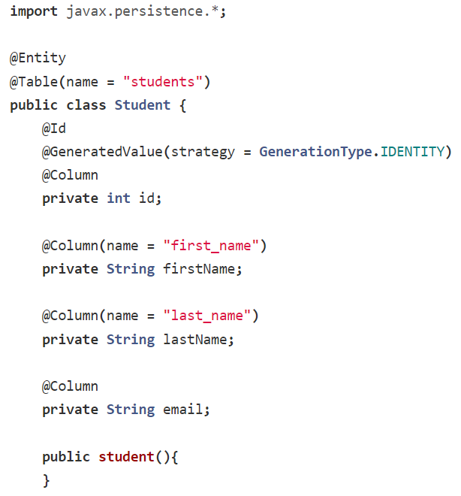
Annotations
Getters / Setters
Parametrized constructor
To String method

Slide 10
Annotations
@Entity - Used to mark a class as a Mapped class/Persistence class.
@Table - Used to specify the table details that used to persist the entity in the database. If the name of the database table differs from the name of the class, the name attribute should be used.
@Id - Used to mark the field as a primary key column. Annotating multiple fields with @id will make them composite keys
@GeneratedValue - Used to instruct the database to generate a value for the field automatically, and to provide a strategy for doing so.

Slide 11
Annotations
@Column - Maps the field to the table column.
The @Column annotation has attributes listed below:
name - used to specify the name of the column. By default, it's assumed the column name and variable name match. This attribute is required if that is not the case.
length - used to specify the size of the String value
nullable - used to mark the column as NOT NULL when the schema is generated.
unique - used to mark the column as UNIQUE to contain unique values.

