Slide 1
Lombok

Slide 2
What is Lombok
According to the official website, "Project Lombok is a java library that automatically plugs into your editor and build tools, spicing up your java.
Never write another getter or equals method again, with one annotation your class has a fully featured builder, Automate your logging variables, and much more."
Project Lombok isn't unique to Spring.
Lombok can be used with vanilla Java
Lombok and Spring have a common goal; reduce the amount of boilerplate code by auto generating the required code elements at compile time.

Slide 3
Why use Lombok
Boilerplate code is code that must be included in many places with little to no alteration. Prime examples of Java boilerplate code.
Getters and Setters
No Arg Constructors
toString
Equals
Hashcode
Logging Variables
Writing boilerplate code is tedious, easily overlooked, reduces testing coverage, and muddies up code.
Lombok exposes a host of annotations that makes generating this code easy while alleviating the above issues.

Slide 4
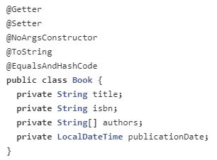
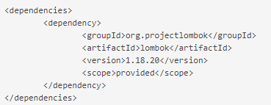
Lombok usage
The following assumes the use of Lombok with Spring.
It is required to used the library with Spring, but this is where we are right now.
Add Lombok as a project dependency in the pom.xml.
The use of the Lombok annotations will automatically generate the require code elements during compile time.

Slide 5
Lombok usage
Annotation | Purpose
@Getter | Generates a getter method for each field
@setter | Generate a setter method for each field
@NoArgsConstructor | Generate a no argument constructor for the class
@tostring | Generate a toString method for the class
@EqualsAndHasCode | Generate and equals and hashCode method for the class

