Slide 1
Linux Operating System
Linux is a widely-used open-source operating system, similar to Windows, Mac.
Linux is a free and open-source family of operating systems that is resilient and flexible.

Slide 2
Linux Operating System
The Linux Operating System is a type of operating system that is similar to Unix, and it is built upon the Linux Kernel.
The Linux Kernel is like the brain of the operating system because it manages how the computer interacts with its hardware and resources.
It makes sure everything works smoothly and efficiently.
The Linux Kernel is combined with a collection of software packages and utilities, which are together called Linux distributions.
These distributions make the Linux Operating System ready for users to run their applications and perform tasks on their computers securely and effectively.
Linux distributions come in different flavors, each tailored to suit the specific needs and preferences of users.

Slide 3
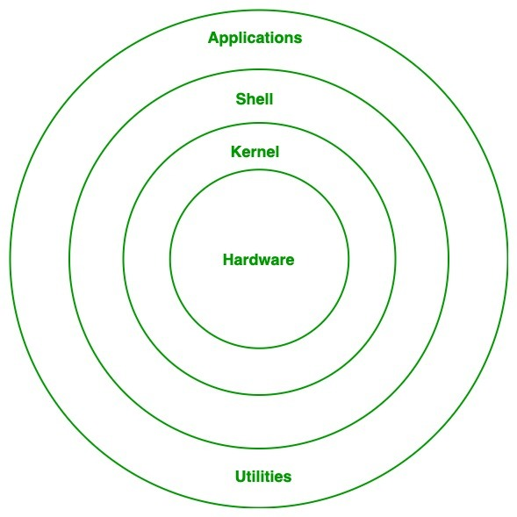
Architecture of Linux
Hardware
Kernel
Shell
Applications
Utilities

Slide 4
Architecture of Linux - Kernel
Kernel is the core of the Linux based operating system.
It virtualizes the common hardware resources of the computer to provide each process with its virtual resources.
This makes the process seem as if it is the sole process running on the machine.
The kernel is also responsible for preventing and mitigating conflicts between different processes.
Different types of the kernel are:
Monolithic Kernel
Hybrid kernels
Exo kernels
Micro kernels

Slide 5
Architecture of Linux - System Library
Linux uses system libraries, also known as shared libraries, to implement various functionalities of the operating system.
These libraries contain pre-written code that applications can use to perform specific tasks.
By using these libraries, developers can save time and effort, as they don’t need to write the same code repeatedly.
System libraries act as an interface between applications and the kernel, providing a standardized and efficient way for applications to interact with the underlying system.

Slide 6
Architecture of Linux - Shell
The shell is the user interface of the Linux Operating System.
It allows users to interact with the system by entering commands, which the shell interprets and executes.
The shell serves as a bridge between the user and the kernel, forwarding the user’s requests to the kernel for processing.
It provides a convenient way for users to perform various tasks, such as running programs, managing files, and configuring the system.

Slide 7
Architecture of Linux - Hardware Layer
The hardware layer encompasses all the physical components of the computer, such as RAM (Random Access Memory), HDD (Hard Disk Drive), CPU (Central Processing Unit), and input/output devices.
This layer is responsible for interacting with the Linux Operating System and providing the necessary resources for the system and applications to function properly.
The Linux kernel and system libraries enable communication and control over these hardware components, ensuring that they work harmoniously together.

Slide 8
Architecture of Linux - System Utilities
System utilities are essential tools and programs provided by the Linux Operating System to manage and configure various aspects of the system.
These utilities perform tasks such as installing software, configuring network settings, monitoring system performance, managing users and permissions, and much more.
System utilities simplify system administration tasks, making it easier for users to maintain their Linux systems efficiently.

