Slide 1
Shell Scripting

Slide 2
What is Shell Scripting
In Linux, shells like bash and korn support programming construct which are saved as scripts.
These scripts become shell commands and hence many Linux commands are script.
A system administrator should have a little knowledge about scripting to understand how their servers and applications are started, upgraded, maintained or removed and to understand how a user environment is built.

Slide 3
How to determine Shell
You can get the name of your shell prompt, with following command
echo $SHELL

Slide 4
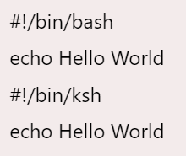
Shell Scripting She-bang
The sign #! is called she-bang and is written at top of the script.
It passes instruction to program /bin/sh.
To run your script in a certain shell (shell should be supported by your system), start your script with #! followed by the shell name.

Slide 5
Shell Scripting Comments
Any line starting with a hash (#) becomes comment.
Comment means, that line will not take part in script execution. It will not show up in the output.

Slide 6
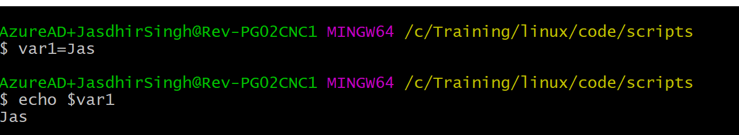
Shell Scripting Variables
Scripts can contain variables inside the script.

Slide 7
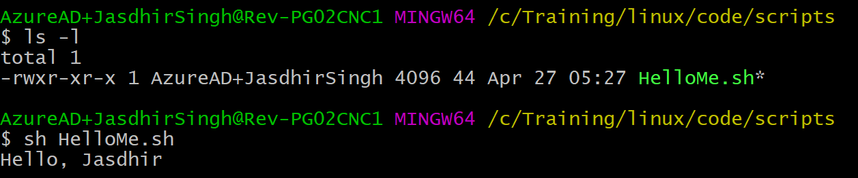
Steps to write and execute a script
Open the terminal. Go to the directory where you want to create your script.
Create a file with .sh extension.
Write the script in the file using an editor.
Make the script executable with command chmod +x <fileName>.
Run the script using ./<fileName>.

