Slide 1
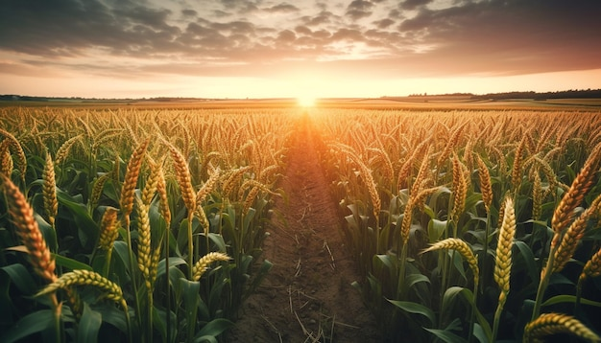
agriculture
in
TELANGANA

Slide 2

Quick Fact
Telangana is India's highest contributor to paddy production. In 2020, Telangana supplied 52.23 lakh tonnes of paddy, which was more than the 83.01 lakh tonnes procured nationwide.

Slide 3
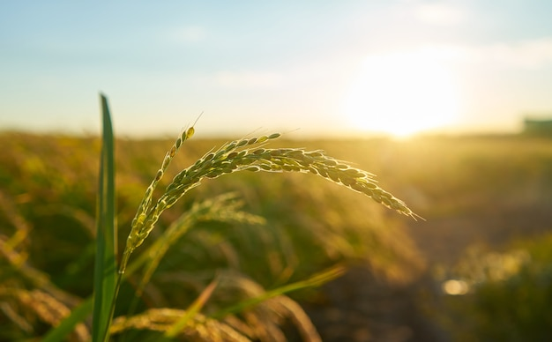
Key Economic Contributor
Telangana's agricultural sector is the backbone of the rural economy, engaging over half of the state's population.
The sector's significant contribution to the Gross State Value Added has steadily increased from 16.3% in 2014-15 to 20.5% in 2020-21, showcasing consistent growth.
Comprising crop cultivation, livestock, forestry, and fishing, this sector plays a pivotal role in shaping Telangana's economic landscape.

Slide 4
Government Initiatives and Support
Government initiatives like Kaleshwaram and Mission Kakatiya focus on improving irrigation infrastructure, crucial for agricultural growth.
The Rythu Bandhu scheme offers investment support to farmers through measures like free power supply and facilitating access to markets, inputs, and credit.
Comprehensive farmer welfare is evident through schemes like Rythu Bima, providing life insurance coverage, showcasing the government's holistic support for farmers' well-being.

Slide 5
Insightful Data and Analysis
Detailed data on soil types, land use, and crop/livestock statistics serves as a vital resource for understanding agricultural dynamics.
This information offers valuable insights into the performance and trends of agriculture and related sectors.
The subsequent analysis provides key observations derived from this data, enhancing comprehension of the sector's trends and performance metrics.

Slide 6
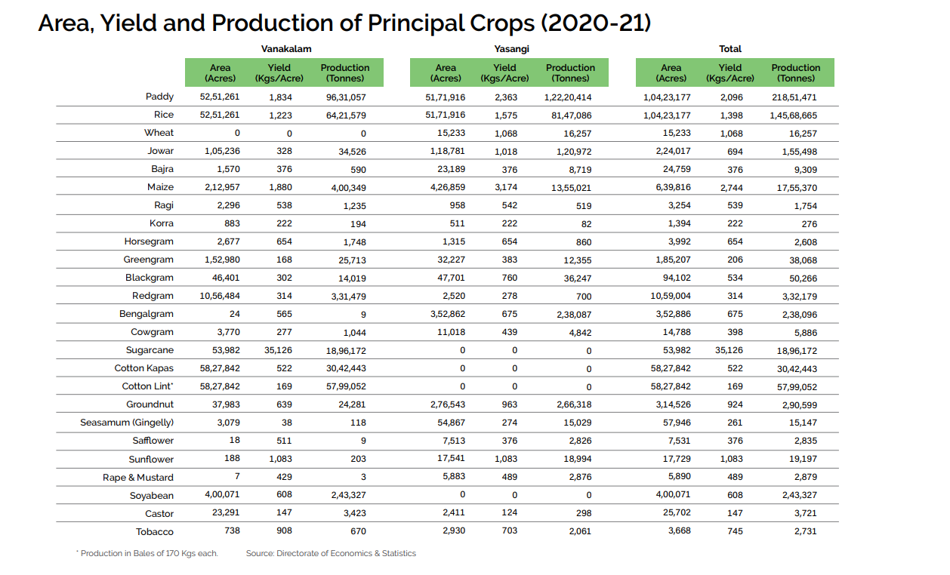

Slide 7
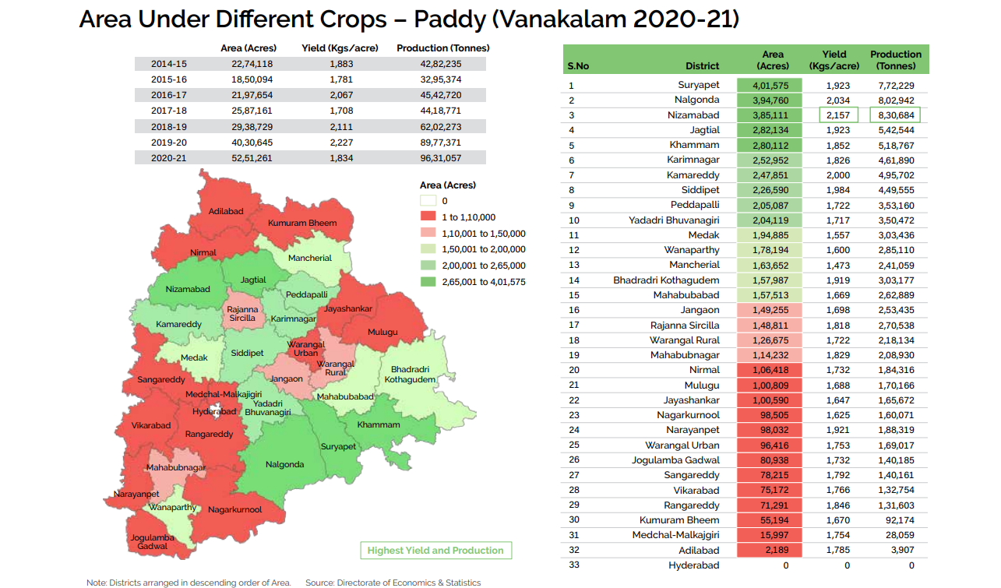

Slide 8
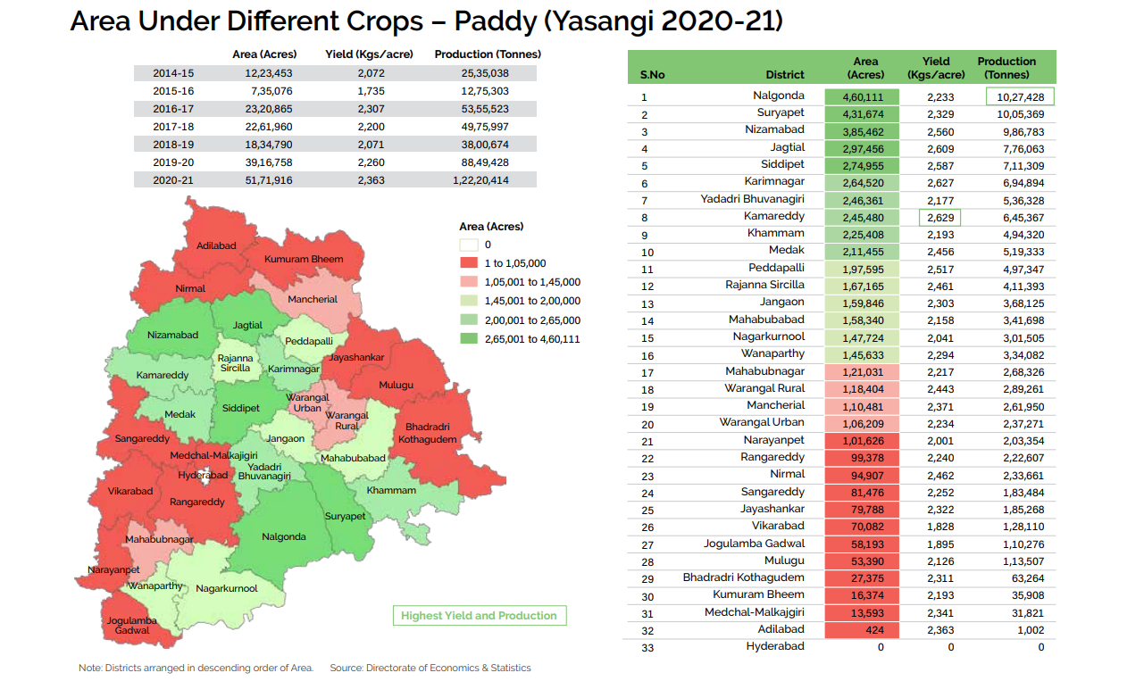

Slide 9
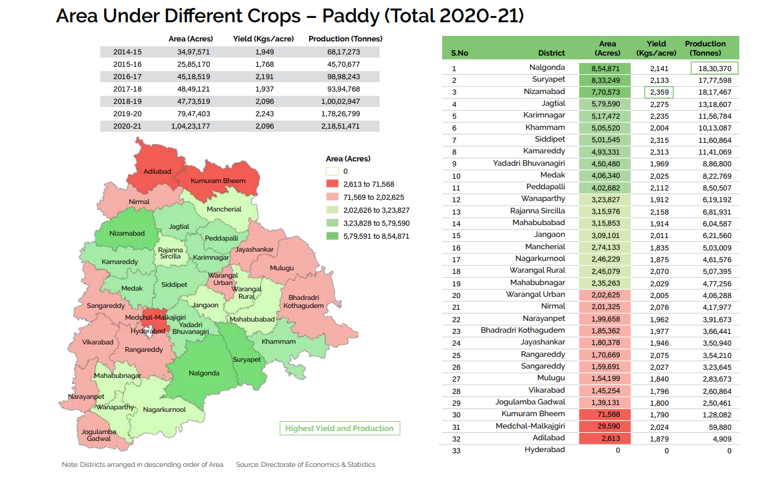

Slide 10
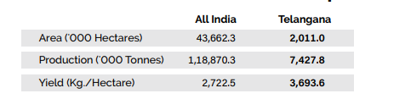
STANDALONE CONTRIBUTION

Slide 11

ADDITIONAL ANALYSIS

Slide 12
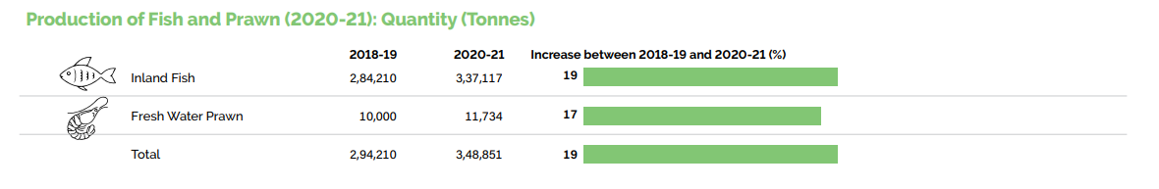

Slide 13
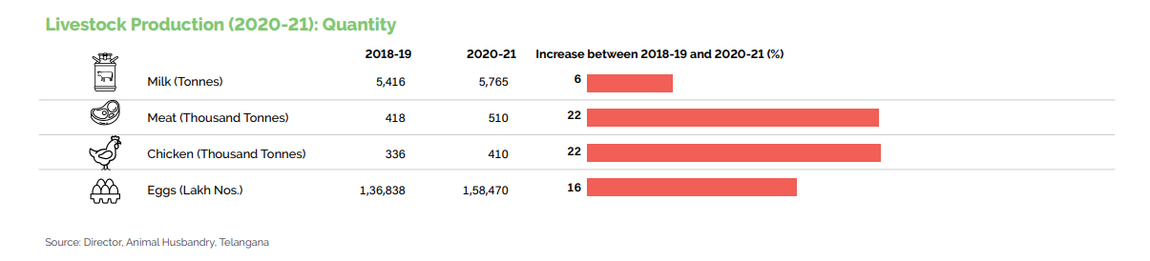

Slide 14
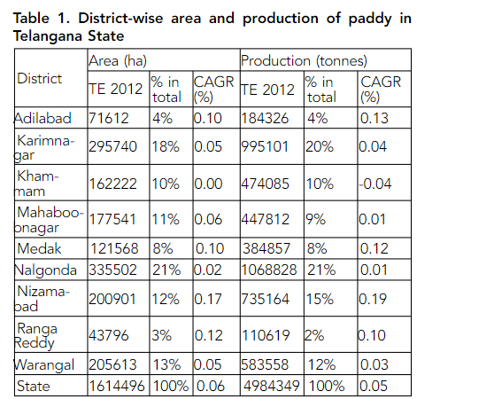

Slide 15
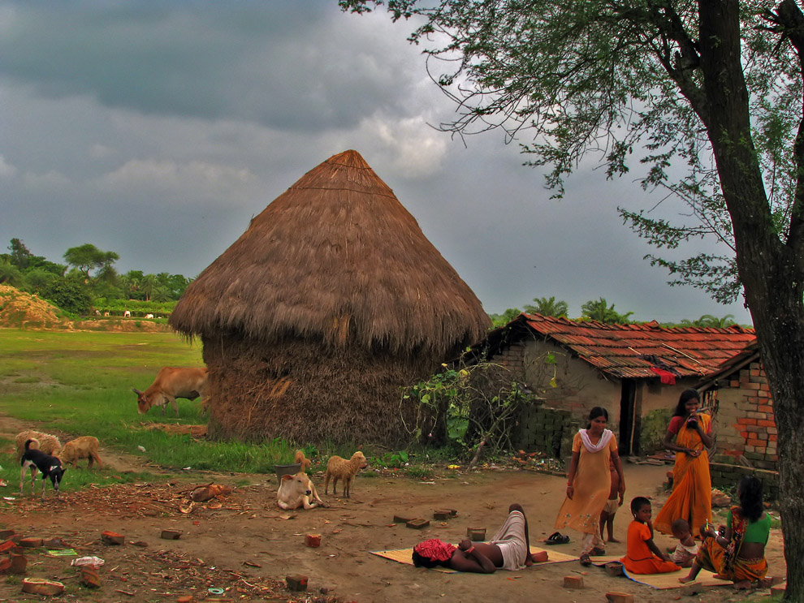
“The soul of India lives in its villages.”
-Mahathma Gandhi

Slide 16
data RESOURCES
https://www.researchgate.net/publication/335716740_Paddy_Production_in_Telangana_State_Current_and_Future_Trends_Statistics_Keywords
https://horticulture.tg.nic.in/downloads/TelanganaStateStatisticalAbstract_19_Jan_2022.pdf
https://www.newindianexpress.com/states/telangana/2020/may/28/telangana-emerges-as-indias-highest-paddy-contributor-2148894.html#:~:text=According%20to%20FCI%20Chairman%20and,tonnes%20in%20the%20same%20season.

Slide 17

TOOLS USED
PowerBI
PowerPoint
ChatGPT
GOOGLE

Slide 18
THANK
YOU.

