Slide 1

Threads
&
daemon threads.
MADHAV - 22AG1A0503

Slide 2
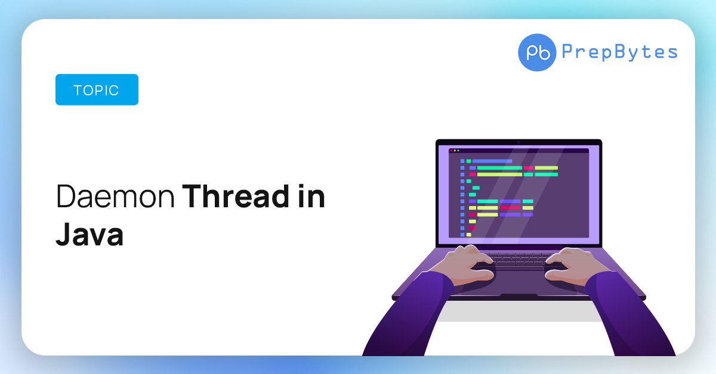

Slide 3

what is a thread??
In Java, a thread refers to the smallest unit of execution within a program. It is a lightweight, independent path of execution that can run concurrently with other threads. Java programs can have multiple threads that execute independently, allowing for concurrent execution of tasks.

Slide 4
what is a deamon thread??
Daemon thread in Java is a service provider thread that provides services to the user thread. Its life depends on the mercy of user threads i.e. when all the user threads die, JVM terminates this thread automatically. There are many Daemon threads in java running automatically e.g. gc, finalizer, etc.

