Slide 1
CONSISTENT HASHING
Advanced Algorithms Project
PES
PES
PES

Slide 2
Distributed hashing
In some situations, it may be necessary or desirable to split a hash table into several parts, hosted by different servers due to memory limitation
In such a scenario, the objects (and their keys) are distributed among several servers.
(DHT) is a decentralized storage system that provides lookup and storage schemes similar to a hash table, storing key-value pairs.
Each node in a DHT is responsible for keys along with the mapped values.
Any node can efficiently retrieve the value associated with a given key.
Properties:
Decentralised & Autonomous
Fault-Tolerant
Scalable

Slide 3
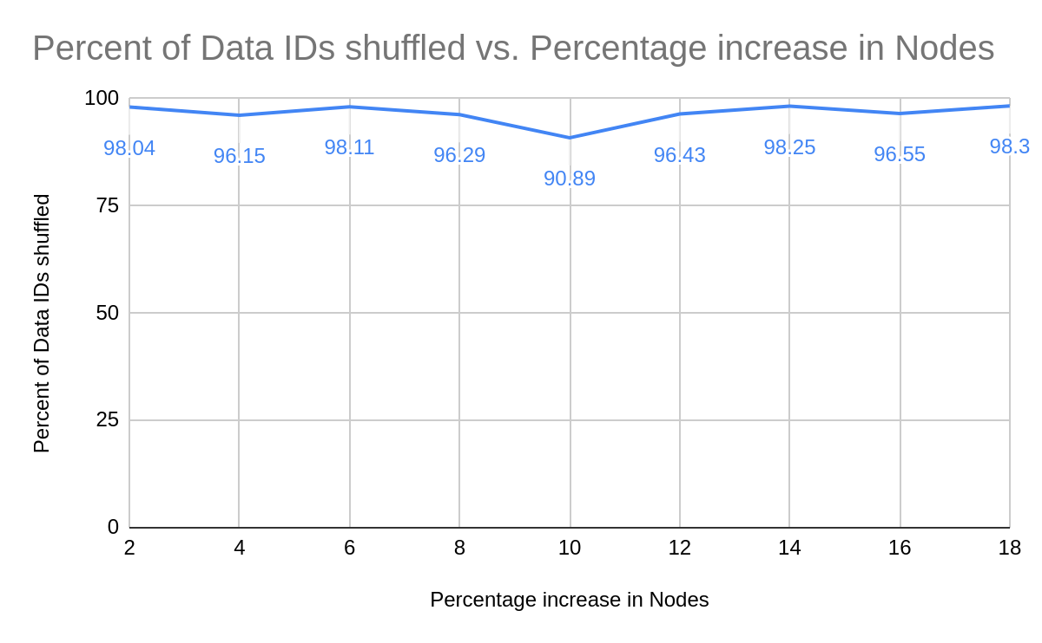
Problems with Naïve Modulo Hashing
Let’s suppose we change the number of nodes by adding/deleting nodes.
Since the keys are distributed depending on the number of nodes, and the number of nodes has changed; the hash value of the new nodes are completely different from the previous node hash values.
As we can see, almost 90-98 % of the data IDs change their nodes
This shifting of data IDs results in a huge performance hit in large scale distributed applications.

Slide 4

Consistent Hashing
It uses a method called “Collision Hashing“ which calculates the Hash function of each node independently of the Number of Nodes in the ring. This avoids repositioning
The Data IDs are mapped onto the next Node they find in Clockwise direction of the ring.
Whenever a Node is added, only the load balance of the 2 servers which the new server is added in between is affected.
Similarly, when a node is deleted, only the server which lies next in the clockwise direction will be affected.

Slide 5
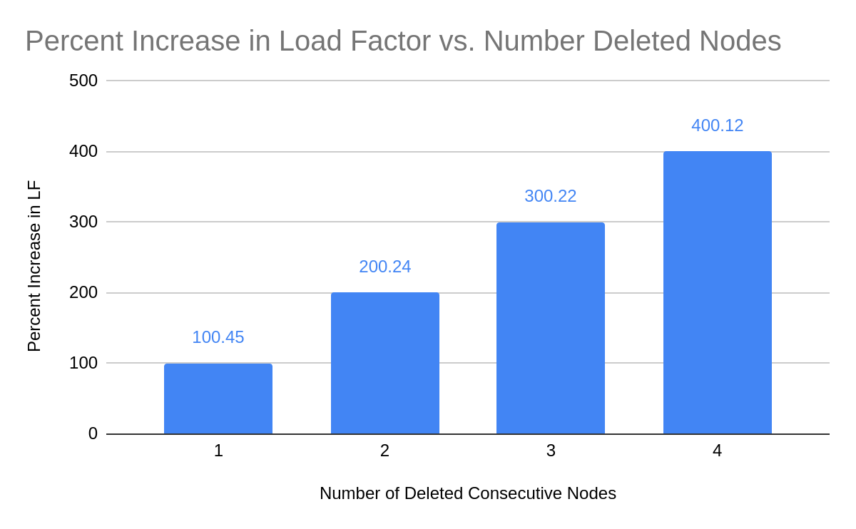
Problems with Naive Consistent Hashing
Although Average theoretical load of each node still remains: 1/N
The load balances of individual nodes can be skewed very heavily above/below the expected average load balance.
Removing continuous nodes in the ring makes transfers the load of the previous ‘n’ servers onto the next server clockwise. This makes the next server’s load increase disproportionately compared to the other nodes.

Slide 6

Consistent Hashing with Virtual Nodes
Multiple virtual nodes are mapped to the same node. (For eg. A1, A2.. An all map to node A)
If we delete A, we actually delete all the virtual nodes from A1 to An. The extra load of deleting A is shared by N other virtual nodes.
Therefore, there is insignificant skewing of data IDs in case of addition/deletion of nodes.

Slide 7
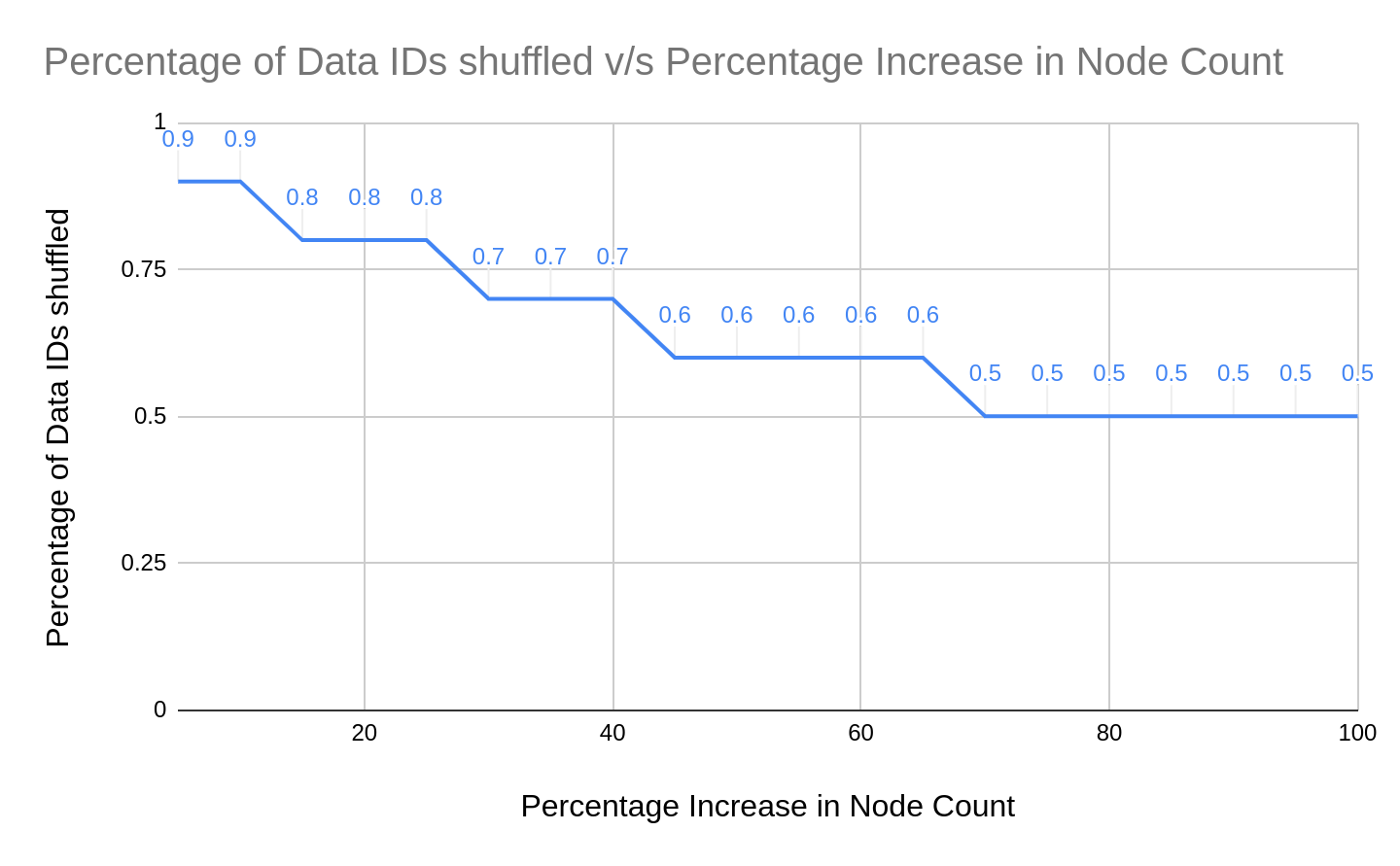
Consistent Hashing with Virtual Nodes
The percentage of reshuffling is only in the range of ( 0.5% to 0.9% ) whereas, in the case of Distributed hashing, it was in the ( 90% to 98% ) range. When adding/deleting nodes, Consistent hashing with Virtual nodes perform 100 times faster than Distributed Hashing.

