Slide 1

AVN Institute of Engineering & Technology
Dept. of Computer Science & Engineering | 2025-2026
FINAL REVIEW
B.Tech Mini Project
GRAPHICAL PASSWORD
AUTHENTICATION SYSTEM
GPAS SECURE
Team Members
Project Guide
M. Sai Madhav – 235U1A05B0
Mrs. Sabitha
Assistant Professor, Dept. of CSE
M. Sree Vidhya – 235U1A05C6
M. Suraj – 235U1A05B4
Batch: 16
GPAS Secure • AVNIET • 2025-2026
1

Slide 2


Abstract
Project Overview
GPAS Secure is a multi-layered web-based authentication system that replaces traditional text passwords with graphical image click-points. Users register by selecting secret points on an image and verify identity via OTP. During login, captcha validation prevents automated attacks, while tolerance-based coordinate matching verifies the graphical password. Failed attempts beyond three lock the account automatically.
Graphical
Password
OTP +
Captcha
Attempt
Limiting
GPAS Secure • AVNIET • 2025-2026
2

Slide 3


Introduction
The Problem with Traditional Passwords
THE PROBLEM
THE SOLUTION
Vulnerable to brute force attacks
Click-point graphical password
Easy to guess or phish
OTP-based email verification
Hard to remember complex strings
Captcha to block bots
Password reuse across platforms
3-attempt account lockout
Keylogging exploits
Session timeout & auto-logout
No multi-layer protection
Admin monitoring & audit logs
GPAS Secure • AVNIET • 2025-2026
3

Slide 4
Literature Review
Existing Research & Prior Systems
Graphical Password Systems
Multi-Factor Auth (MFA)
Click-based, recall & recognition methods improve memorability over text passwords.
Combining passwords with OTP, biometrics, or captcha significantly reduces breach risk.
Captcha Systems
Shoulder-Surfing Studies
Mathematical and image-based captchas prevent automated bot login attacks effectively.
Tolerance-based matching and multi-image selection reduce observation-based attacks.
OTP Authentication
Audit Logs & Analytics
Time-sensitive one-time codes verified via email/SMS provide strong user validation.
Admin dashboards with charts detect anomalies and maintain system integrity.
GPAS Secure • AVNIET • 2025-2026
4

Slide 5


Hardware & Software Requirements
Technology Stack
HARDWARE
SOFTWARE
Processor
Intel Core i3 or above
Frontend
HTML • CSS • JavaScript • Bootstrap
RAM
Minimum 4 GB
Backend
Storage
500 MB free space
Node.js • Express.js
Database
System
64-bit OS
MySQL
Input
Keyboard + Mouse
Libraries
Chart.js • Multer • SMTP
Network
Internet Required
Browser
Chrome • Firefox • Edge
GPAS Secure • AVNIET • 2025-2026
5

Slide 6
Existing System vs Proposed System
Problem & Solution
⚠ EXISTING SYSTEM
✔ PROPOSED SYSTEM
Text-Based Password Authentication
GPAS Secure – Multi-Layer Authentication
✕ Weak & reused passwords common
✓ Image click-point graphical password
✕ Brute force & dictionary attacks
✓ OTP email verification
VS
✕ Phishing & social engineering
✓ Captcha bot prevention
✕ No visual memory advantage
✓ Login attempt limiter (max 3)
✕ No attempt limit protection
✓ Account locking mechanism
✕ No admin monitoring
✓ Admin panel & audit logs
GPAS Secure • AVNIET • 2025-2026
6

Slide 7
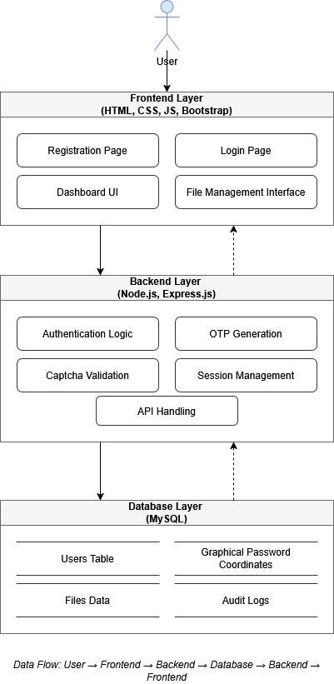


System Architecture
3-Layer Client-Server Design
Frontend Layer
HTML • CSS • JS • Bootstrap
Registration, Login, Dashboard, File Management UI
Backend Layer
Node.js • Express.js
Auth Logic, OTP Generation, Captcha, Session Mgmt
Database Layer
MySQL
Users, Files, Graphical Coords, Audit Logs
GPAS Secure • AVNIET • 2025-2026
7

Slide 8
Methodology – Agile Model
Iterative Development Approach
01
02
03
Registration
→
Image Setup
→
Login Flow
User registers, OTP sent & verified
User selects image & 4 click-points
Username + Captcha entry
04
05
06
Graphical Auth
→
Access Control
→
Dashboard
Click-point selection & validation
Grant access or lock account
File management & analytics
GPAS Secure • AVNIET • 2025-2026
8

Slide 9
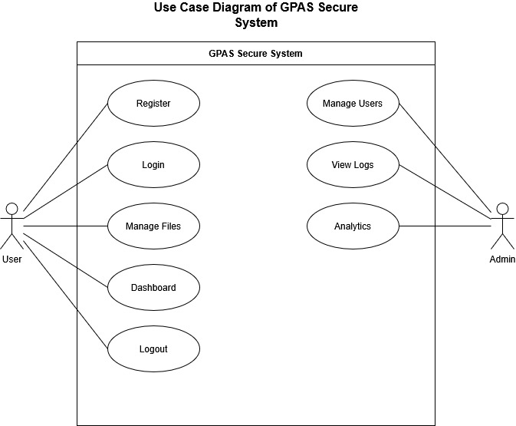
UML – Use Case Diagram
Actors: User & Admin
USER ACTIONS
› Register
› Login (Captcha + Graphical)
› Manage Files (Upload/Download)
› View Dashboard
› Logout
ADMIN ACTIONS
› Manage Users
› View Activity Logs
› Analytics & Charts
› Monitor Security Alerts
GPAS Secure • AVNIET • 2025-2026
9

Slide 10
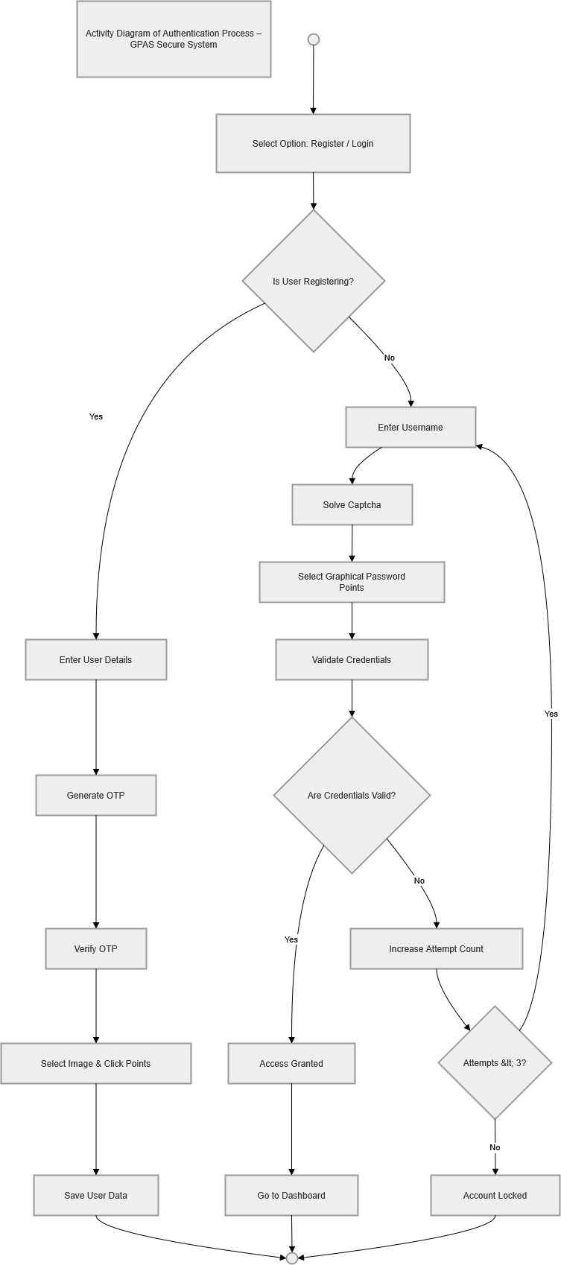
UML – Activity Diagram
Authentication Process Workflow
KEY DECISION POINTS
◆ User Registering?
YES: Enter Details → OTP → Save
NO: Enter Username
◆ Credentials Valid?
YES: Access Granted → Dashboard
NO: Increase Attempt Count
◆ Attempts < 3?
YES: Retry Login
NO: Account Locked
GPAS Secure • AVNIET • 2025-2026
10

Slide 11
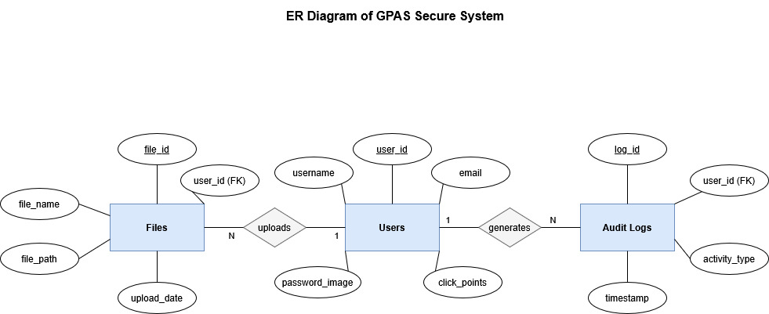
UML – Entity Relationship Diagram
Database Design
Users
Files
Audit Logs
user_id, username, email, password_image, click_points
file_id, user_id (FK), file_name, file_path, upload_date
log_id, user_id (FK), activity_type, timestamp
Relationships: Users 1→N Files | Users 1→N Audit Logs
GPAS Secure • AVNIET • 2025-2026
11

Slide 12
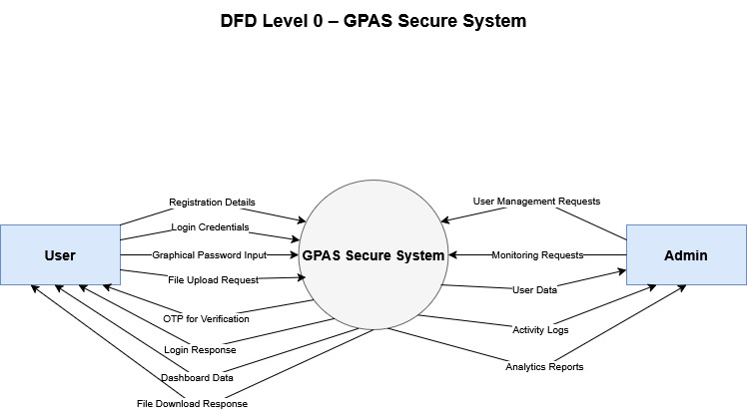
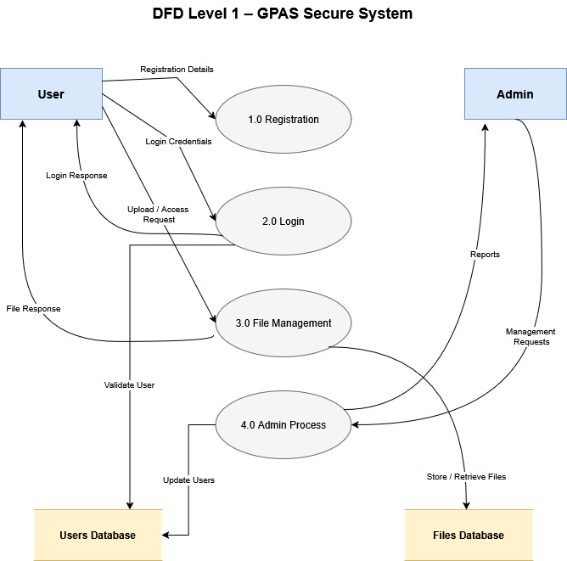
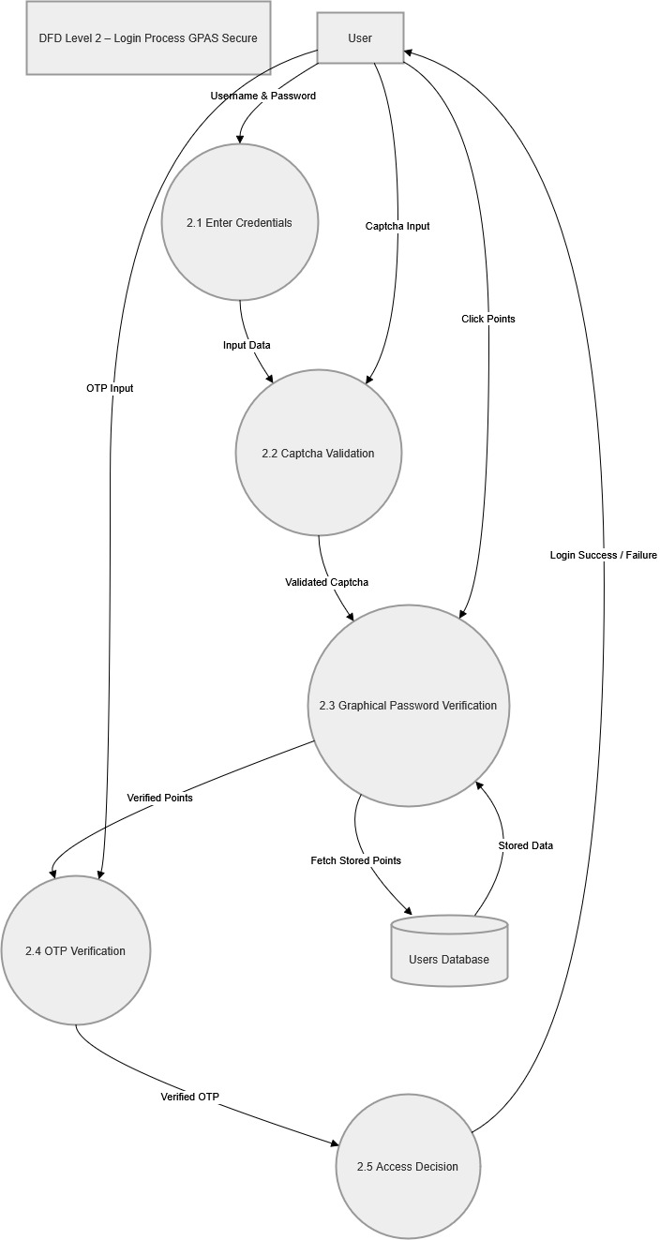
UML – Data Flow Diagrams
Level 0 • Level 1 • Level 2
DFD LEVEL 0
DFD LEVEL 1
DFD LEVEL 2
Context Diagram
Major Processes
Login Process Detail
GPAS Secure • AVNIET • 2025-2026
12

Slide 13
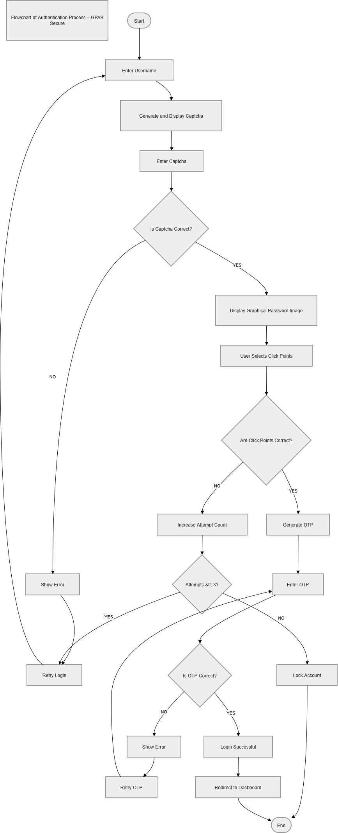
Authentication Flowchart
Step-by-Step Login Process
Start
User enters username
Captcha
Solve math captcha
Graphical PW
Select 4 click-points
Validate
Tolerance-based match
OTP Check
Enter emailed OTP
Decision
Grant or lock account
GPAS Secure • AVNIET • 2025-2026
13

Slide 14



System Modules
Feature-by-Feature Breakdown
Registration Module
Login Module
Username, email input, OTP verification, image selection & click-point setup
Captcha validation, graphical password matching, attempt limiting, account lock
Dashboard Module
File Management
Security status, session timer, activity overview, security analytics graph
Drag & drop upload, file preview, download & delete with Multer backend
Admin Panel
Security Module
User management, role promotion, activity monitoring, threat detection
OTP, captcha, attempt limit, session timeout, audit logging, encryption
GPAS Secure • AVNIET • 2025-2026
14

Slide 15
Implementation – Frontend
HTML • CSS • JavaScript • Bootstrap
index.html
Registration & Login UI, image canvas for click-point selection
style.css
Dark theme styling, responsive layout, animation effects
script.js
Canvas click capture, coordinate tracking, form validation
// Canvas click capture – script.js
canvas.addEventListener("click", function(e) {
const rect = canvas.getBoundingClientRect();
const x = Math.round(e.clientX - rect.left);
const y = Math.round(e.clientY - rect.top);
clickPoints.push({ x, y }); // store coordinates
});
GPAS Secure • AVNIET • 2025-2026
15

Slide 16
Implementation – Backend & Database
Node.js • Express.js • MySQL
Frontend
Request
Express
Route
Auth
Logic
MySQL
Query
Response
Back
→
→
→
→
// OTP Generation — server.js
const otp = Math.floor(100000 + Math.random() * 900000);
req.session.otp = otp; // store in session
// Login Attempt Limiter — server.js
if (attempts >= 3) { return res.send('Account Locked'); }
db.query('UPDATE users SET locked=1 WHERE id=?', [id]);
// File Upload — server.js (Multer)
const upload = multer({ dest: 'uploads/' });
app.post('/upload', upload.single('file'), (req, res) => {
db.query('INSERT INTO files SET ?', { filename, user_id });
});
GPAS Secure • AVNIET • 2025-2026
16

Slide 17
System Testing
Validation & Quality Assurance
Unit
Integration
Functional
Security
Performance
TC ID | Description | Input | Expected Output | Result
TC1 | User Registration | Valid username & OTP | Registration Successful | ✓ Pass
TC2 | OTP Verification | Correct OTP | Verification Successful | ✓ Pass
TC3 | OTP Failed | Incorrect OTP | Error message shown | ✓ Pass
TC4 | Correct Login | Valid captcha + points | Login Successful | ✓ Pass
TC5 | Wrong Captcha | Invalid captcha input | Error message shown | ✓ Pass
TC6 | Wrong Points | Incorrect click-points | Login Failed | ✓ Pass
TC7 | Account Lock | 3 wrong attempts | Account Locked | ✓ Pass
TC8 | File Upload | Valid file | File Uploaded OK | ✓ Pass
GPAS Secure • AVNIET • 2025-2026
17

Slide 18
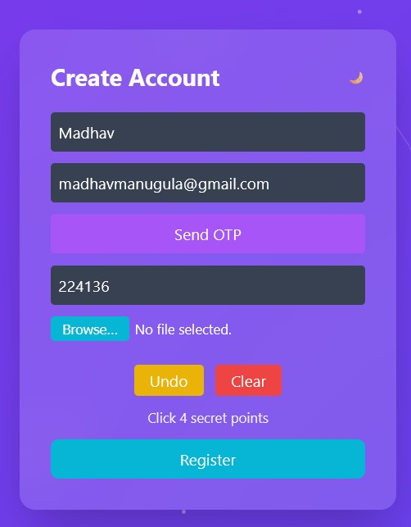
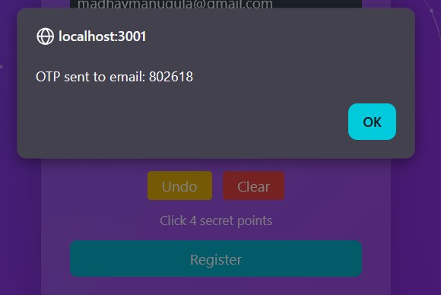
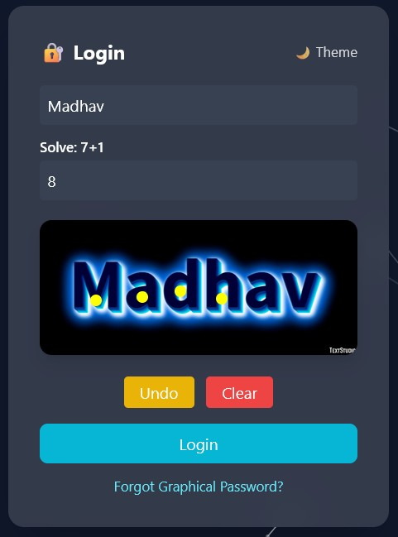
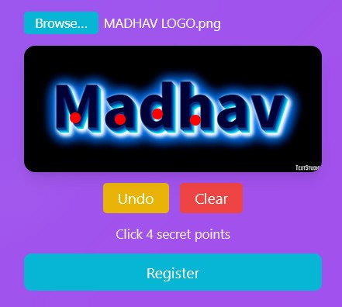
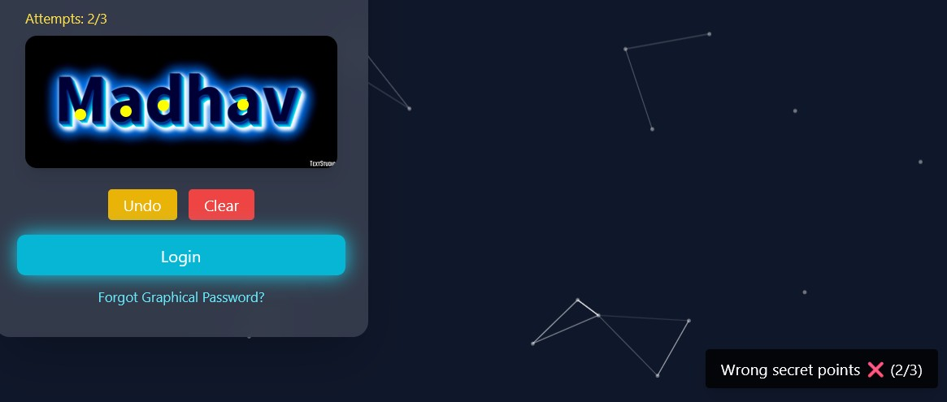
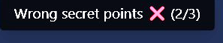
Output Screenshots – Authentication
Registration • OTP • Graphical Password • Login
OTP Verification
Login with Captcha
Registration Page
Selecting Click Points
Wrong Clickpoints
18
GPAS Secure • AVNIET • 2025-2026

Slide 19
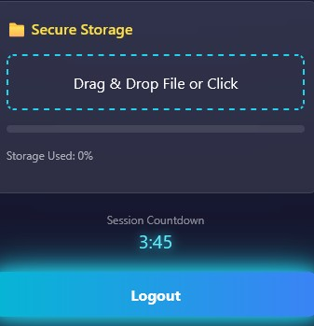
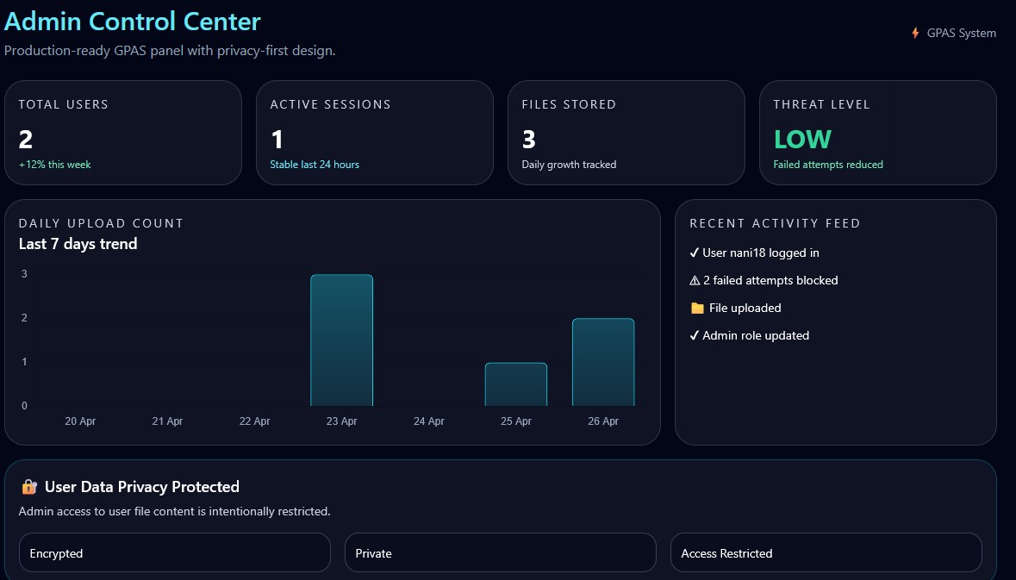
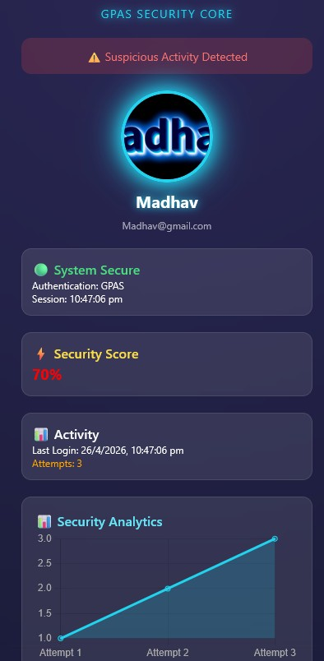
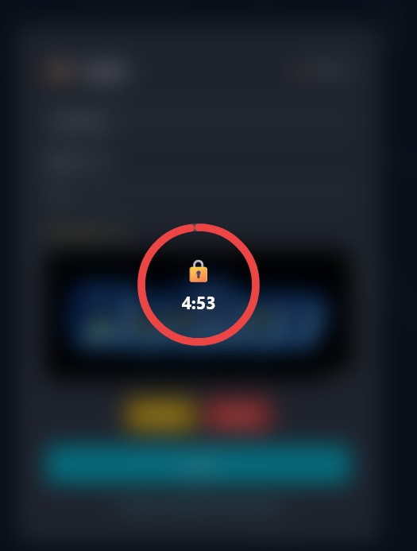
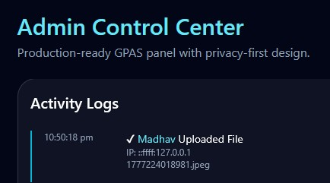
Output Screenshots – Dashboard & Admin
Account Lock • Dashboard • File System • Admin Panel
File Upload System
Admin Dashboard
User Dashboard
Account Locked
Activity Logs
GPAS Secure • AVNIET • 2025-2026
19

Slide 20
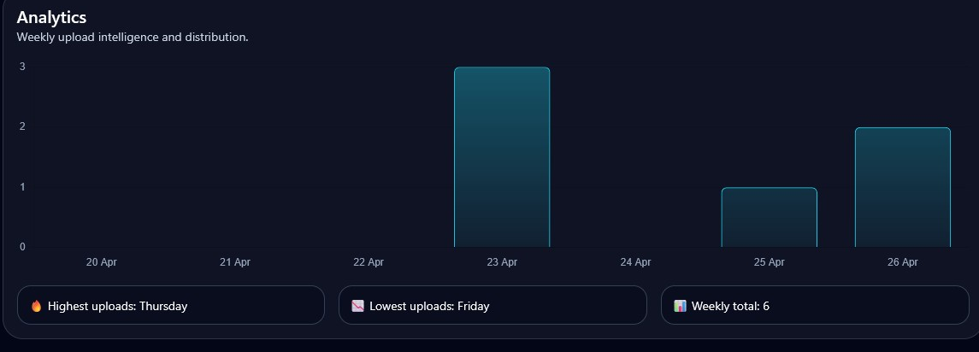
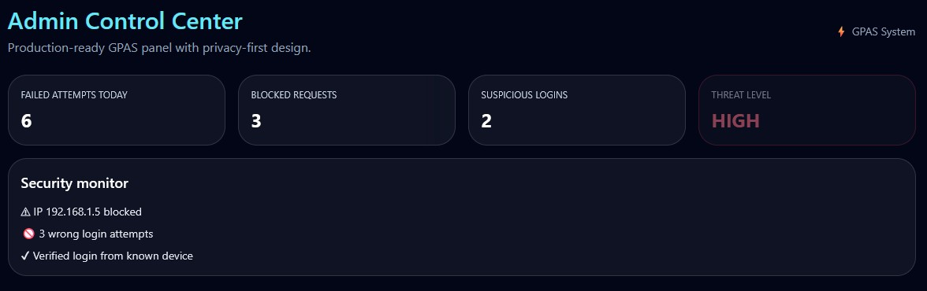
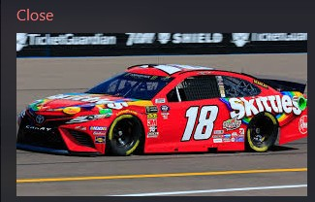
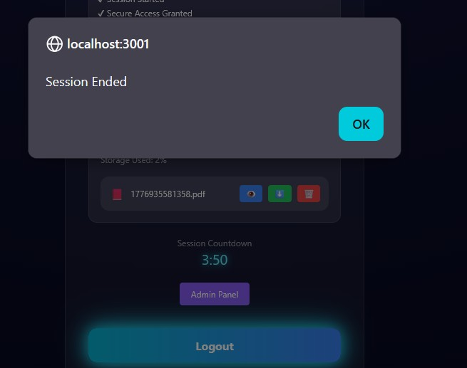
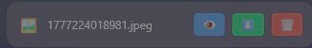
Output Screenshots – Security & Analytics
Analytics • Security Alerts • Logout
Analytics Charts
Security Alerts
File Management (Preview, Download & Delete)
Logout Screen
GPAS Secure • AVNIET • 2025-2026
20

Slide 21



Conclusion & Future Scope
Summary & Road Ahead
CONCLUSION
FUTURE SCOPE
Multi-layer graphical authentication implemented
Biometric authentication integration
OTP + Captcha prevents automated attacks
Mobile application (Android/iOS)
Login attempt limiter secures against brute force
Cloud storage integration (AWS/GCP)
Secure file management with audit trail
Real-time email OTP service
Admin monitoring ensures system integrity
Advanced encryption (AES-256)
User-friendly, visually intuitive interface
AI-based anomaly detection
GPAS Secure • AVNIET • 2025-2026
21

Slide 22
References
Research Papers & Documentation
01
R. Dhamija & A. Perrig — "Déjà Vu: A User Study Using Images for Authentication", USENIX Security, 2000
02
S. Wiedenbeck et al. — "Shoulder-Surfing Resistant Graphical Password Scheme", AVI Conference, 2006
03
J. Thorpe & P. van Oorschot — "Human-Seeded Attacks in Graphical Passwords", USENIX, 2007
04
OWASP Foundation — Authentication Cheat Sheet: https://owasp.org/www-project-cheat-sheets/
05
Node.js Official Documentation: https://nodejs.org/en/docs
06
Express.js Documentation: https://expressjs.com
07
MySQL Documentation: https://dev.mysql.com/doc
08
Mozilla Developer Network (MDN) — Web Security: https://developer.mozilla.org
GPAS Secure • AVNIET • 2025-2026
22

