Slide 1
PROJECT TITLE
COLLAGE CHATBOT
Presented By:
Madhav Phad

Slide 2
OUTLINE
Problem Statement (Should not include solution)
Proposed System/Solution
System Development Approach (Technology Used)
Algorithm & Deployment
Result
Conclusion
Future Scope
References

Slide 3
PROBLEM STATEMENT
Example: The current communication and information retrieval systems in our college are outdated and do not effectively cater to the dynamic needs of the academic community. Students, faculty, and staff often face difficulties in accessing essential information, obtaining quick responses to queries, and navigating through the students Perspective

Slide 4
PROPOSED SOLUTION
Proposed Solution:
Introduce the College Communication and Information Retrieval System (CCIRS).
A centralized platform to address communication and information retrieval needs.
Key Features:
Centralized Information Hub
User-friendly Interface
Real-time Communication
Advanced Search and Retrieval Tools
Benefits:
Improved Accessibility
Enhanced Efficiency
Increased Engagement
Implementation Plan:
Requirements Gathering
Development
Testing
Deployment

Slide 5
SYSTEM APPROACH
System Identification:
Define system scope and stakeholders.
Requirements Analysis:
Gather and analyze requirements.
System Design:
Develop architecture and design.
Implementation:
Code and integrate system components.
Testing:
Conduct testing activities.
Deployment:
Prepare and roll out the system.
Maintenance and Support:
Provide ongoing maintenance and support.

Slide 6
ALGORITHM & DEPLOYMENT
Algorithm Design:
Intents and Entities:
Define main user goals (intents) and key information (entities).
Dialog Flow:
Create conversation flow with dialog nodes.
Implement branching logic for different scenarios.
Deployment:
Deployment:
IBM Cloud Setup:
Create Watson Assistant instance on IBM Cloud.
Export and Import:
Export trained chatbot from Watson Assistant.
Import chatbot skill into Watson Assistant instance on IBM Cloud.
Integration:
Integrate chatbot with preferred platform or application.
Testing and Monitoring:
Test chatbot functionality and monitor performance.
Continuous Improvement:
Gather feedback and update chatbot iteratively.

Slide 7
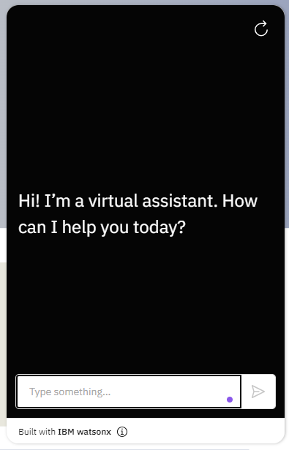
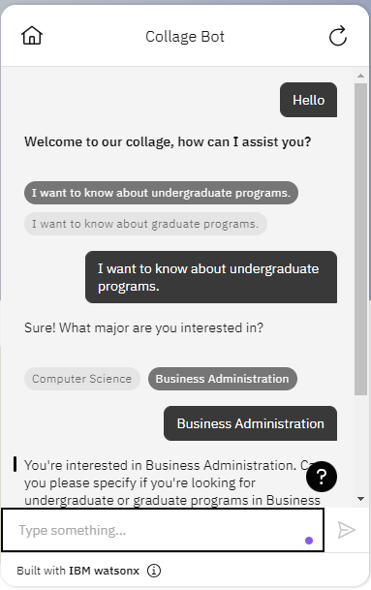
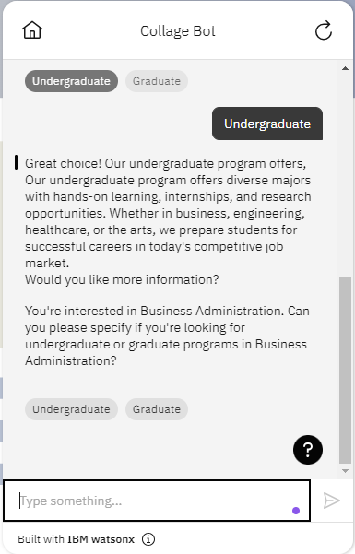
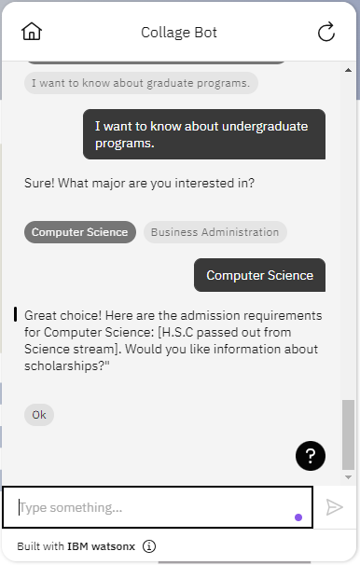
RESULT
DEPLOYED LINK

Slide 8
CONCLUSION
Addressed Problem:
Proposed solution addresses outdated communication and information retrieval systems in the college.
Proposed Solution:
College Communication and Information Retrieval System (CCIRS) offers centralized access and efficient retrieval of information.
Key Benefits:
Improved accessibility, enhanced efficiency, and increased engagement for the college community.
Next Steps:
Implement CCIRS to enhance communication and information retrieval processes.

Slide 9
FUTURE SCOPE
Advanced Features:
Implement AI-driven features like natural language understanding for more intuitive interactions.
Integration with IoT:
Integrate with Internet of Things (IoT) devices to provide seamless access to information.
Personalization:
Enhance user experience through personalized recommendations and tailored content delivery.
Analytics and Insights:
Utilize data analytics to gain insights into user behavior and preferences for continuous improvement.
Expansion:
Extend the system to other departments or institutions to facilitate broader communication and collaboration.

Slide 10
REFERENCES
IBM Watson Assistant Documentation:
Official documentation provided by IBM for Watson Assistant.
Website: IBM Watson Assistant Documentation
IBM Watson Assistant Tutorials:
Step-by-step tutorials and guides for building chatbots using Watson Assistant.
Website: IBM Watson Assistant Tutorials
IBM Cloud Documentation:
Blog posts and articles on IBM Cloud services and chatbot development.
Website: IBM Cloud Blog
IBM Cloud YouTube Channel:
Video tutorials and demonstrations on using IBM Cloud services, including Watson Assistant.
Website: IBM Cloud YouTube Channel

Slide 11
COURSE CERTIFICATE 1

Slide 12
COURSE CERTIFICATE 2

Slide 13
THANK YOU

