Slide 1


Department of Electronics and Communication Engineering, GMRIT
DESIGN OF LOW POWER DIGITAL CIRCUITS USING MEMRISTOR WITH CMOS LOGIC IN COMPARISION WITH FINFET & CMOS TECHOLOGY
INTERNSHIP COMPLETED
AT
MAHINDRA UNIVERSITY
Internal Supervisor
Mrs. P. Revathi
Assistant Professor
(Dept of ECE)
Presented by :
M. Lokesh (20341A04B3)
N. Manoj Kumar (20341A04C7)
S. Anvesh (20341A04G7)

Slide 2
CONTENTS
Abstract
Introduction
Methodology
Results
Conclusion
References

Slide 3
ABSTRACT
The constant need for low-power electronic devices has prompted studies into modern techniques of circuit design. Because of their special qualities, memristors have a lot of potential for reducing power consumption in digital circuits. In this work, the design of low-power digital circuits utilizing CMOS logic and memristors is compared to FinFET and standard CMOS technologies. The study examines the Wallace and Dadda multipliers as well as the power consumption and propagation delay of logic gates. As compared to current technologies, simulation findings show that memristor-based designs have the ability to drastically cut power consumption while retaining competitive performance levels. Additionally, memristor-based circuits' scalability and adaptability for upcoming technological breakthroughs are explored. This study adds important new information on how memristors and CMOS logic can work together.
Key Words: : MOSFET, CMOS, finFET, Memristor, Wallace and Dadda Multiplier

Slide 4
INTRODUCTION
CMOS (complementary metal oxide semiconductor) is primary technology for the design of integrated circuits (IC). The major challenge in the IC design is reducing the power dissipation and propagation delay.
The parameters are highly depend on the scaling of the MOS device [1]. The scaling process is predicted by Moore’s law. Moore’s law states that number of transistors will be doubled for every 18 months.
The number of transistors on a chip can be increased by scaling down the parameters of each MOSFET transistor. Several works have been done on scaling down of MOSFET [2].
By reducing the size MOS transistor, we can insert more transistors on a single chip. With the increase in the number of transistors the speed of the operations will be increased. Since it switches the states much faster, the dynamic power reduces [3].

Slide 5
INTRODUCTION
The major disadvantage of the scaling of MOS transistor is the increase in the leakage current due to the short channel.
In short channel MOSFET, the gate terminal is no longer able to control the channel current efficiently.
Because of that the static power dissipation will get increased [4]. It can be reduced by gate having a better control over the channel.
The scaling down in a conventional MOSFET transistor becomes difficult under 32nm technology because of existing of short channel effects [4].

Slide 6
INTRODUCTION
A FinFET (fin field-effect transistor) is basically a multi gate 3-dimensional MOSFET (metal-oxide semiconductor field-effect transistor) where the gate is placed on multiple sides of the channel.
In order to provide the full control over the channel, multi gate finFETs are used [4]. The source and drain of this FET resemble the fin of a fish.
FinFET replaces the conventional MOSFET because of several advantages over traditional MOSFET.
One of the major advantages of finFET over MOSFET is its gate control over the channel to reduce the leakage current.

Slide 7
INTRODUCTION
Advantages of finFET over MOSFET [5]: -
Lower DIBL: Drain Induced Barrier Lowering for CMOS (124mV/V) transistor is much higher than FinFET (58mV/V).
Less leakage current.
subthreshold swing (SS) of the FinFET is lower than MOS transistor.

Slide 8
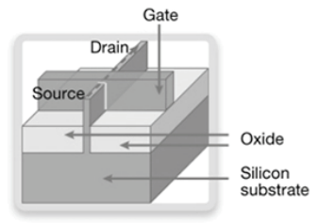

INTRODUCTION
Structure of finFET: -
Fig.1 Structure of finFET
This is the basic structure of basic finFET which is similar to traditional MOSFET. The same parameters ‘W’ and length ‘L’ is used for the finFET as well.
The width ‘W’ is given by [4]
$W=2×H_{fin}+ W_{fin}$ (1)
Where
$H_{fin}$ = vertical height of the fin
$W_{fin}$ = width of the fin

Slide 9
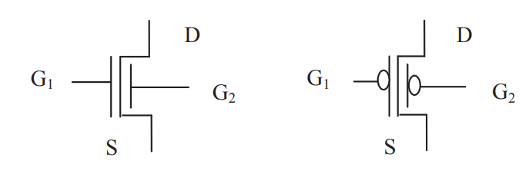
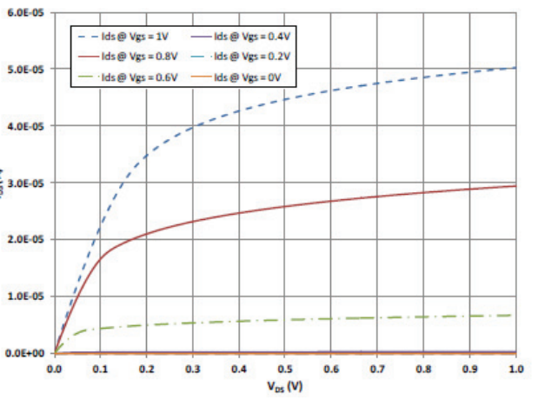
INTRODUCTION
Symbols: -
Fig.2 Symbol of n-channel and p- channel FinFET [2]
Fig.3 Ids vs Vds for n-channel finFET [2]

Slide 10
INTRODUCTION
Different configurations of finFET Inverter: -
There are 3 different kinds of basic configurations of finFET are available [4]. 1. Shorted gate configuration (SG)
2. Low Power Configuration (LP)
3. Independent Gate Configuration (IG)

Slide 11
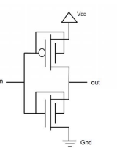
INTRODUCTION
Shorted gate configuration (SG) inverter: -
Fig.4 Shorted gate Configuration
In this configuration, the back gate and front gate for the n-channel finFET and p-channel finFET will be shorted means that both the gates will be given a common voltage.
Since it is like having a single gate, the leakage and switching power consumption is more.

Slide 12
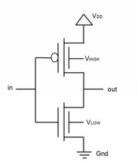
INTRODUCTION
Low Power Configuration (LP): -
Fig.5 Low Power Configuration
In this configuration, the back gate and front gate for the n-channel finFET and p-channel finFET are connected to voltage levels HIGH and LOW respectively.

Slide 13
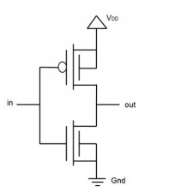
INTRODUCTION
Independent Gate Configuration (IG): -
Fig.6 Independent gate Configuration
This configuration is similar to CMOS configurations. The front gate and back gate will be connected independently. Leaking currents are almost equal to that of SG configuration but the dynamic power is less than that of SG configuration.

Slide 14
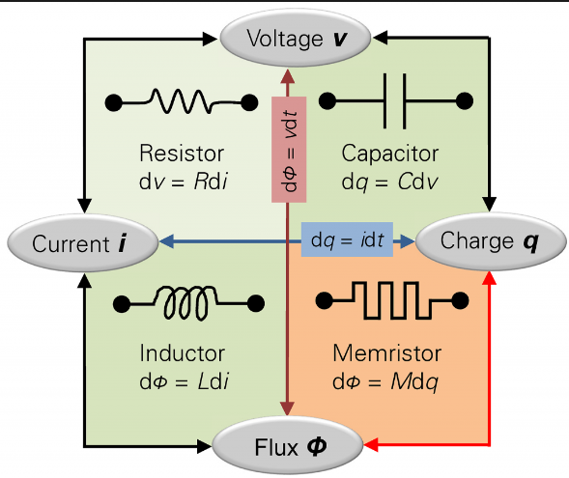
INTRODUCTION
Capacitor, resistor and inductor are three fundamental circuit elements. These circuit elements are defined by the relation between two of the four fundamental circuit variables current, voltage, charge and flux.
Prof. Leon Chua [15] proposed that there should be a fourth fundamental circuit element which gives the relation between flux and charge.
Fig.7 Relation between electrical parameters

Slide 15
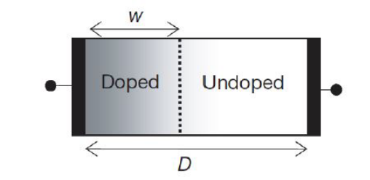

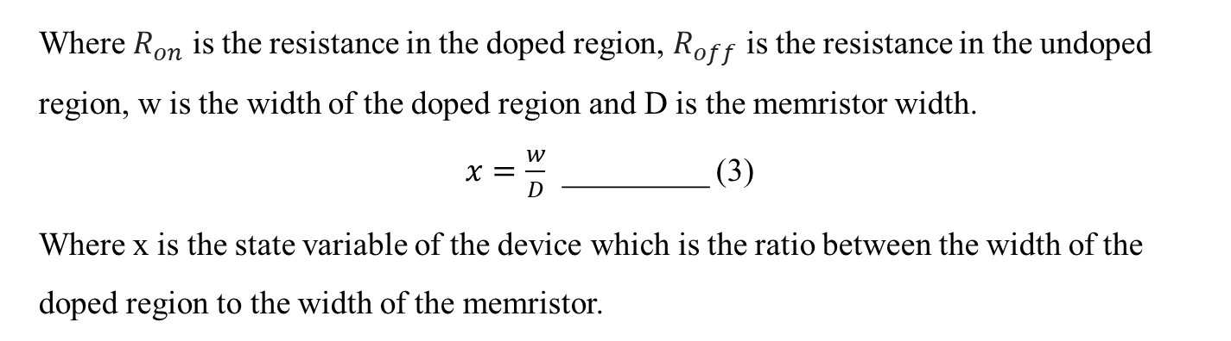
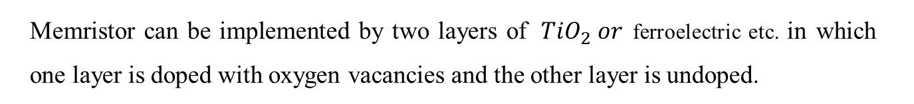
INTRODUCTION
Fig.8 HP memristor model
Memristor can be implemented by two layers of ${TiO}_{2} or$ferroelectric etc. in which one layer is doped with oxygen vacancies and the other layer is undoped.
$R_{mem}=R_{on}x+R_{off}(1−x)$__________ (2)
Where $R_{on}$ is the resistance in the doped region, $R_{off}$ is the resistance in the undoped region, w is the width of the doped region and D is the memristor width.
$x=\frac{w}{D}$ _________ (3)
Where x is the state variable of the device which is the ratio between the width of the doped region to the width of the memristor.

Slide 16
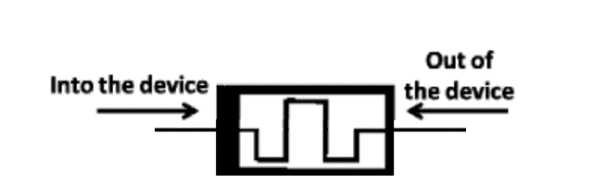
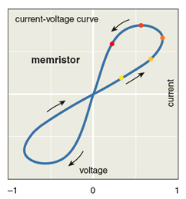
INTRODUCTION
Fig.9 Symbol of Memristor
In memristor dark colour thick line represents the polarity of the device. When the current flows into the device conductivity increases i.e., resistance decreases and when current flows out of the device conductivity decreases i.e., resistance increases.
Fig.10 Hysteresis curve of the memristor

Slide 17
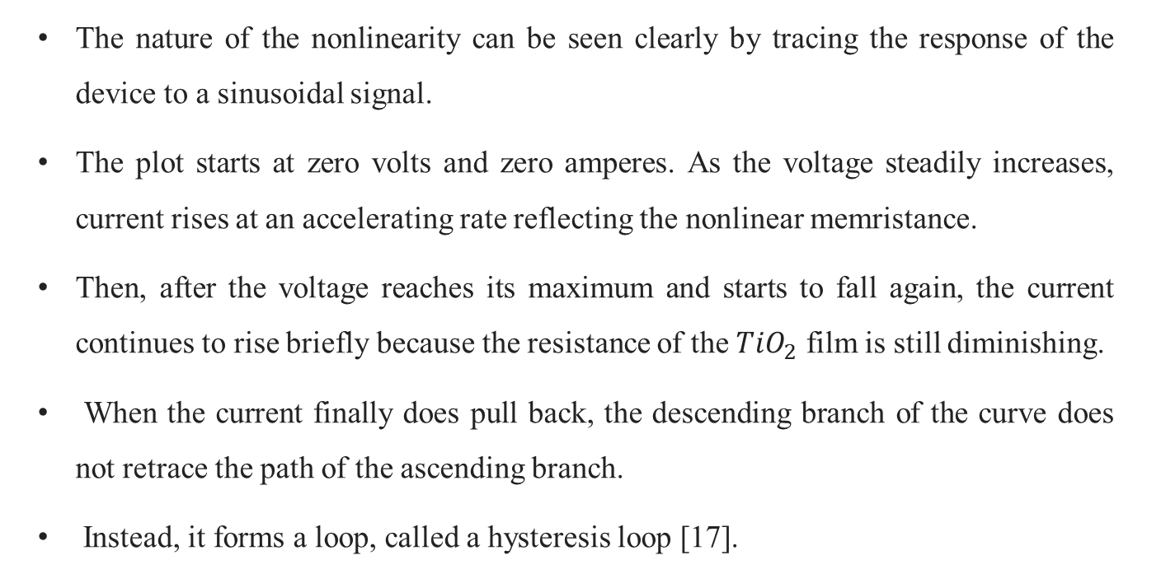
The nature of the nonlinearity can be seen clearly by tracing the response of the device to a sinusoidal signal.
The plot starts at zero volts and zero amperes. As the voltage steadily increases, current rises at an accelerating rate reflecting the nonlinear memristance.
Then, after the voltage reaches its maximum and starts to fall again, the current continues to rise briefly because the resistance of the ${TiO}_{2}$ film is still diminishing.
When the current finally does pull back, the descending branch of the curve does not retrace the path of the ascending branch.
Instead, it forms a loop, called a hysteresis loop [17].

Slide 18
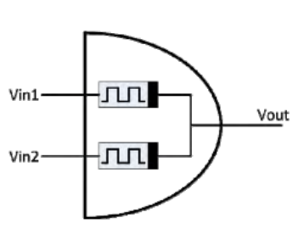
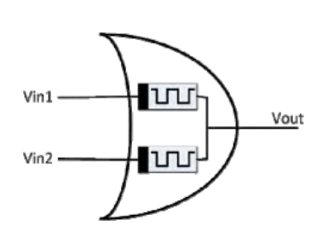
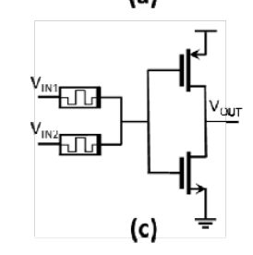
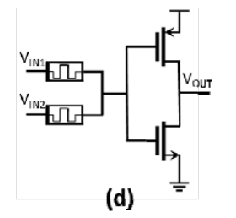
METHODOLOGY
Fig.11 AND gate using memristors Fig.12 OR gate using memristors
Fig.13 NAND gate using memristors Fig.14 NOR gate using memristors

Slide 19
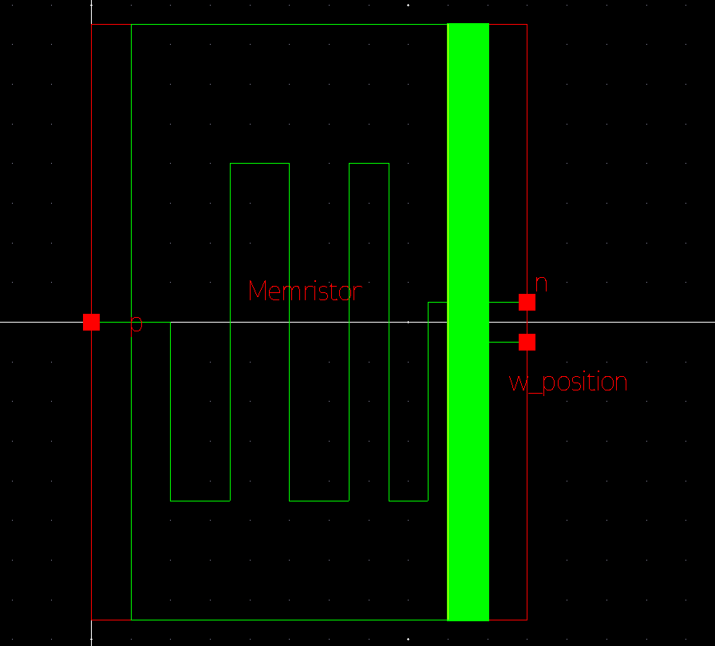
METHODOLOGY
Memristor Symbol :-
Fig.15 Memristor Symbol

Slide 20
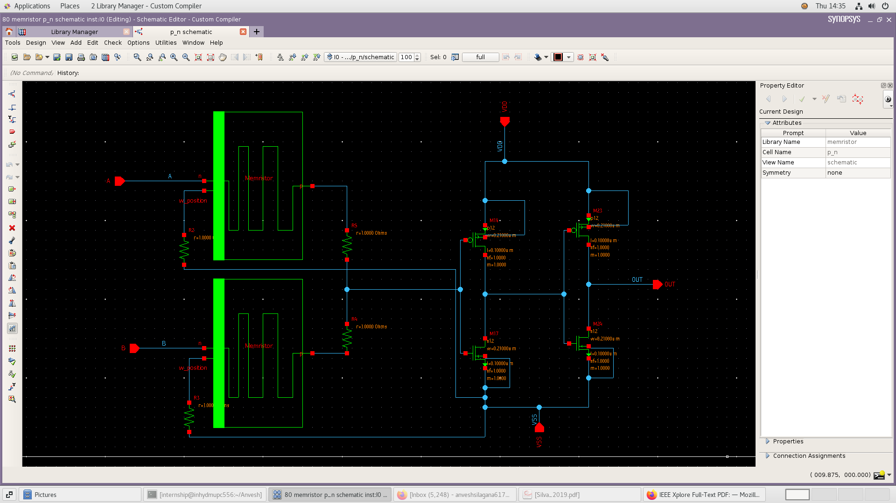
METHODOLOGY
OR gate:-
Fig.16 OR Gate

Slide 21
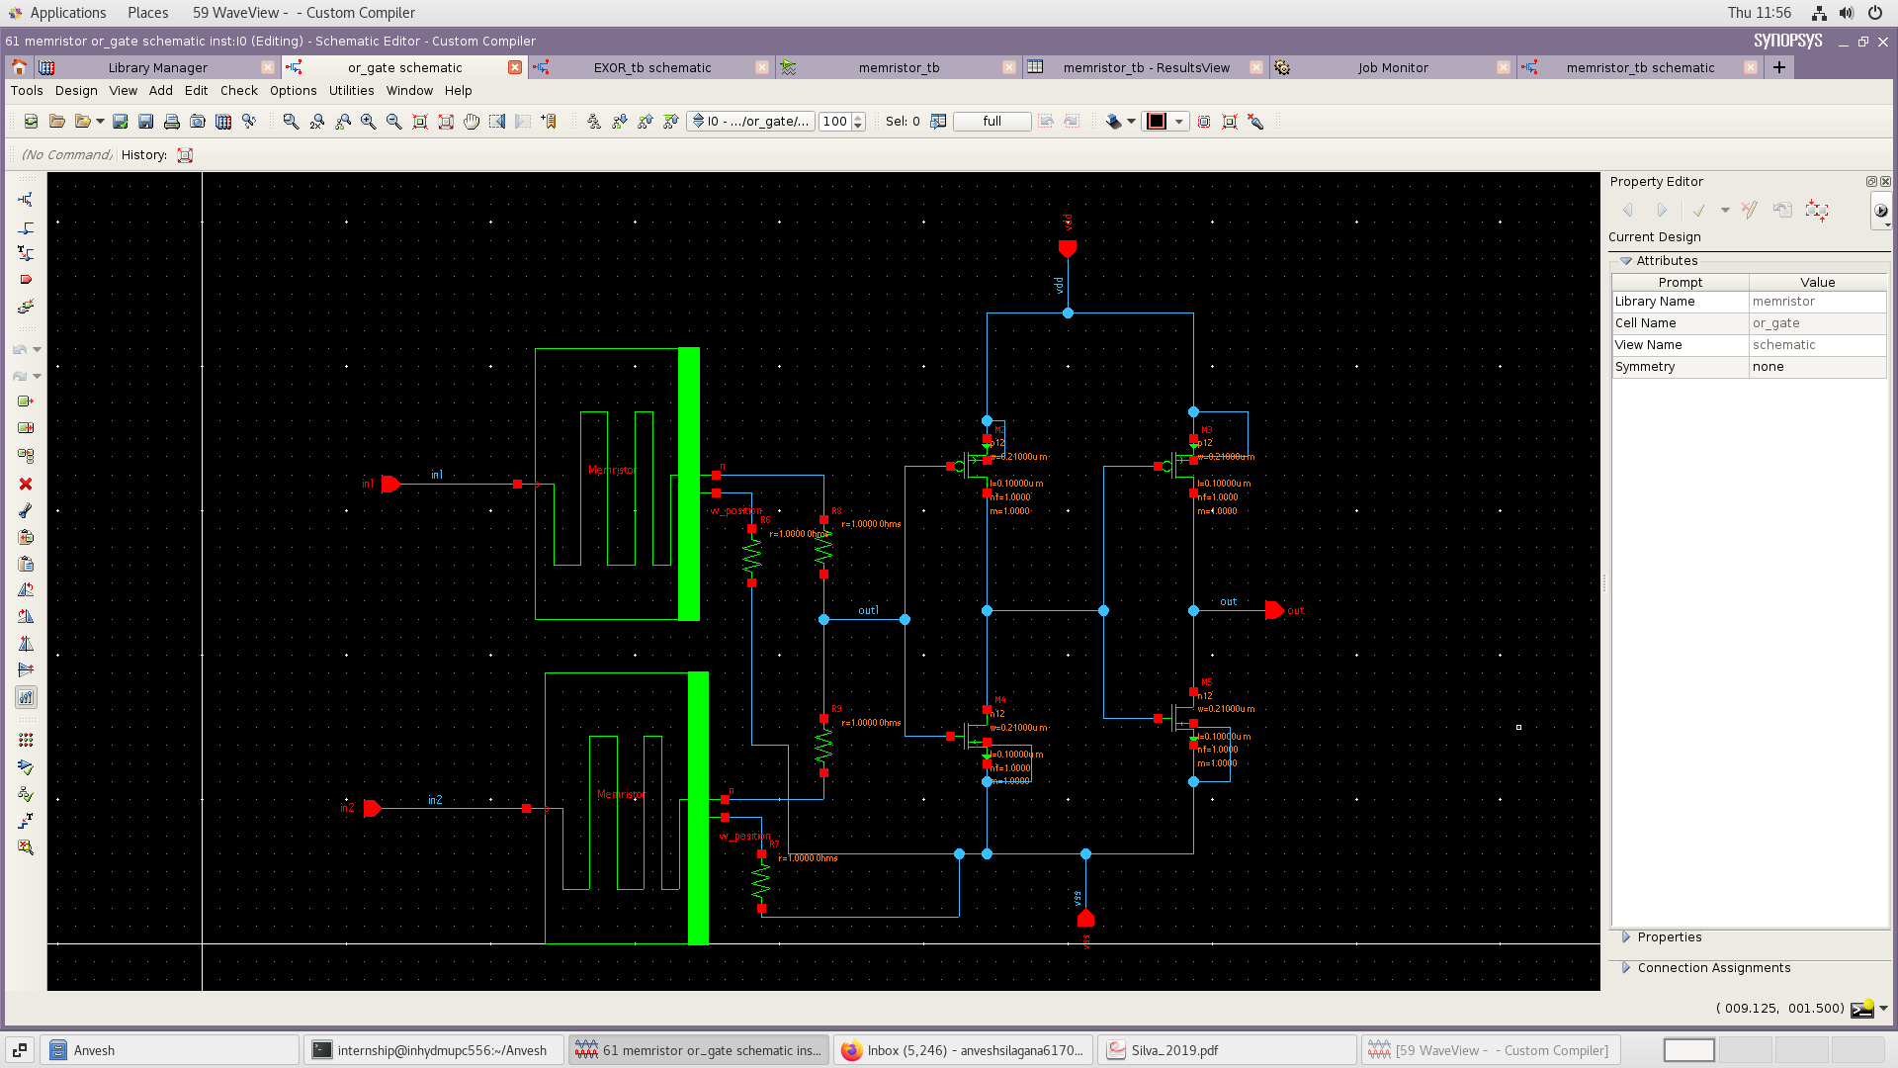
METHODOLOGY
AND gate:-
Fig.17 AND gate

Slide 22
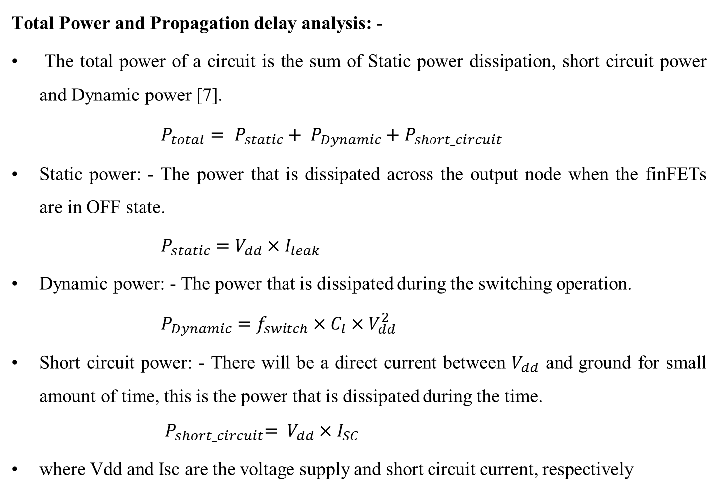
METHODOLOGY
Total Power and Propagation delay analysis: -
The total power of a circuit is the sum of Static power dissipation, short circuit power and Dynamic power [7].
$P_{total}= P_{static}+ P_{Dynamic}+{ P}_{short_circuit}$
Static power: - The power that is dissipated across the output node when the finFETs are in OFF state.
$P_{static}=$ $V_{dd}×I_{leak}$
Dynamic power: - The power that is dissipated during the switching operation.
$P_{Dynamic}=$ $f_{switch}×C_{l}×{ V}_{dd}^{2}$
Short circuit power: - There will be a direct current between $V_{dd}$ and ground for small amount of time, this is the power that is dissipated during the time. ${ P}_{short_circuit}=$ $V_{dd}×$ $I_{SC}$
where Vdd and Isc are the voltage supply and short circuit current, respectively

Slide 23

METHODOLOGY
Propagation Delay: -
The propagation delay can be written as
$t_{p}=\frac{t_{pLH}+t_{pHL}}{2}$
tpHL is the average propagation delay from high to low transition of output and tpLH is defined as the average propagation delay from low to high transition of output.

Slide 24
METHODOLOGY
Wallace Multiplier: -
A Wallace multiplier is a hardware implementation of a binary multiplier, a digital circuit that multiplies two integers. It uses both full and half adders (the Wallace tree or Wallace reduction) to sum partial products in stages until two numbers are left [11].
The Wallace tree has three steps [10]:
1. formation of partial products
2. groups of three adjacent rows are collected.
3. Each group of three rows is reduced by using half adders and full adders.
The benefit of the Wallace tree is its faster speed and it uses less half and full adders than conventional array multiplier [11]

Slide 25
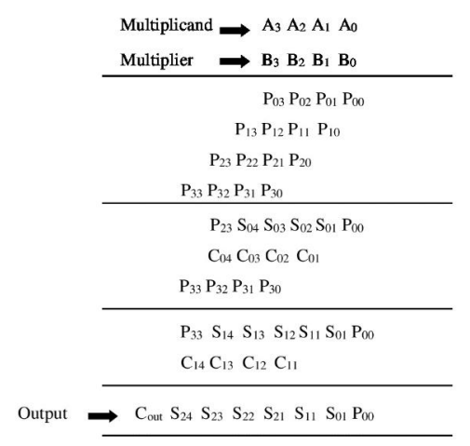
Wallace Multiplier: -
Fig.18. Operation of 4x4 Wallace Tree Multiplier

Slide 26

Dadda Multiplier: -
Array multiplier has more power consumption and propagation delay compared to other multipliers. Wallace multiplier has large area wastage problem due to irregularity in the structure. To overcome these disadvantages in the existing multipliers Dadda multiplier is proposed [12].
Different reduction tree reduces the number of gates required and makes it slightly faster. Reduce the adding steps required to add some products. It is obtained by reducing the number of rows in the matrix by a half adder in each addition step [11].
Dadda multiplier starts with a specific sequence of integers

Slide 27
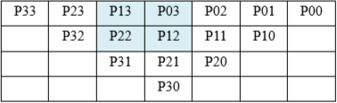
For the multiplier 𝑁 × 𝑀 , we choose 𝑑 < 𝑚𝑖𝑛 (𝑁, 𝑀) .
For example: for the multiplier 4 × 4, d values are 3, 2 [11].
There are 3 stages in Dadda algorithm along with partial products. They are represented by the following figure.
STAGE 1:
Dadda sequence of stages is 2, 3, 4, 6, 9, 13, 19, 28…….

Slide 28


STAGE 2:
STAGE 3:

Slide 29
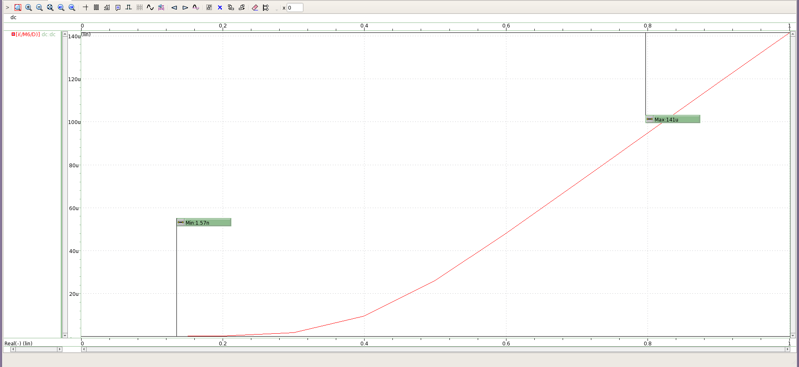
SIMULATIONS
Fig. 19(a). I_{DS} vs V_{GS} plot showing I_{ON} and I_{OFF} for NMOS
$$\frac{I_{ON}}{I_{OFF}}=\frac{141µ}{1.57n}=89808.917$$

Slide 30
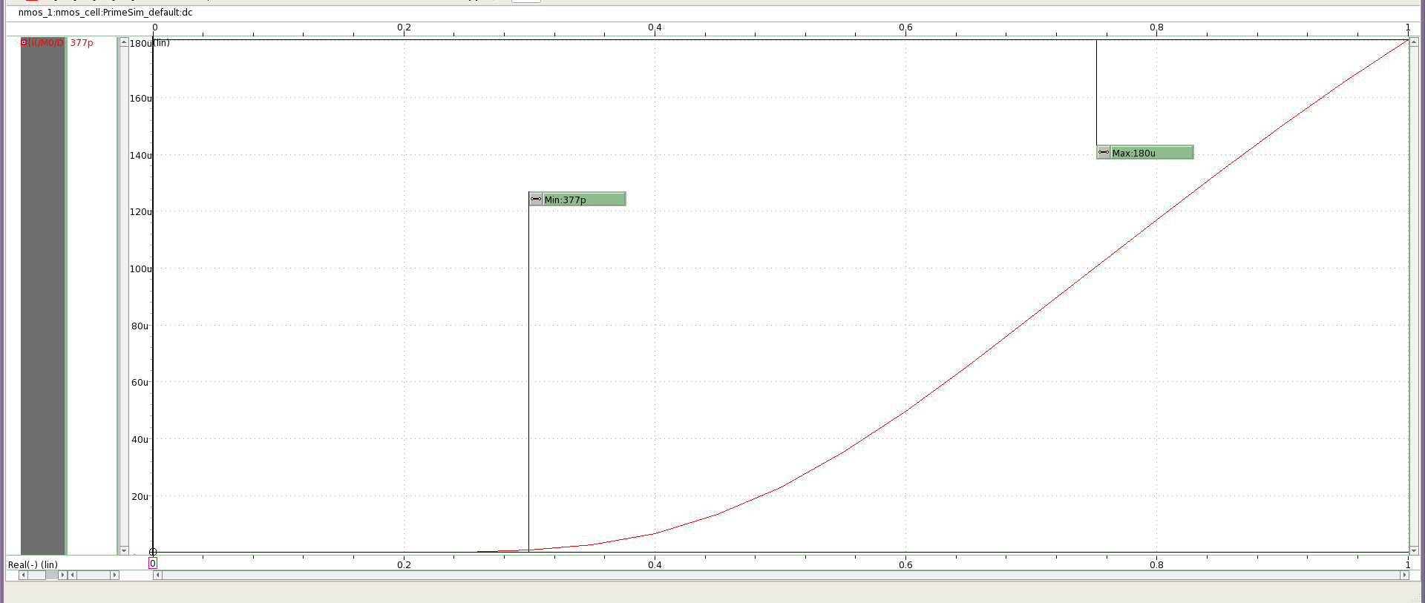

SIMULATIONS
Fig. 19(b) I_{DS} vs V_{GS} plot showing I_{ON} and I_{OFF} for NFET
$\frac{I_{on}}{I_{off}}$ = $\frac{180u}{377p}$ = 477453.5

Slide 31
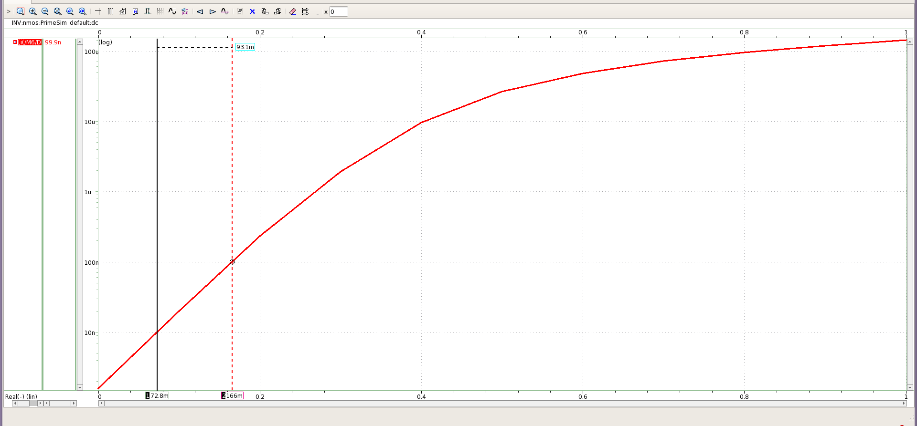
SIMULATIONS
Fig. 20(a). I_{DS} vs V_{GS} of NMOS (Logarithmic scale)
The Sub-threshold Swing (SS) of NMOS is 93.1mV/decade.

Slide 32
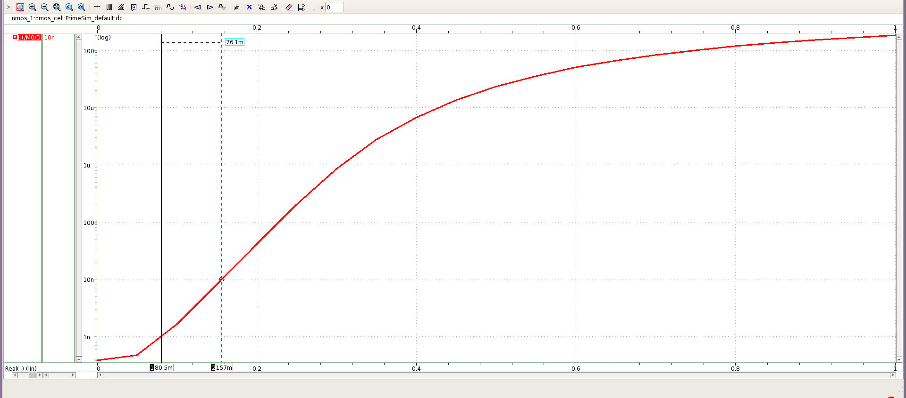
SIMULATIONS
Fig. 20(b). I_{DS} vs V_{GS} of N-FET (Logarithmic scale)
The Sub-threshold Swing (SS) of NFET is 76.1mV/decade.

Slide 33
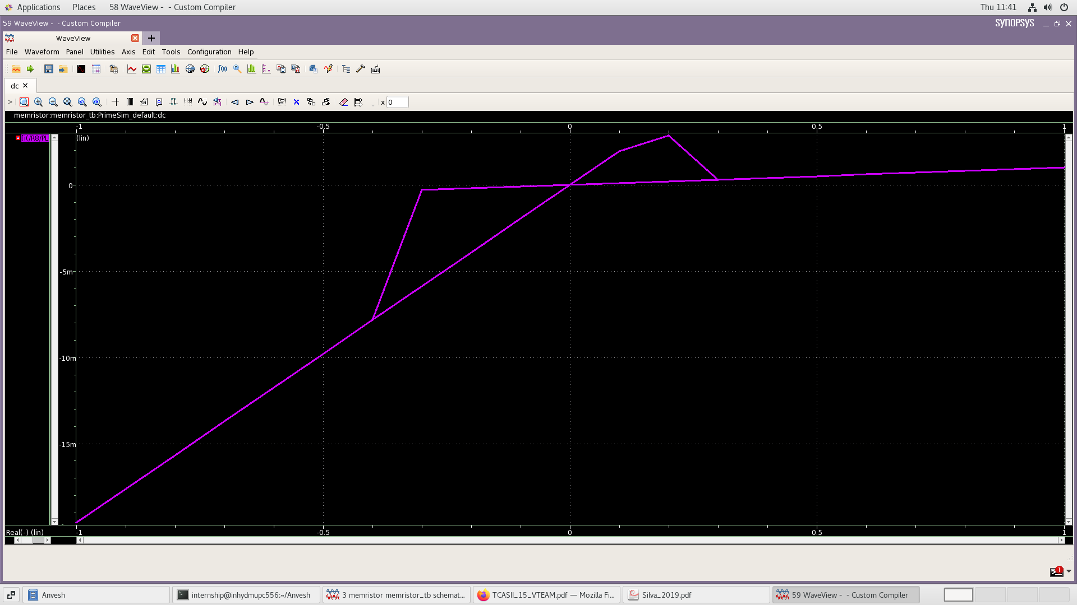
SIMULATIONS
Hysteresis: -
Fig.21 Hysteresis of the Memristor

Slide 34
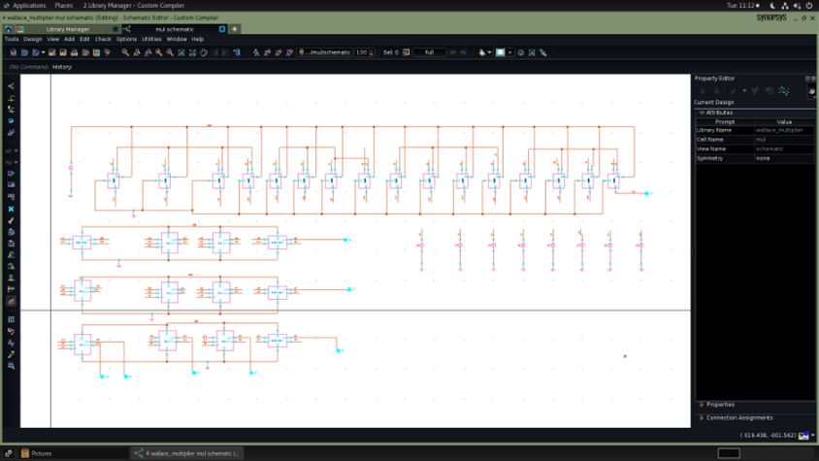
SIMULATIONS
Wallace multiplier: -
Fig. 22 Schematic of Wallace multiplier

Slide 35
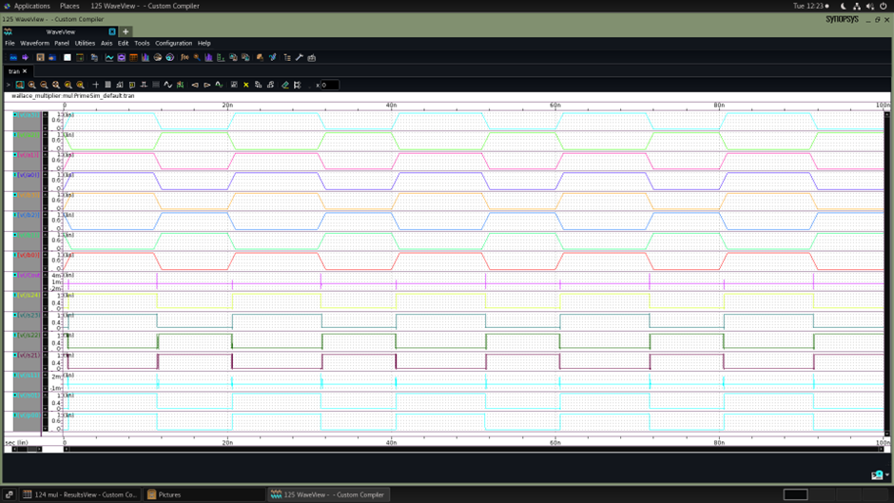
SIMULATIONS
Wallace multiplier: -
Fig. 23 Transient Response of Wallace multiplier

Slide 36
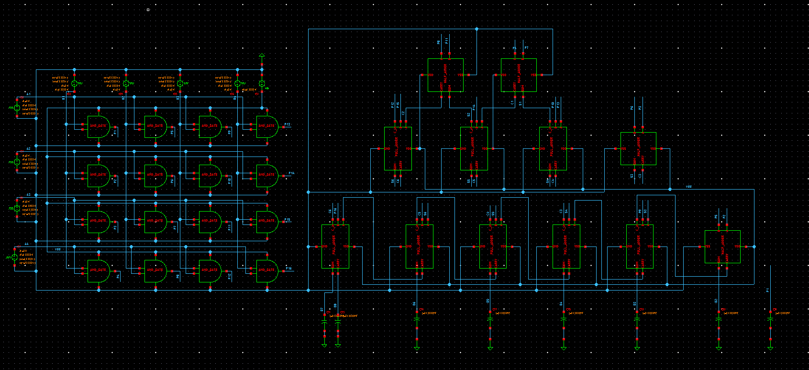
SIMULATIONS
Dadda multiplier:
Fig. 24 Schematic of Dadda multiplier

Slide 37
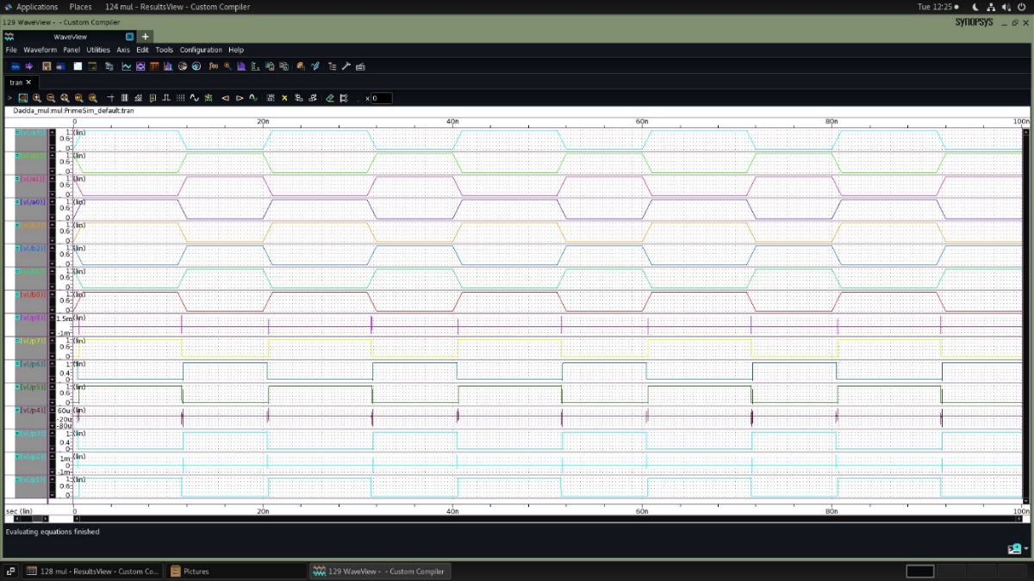
SIMULATIONS
Dadda multiplier: -
Fig. 24 Transient response of Dadda multiplier

Slide 38
RESULTS
Table 1 Comparing results of finFET vs Traditional MOSFET vs Memristor
Gate | Power ( μW) | Delay (ps) | Power (μW) | Delay (ps) | Power ( μW) | Delay (ps)
 | finFET | finFET | CMOS | CMOS | Memristor | Memristor
Inverter | 5.18 | 6.51 | 9.02 | 22.25 | - | -
NAND | 6.28 | 4.05 | 7.33 | 37.25 | 1.517 | 166
NOR | 5.99 | 8.31 | 7.17 | 45.75 | 1.548 | 88
AND | 13.8 | 16.94 | 17.1 | 77.2 | 1.002 | 70.5
OR | 12.8 | 15.11 | 15.8 | 82.45 | 1.418 | 69.5
XOR | 19.1 | 19.98 | 24.5 | 98.5 | 4.765 | 262.5
Half adder | 18.6 | 22.85 | 31.8 | 79.5 | 11.69 | 311.5
Full adder | 33.2 | 25.35 | 73.7 | 143.85 | 21.13 | 291
Wallace multiplier | 259 | 53.5 | 488 | 394 | 65 | 507
Dadda multiplier | 226 | 47.05 | 422 | 260 | 56.3 | 451

Slide 39
CONCLUSION
When compared to traditional technologies like FinFET and CMOS, the integration of memristors with CMOS logic circuits offers interesting paths for creating low-power digital circuitry. We have investigated the advantages and disadvantages of this integration through our project. Our research concludes that there are a number of benefits to using memristors in CMOS logic circuits. First of all, memristors have the ability to store information without losing it due to their non-volatile memory properties. This lowers the power used on standby. Furthermore, memristors' intrinsic qualities such as their low power consumption and high integration density make them appealing options for implementing energy-efficient digital circuits. Additionally, our comparison study shows that memristor-based CMOS circuits perform better than both in terms of power efficiency.

Slide 40
REFERENCES
[1] N. A. Badiger, S. Iyer and S. Gejji, "Power and Delay Analysis of a CMOS Inverter," 2023 International Conference on Data Science and Network Security (ICDSNS), Tiptur, India, 2023, pp. 1-6, doi: 10.1109/ICDSNS58469.2023.10244825.
[2] P. U. Jain and V. K. Tomar, "FinFET Technology : As A Promising Alternatives for Conventional MOSFET Technology," 2020 International Conference on Emerging Smart Computing and Informatics (ESCI), Pune, India, 2020, pp. 43-47, doi: 10.1109/ESCI48226.2020.9167646.
[3] A. Islam, "Technology scaling and its side effects," 2015 19th International Symposium on VLSI Design and Test, Ahmedabad, India, 2015, pp. 1-1, doi: 10.1109/ISVDAT.2015.7208164.
[4] A. K. Kuna, K. Kandpal and K. B. R. Teja, "An investigation of FinFET based digital circuits for low power applications," 2017 International Conference on Circuit ,Power and Computing Technologies (ICCPCT), Kollam, India, 2017, pp. 1-6, doi: 10.1109/ICCPCT.2017.8074280.

Slide 41
REFERENCES
[5] H. Farkhani, A. Peiravi, J. M. Kargaard and F. Moradi, "Comparative study of FinFETs versus 22nm bulk CMOS technologies: SRAM design perspective," 2014 27th IEEE International System-on-Chip Conference (SOCC), Las Vegas, NV, USA, 2014, pp. 449-454, doi: 10.1109/SOCC.2014.6948971.
[6] A. N. Bhoj and N. K. Jha, "Design of Logic Gates and Flip-Flops in High-Performance FinFET Technology," in IEEE Transactions on Very Large Scale Integration (VLSI) Systems, vol. 21, no. 11, pp. 1975-1988, Nov. 2013, doi: 10.1109/TVLSI.2012.2227850.
[7] A. Verma, V. Singh, A. K. Upadhyay, A. Upadhyay and S. A. Taya, "The Power Dissipation of Complementary Metal Oxide Semiconductor (CMOS) Inverter and Propagation Delay for Various Technologies," 2023 International Conference on Sustainable Emerging Innovations in Engineering and Technology (ICSEIET), Ghaziabad, India, 2023, pp. 25-30, doi: 10.1109/ICSEIET58677.2023.10303532.

Slide 42
REFERENCES
[8] Esa, Mohd & Achyut, Konasagar. (2019). Design and Verification of 4 X 4 Wallace Tree Multiplier. 10.5281/zenodo.3757325.
[9]Gowri, Mangala & H., Girish. (2023). DESIGN OF 3-BIT CMOS WALLACE MULTIPLIER. Seybold Report. 18. 1260-1271.
[10] Singh, Shikha & Shukla, Yagnesh. (2023). Implementation of FinFET technology based low power 4×4 Wallace tree multiplier using hybrid full adder. TELKOMNIKA (Telecommunication Computing Electronics and Control). 21. 1139. 10.12928/telkomnika.v21i5.24304.
[11] S. T. Prasad and S. K. Sinha, "Power Efficient and High-performance 4-bit Dadda Multiplier using Multiplexer based BEC-1 converter," 2021 International Conference on Recent Trends on Electronics, Information, Communication & Technology (RTEICT), Bangalore, India, 2021, pp. 749-754, doi: 10.1109/RTEICT52294.2021.9573750.

Slide 43
REFERENCES
[12] Mathews, Manoj. (2022). Mathematical Modelling of TEAM and VTEAM Memristor Model Using Verilog-A. 10.48550/arXiv.2205.12472.
[13] Yang, J., Strukov, D. & Stewart, D. Memristive devices for computing. Nature Nanotech 8, 13–24 (2013). https://doi.org/10.1038/nnano.2012.240.
[14] Emara, A.S., Madian, A.H., Amer, H.H., Amer, S.H. and Abdelhalim, M.B. (2016) On the Production Testing of Memristor Ratioed Logic (MRL) Gates. Circuits and Systems, 7, 3016-3025.
[15] Singh, Tejinder. (2015). Hybrid Memristor-CMOS (MeMOS) based Logic Gates and Adder Circuits. arXiv [cs.ET]. 1506. 1-11.
[16] Agarwal, Tarun. “What Is a Memristor? Types of Memristors, Construction and Applications.” ElProCus - Electronic Projects for Engineering Students, 4 Mar. 2019, www.elprocus.com/what-is-a-memristor-types-of-memristors-and-their-applications.
[17] “The Memristor.” American Scientist, 3 Feb. 2018, www.americanscientist.org/article/the-memristor.

Slide 44
THANK YOU

